Slide 1
Conducting the Brief Intervention
Chapter 5

Slide 2
What is a Brief Intervention?
A Brief Intervention is a low-intensity, short-duration “conversation” with those who screen positive
Builds commitment to change through motivational interviewing
Often brochure driven
Provides feedback about risks and consequences of use
Provides advice about recommended use limits
Weighs pros and cons of behavior in light of goals and values
Collaboratively makes and strengthens arguments for change
Supports change by helping patients design change plans
Conducted immediately following screening
Notes:
Brief interventions are short, structured conversations based on the principles of motivational interviewing (MI) in which counselor explores problems, recognizes ambivalence, and listens for “change talk” from the patient (Miller & Rollnick, 2013). “Change talk” refers to any statement in which an individual expresses a willingness to quit or cut down, or acknowledges the negative aspects of substance use.
Brief motivational interventions are based in the premise that individuals who have experienced problems can identify the potential benefits of reducing substance use, though they may not want to change their behavior due to the high “cost” of giving up use. For example, a patient may realize that marijuana use causes tension with his or her spouse, but may continue to use because smoking is a way of reducing stress.
The core of a brief motivational intervention involves exploring the benefits of continued substance use compared to the potential benefits of behavior change.
Brief interventions may also be useful in motivating individuals who have severe substance use disorders to accept a referral to more intensive treatment.

Slide 3
Guidelines for Assessing Risk Level Moderate Risk = Brief Intervention
Screening
No or Low Risk
Moderate Risk
High Risk
Educational Feedback
Brief Intervention
Brief Intervention + Referral to Treatment
Notes:
Brief interventions are conducted with those who screen at the moderate risk level. For those screening at a high risk level, the brief intervention may be used to motivate an individual to accept a higher level of care.

Slide 4
Harm Reduction Approach
Balances costs and benefits of use
Provides accurate information
Attempts to promote & facilitate access to care for addiction & mental health problems
Engage drug users in a continuum of care from which they would otherwise be excluded
Behavior
Safer
Harmful
Notes:
Harm reduction refers to policies, programs and practices that aim to reduce the harms associated with the use of psychoactive substances in people unable or unwilling to stop. The defining features are the focus on the prevention of harm, rather than on the prevention of drug use itself, and the focus on people who continue to use drugs.
Harm reduction complements approaches that seek to prevent or reduce the overall level of alcohol and other drug consumption. Access to good treatment is important for people with alcohol or drug problems, but many people with substance problems are unable or unwilling to get treatment. Furthermore, the majority of people who use psychoactive substances do not need treatment.
There is a need to provide people who use drugs with options that help to minimize risks from continuing to use, and of harming themselves or others. Many people who use drugs prefer to use informal and non-clinical methods to reduce their drug consumption or reduce the risks associated with their drug use.
From: https://www.hri.global/what-is-harm-reduction

Slide 5
Components of Effective Brief Intervention: The FRAMES Approach
Feedback (with permission)
Responsibility
Advice
(with permission)
Menu of Options
Empathetic style
Support self-efficacy
Notes:
Research into effective brief interventions for substance use have found that they include a number of consistent features which appear to contribute to their effectiveness. These have been summarized using the acronym FRAMES:
Feedback of personal risk.
Responsibility, or, for the client to acknowledge that they are responsible for their own behavior and that they can make choices about their substance use. The message that “what you do with your substance use is up to you” and that “nobody can make you change or decide for you” enables the patient to retain personal control over their behavior and its consequences. This sense of control has been found to be an important element in motivation for change and to decrease resistance.
Advice to change or quit.
Menu of change options.
An Empathic counseling style
Supporting Self efficacy (confidence for change).
Many of these features are also associated with MI.

Slide 6
How to Engage Patients Using MI in a Structured Way: The FRAMES Approach to Brief Intervention
With permission, provide personalized Feedback about screening scores.
Acknowledge that the patient has Responsibility for their choices.
With permission, give simple Advice about how to reduce risk associated with substance use and elicit their thoughts.
For patients ambivalent about changing, elicit change-talk
Decisional balance
Rulers
Discuss a Menu of options to promote personal choice and goals.
Express Empathy, which is a potent determinant of motivation and change.
Self-efficacy is supported to instill optimism.
Notes:
Miller and Sanchez (1993) proposed six elements summarized by the acronym FRAMES in which to provide a brief intervention framework.
Feedback
The provision of relevant, personal feedback is critical generally follows the ASSIST assessment of drug use and related problems. Feedback can include information about the individual’s drug use and problems, information about personal risks associated with current drug use patterns, and general information about substance-related risks and harms. If the client’s problems are likely related to substance use, it is important to inform the client about this potential link as part of the feedback session. In providing feedback, you might compare the client’s substance use and associated problems to others who have similar experiences.
Responsibility
It is important to acknowledge that they are responsible for making decisions about their own behaviors and that they can make choices about their substance use. You should provide messages like “What you do with your substance use is up to you” and “Nobody can decide for you” to enable clients to retain personal control over their behavior and associated consequences. Clients who have this sense of control will be more motivated to make changes and will be less resistant to change.
Advice
Provision of clear advice regarding the harm associated with continued drug use is fundamental. Clients are often unaware that their current patterns of substance use could lead to health or other problems, or make existing problem worse. Providing clear advice that cutting down or stopping substance use is the best way to reduce their risk of future problems will increase their awareness of personal risk and provide reasons to consider changing their behaviors. The decision matrix can be helpful a helpful tool for this element.
Menu of alternative change options
Effective interventions provide clients with a range of alternative strategies to cut down or stop their substance use. This allows clients to choose the strategies that are most suitable for their situations and that they feel will be most helpful. Providing choices reinforces clients’ sense of control, responsibility and motivation for making changes. Ideally, clients’ choices will be linked to their stage of change. The self help resource will asist.
Empathy
Effective interventions employ a warm, reflective, empathic and understanding approach. These qualities will ensure that clients feel comfortable and welcome. They will also increase the likelihood that clients will remain in counseling and treatment, therefore increasing positive counseling and treatment outcomes.
Self-efficacy (confidence)
It is critical to help build clients’ confidence that they are able to make changes to their substance use. People who believe that they are able to make changes are much more likely to do so than those who feel powerless or helpless. Counselors should assist clients to make self-efficacy statements; they are more likely to believe what they hear themselves say, rather than what they hear someone else tell them.

Slide 7
Brief Intervention Steps
Step 1. Ask Permission | Thank you for completing that questionnaire with me. Do you mind if we talk a little more about the results?
Step 2. Provide personalized feedback | First of all, congratulations on your low-risk use of many of these substances. Based on your screening scores, you are at moderate risk for health and other problems related to your current pattern of alcohol use. For example, you mentioned that you sometimes have heart palpitations after a heavy drinking episode. That is because acute alcohol ingestion can cause short circuits in the heart’s electrical rhythm. ELICIT: Given this information, what are your thoughts about this?
Notes:
Asking permission to provide feedback is the very first step in the in the delivery of a brief intervention. When providing personalized feedback, one highlights certain aspects of a patient’s behavior using information gathered during screening. It involves an interactive dialog for discussing the screening findings and is not just provider driven. Feedback should be given in small amounts. After describing the risk level and meaning of the level (low, moderate, high), the provider then gives a specific piece of feedback and asks for a response from the patient. Most health professionals provide patients with feedback on their risks for substance use problems based on their presenting health or other problems (depending on the setting of the intervention). Factors such as an individual’s current drinking pattern, laboratory test results or other medical consequences of their drinking may be used for feedback. For example, a physician may tell a patient that his or her drinking may be contributing to their hypertension, or may increase the risk for heart disease. The provider should always ask permission before presenting the screening scores or in providing feedback.
***Feedback should be provided using an empathic style (neutral and non-judgmental manner) and the practitioner should always avoid labels like “drug addict” and “alcoholic.”
Eliciting personal interpretation, which may be done at several points during the BI, entails asking the patient what they think about the information and what they would like to do. You can do this by asking one of the following key questions:
How do you feel about that?
Where do we go from here?
What would you like to do about that?
How concerned are you by this?
What concerns you most?
>>>Remind students that expressing empathy and evoking self-efficacy can be used throughout the BI.

Slide 8
Step 3. Advise with permission and promote personal responsibility | May I provide you with some advice? To lower your risk, my advice is that you cut back on your drinking or quit altogether, but the decision to change is up to you! These are recommended drinking limits: for men of your age, we recommend no more than 2 drinks per day or 14 per week, and no more than 4 drinks on any one occasion. We know that individuals who regularly drink above these limits can develop acute or long-term problems related to their use. ELICIT: What are your thoughts about the lower-risk drinking limits?
Step 4. Enhance motivation, elicit change talk, support self efficacy | Decisional balance: So, what are some of the good things about drinking? What about the not-so-good things? Summarize what has been said. Rulers: On a scale of 0 to 10, with 0 being not at all ready/confident/ important and 10 being completely ready/confident/important, how ready/confident/important are you to change any aspect related to your drinking? Why did you choose that number and not a lower one, like a 1 or a 2? That’s great! That means you’re ___% ready to make a change. Let’s talk about what that change would look like..
Notes:
During the brief intervention, health care professionals should give patients explicit advice to reduce or stop using. While expressing concern about the patient's current drinking and the related health risks, the provider may discuss guidelines for "lower-risk" drinking, for example. For individuals reporting at-risk drug use, discuss harm reduction approaches to minimize risk.
Through supporting self-efficacy, the objective is to increase their self-confidence that they can change. Self-confidence statements can be sought from patients using scaling techniques (e.g, Change Rulers: Readiness, Importance and Confidence).
Uses for ruler include:
How READY are you to make a change?
How IMPORTANT is it for you to make a change?
How CONFIDENT are you that you can make a change?

Slide 9
Step 5. Menu of options to negotiate a plan | What are some steps that you can take to start cutting back on your use? I have some additional strategies that might be helpful. Would you like to hear about them? How were you able to successfully quit smoking in the past? How might you go about accomplishing your goal? What might be some of the challenges to reaching your goal? Those are great ideas! I think that’s a great plan. You’re obviously a very resourceful person. Refer to Treatment (if applicable): I can also refer you to some places that can help you with _________. Schedule a Follow-Up (if applicable): Would it be alright if we scheduled another appointment sometime in the future to follow-up on what we discussed today?
Notes:
Offer patients a variety of strategies from which to choose. These may include setting a specific limit on substance use consumption; learning to recognize high risk situations and developing skills to avoid using in those situations; planning ahead to limit use; pacing one's use (e.g., sipping, measuring, diluting, and spacing); and learning to cope with the everyday problems that may lead to drinking or other drug use.
Give patients self-help materials or brochures that will help them carry out these strategies. Self-help materials often include drinking or drug use diaries to help patients monitor their abstinent days and the amount consumed when drinking or using other drugs, record instances when they are tempted to use or experience social pressure to drink or use other drugs.
Creating an action plan is a powerful tool that often gets skipped. Help the patient identify exactly what they can do to make the changes they are talking about. If they are willing, write it down for them.
Finally, summarize what has been said, provide take home materials and thank patient for their time

Slide 10
Options for Smoking Cessation
Nicotine Replacement Therapy (NRT)
Patch
Gum
Lozenge/ mini lozenge
Nasal Spray
Inhaler
Non-nicotine
Bupropion SR (a.k.a. Wellbutrin and Zyban)
Varenicline (a.k.a. Chantix)
Quitline
#1-800-QUIT-NOW
Provides cessation counseling, quitting information, answers to your questions, and support free of charge.
Notes:
OPTIONAL SLIDE
SMOKING CESSATION:
It is recommended to try different agents and combine them including behavioral therapy. Combination drug therapy is usually more effective than monotherapy, particularly for more heavily tobacco-dependent patients. These go-to combinations are nicotine replacement therapy (NRT) plus bupropion (Zyban), or high-dose NRT using a nicotine patch plus nicotine gum or lozenges (http://findarticles.com/p/articles/mi_hb4345/is_10_37/ai_n42054323/).

Slide 11
ACTION PLAN
These are the reasons I want to drink less:
______________________________________________
______________________________________________
______________________________________________
______________________________________________
My drinking goal is:
☐ To cut back ☐ To quit entirely
I will make a change on this day: ____ / ____ / ____
I will not drink more than _____ drinks in 1 day.
I will not drink more than _____ drinks in 1 week.
Date: July 22, 2014 S2BI Screen Result:
Substance | None | 1-2X | Monthly | Weekly +
Alcohol |  |  | X
Marijuana | X
Tobacco | X
Notes:
If possible, write the action plan down. List the reasons that the patient gives for cutting down or quitting.

Slide 12
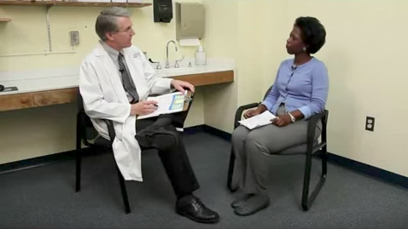
Video Demonstration: Brief Intervention
Dr. Seale and Lisa (6:37)
https://www.youtube.com/watch?v=AcGCRJcfl4w
Notes:
In this example, the practitioner is using the AUDIT to screen for at-risk alcohol use. The first minute or so demonstrates screening, then the Dr. delivers a BI based on the results.
https://www.youtube.com/watch?v=AcGCRJcfl4w
Time: 6:37

Slide 13
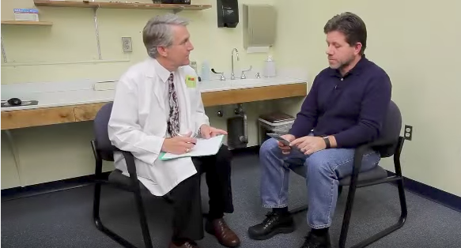
Video Demonstration: Brief Intervention + Referral
Dr. Seale and Warren (8:31)
https://www.youtube.com/watch?v=b5PUe8RRfe8
Notes:
In this example, the practitioner is following up with a patient who had already tried to cut back on his drinking. This BI incorporates the use of MAT and a referral to a behavioral health specialist for ongoing counseling.
https://www.youtube.com/watch?v=b5PUe8RRfe8
Time: 8:31

Slide 14
Additional demonstration videos
BI for at-risk marijuana use (Dr. Seale)
https://www.youtube.com/watch?v=sRUHv6_cRpE
BI for possibly dependent marijuana use (Dr. Seale)
https://www.youtube.com/watch?v=o2CEsBC5UyU
SBIRT for Pharmacists
https://www.youtube.com/watch?v=L8Azv6XzktA
Alcohol Screening and Brief Intervention in Emergency Room
https://www.youtube.com/watch?v=xARF8jSxnsc
Marijuana Screening, Brief Intervention and Referral to Treatment in Dental Clinic
https://www.youtube.com/watch?v=8zOr-K7mUxU
Notes:
OPTIONAL SLIDE
This slide contains links to BI demonstration videos. In addition to showing students one or more demonstration videos, you may also ask students to follow along using the SCORe tool.
(Please note that these videos may use different screening questions)

Slide 15
Case vignette
The following case vignette can be used as a group exercise to practice brief intervention. Tailor as needed to customize to your audience.
Notes:
OPTIONAL EXERCISE
You can pick and choose the slides you may wish to use.

Slide 16
Case Vignette
You manage the Primary Health Care clinic at St. Claire College.
Katie, a junior, has been accepted to study abroad and needs a current physical and all required vaccinations.
Your clinic routinely screens all patients for at-risk substance use in order to detect and reduce the harm of risky substance use.
You administer the ASSIST Screening Test and Katie reveals the following:

Slide 17
Case Vignette: Katie
In her lifetime, Katie reports that she has used alcohol (no other substances).
In the past 3 months, she admits to drinking on weekends (Thurs.-Sat.) and reports having 4-5 shots when she drinks.
She has blacked out once or twice in the past 3 months even though she’s never missed class because of her drinking.
Her roommate has expressed concern. Katie doesn’t always remember what happened the night before.
She scores a 14 for alcohol on the ASSIST, which puts her in the moderate risk range.

Slide 18
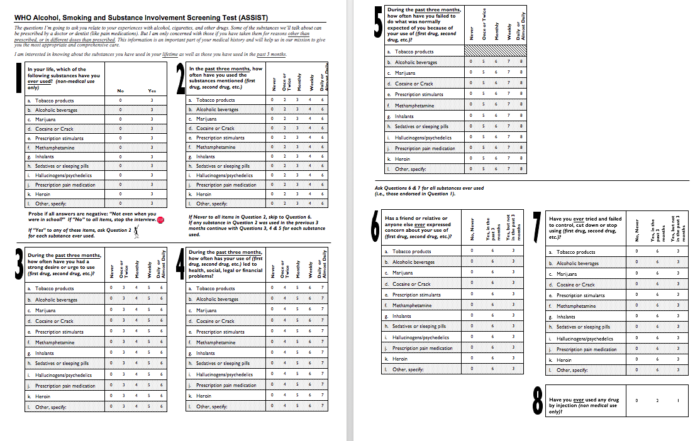

Slide 19
What should you do next?
Notes:
Wait for the trainees’ to dictate the next step.

Slide 20
Ask Permission!
Notes:
Move to the next slide for an example.

Slide 21
Ask Permission!
Thank you for completing that questionnaire with me…Do you mind if we talk a little more about the results?
…I guess so, sure.

Slide 22
What should you do next?
Notes:
Wait for the trainees’ to dictate the next step.

Slide 23
Provide Feedback
Notes:
Move to the next slide for an example.

Slide 24
Provide Feedback
First of all, congratulations on your low-risk use of many of these substances.
Based on your screening scores, you are at moderate risk for health and other problems related to your current pattern of alcohol use. For example, you mentioned that you sometimes don’t remember what happened when you were drinking.
What are your thoughts about how your drinking affects your memory?
Notes:
Provide personalized feedback using an empathic style.
After providing feedback, the provider should elicit the patient’s thoughts on the feedback provided.

Slide 25
Maybe that was too much….
Notes:
Katie does not think she has an alcohol problem and is not interested in quitting. She does realize that maybe she over-does it sometimes.

Slide 26
What should you do next?
Notes:
Wait for the trainees’ to dictate the next step.

Slide 27
Promote Personal Responsibility, Advise with Permission
Notes:
Move to the next slide for an example.

Slide 28
Promote Personal Responsibility, Advise with Permission
To lower your risk, my advice is that you cut back on your drinking or quit altogether, although the decision to change is up to you.
May I share some information with you that has helped other patients lower their risk?
OK.

Slide 29
These are recommended drinking limits: for women of your age, we recommend no more than 1 drink per day, and no more than 3 drinks on any one occasion. We know that individuals who regularly drink above these limits can develop acute or long-term problems related to their use.
What are your thoughts about the lower-risk drinking limits?

Slide 30
Everyone drinks like that, don’t they?
Notes:
Katie thinks that maybe she should cut down and be “smarter” about her alcohol use.

Slide 31
What should you do next?
Notes:
Wait for the trainees’ to dictate the next step.
Students may choose from a variety of strategies, including a decisional balance, pros-cons exercise or use of rulers (readiness, importance, confidence).

Slide 32
Enhance Motivation and Elicit Change Talk, Support Self-efficacy
So, what are some of the good things about drinking?
What about the not-so-good things?
Notes:
Discuss the pros and cons of drinking.

Slide 34
Enhance Motivation and Elicit Change Talk, Support Self-efficacy
On a scale of 0 to 10, with 0 being not at all important and 10 being completely important, how important is it for you to to change any aspect related to your drinking?
Notes:
Elicit change talk by using the importance ruler.

Slide 35
Enhance Motivation and Elicit Change Talk, Support Self-efficacy
Why did you choose that number and not a lower number like a 1 or a 2?
That’s great! That means you’re 70% ready to make a change. Let’s talk about what that change would look like..
Notes:
Note the use of an affirmation to evoke self-efficacy.

Slide 36
What should you do next?
Notes:
Wait for the trainees’ to dictate the next step.

Slide 37
Menu of Options to Encourage a Change Plan
Notes:
Move to the next slide for an example.

Slide 38
Menu of Options to Encourage a Change Plan
Strategies that have worked for others include ….
What makes sense to you?
What might your first steps be?
How might you go about accomplishing your goal?
What might be some of the challenges to reaching your goal?
Notes:
Some examples of ways to encourage a change plan by providing a menu of options.

Slide 39
Menu of Options to Encourage a Change Plan

Slide 40
Menu of Options to Encourage a Change Plan
Those are great ideas! I think that’s a great plan. You’re obviously a very resourceful person.
Notes:
Don’t forget to encourage patients’ confidence that they are able to make changes in their substance use behavior.

Slide 41
What should you do next?
Notes:
Wait for the trainees’ to dictate the next step.

Slide 42
Evoke Self-efficacy Summarize
Notes:
Move to the next slide for an example.

Slide 43
Evoke Self-efficacy Summarize
On the one hand, drinking allows you to let loose with your friends, and on the other hand, you also mentioned that the blackouts and hangovers are scary.
We’ve discussed a change plan for cutting back on your drinking that you think will work for you [describe strategies]. Is there anything I missed or that you’d like to include?
Notes:
Summarize the discussion.

Slide 44
Express Empathy and Evoke Self-efficacy by Summarizing and Reflecting
Here is a brochure about alcohol, and it includes some additional ideas to help you cut back or quit. You can write down your plan on the back if you’d like?
Thanks so much for sharing with me today. I know you can make this change if you set your mind to it!
Notes:
Summarize and emphasize patient’s strengths.

Slide 45
Notes:
Now we are going to work through some case examples to practice as a group.
*Please note that the role-play practice is an essential part of the SBIRT curriculum.

Slide 46
Instructions for Role-play Practice
When the activity starts, you will work in pairs.
One person will be the Patient –
Answer questions using the information provided in Case A. Don’t give too much away unless asked, but also don’t be deliberately difficult.
The other person will be the Provider –
Use ASSIST-FC to screen the patient and provide a brief intervention.
DON’T FORGET to read the introduction and use the Response Card.
Then switch roles, using Case B.
Before you start, both take a minute to read over the information on your handout.
After, prepare for feedback to the whole group on this question: What went well and not so well?
Notes:
Instructions may be tailored as needed, however role-play practice is an essential part of the SBIRT curriculum. The SBIRT Training Institute has developed numerous role-play scenarios for different disciplines and are happy to share with you upon request.

Slide 47
Brief Intervention (review)
Ask patients if they would like to see their questionnaire score
Provide personalized feedback to patients
With permission, give advice about how to reduce risk associated with substance use
Allow patients to take the ultimate responsibility for their choice
Ask patients their thoughts on the score and cutting back (or stopping)
For patients ambivalent about changing, elicit change-talk
Decisional balance
Rulers
Develop or reinforce change plan for willing patients
Thank and provide take-home information

Slide 48
Discussion
Provider
Patients
How did it feel to integrate new content, techniques, and job aids into your interaction?
What worked well?
What still feels awkward and requires more practice?
What did the provider do in this situation that was effective?
What might the dentist consider doing differently?
Were you able to understand and use the information the provider gave you?
Notes:
This slide includes sample discussion points which can be used following the role play exercise.
While playing the role of the provider:
How did it feel to integrate new content, techniques, and job aids into your interaction?
What worked well? What still feels awkward and requires more practice?
What did you think about the length of the screening tool?
Did the client raise issues or questions that you did not know how to answer?
While playing the role of the patient
Did the provider adequately address your main reason for coming to the clinic?
Were you able to understand and use the information the provider gave you?
Did the provider address all of your concerns?
Were you comfortable asking questions?
After being a client, what changes will you make the next time you role-play the provider?
While playing the role of the observer
Did the provider create a comfortable environment? Did the provider build adequate rapport with his/her client?
Can you share some examples of interesting interactions and creative solutions that you observed in the role plays?

