Slide 1
MOTIVATIONAL Interviewing Basics
Chapter 4
Notes:
Depending on the training audience, you may want to begin by asking who is familiar with/ trained in MI.
If some are familiar, ask audience to share strategies that might prove helpful when working with AOD.
This module introduces the concept of MI, provides information on the theoretical basis of MI, a description of skills and tools that are used in MI, and practical guidance on integrating the spirit and skills associated with MI into your work and/or Brief Interventions .
Motivational Interviewing forms the basis of the Brief Intervention, which is an interpersonal interaction whose primary impact is motivational, working to trigger a decision and commitment to change.

Slide 2
Writing Exercise
Spend 3 minutes identifying an area in your life where you would like to make a change. Select something that is important to you.
Notes:
Invite participants to reflect upon something they would like to make a change in. This might be a health or other behavior, a relationship or relational pattern, or any other issue that they would like to see change in some way.
Provide paper and pen/pencil to each participant.
For this exercise the trainees do not have divulge what it is that they’d like to change.
See “Questions” on the next page, followed by “Goals” to finish the exercise .

Slide 3
Questions
Thinking about the problem or area you identified, reflect on the following questions:
  How important is it to you to make this change or have this problem improve?
  What are the barriers or things that make it difficult for you to make this change?
  What would need to happen in order for you to bring this change about?
Notes:
Ask participants to record on paper their answers to these questions regarding the area they’d like to change.

Slide 4
Goals of Writing Exercise
Increase self-awareness
Increase empathy, compassion for plight of individual with a substance use or other addictive problem
Recognize the inherent difficulties involved in making changes
Notes:
If time, ask participants to share about reflection/writing exercise.

Slide 5
What is Motivational Interviewing?
Therapeutic treatment strategy
Geared toward behavioral or attitudinal change
Strong focus on engagement and empathy
Developed in the context of substance abuse treatment, then addictive disorders
Has been applied to many other domains: health and lifestyle, mood, anxiety
Notes:
Highlight the background of MI, it’s history of having been developed for substance abuse problems, and then extended to other areas.

Slide 6
Problems/Areas MI has Been
Applied to:
Alcohol, substance use, tobacco
Pathological gambling
Forensics: criminal offenders
Childhood obesity
Dietary change, Exercise
HIV risk behaviors
Medication adherence
Promoting breastfeeding
Child behavior problems
Diabetes
Chronic Pain
Shopping
Engage and retain women in treatment for PPD
Notes:
There has been broad extension and application to other behavioral health problems, general health, and lifestyle issues.

Slide 7
Why Might this Approach Work with Your Patients?
Engagement is a primary focus with MI
Everyone struggles on some level to be understood and to understand themselves
It can be challenging to cultivate positive change in the context of a “sea of changes” clients are often faced with
Notes:
OPTIONAL SLIDE
Discuss how MI may be of particular value in working with various populations because it emphasizes engagement and attunement.
Individuals may be struggling being/feeling misunderstood and as though their perspective is not sufficiently attended to - or they might feel others’ aren't attending to their needs.

Slide 8

Traditional Approach to
Behavior Change
Change is motivated by discomfort.
It’s important to break through people’s denial.
Shaming people gets them to change.
People have to “hit bottom” to be ready for change.
If the stick (threat of punishment) is big enough, there’s no need for a carrot (positive incentive/reward for change).
Notes:
Before we get into Motivational Interviewing, it is helpful to first talk about what is known about how people change.
The traditional approach to behavior change posits that change is motivated by discomfort, and that if you can break through someone’s denial, or shame them, this is what is needed for them to change. Interactions based on this approach are often designed to use “the stick” to change behavior. (This will be explored further in the next several slides in the Learning Activity: ‘The Stick’).
(Adapted from Miller, W.R., & Rollnick, S. (2002). Motivational Interviewing: Preparing people for change. New York: Guilford Press.)

Slide 9
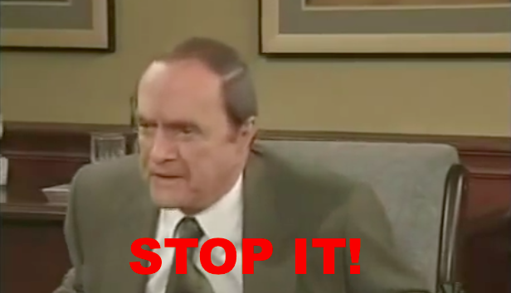
Video Demonstration:
Behavior Change
Bob Newhart’s Stop it (6:20) https://www.youtube.com/watch?v=36MEqSyGIVY
Notes:
Sometimes it’s easier to define something by saying what it is NOT.
Pictures can be better than words….
Bob Newhart: “Stop it”
Time: 6:20
https://www.youtube.com/watch?v=36MEqSyGIVY

Slide 10
‘The Stick’ vs
‘the carrot’
Learning Activity
Notes:
Persuade… Convince … Cajole

Slide 11
The Stick (Not MI)
“Speakers”
Identify something about yourself that you
want to change, need to change, should change, have been thinking about changing - but you haven’t changed yet.
in other words – something you are
ambivalent about…
Notes:
Instructions for Trainees:
Have participants break up into dyads (or triads, depending upon goals and the number in the group). Have one member play the “speaker” and the other play the “helper”. If using triads, have a third member play “observer”.
“Speaker” role:
Suggest that the speakers use the example that they wrote about in the reflection/writing exercise, or something from their clinical practice.
Identify a change that you are considering, something you are thinking about changing in your life, but have not definitely decided on – something you feel two ways about (habit, attitude, behavior, etc.). It might be a change that would be “good for you,” that you “should” make for some reason, but have been putting off.
For example, you want to exercise more but not enough time with work and kids, want to drink less caffeine to go to bed earlier but need that 3:00pm coffee, you want to stop eating sugar but…
Tell the “Helper” about this change you are considering.

Slide 12

“Helpers”
Your “job” is to be a non-MI helper.
Following are some suggestions:
  Explain why the person should make this change.
  Identify specific benefits that would result from making the change in order to persuade them to do so.
  Tell the person how they should make the change.
  Emphasize how important it is for them to make the change.
  Convince the person to “just do it”! If you encounter resistance, tell them again! This time more emphatically.
WARNING: This is NOT motivational interviewing!
Notes:
Instructions for Trainees:
“Helper” role:
Your task is to try as hard as you can to convince and persuade the “Speaker” to make the change that he or she is considering. Once you find out what the change is that the “Speaker” is considering, consider the following ideas:
Explain why the person should make this change.
Provide specific benefits that would result from making the change.
Tell the person how they could make the change.
Emphasize how important it is for them to make the change. This might include the negative consequences of not doing it.
Tell/persuade the person to just do it! And if you encounter resistance, repeat the above, perhaps more emphatically.
Remember, it’s very important to use only the methods here. Be directive - warn, threaten, blame if you have to!
Discussion Guide:
For the discussion that follows, focus primarily on the experience of the “Speakers” in these conversations. What were they feeling and thinking? Write bullet-point reactions on the board or flip chart.
Some common human responses to such advice are: angry, agitated, oppositional, discounting, defensive, justifying, not understood, not heard, passive, overwhelmed, ashamed, trapped, disengaged, uncomfortable, resistant.

Slide 13
Thomas Gordon’s 12 Roadblocks to “active listening”
(1970; from Miller & Rollnick, 2013)
Ordering, directing, or commanding
Warning, cautioning, or threatening
Giving advice, making suggestions, or providing solutions
Persuading with logic, arguing, or lecturing
Telling people what they should do; moralizing
Disagreeing, judging, criticizing, or blaming
Agreeing, approving, or praising
Shaming, ridiculing, or labeling
Interpreting or analyzing
Reassuring, sympathizing, or consoling
Questioning or probing
Withdrawing, distracting, humoring, or changing the subject
Notes:
These are examples of the “righting reflex.”
They may emerge naturally in the face of interacting with someone who seems to be making poor decisions about their life and their health.

Slide 14
MI: Background/Theory
Miller & Rollnick
Studies comparing traditional treatment approach for substance abuse
Direct confrontation was not helpful
Led to promoting alternative approach to SA treatment
MI, non-confrontational style, became a standard in substance abuse counseling
Carl Rogers’ client-centered principles
  Accurate empathy
  Genuineness
  Unconditional positive regard
Notes:
The traditional approach to substance abuse treatment was not based upon research.
Once someone studied this, e.g., comparing confrontation (breaking through denial) vs. non-confrontational approach, findings did not support to prevailing attitudes about “what works.”
Sometimes it’s easier to define something by saying what it is NOT.

Slide 15

Another Approach....
Motivation - internal and external forces and influences that move an individual to become ready, willing and able to achieve certain goals and engage in the process of change.
Motivational Interviewing (MI) - a collaborative conversation style for strengthening a person’s own motivation and commitment to change.
Miller, W. R., & Rollnick, S. (2012). Motivational Interviewing: Helping People Change (3rd ed.). New York, New York: The Guildford Press.
Miller W.R., Rollnick S. Ten things that motivational interviewing is not. Behav Cogn Psychoter, 2009; 37:129-40.
Notes:
When we talk about motivation, we’re talking about internal and external forces and influences that move an individual to become ready, willing and able to achieve certain goals and engage in the process of change. Motivation is key to change.
Motivational Interviewing (MI) is a collaborative, goal-oriented method of communication with particular attention to the language of change.
It is intended to strengthen personal motivation for and commitment to a target behavior change by eliciting and exploring an individual’s own arguments for change.
So the provider’s task is to elicit and enhance motivation, not to confront or punish the individual.
MI is not therapy in and of itself.
MI is a dialogue, a conversation.

Slide 16
The Spirit of MI
The Spirit of MI
Respects a person’s autonomy
Fosters person-centered collaboration
Evokes/elicits person’s own reasons for change
Recognizes change must derive from intrinsic vs. extrinsic factors
Miller, W. R., & Rollnick, S. (2012). Motivational Interviewing: Helping People Change (3rd ed.). New York, New York: The Guildford Press.
Miller W.R., Rollnick S. Ten things that motivational interviewing is not. Behav Cogn Psychoter, 2009; 37:129-40.
Notes:
Motivation for change can be fostered by an accepting, empowering, and safe atmosphere which:
1. Respects a person’s autonomy. This is very important in our work. This means that we:
Have acceptance of what the person brings
Acknowledge strengths and efforts
Do not judge
See the world through the other person’s eyes
Allow freedom to choose. This does not necessarily mean approval of what the person does, but accepting that it’s up to them. Acknowledging people’s ability and freedom to choose diminishes defensiveness and can facilitate change.
2. Fosters person-centered collaboration
MI is done for and with someone, not to or on someone
Work is done in partnership
Change cannot happen alone, the provider needs the patient. Avoid being the expert – the patient is the expert when it comes to personal change. This builds rapport and facilitates trust.
3. Evokes/elicits individual’s own reasons for change
People have strengths within themselves to change, our task is to call it forth
Peoples’ own positive motivations for change are likely to be more persuasive than any suggestion you might make.
We’re not judging – we’re working in partnership!

Slide 17
The Spirit of MI
Collaboration
Client is own expert;
Work done in partnership
Evocation
Client has resources and motivation to change within;
Provider must call this forth from within the client
Acceptance/ Autonomy
Client has right and capacity for self-direction;
Provider respects and affirms this
Notes:
This graphic crystalizes the Spirit of MI in relation to the patient/client.

Slide 18
MI Principles
Express Empathy:
  Convey emotional understanding about the person’s experience
Resistance:
  Roll with it, recognize it as fear, or problem with engagement, not an inherent flaw or conscious sabotaging by the individual
Support Self-Efficacy:
  Find opportunities to highlight the individual’s capacities
Recognize and Work with Ambivalence:
  Seen as a given, not a problem
Make Use of Feedback:
  Careful reflections are used to highlight areas the individual has described are important to him/her
Notes:
Based upon the Spirit of MI, these are some important principles that guide this type of work.
We want to notice, praise, cultivate, and strengthen positive capabilities, successes, intentions, efforts.

Slide 19
The Importance of Connection
Empathy
Convey an emotional understanding about someone’s experience
Curative, healing
Common factor
We are hard-wired for it: Attunement
Mirror neurons (e.g., Daniel Goleman)
Is different from Sympathy
Notes:
Empathy is :
Something we are hard-wired for! Attunement (origins in attachment); a biologically based need in humans to be mirrored, understood
Curative factor in psychotherapy and other intervention work
Common factor, not specific to a particular approach
Is different from Sympathy (see the Brene Brown “Empathy” video – next slide)

Slide 20
Video Demonstration:
Empathy
Brene Brown on Empathy (2:53) https://www.youtube.com/watch?v=1Evwgu369Jw
Empathy: The Human Connection to Patient Care (4:23)
https://www.youtube.com/watch?v=cDDWvj_q-o8
Notes:
OPTIONAL VIDEO EXAMPLES
Even if you don’t use the video the notes can be used to round out your discussion on Empathy.
The second video, produced by the Cleveland Clinic, explores the meaning of empathy, which is the ability to understand and share in the feeling of another. Empathy involves seeing the world through another person’s eyes, thinking about things as the other thinks about them, feeling things as that person feels them, sharing in their experiences.
Conveying empathy is critical to the MI approach. When people feel that they are understood, they are more able to open up to their own experiences and share those experiences with others.
Having someone share their experiences with you in depth allows you to assess when and where they need support, and what potential pitfalls they may need focus on in the change planning process.
Importantly, when an individual perceives empathy on a counselor's part, they become more open to gentle challenges by the provider about lifestyle issues and beliefs about substance use. People become more comfortable fully examining their ambivalence about change and less likely to defend ideas like their denial of problems, reducing use vs. abstaining, etc.
In short, the provider’s accurate understanding of the person’s experience facilitates change. When we relate to those around us by understanding their back stories and their circumstances, we improve the way we work, the way we live, the way we take care of one another, and the way we relate going forward.

Slide 21
The Importance of Feeling “Seen” and Building Trust
Patients that we interact with may have difficulty trusting, both people and information
“Emotional presence” matters
Rakel study, 2009 (Perception of empathy and the common cold)
Empathy in healthcare video
Rakel, D. P., Hoeft, T. J., Barrett, B. P., Chewning, B. A., Craig, B. M., & Niu, M. (2009). Practitioner Empathy and the Duration of the Common Cold. Family Medicine, 41(7), 494–501.
Notes:
Our job is to create an environment where connection can take place and trust has a chance of developing.
It can happen in brief interactions.
Emotional presence matters; it can lead to better recovery time, less resistance.
Reference:
Rakel, D. P., Hoeft, T. J., Barrett, B. P., Chewning, B. A., Craig, B. M., & Niu, M. (2009). Practitioner Empathy and the Duration of the Common Cold. Family Medicine, 41(7), 494–501.

Slide 22

Handling Resistance
What is most challenging in this work?
Notes:
OPTIONAL SLIDE
Ask trainees, “What is most challenging in this work?”
The following slide offers a few tips for handling resistance.

Slide 23
Keys to Working with Resistance
Rolling with it rather than confronting
Cultivating compassion and understanding
“Never take away someone’s defenses” without having something to replace them with
Look for other pathways
You catch more flies with honey than you do with vinegar (G. Torriano's 'Common Place of Italian Proverbs’)
Notes:
People don’t generally respond well to criticism, or direct confrontation, and they may be well-defended against seeing themselves in a certain light.
Practice the strategy, “You catch more flies with honey than you do with vinegar”!

Slide 24
Core Assumptions of MI
1. Motivation is a state NOT a trait
Notes:
The motivational approach is based on the following assumptions about the nature of motivation:
Motivation is a state, NOT a trait. This means that:
Motivation is not a crystallized, unmoving aspect of a person
Rather, motivation is fluid, it fluctuates
Motivation is interactive
Motivation can be modified
The provider’s style influences patient’s motivation (e.g., establishing a helping alliance with the patient that leads to better outcomes vs. confronting them, which can increase resistance to change).
Lecturing, directing or ordering someone to change an entrenched or pleasurable habit will result in resistance (decreased motivation), while collaborative exploration of ambivalence will result in increased motivation.

Slide 25
Core Assumptions of MI
2. Ambivalence to change is normal
Notes:
People are ambivalent about change, and ambivalence to change is completely natural! People often have one foot “in” and one foot “out” the door. Making a lifestyle change is difficult, and thoughtful people will have moments when they are more or less motivated to adopt a change. It’s important to accept this is natural rather than an aberration.
Stress, frustration, anger or “resistance” may indicate that an individual is considering the implications of change very seriously.

Slide 26
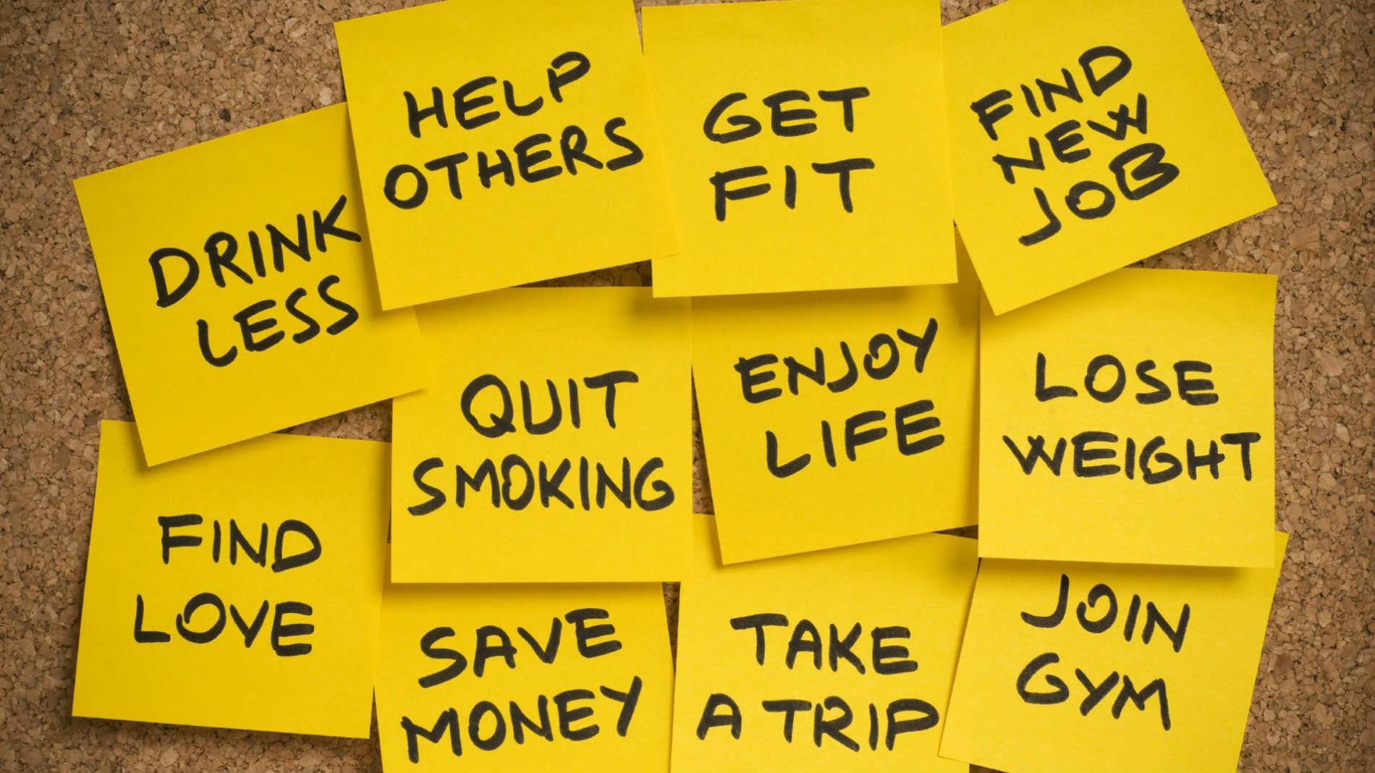
In 2017, I will…
Notes:
So when talking about behavior change, it’s important to recognize and remember that we all have feelings of ambivalence and that ambivalence is normal and shouldn’t be interpreted as denial or resistance - which often causes friction between the provider and the patient.
Anyone who has ever made a New Year’s resolution only to break it by January 15 and then “start again” in February has insights into the waxing and waning nature of motivation. Motivation to make and sustain a behavior change is not an intrinsic character trait, but rather a constantly changing state.
For many people, lifestyle changes - exercising more, drinking less, pursuing occupational goals - can improve health or overall functioning. In many instances, people are already aware of these potential health benefits, but they do not want to give up a competing behavior.
For example, someone may find exercise too strenuous, heavy alcohol use pleasurable, or that a medication has an unpleasant side effect.
Clinician advice tends to focus on the benefits of changing behavior.
In contrast, MI focuses on exploring the benefits of a current behavior compared with the potential benefits of behavior change.

Slide 27
Stages of Change
Action
Maintenance
Relapse
Contemplation
Preparation
Stable Behavior
Pre-contemplation
Notes:
We all move through stages when making a behavior change.
Pre-contemplation stage: People at this stage are the “happy users.” They are unconcerned about their behavior and do not recognize any need to make changes.
Contemplation stage (considering whether to change): At this point in the cycle, individuals are contemplating change. They feel two ways about their behavior. On the one hand, it is an enjoyable, exciting, or pleasurable activity. But on the other hand, they are starting to experience some adverse consequences. They are ambivalent about continuing their behavior.
Determination/preparation stage (considering how to change): Individuals in this stage have decided they will make the indicated change. They are making decisions about what kind of help they may need, what resources they will need, and what preparatory changes they need to make before they begin to make the identified change.
Action stage: At this stage, people have resolved to change and have committed themselves to that process. They have embarked on the road to change their behavior. It is important to remember that they still may experience some ambivalent feelings at this time.
Maintenance stage: In the maintenance stage, people have successfully made a change and have sustained the change for a significant period of time (generally occurs at least 6 months after the behavior has changed).
While the graphic depicts the stages moving in a circle, they are often not that straightforward. People can move back and forth across stages at any time.
*Remind trainees that most individuals may come to us at pre-contemplative or contemplative stages.

Slide 28
Why is Stage of Change/Readiness Important?
Recognition that the change process is fluid, not stagnant
There are ebbs and flows
Highlights the need to meet people “where they are”
Engagement is a necessary first step in identifying where someone is in their process
Notes:
Highlight the benefits of incorporating a “stage of change” approach which acknowledges the fluidity of behavioral and attitudinal changes and the value and importance of conveying an emotional connection and attunement to the person’s situation.

Slide 29

Helping People Change
Helping people change involves increasing their awareness that change might be important for them, and then assisting them to move through the different stages
  Try to see things from the person’s point of view
  Start “where the person is”
  Involves setting goals that the person accepts as meeting her/his needs
Notes:
Helping people change involves increasing their awareness of their need to change and helping them to start moving through the stages of change.
Start “where the person is”
Involves setting goals that the person accepts as meeting her/his needs
This can help to insure that the provider does not “get ahead” of the patient and can also signal the importance of the patient’s point of view.
Example:
“You were not thinking about quitting completely and you don’t want to risk setting a goal that is unrealistic for you right now, such as stopping forever. How willing are you to quit for a month to see how that goes?”
(You can also remind trainees that MI is just one of many approaches to helping people change.)

Slide 30

MI Principles → Practice
Key MI Skills for Brief Intervention
Open-ended questions
Affirming
Reflective listening
Summarizing
Notes:
The Spirit of MI and the Principles have been operationalized in a number of ways. We use the OARS acronym as a way to organize some of the key tools that MI clinicians can use.
Motivational interviewing makes use of four specific skills. These skills are used together to encourage people to talk and to explore their ambivalence about their substance use.
The four basic skills are often known by the acronym OARS:
Open-ended questions,
Affirmation,
Reflective listening, and
Summarizing.
Many of these are already familiar to providers and clinicians. They represent general therapeutic skills, and are not specific to MI.

Slide 31

OARS:
Open-ended Questions
Tell me about your marijuana use.
What problems have you had because of drinking?
What made you decide to quit smoking last winter?
Why do you think your boyfriend is so worried about you?
Notes:
Open-ended questions elicit more of the person’s thoughts and feelings about a behavior, which is likely to help evoke change talk. They cannot be answered with a single word or phrase.
Examples:
Tell me a little bit about your marijuana use.
What are your thoughts on setting a quit date?
Why did you quit smoking last winter?
Why do you think your [partner, spouse, brother, friend] is so worried about you?

Slide 32
Open-Ended Questions
???
Invite exploration and self-inquiry
Lead to discussion, ideas exchange
Can lead to expansiveness vs. constriction
Notes:
Highlight the benefits of open-ended questions in terms of their leading to further self-reflection, curiosity, dialogue vs. closing off discussion and thinking.

Slide 33
Asking Open & Closed-Ended Questions
Closed-Ended Questions | Open-Ended Questions
So, you are here because your partner is concerned because of your marijuana use, correct? | Tell me, what is it that brings you here today?
On a typical day, how much do you drink? | Tell me about your alcohol intake during a typical day.
Do you think you drink alcohol too much? | In what ways are you concerned about your drinking?
How long ago did you last use Vicodin? | Tell me about the last time you used Vicodin.
Do you agree that it would be a good idea for you to get treatment for your alcohol use? | What do you think about the possibility of getting treatment for your alcohol use?
When do you plan to quit smoking? | So what do you think you want to do about your smoking?
Notes:
OPTIONAL SLIDE can be tailored to audience
This slide can be used to demonstrate the different types of responses that are solicited when using close vs. open-ended questions.
Alternatively, you may ask participants to determine if the following questions are open or closed. If they are closed, ask them to reword them as open questions:
“How are you?”
“Would you like to stop smoking?” (Closed)
“Tell me what kind of exercise you like better; hiking, swimming, or riding a bicycle?” (Closed)
“What is your biggest concern about stopping smoking?” (Open)

Slide 34
Learning Activity:
Creating open-ended questions
Closed | Open
How many cigarettes do you smoke on a typical day?
Do you like smoking marijuana?
Don’t you think you might do better at work if you weren’t using drugs?
You’re not drinking while taking this medication, right?
Notes:
OPTIONAL SLIDE can be tailored to audience
Here are some other examples of closed-ended questions. Ask the students to turn them into open-ended questions.
By asking “What do you like about smoking marijuana?” the health professional is more likely to encourage dialogue than asking “Do you like smoking marijuana?” in which case the patient is likely to give a yes or no response.
By asking “How do you think things at work would be for you if you stopped using drugs?” the health professional is encouraging the patient to contemplate his life drug-free. Whereas “Don’t you think you might do better at work if you weren't using drugs?” might cause the patient to be resistant and defensive.

Slide 35
OARS:
Affirmations
Seek to affirm the person’s:
  Goals
  Values
  Intentions
  Efforts
  Strengths
  Willingness to engage in conversation and explore issues
  Inherent value as a person (especially important for a very discouraged or overwhelmed person)
Notes:
It’s important to recognize the difference between affirmations and praise. Praising someone for doing what you think they should be doing is quite different from encouraging someone by recognizing their strengths and accomplishments. When affirming someone, focus on the topics listed here.
Ask participants, “What are some affirmations you might use in your work?”
Values:
“I can see that you care about your future.”
“Your family and friends, and the idea of letting them down, really matters to you.”
“Getting through this probationary period at your new job is one of the most important things in your life right now.”
Strengths:
“I have noticed that you are really good at identifying strategies which help you reduce stress.”
“I know this appears very difficult to overcome. You have been able to do it before.”
Efforts:
“You did a great job dealing with the pressure from your friends to continue drinking when you’d made a commitment to cut back.”
Goals:
“You’re making great progress. Tell me how you feel in comparison to 2 weeks ago.”
“It seems to me that work is going better for you. You’ve been getting there a little early to settle into your day and that seems to lessen your stressed out state. That must feel really good.”
Compliment willingness to talk about difficult issues:
“Thank you for taking a few minutes to talk with me about your alcohol/marijuana use. I appreciate your openness and sharing your experiences and thoughts with me today.”
“Thank you for showing up to this appointment and being willing to talk with me.”
“I appreciate your willingness to discuss these things with me. I can tell that you really care about other people in your life.”

Slide 36

Affirmations
You are someone who sticks to her goals.
Even with all the pressures you have been facing, you still managed to do well in school.
You thought through the risks of smoking and made the decision to quit.
Notes:
Affirming is recognizing the person’s strengths and accomplishments, complimenting, or making statements of appreciation and understanding. Affirmations must be genuine or they will sound phony, which most people will pick up on.
(Precursor to next slide)
What is the difference between an affirmation and a compliment?

Slide 37
Affirming:
Support Self Efficacy
Affirmations can support a person’s sense of competence.
People need to believe they can be successful in order to be willing to attempt a behavior change.
Positive messages from a provider, especially those that build on strengths, can help the patient prepare for a behavioral change.
  “I realize that drinking is a big part of your life right now and quitting may not be easy. You have a lot of strengths including strong willpower, and family and friends that support you. I believe that you have what it takes to be successful.”
Notes:
Anyone with substance use problems may feel overwhelmed by feelings of shame and inadequacy.
Affirming is a strength-based approach to support self-efficacy, which is their self-confidence that change is achievable.
Affirming makes it more likely that they will recognize their own capacity to discuss difficult topics and appreciate their ability to alter them.
Providers should demonstrate appreciation and understanding through the use of compliments and reflective listening statements that recognize the person’s strengths and capacity to change.

Slide 38

Examples of Affirmative Statements
“I think it’s great you want to do something positive for yourself.”
“That must have been very difficult for you.”
“I appreciate that you are willing to talk with me about your substance use.”
“That’s a good suggestion.”
Notes:
OPTIONAL SLIDE
The following are examples of affirmative statements:
“I think it’s great you want to do something positive for yourself.”
“That must have been very difficult for you.”
“I appreciate that you are willing to talk with me about your substance use.”
“That’s a good suggestion.”

Slide 39
Learning Activity:
Finding Affirmations (1)
Rosa smokes. She knows it isn’t good for her and is fed up with people reminding her of it. Over time, she has come to realize that her social habit has moved to a full-fledged addiction. At some point she will stop, but just not yet. Indeed with all the other things happening in her life, this is the one area she feels is her own. She feels guilty about it, tries to hide it from her son and avoids the topic with her husband. She knows he’s right when he brings it up, but it still makes her angry. She wants to be the one to decide whether she will give it up or not and doesn’t like others telling her what she should do. She was able to lose 50 pounds 10 years ago and is afraid of putting the weight back on if she stops smoking.
Notes:
OPTIONAL SLIDE
The following slides contain different optional learning activities around making affirmations
(Instructions for activity 1 on following slide).

Slide 40
Finding Affirmations (1)
In small groups, identify at least 3 strengths that you observe in Rosa.
Go around and have each person state an affirmation you might offer in response to one of these strengths or inner quality that is important and may facilitate motivation.
  Try to use “you” language.
Write these down.
Notes:
OPTIONAL SLIDE
Have students write down the strengths they observe, then form affirmations based on these strengths. Try to use “you” language.
Strengths: Independently minded; Aware of changes in her behavior and it bothers her; Wants to be more healthy.
Affirmation: You are somebody who makes up her own mind. You will not simply cave to the desires of others, and in fact you may be quite determined once you’d made up your mind to change

Slide 41
Learning Activity:
Finding Affirmations (2)
Think about either a patient, friend, or family member who is struggling with a problem that they want to change. Perhaps you have become frustrated with them at times for not being able to take steps in a positive direction.
Write down 3 strengths or positive qualities in this person that you may sometimes have difficulty noticing or focusing on.
Notes:
OPTIONAL SLIDE
Write down the strengths you observe, then form affirmations based on these strengths. Try to use “you” language.
Strengths: Defends his friends, willing to stand up for himself even if it costs him.
Affirmation: You are a loyal friend, willing to defend others, even when it causes you trouble.

Slide 42

OARS:
Reflective Listening
Demonstrates that you have accurately heard and understood a person's communication by restating its meaning.
You hazard a guess about what the individual intended to convey and express this in a statement, not a question.
  Reflective listening is a way of checking rather than assuming that you know what is meant.
Can help the individual clarify their thoughts and emotions.
Reassures the individual that you are listening and understand their point of view.
Notes:
Reflective listening involves repeating or (slightly) interpreting what has been said. Reflective listening shows the individual that the provider understands what is being said, or it can be used to clarify what the she/he means.
One of our main tasks is to help people accurately identify their feelings, thoughts and perceptions. Individuals often have difficulty accurately describing how they feel about a particular situation and often have conflicted perceptions and emotions. Reflective listening statements can help the person clarify their thoughts and emotions and help you to better understand them.
For example, a person may say, “I hate my volleyball league. I should just quit.” You might assume that they do not like playing. However, by making reflective listening statements, you can encourage them to explore their feelings further, as well as clarify your understanding of their feelings about their performance (optional sample dialogue on next slide).

Slide 43
Reflective Listening
Patient: “Who are you to be giving me advice? What do you know about drugs? You’ve probably never even smoked a joint.”
Clinician: “It’s hard to imagine how I could possibly understand.”
Patient: “I just don’t want to take pills. I ought to be able to handle this on my own.”
Clinician: “You don’t want to rely on a drug. It seems to you like a crutch.”
Patient: “But I can't quit smoking. I mean, all my friends smoke.”
Clinician: “You can't imagine how you could not smoke with your friends, and at the same time you're worried about how it's affecting you.”
Notes:
Ask the participants for examples of reflective listening, perhaps from a recent situation they encountered.
Or, ask the trainees to take turns reading the examples from the slide.
In another example, a person may say, “I hate my volleyball league. I should just quit.” You might assume that they do not like playing. However, by making reflective listening statements, you can encourage them to explore their feelings further, as well as clarify your understanding of their feelings about their performance.
Ask: “What might you say to reflect back to encourage the person to explore their feelings?”
(Optional sample dialogue on next slide).

Slide 44
Utilizing Reflective Listening
I understand the problem is…
I’m sensing…
I wonder if…
I get the impression that…
As I hear it, you…
From your point of view…
In your experience…
I’m picking up that…
You mean…
Could it be that…
Let me see if I understand. You…
You feel…
From where you stand…
You think…
What I think I hear you saying…
Notes:
Here are examples of several phrases you can use to clarify and reflect back your understanding of what the patient is trying to convey.
Provide/ ask trainees for some examples of reflective listening statements such as:
“You are surprised that your screening results show you are at risk of problems.”
“It’s really important to you to keep your relationship with your boyfriend.”
“You’re feeling uncomfortable talking about this.”
“You’re angry because your partner keeps nagging you about your substance use.”
“You would like to cut down your substance use at parties.”
“You really enjoy your marijuana use and would hate to give it up, and you can also see that it is causing some financial and legal problems.”
(Point out that the speaker’s voice goes DOWN when forming a reflection and UP when forming a question.)

Slide 45

Reflective Listening
Patient: “I hate being on a volleyball team. I should just quit, I don’t enjoy it.”
Provider: “You hate being on the team and you’re thinking about quitting volleyball.”
Patient: “Yeah! It’s a hassle to get there after work, and then keeping up with a couple of younger guys –
It’s hard with all the games and practices when I have so much to do at my condo. Lately I go over to my buddy’s house after practice and we smoke a little weed – I’m staying out too late so the next day I’m tired. I’m barely getting to work on time. Then it’s the same thing -off to another game or practice…..
I’m getting so out of breath and feel like I’m going to get sick.
Still, I’ve been on this team for 8 years -most of us graduated together! I should try to keep up, I owe them my best.”
Provider: “What I hear you saying is that because of your marijuana use, you are finding it difficult to perform at your best in with your volleyball team.”
Patient: “Yeah, I guess so.”
Notes:
OPTIONAL SLIDE
Ask one trainee to play the patient and one to play the provider and read the parts aloud.
The example above illustrates how one young man may say one thing and mean something entirely different. Taken at face value, he says that he hates being on a volleyball and doesn’t enjoy it. On the other hand he feels a loyalty to his long time friends and teammates. Actually, the guy is not performing as expected due to the physical effects related to smoking marijuana. Reflective listening statements help the patient feel they are being heard and allows the discussion to stay focused and truthful.

Slide 46
Learning Activity:
Reflective Listening (1)
Your task is to write down a reflective listening response for the patient statement:
I really can’t stand this job. My boss is driving me crazy. He’s so disorganized and I’m always getting calls from angry people about the things he hasn’t done. I like to feeling productive and I just can’t in this job. It makes me have to take Xanax just to calm down.
Notes:
OPTIONAL SLIDE
“Your task in the next 30 seconds is to write down a reflective listening statement. What are you hearing the client say?”
After 30 seconds ring the bell and invite several learners to share their reflections: “Please stop your writing. The next step: I’m curious to hear several of your reflections. What did you come up with?” “Before we hear reflective listening responses from several new voices, I have an important question: From this point on—if you share a reflection—are you open to me offering you individual feedback to support fine-tuning of your reflection? …
“If you’re struggling with this activity, no worries. You’re not the only one. Reflective listening is a radically different way of thinking and responding for many people. It’s one of those skills that requires on-going practice.”
Or “Before I read the next client statement, can I offer a recommendation? Don’t think about it! If you get caught up in your head trying to come up with the right reflection, it
often misses the mark. So, get out of your head and allow the reflection to find you rather than you trying to find it.

Slide 47
Learning Activity:
Reflective Listening (2)
Practice reflections at each table
Use the following stem:
Well I keep trying and trying to quit smoking. A lot of times everything becomes too much and I just need a cigarette. I know it’s contributing to my gum problems.
Notes:
OPTIONAL SLIDE
Possible responses include:
You’ve tried many times before but you’ve always gone back to smoking.
It sounds like you often smoke because you’re overwhelmed.
So you’d very much like to quit.

Slide 48
OARS:
Summarizing
A good summary:
  Presents the essence of what the patient has said
  Reinforces what has been said
  Shows that you have been listening carefully
  Prepares the patient to move on to the next step
  “On the one hand, you’ve mentioned a lot of good things about drinking: it helps you to relax and you’re not so inhibited around your friends. On the other hand, it sounds like you are concerned about some of the health problems you’ve been experiencing.”
Notes:
Most health providers find it useful to periodically summarize what has occurred in a session. Summarizing consists of distilling the essence of what a patient has expressed and communicating it back. Summaries reinforce what has been said, show that you have been listening carefully, and prepare the patient to move on.
A good summary:
Presents the essence of what the patient has said
Reinforces what has been said
Shows that you have been listening carefully, and
Prepares the patient to move on to the next step.

Slide 49
Summarizing
“On the one hand, you enjoy using marijuana and want to relax, and you say you’re not using any more than your friends do.
On the other hand, you’ve spent a lot more money than you can afford to and that concerns you. So does feeling tired all the time and not getting things done- you want to accomplish some things around your new condo.
You’re feeling like you aren’t holding up your end at volleyball. These are people that are important to you. You don’t want to let them let them down.”
Notes:
Summarizing allows you to help the patient see patterns, highlight similarities or inconsistencies, and emphasize his/her choices and strengths.
Summarizing:
demonstrates you are actively listening and remembering the current and previous conversations;
reinforces information and brings into focus themes and strengths presented by the patient; and
provides an opportunity for you to highlight aspects of the thoughts and feelings expressed that support change.

Slide 50

MI Strategy:
Developing Discrepancy
Identify any discrepancy between the patient’s current situation and where they want to be
  Help the patient describe the discrepancy between how their life is when abusing substances and how it was or could be without them
  Explore costs and benefits with patient’s goals and values.
Conduct a decisional balance
  Accept/explore answers
  Note both the benefits and costs of current behavior and change
Notes:
Most people who have had consequences related to their alcohol or drug use will have both positive and negative feelings about their use, but the negative feelings often become buried because of the psychological need to justify continued use. A provider may uncover some of these negative feelings while taking a history, or simply by asking, “Is there anything you don’t like about your drinking?”
Awareness of discrepancy can drive the desire to change- Awareness of discrepancy creates cognitive conflict within the patient, which can then serve as a stimulus to change.
The following statement is an example of how a health care worker can help the patient to recognize the discrepancy between how their life is when abusing substances how it was or could be without them:
“On the one hand you want to keep getting high, on the other hand you want to get a job and you think that you might fail the drug test.”
Also ask about good things and not-so-good things.

Slide 51

Developing Discrepancy
I just enjoy having some drinks with my friends…that’s all. Drinking helps me relax and have fun. I think that I deserve that for a change.
So drinking has some good things for you. Now tell me about the not-so-good things you have experienced because of drinking.
Well…as I said, there was a couple nights that I couldn’t remember anything because of my drinking…and I often get sick.
Notes:
OPTIONAL SLIDE
This can be done by:
Clarifying important goals for the patient
Exploring the consequences or potential consequences of his/her current behaviors
Creating and amplifying in her/his mind a discrepancy between their current behavior and their goals

Slide 52
MI Strategy:
Readiness Rulers
Readiness rulers can address—
Importance
Confidence
Readiness
Confidence
Readiness
Importance
Notes:
Readiness rulers can be used in order to assist the patient:
Discover their own interest in considering and/or making a change in their life (e.g., diet, exercise, managing symptoms of physical or mental illness, reducing and eliminating the use of alcohol, tobacco, and other drugs)
Express in their own words their desire for change (i.e., "change-talk")
Examine their ambivalence about the change
Plan for and begin the process of change
Elicit and strengthen change-talk
Enhance their confidence in taking action and noticing that even small, incremental changes are important
Strengthen their commitment

Slide 53
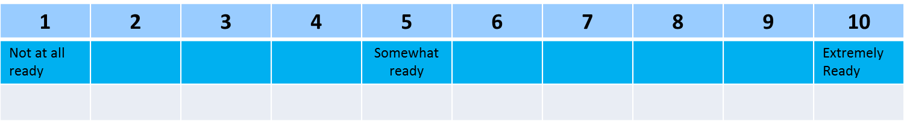
Readiness Ruler
On a scale of 1 to 10, how ready are you to make a change?
Follow-up: Why did you put yourself at a 3, and not a 1?
Notes:
If you think of a scale 0 to 10, where 0 is not at all confident and 10 is completely confident, how confident would you say you are about your ability to change your alcohol use?
If you think of a scale of 0 to 10, where 0 is not at all important, and 10 is the most important thing for you right now, how important is it to you to reduce your risk from drinking?
Why here and not a lower number?
Where would you like to be?
What would need to happen for you to get to a higher point?
This strategy helps the patient voice reasons for change and their strengths.

Slide 54
Learning Activity
Ruler Lineup
Have participants line up along a “ruler” on the floor, with numbers from 1 to 10. Various topics can be used for self rating:
    “How would you rate your own current level of skill in practicing MI?”
    “How important is it for you to learn MI?”
Then interview people at various points along the ruler as to why they are where they are on the scale to model the types of questions used with patients.
    “Why are you here at (number)?”
    “Why here and not (zero or a lower number)?”
    “What might it take to move you from a (chosen number) to (higher number)?”
Notes:
OPTIONAL SLIDE
*Slide for instructor only*
Use numbers that correspond to the readiness rulers that trainees will be using with their own clients. Use index cards or pieces of paper to write numbers corresponding to the ruler. Spread the numbers out on the floor or along a wall and ask trainees to stand next to the number that corresponds to their current level. Then ask questions to elicit self-motivational statements and confidence. Go up and down the line and interview people at different numbers. Note that you are modeling the kinds of questions that are also used with patients.
“Why are you here at (number)?”
“Why here and not (zero or a lower number)?”
“What might it take to move you from a (chosen number) to (higher number)?”

Slide 55
Try to Keep This in Mind:
Although Tempting,
Resist the Righting Reflex
Notes:
Resisting the righting reflex is very important when we hear someone describing a behavior that we know to be harmful.
We know that lecturing anyone on their behavior is a quick way to make them defensive and shut down any chance at a conversation.

Slide 56
Video Demonstration:
The Art of Listening
It’s NOT about the Nail (1:42)
https://www.youtube.com/watch?v=-4EDhdAHrOg
Notes:
OPTIONAL SLIDE
(Comment after the video)
It’s Not About the Nail demonstrates that often, people just want to be heard. Reflective listening involves less talking, no judging or advice.
It’s Not About the Nail
Time: 1:41
https://www.youtube.com/watch?v=-4EDhdAHrOg

Slide 57
Learning activity
Role play the example you wrote about earlier where you wanted to make a change.
Notes:
This is a “new and improved” version of the earlier role play.
Have the group return to earlier dyads (or switch). One partner will play a person who wants help with a particular problem or situation. The other will be the “helper”.
Spend about 5 minutes on this exercise and then have the partners switch roles so that each has a turn to be the “helper.”

Slide 58

“Helpers”
Listen carefully with a goal of understanding.
Give no advice.
Use OARS as appropriate.
Give a short summary/reflection of the speaker’s motivations for change.
Notes:
Instructions to trainees:
For this exercise, don’t try to persuade or fix anything.
Don’t offer advice.
Instead try to listen with compassion and try to understand the person’s situation and identified problem, as well as why they want to make this change.
Use what you’ve learned about MI, conveying genuine interest and empathy toward them, inviting discussion and exploration of the problem, providing reflections.
After you have listened carefully to the answers to these questions, give back a short summary of what you heard, of the person’s motivations for change.
Then ask one more question: So what do you think you’ll do? and listen with interest to the answer.

Slide 59
Role Play Questions
What did you learn in process of this
exercise? About yourself/partner/interviewer?
How skillful was the use of reflective statements?
To what degree did you build a positive rapport or connection?
Did you/partner use affirmations?
Did you notice any particular barriers either in you or with this partner that made it difficult to: experience empathy, provide feedback, work collaboratively, develop goals?
Notes:
Debrief the role play as time allows. Compare and contrast the two approaches practiced.

Slide 60
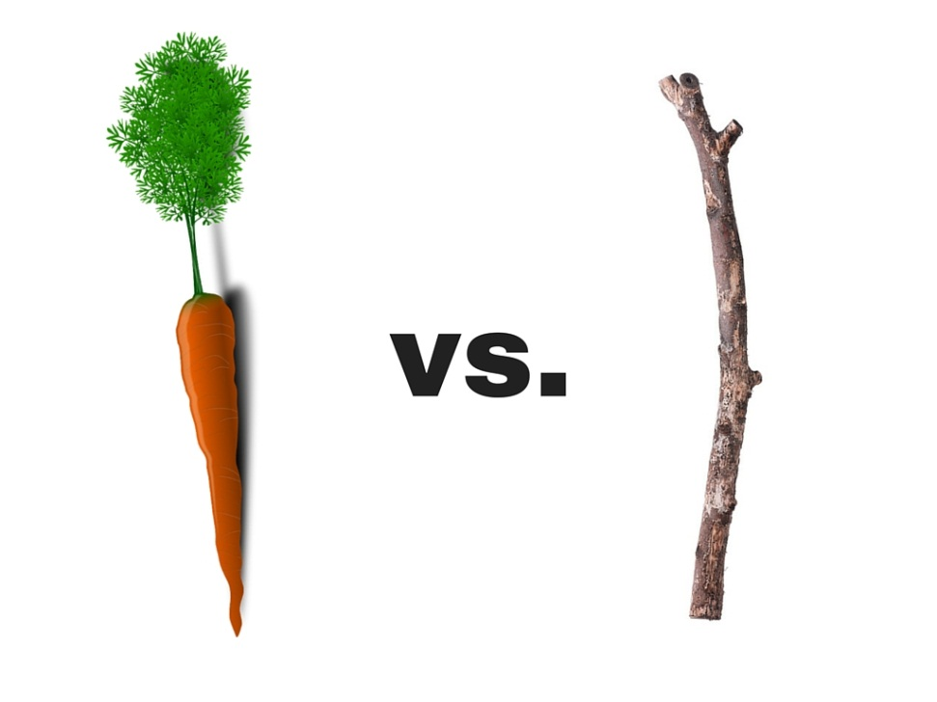
Review and Compare the Different Styles of Interaction
Notes:
Discussion Guide:
Following the exercise, first ask about the “Speakers’” experience in this conversation. What was happening? Write bullet-point responses on the board or flip chart.
Some common responses are: understood, want to talk more, liking the listener, open, accepted, respected, engaged, able to change, safe, empowered, hopeful, comfortable, interested, want to come back, cooperative.
If the Stick Exercise was done first, you now have two lists of “Speaker” reactions. Put them side by side and ask, “Which would you rather work with?” The point, of course, is that they are the same people responding in different ways to these two communication styles.

Slide 61
Sample Demonstration Videos
The Effective Dentist: Motivational Interviewing Demonstration (8:12)
https://www.youtube.com/watch?v=f8QSA_5PEFM
The Ineffective Dentist: Non-Motivational Approach (6:31)
https://www.youtube.com/watch?v=3xrEaFPbYC8
Notes:
OPTIONAL SLIDE

