Slide 1
Screening for Substance Misuse
Chapter 3
Notes:
This chapter on screening for will review following points:
The importance of screening patients for substance misuse.
How to obtain accurate information from patients about their use
How to use the ASSIST and ASSIST-FC screening tool

Slide 2
Why do people use drugs?
Fun/enhance pleasurable activities/intensify feelings
Experiment, explore new experiences
Unwind, cope with stress
Escape reality, numb feelings
Deal with emotional pain or discomfort
Respond to social pressure or norms
Make social contact easier
Enhance artistic creativity
Spiritual or meditative pursuits
Self-medicate for anxiety, depression, cognitive dysfunction
Notes:
Let’s first think for a minute about why people use drugs… what are some of the reasons?
People use psychoactive substances for what they believe are very good reasons. It’s important to see things from their perspective.

Slide 3
Why do people use drugs?
They have a “chronic, relapsing brain disease that changes the structure and functionality of the brain.” (NIDA)
Addiction is a “primary, chronic disease of brain reward, motivation, memory and related circuitry.” (ASAM)
Notes:
OPTIONAL SLIDE
Let’s first think for a minute about why people use drugs… what are some of the reasons?
People use psychoactive substances for what they believe are very good reasons. It’s important to see things from their perspective.

Slide 4
Rapport Building
Be personable
Be empathetic: Imagine yourself as your patient
this does not compromise your beliefs and values but helps to understand their world
Be open to seeing things from their perspective
Use your natural skills and abilities
Talk like them (i.e. tone, rate of speech, etc.)
Find points of relation (weather, pets)
Notes:
Asking patients about their use can seem uncomfortable at first. But before asking about sensitive information it’s important to develop rapport in the same way you would about any other aspect of your job.
Remain neutral and professional while being personable and expressing empathy.
If met with resistance, you can respond by saying “I appreciate your willingness to answer these questions. This information is important for me to know in order to give you the best care.”

Slide 5
Alcoholic
Addict
Strung out
Junkie
Crack-head
Druggie
Drunk
Burn-out
Dope fiend
The language we use matters
Notes:
OPTIONAL SLIDE
What do these words describe?
What do you think of when you see these words? What do they mean to you?

Slide 6
Class Participation
Raise your hand if you went to a doctor’s appointment in the past year.
Raise your hand if you were admitted to the hospital for any reason in the past year.
Raise your hand if you took any medication over the past year.
How do you feel answering these questions in a group setting?
…if you saw a mental health professional in the past year.
...if you took any psychiatric medication in the past year.
How would you feel?
Notes:
OPTIONAL SLIDE

Slide 7
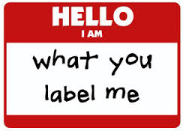
Stigma
A complex idea that involves beliefs, attitudes, feelings and behavior.
Refers to the negative “mark” attached to people who possess any attribute, trait, or disorder that marks that person as different from “normal” people.
This “difference” is viewed as undesirable and shameful and can result in negative attitudes/responses (prejudice and discrimination) from those around the individual.
Stigma is a way we disgrace others because of their behavior or characteristics.
Stigma manifests because of misconceptions and stereotypes due to lack of information.
Stigma can prevent important and sometimes lifesaving information from reaching target audiences.
Notes:
Stigma is something that is important to address with your trainees. It is the very reason many people with SUD don’t seek treatment.
What influences stigma?
(Media, experiences, culture, upbringing, education, exposure, fears, religion.)
“Stigma exists when elements of labeling, stereotyping, separation, status loss, and discrimination occur together in a power situation that allows them.” (Link & Phelan, 2001)
One of the barriers that individuals who use psychoactive substances face, especially when attempting to initiate treatment is the feeling of being labeled or stigmatized because of their use. Engage your trainees by having a brief discussion about their experiences with patients as well as their colleagues around the topic of stigma. Stigma is a multifaceted concept involving attitudes, behavior, beliefs and feelings. It is influenced by exposure, upbringing, religion, culture, education, fears and experiences. Individuals who possess, this undesirable or shameful “mark” (attribute or trait) that distinguishes them from “normal” people are viewed with negative attitudes and discrimination (Goffman, 1963). Stigma manifests because of misconceptions and stereotypes due to lack of information (e.g., people with HIV are dirty or promiscuous, people with mental illness are weak minded), which can prevent important, sometimes lifesaving information from reaching target audiences.
For example, fear of being labeled an addict or acquainted with one, can prevent family members of opiate-addicted individuals from obtaining the lifesaving drug Naloxone.
Link, B. G., & Phelan, J. C. (2001). Conceptualizing stigma. Annual Review of Sociology (27), 363–385.
Goffman, E. (1963). Stigma: Notes on the Management of Spoiled Identity. Englewood Cliffs, NJ: Prentice Hall.

Slide 8
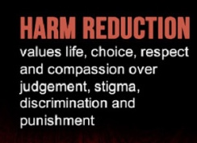
Harm Reduction Key Concepts
Aims to reduce the adverse health, social, and economic consequences of alcohol/drug use without requiring abstinence
Goal is to reduce harms to the individual and the community
Focuses on reducing harms and not necessarily on reducing use
Accepts that drug use is universal and brings with it both risks and benefits
Does not judge drug use as good or bad
Morally neutral
Non-coercive
Notes:
In an effort to reduce stigma around psychoactive substance users we embrace a non-judgemental attitude towards use.
Substance users may do things that are unhealthy or seen in a negative light, but that does not mean that they are bad people.
The Harm Reduction Approach aims to reduce the adverse health, social, and economic consequences of alcohol/drug use without requiring abstinence.
Goal is to reduce harms to the individual and the community.
Focuses on reducing harms and not necessarily on reducing use.
Accepts that drug use is universal and brings with it both risks and benefits.
Does not judge drug use as good or bad
Morally neutral (does not promote or condemn use)
Non-coercive
Programs supporting this approach focus on reducing harms and not necessarily on reducing use; accepts that drug use is universal and brings with it both risks and benefits; does not judge drug use as good or bad; respects the dignity and rights of the user; remains morally neutral (does not promote or condemn use) and non-coercive.
(http://www.ukhra.org/harm_reduction_definition.html)

Slide 9
What is SBIRT?
Screening is method for identifying someone at risk for a condition
Validated assessments include ASSIST, ASSIST-FC, AUDIT, DAST, FTND
Screening score provides an assessment of a patient’s risk level (lower, moderate, high)
Is not appropriate for diagnosing disease
Takes as little time as possible and provides an opportunity for feedback
Should be administered regularly
Notes:
What is UNIVERSAL SCREENING?
Universal screening is asking validated questions to every person in a population regardless of whether or not you think they show signs of risk.
Opposed to random or selected screening, universal screening increases the chances of detecting risky behavior at an early stage.
Screening can also be a significant step to effective intervention – if we don’t ask we don’t know. The screening process allows the patient and provider to have an open conversation about substance use.
Evidence-based screening makes use of a valid tool, is efficient in that it takes as little staff and patient time as possible and should be conducted regularly to detect changes in use.

Slide 10
Accuracy of Self-report Screening Tests
Is it possible to obtain accurate substance use information from patients?
Will patients be truthful? How will we know?
Why bother?
Notes:
Do you think it’s possible to obtain accurate information about substance use from patients?
Before moving on to the next slide:
What are some of the things that might influence the effectiveness of the screening?

Slide 11
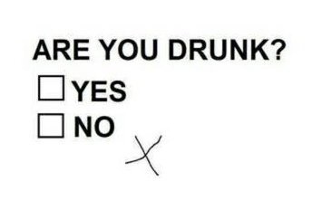
Accuracy of Self-report Screening Tests
Research shows that you can get very accurate information from individuals under the right circumstances.
Interviewer characteristics: non-threatening, empathetic, sensitive, objective and professional
Patient characteristics: understands rationale for questions and how they relate to their health status, understands limits of confidentiality, is not intoxicated
Question characteristics: Clear, evidence-based, memory aids and response cards are used
Notes:
The interviewer, the patient and the assessment all play a role in obtaining accurate information about a patient’s substance use behavior.
Before moving on to the next slide:
What are some of the potential challenges or problems with universal screening and how might you over come them? (Write the responses on a white board before going to the next slide.)

Slide 12
Top Reasons for Not Screening
Lack of time
Inadequate training
Privacy concerns
Need to triage competing problems
Not familiar with screening
Perceived lack of treatment options
Notes:
OPTIONAL SLIDE
Screening doesn’t need to be a scary experience for anyone. Even if a patient is using substances, he or she won’t necessarily need a referral.
Your job is to show them that you care about their wellbeing and provide a safe environment for them to talk about any substance use.
Barriers for screening for substance use include: Time restraints; feeling intrusive; someone else is in the room; lack of substance abuse knowledge or self efficacy; fear of losing/alienating patient; negative attitudes around use; stigma; opening up Pandora’s box.
If the screener is uncomfortable, the patient will feel uncomfortable. Normalize the screening by letting the patient know that asking these questions is standard practice and that it is a way to detect potential problems.

Slide 13
What makes a good screening question?
Written so that the respondent knows what the question means and that their understanding is what was intended by the person who wrote it.
Reliable (Will something influence the answer?)
Will you get the same answer no matter who asks, where it’s asked or when.
Valid (Is it measuring the construct?)
If you want to know about psychoactive substance misuse, what’s wrong with the validity of the following question?
“Do you use any illegal or street drugs?”
Notes:
Screening questions should be evidence-based – reliable and valid.
Reliable: If I ask the question again will I get the same answer? Will something influence the answer? (person, place, time, format)
Valid: Is the question measuring what I am trying to get at? If I’m trying to find out if someone has misused prescription pain medications, I need to go beyond the question: Have you used a prescription pain medication in the past 3 months. I need to ask about whether they have used someone else’s prescription or taken the drug more frequently or in higher doses than prescribed.

Slide 14
Bottom Line
A lot work (science) goes into creating good questions.
Questions are written to elicit a specific response
Have you ever used any drug by injection? (yes/no)
When did you quit smoking? (date)
Where did you last attend treatment? (place)
How much marijuana do you smoke in a week? (amount)
How many days per week do you drink? (number)
Responses will help you properly code the answer.
READ THE QUESTIONS AS WRITTEN!!!
Notes:
A lot of science goes into creating good questions. They are typically written in such a way as to elicit the response you are looking for.
Have you? (yes/no)
When? (date)
Where (place)
How much? (amount)
How many? (number)
Questions should not be difficult to understand, double barreled, or contain a double negative.
Double barreled (Do you like wine and cheese?)
Double negative (Are you unable to stop drinking when you want to?)
Loaded (You don’t smoke or drink do you?)
If you read the questions as written, you should be able to get an answer that will help you score the response properly.

Slide 15
Pre-screen Questions
Designed to quickly find out which patients are currently at risk for alcohol misuse or using other psychoactive substances.
Alcohol
AUDIT-C: 3 questions about frequency of use, quantity, and binge drinking
NIDA Quick Screen for Alcohol: In the past year, how often have you had
*(for men) 5 or more drinks a day? *(for women) 4 or more drinks a day?
Other drugs
NIDA Quick Screen for Drugs: In the past year, how often have you used a prescription medication for non-medical reasons or used an illegal drug?
Failure to obtain good information from patients can make or break your program.
Notes:
Some screening programs use a validated pre-screen question or set of questions to quickly identify which patients are currently at risk for alcohol misuse or are using psychoactive substances.
A few studied pre-screen questions are listed here.
Remember, if you don’t properly detect at-risk use at this point, you have lost the opportunity to intervene.

Slide 16
NIDA-endorsed EB Screening Tools (Adults)
Screening Tool | Substance Type |  | Administration Format
 | Alcohol | Drugs | Self | Clinician
Prescreens
NIDA Quick Screen | A | D | S | C
AUDIT-C | A |  | S | C
Opioid Risk Tool |  | D | S
Full Screens
ASSIST | A | D |  | C
AUDIT | A |  |  | C
CAGE-AID | A | D |  | C
CAGE | A |  |  | C
DAST-10 |  | D | S | C
Notes:
These are the most commonly used evidence-based screening tools for alcohol and other drugs. Some are validated for self-administration and some should be administered by the clinician in an interview format.

Slide 17
Screening using the assist

Slide 18
The ASSIST Screening Tool
Alcohol, Smoking & Substance Involvement Screening Test
Developed by an international group of scientists in collaboration with WHO
8 item, clinician-administered questionnaire
Administration time: 5-10 minutes
Developed for health care workers in primary care settings
Cross-culturally valid
Humeniuk, R., Ali, T., Babor, T., Farrell, M., Formigoni, M., et al. (2008). Validation of the alcohol, smoking and substance involvement screening test (ASSIST). Addiction, 103, 1039-1047.
Notes:
I’d now like to introduce you to the tool commonly used to screen for tobacco, alcohol and other drugs.
The ASSIST is the Alcohol, Smoking and Substance Involvement Screening Test. It is a brief screening questionnaire to find out about people’s use of psychoactive substances. It was developed with primary health care providers in mind by the World Health Organisation (WHO) and an international team of substance use researchers as a simple method of screening for hazardous, harmful and dependent use of alcohol, tobacco and other psychoactive substances.
The ASSIST is the first screening test which covers all psychoactive substances including alcohol, tobacco and illicit drugs.
It takes about 5-10 minutes to administer and is cross-culturally valid (tested in a several countries including the US, India, Thailand, Brazil, Australia, the UK and Africa).
Humeniuk, R., Ali, T., Babor, T., Farrell, M., Formigoni, M., et al. (2008). Validation of the alcohol, smoking and substance involvement screening test (ASSIST). Addiction, 103, 1039-1047.
Humeniuk, R., Ali, R., Babor, T., Formigoni, M.L., Boerngen, et al. (2011). A Randomized Clinical Trial of a Brief Intervention for Illicit Drugs Linked to the Alcohol, Smoking and Substance Involvement Screening Test (ASSIST) in Primary Health Care Settings. Addiction, 107, 957-66.

Slide 19
What Does the ASSIST Do?
Screens for health risks and problems associated with psychoactive substance use (at-risk use)
Provides lifetime and current (past 3 months) estimates of substance use and related risks
Helps warn people that they may be at risk of developing problems related to their use
Provides an opportunity to start a discussion with patients about substance use
Notes:
The ASSIST screens for health risks and problems associated with psychoactive substance use and provides both lifetime and current estimates of substance use and related risks.
The ASSIST can help warn people that they may be at risk of developing problems related to their substance use in the future and it can provide an opportunity to start a discussion with a patient about their use. It can identify substance use as a contributing factor to the presenting illness. The ASSIST can be linked to a brief intervention to help high at-risk substance users cut down or stop their use and so avoid the harmful consequences of their use.
The scoring procedure estimates the relative importance of these different risk behaviors for the purpose of prioritizing counseling interventions.

Slide 20
Domains of the ASSIST
Lifetime use of 10 categories of drugs
Frequency of recent use (past 3 months)
Compulsion to use (recent)
Health, social, legal, financial problems (recent)
Failure to fulfill role obligations (recent)
Others’ concern about substance use (lifetime/recent)
Failed attempts to quit/control use (lifetime/recent)
Injecting drug use (lifetime/recent)
Notes:
In particular, the ASSIST measures:
Lifetime use of 10 categories of drugs
Frequency of recent use (past 3 months)
Compulsion to use (recent)
Health, social, legal, financial problems (recent)
Failure to fulfill role obligations (recent)
Others’ concern about substance use (lifetime/recent)
Failed attempts to quit/control use (lifetime/recent)
Injecting drug use (lifetime/recent)

Slide 21
Introducing the ASSIST
The ASSIST questionnaire comes with an introduction (may be modified to suit agency needs or circumstances)
BUT introduction should include:
Time frame of interest: Lifetime or past 3 months
Response Card
List of substances, slang and street terms
Non-prescribed use only
Limits of confidentiality

Slide 22
ASSIST Introduction
The questions I’m going to ask you relate to your experiences with alcohol, cigarettes, and other drugs. Some of the substances we’ll talk about can be prescribed by a doctor or dentist (like pain medications). But I am only concerned with those if you have taken them for reasons other than prescribed, or in different doses than prescribed. This information is an important part of your medical history and will help us in our mission to give you the most appropriate and comprehensive care. I am interested in knowing about the substances you have used in the past 3 months.
Use Response Card!
Notes:
Using a standardized introduction can help in a number of ways.
It provides a rationale for the questions, it informs patients about what you will be asking about, and it defines a time window of interest.
It is helpful to also provide anchor points for the past 3 months, such as from the 15th of May up to today. And its also helpful to provide the patient with a Drug List that lists the substances (and their slang terms) that you will be asking about.
Have a trainee read the introduction.

Slide 23
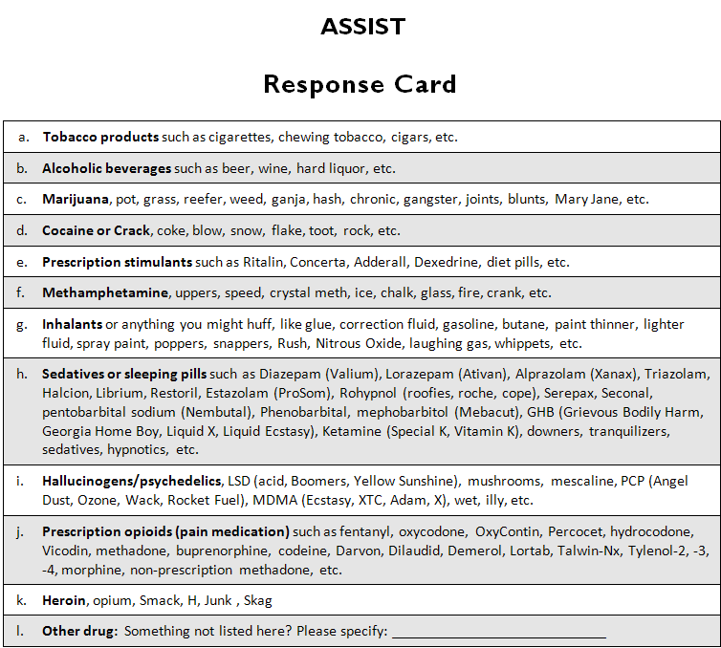
Notes:
The Response Card for Patients contains a list of the substance categories covered by the ASSIST together with a range of names associated with each category. It also contains frequency responses for each question. The drug names on the card are those which are most commonly used in the countries in which the ASSIST was tested, but the interviewer should use the most culturally appropriate names for their location. Check with patients what names they use to describe particular drugs and use the names that they use.

Slide 24
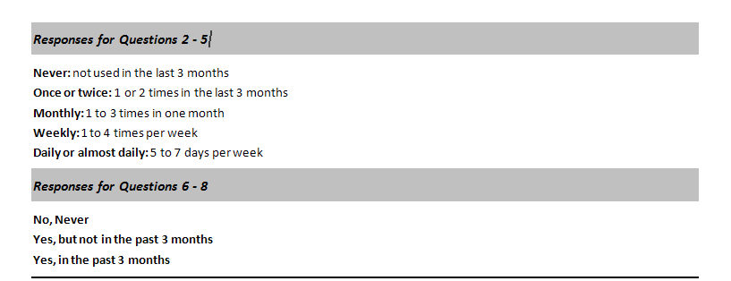
Response Items
It is important to understand these responses. (3 months = 12 weeks = 90 days)
Notes:
As the patient responds to your questions have him refer to the response categories if clarification is needed. This helps in accurate and consistent coding of each item.

Slide 25
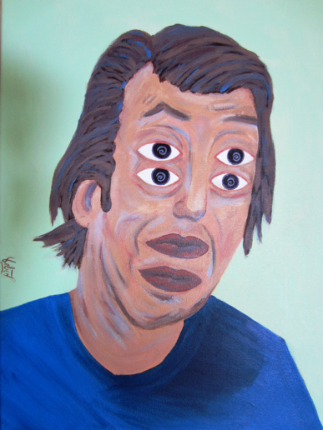
Lower Risk Drink Limits
“Binge” drinking: Consuming more than the recommended lower risk guidelines for drinking on any one occasion
[Males] Have you ever had 5 or more drinks on one occasion?
[Females] Have you ever had 4 or more drinks on one occasion?
Puts patients at risk for injuries, unintended sexual practices, motor vehicle accidents, fights, violence, falls, drownings
Notes:
When querying patients about their alcohol use, it’s important to remember that there are two types of at-risk drinking. One is drinking too many on a daily basis; the other is drinking too many at one time, commonly referred to as binge drinking.
Because alcohol use can affect you health as well as create a number of other problems, NIAAA recommends guidelines for lower risk drinking.
Men under the age of 65 should have no more than 2 drinks a day, 14 per week, and no more than 4 on any one occasion.
For women and men over the age of 65, the limits are 1 a day, 7 a week, and no more than 3 on any one occasion.
For this reason, there is a question on the ASSIST-FC that queries about binge drinking. This question is not included in the scoring for Alcohol, however, if a patient reports drinking more than the recommended limit per occasion (binge drinking) even if the ASSIST-FC Alcohol score is categorized as low (0-5) then a Brief Intervention would be recommended to educate the patient on the risks of acute intoxication.

Slide 26
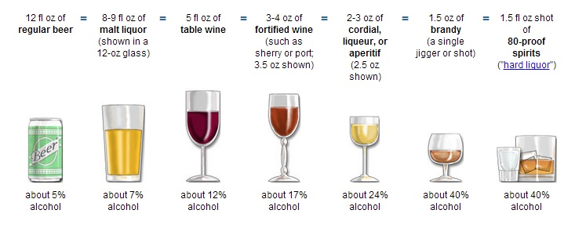
1 US Standard Drink: 14 grams = .6 fluid ounces of ethanol
# ounces X % ETOH
.6
= #standard drinks
Notes:
When asking patients about their alcohol consumption, it is important to know what constitutes a standard drink.
In the Untied States, a standard drink contains 14 grams of pure alcohol or .6 fluid ounces.
So a 12 ounce can of beer containing 5% alcohol is one standard drink: (12oz. X .05)=.6 of pure ethanol.
Similarly, 5oz. of wine containing 12% alcohol is one standard drink: (5oz. X .12) = .6
A shot of 80 proof liquor, 1.5oz. X .4 = .6

Slide 27
The ASSIST Question Content
Lifetime use
Q1. Lifetime use (filter question)
Past 3 months use (How often…)
Q2. Frequency of use (substances relevant to current health status)
Q3. Strong desire to use (reflects dependence or high-use)
Q4. Health, social, legal, financial problems (relate to current health status)
Q5. Failure to fulfil role obligations (not asked for tobacco)
Lifetime use
Q6. Concern by others (note change back to lifetime substances)
Q7. Failed attempts to control use (reflects dependence or high-risk use)
Q8. Injecting behavior (reflects dependence or high-risk use, assess frequency and discuss risks)
Notes:
The following items are asked of each substance category.

Slide 28
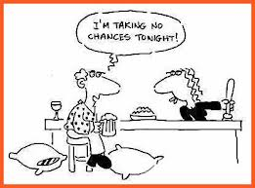
Problems Related to Substance Use
People use substances because they have a pleasurable or desirable effect
Problems can arise as a result of:
Acute intoxication (moderate risk)
Regular use (moderate risk)
Dependence (high risk)
Injecting behavior (high risk)
The ASSIST covers a range of these problems
Notes:
It’s important to remember, when querying patients about their substance use, that people use substances because they have a pleasurable or desirable effect.
However, problems can arise as a result of acute intoxication (such as fights), regular use (such as decreased work performance), dependence (such as withdrawal symptoms) and for those who inject - several health problems including contracting Hepatitis C, HIV, and other infections.
The ASSIST covers a range of these problems.

Slide 29
Question 1: Lifetime Use
In your life, which of the following substances have you ever used? (non-medical use only)
No
Yes
Ask for all substances – use other terms or slang or street names
Record any use (even if only tried once)
Probes: Not even at a party? Not even when you were in school?
If “No” to any substance, don’t ask about it again
If “No” to all substances, end the interview
Q1 is not included in the ASSIST Risk Scores
Lifetime Use
Notes:
Question 1 asks about lifetime use of substances, i.e., those drugs the patient has ever used, even if it is only once.
Every patient should be asked this question for all the substances listed.
If the patient answers ‘No’ to every substance the interviewer should ask a probing question “Not even when you were in school?”.
If the response is still ‘No’ to all the substances then the interview should be stopped.
If the patient answers ‘Yes” to Question 1 for any of the substances listed then move on to Question 2 which asks about substance use in the previous three months.

Slide 30
Question 2: Recent Use
In the past three months, how often have you used the substances you mentioned?
Never (0)
Once or twice (2)
Monthly (3)
Weekly (4)
Daily or almost daily (6)
An indication of the substances most relevant to the individual’s current health status
If “Never” to all, end the interview
Notes:
Question 2 asks about the frequency of substance use in the past three months, which gives an indication of the substances which are most relevant to current health status.
If any substances have been used in the past three months then continue with each substance used.
(For paper version, circle all answers – even the Never responses.)
Remember the coding definitions for the last 3 months (never, once or twice, monthly, weekly, daily or almost daily).

Slide 31
Question 3: Strong Urge to Use
In the past three months, how often have you had a strong desire or urge to use (…list drugs one at a time)?
Never (0)
Once or twice (3)
Monthly (4)
Weekly (5)
Daily or almost daily (6)
Reflects dependent or high-risk use
Distinguish “frequency of use” and “strong desire to use”
Notes:
Question 3 asks about the frequency of experiencing a strong desire or urge to use each substance in the last three months.
Distinguish between “frequency of use” and “strong desire to use”. This is not just mild or transient desire. Daily cigarette smoking is a good example.
This question reflects dependent or high risk use.

Slide 32
Question 4: Health, Social, Legal or Financial Problems
During the past three months, how often has your use of (…list drugs one at a time) led to health, social, legal or financial problems?
Never (0)
Once or twice (4)
Monthly (5)
Weekly (6)
Daily or almost daily (7)
Relate to the individuals current health status if possible
Notes:
Question 4 asks about the frequency of health, social, legal or financial problems related to substance use in the last three months.
You may be able to relate this to the individual’s current problems…asthma, bronchitis, cough, accident, anxiety?
Prompt with examples of the most common problems for each substance used.

Slide 33
Question 4 Prompts
Tobacco
breathlessness, feeling less fit than usual, takes longer to recover from illness, respiratory problems
Alcohol
bad hangovers, GI problems/pain, arguments, poor sleep, relationship tension
Cannabis
↓ attention & motivation, ↓ short term memory, ↓ problem solving, depression, anxiety, panic
Amphetamine-type stimulants
Bad come down – depression, anxiety, irritable; anger & aggression, headaches, poor sleep, dental problems (teeth grinding)
Notes:
Let’s think about some of the typical problems caused by Smoking…
Tobacco
breathlessness, less fit than usual, takes longer to recover from illness, respiratory problems
Alcohol
bad hangovers, GI problems/pain, arguments, poor sleep, relationship tension
Cannabis
↓ attention & motivation, ↓ short term memory, ↓ problem solving, depression, anxiety, panic
Amphetamine-type stimulants
Bad come down – depression, anxiety, irritable; anger & aggression, headaches, poor sleep, dental problems (teeth grinding)

Slide 34
Question 5: Failure to Fulfill Major Role Responsibilities
During the past three months, how often have you failed to do what was normally expected of you because of your use of (…list drugs one at a time)?
Never (0)
Once or twice (5)
Monthly (6)
Weekly (7)
Daily or almost daily (8)
Not asked for Tobacco
Examples include tardiness/absenteeism from work or school, neglecting relationships, not looking after children, etc.
Notes:
Question 5 asks about the frequency with which use of each substance has interfered with role responsibilities in the past three months.
** It should be noted that Question 5 is not asked for tobacco because it is unlikely that tobacco use would lead to the failure to fulfil role obligations.
E.g., missing work or school, not looking after children, neglecting relationships, missing family events or appointments, etc.
Generally there are consequences for behaviour (lost pay, warnings, failing study impact on others, arguments, relationship problems)

Slide 35
Question 6: External Concern
Has a friend or relative or anyone else ever expressed concern about your use of (…list drugs one at a time)?
No, Never (0)
Yes, in the past 3 months (6)
Yes, but not in the past 3 months (3)
Lifetime Use
Notes:
Question 6 and 7 should be asked for all substances endorsed in question 1, even if the substance is no longer being used.
Question 6 asks whether anyone has ever expressed concern about the patient’s use of each substance and how recently that occurred.
Concern can come from a partner, parents, children, friends, employer, colleague, doctor, etc.

Slide 36
Question 7: Failed Attempts to Control Substance Use
Have you ever tried and failed to control, cut down or stop using (…list drugs one at a time)?
No, Never (0)
Yes, in the past 3 months (6)
Yes, but not in the past 3 months (3)
Reflects dependent or high-risk use
Break down the question
Have you ever tried to cut down or quit (substance)?
Were you successful?
When was the last time you tried and weren’t successful?
Lifetime Use
Notes:
Question 6 and 7 should be asked for all substances endorsed in question 1, even if they are no longer using them.
Question 7 asks whether the individual has ever tried and failed to cut down or give up their use of each substance and how recently that occurred.
This question reflects dependent or high risk use.
Note: Tried and failed.
You may need to ask the question in parts:
Have you ever tried to cut down or quit smoking cigarettes?
Were you successful?
When was the last time you tried and weren't successful?
Individuals can respond ‘Never’ for three reasons
Not an issue (i.e., don’t use enough to cut down)
Never tried
Tried and was successful at first attempt
For multiple attempts at cutting down, record the most recent failure – i.e., was it in the last 3 months or prior to that?

Slide 37
Question 7 Responses
Individuals can respond ‘Never’ for three reasons
Not an issue (i.e., don’t use enough to cut down)
Never tried
Tried and was successful at first attempt
For multiple attempts at cutting down, record the most recent failure – i.e., was it in the last 3 months or prior to that?
Notes:
Individuals can respond ‘Never’ for three reasons
Not an issue (i.e., don’t use enough to cut down)
Never tried
Tried and was successful at first attempt
For multiple attempts at cutting down, record the most recent failure – i.e., was it in the last 3 months or prior to that?

Slide 38
Question 8: Injecting Drug Use
Have you ever used any drug by injection? (non-medical use only)
No, Never (0)
Yes, in the past 3 months (2)
Yes, but not in the past 3 months (1)
Reflects dependent or high-risk use
If yes, query about pattern of injecting and discuss risks
Notes:
This question reflects dependence or high risk.
Not included in any Substance Specific Score, but it contains important information in determining patients risk and treatment.
Individuals who have injected drugs in the last 3 months should be asked about their pattern of injecting to determine their risk level and the best course for intervention.
Those who inject have an increased likelihood of dependence, overdose, psychosis, infection (local and systemic), abscesses and ulcers, vein collapse, HIV and Hepatitis B/C.

Slide 39
Scoring the ASSIST
For each substance, add up the scores received for questions 2 through 7 inclusive. Do not include the results from questions 1 or 8 in this score.
To calculate an ASSIST Risk Score for Marijuana…
A patient has given the following answers on the ASSIST for marijuana use.
Question 2c | Weekly | Score = 4
Question 3c | Once or twice | Score = 3
Question 4c | Monthly | Score = 5
Question 5c | Once or twice | Score = 5
Question 6c | Yes, but not in the past 3 months | Score = 3
Question 7c | No, never | Score = 0
ASSIST Risk Score for Marijuana |  | 20

Slide 40
Guidelines for Assessing Risk Level Using the ASSIST
Alcohol | All Other Substances | Risk Level
0-10 | 0-3 | Low Risk (Provide education/feedback)
11-26 | 4-26 | Moderate Risk (Brief Intervention, take-home materials)
27+ | 27+ | High Risk (Brief Intervention, referral to substance abuse treatment for for a more comprehensive assessment)
Notes:
Low Risk
While these individuals may use substances occasionally, they are not currently experiencing any problems related to their use and are at low risk of developing health or other problems related to their use in the future.
Moderate Risk
Individual are at moderate risk of health and other problems and may be experiencing some of these problems now. Continuing use in this way indicates a likelihood of future health and other problems, including the possibility of dependence. Risk is increased for those with a past history of substance problems and dependence.
High Risk
These individuals are experiencing severe health and other problems and are most likely dependent on the substance(s).

Slide 41
Guidelines for Assessing Risk Level Using the ASSIST
Screening
Alcohol: 0-10
Drugs: 0-3
No or Low Risk
Alcohol: 11-26
Drugs: 4-26
Moderate Risk
Alcohol: 27+
Drugs: 27+
High Risk
Educational Feedback
Brief Intervention
Brief Intervention + Referral to Treatment
Notes:
Low Risk
While these individuals may use substances occasionally, they are not currently experiencing any problems related to their use and are at low risk of developing health or other problems related to their use in the future.
Moderate Risk
Individual are at moderate risk of health and other problems and may be experiencing some of these problems now. Continuing use in this way indicates a likelihood of future health and other problems, including the possibility of dependence. Risk is increased for those with a past history of substance problems and dependence.
High Risk
These individuals are experiencing severe health and other problems and are most likely dependent on the substance(s).

Slide 42
Screening using the assist-fc

Slide 43
ASSIST-FC (Frequency and Concern)
Newly validated shortened version of the ASSIST (2-item)
Reduced number of drug categories
Frequency of current use
Concern about use from others
Quick and easy to score
Notes:
A shortened version of the full 8-item ASSIST has recently been validated. It’s called the ASSIST-FC because it contains only the “frequency” and “concern” items from the full ASSIST.

Slide 44
Introducing the Screening
Key elements that must be emphasized in the initial interaction in order to make the screening process successful:
Screening is universal (“…we ask all patients these questions”).
Alcohol and other drug use screening is a standard of care (“…we’re asking these questions because the use of these substances may effect your health and can interfere with many medications”).
Confidentiality (“…like all aspects of your medical record, the information we talk about will be kept confidential”).
Notes:
This component is particularly important for patients who may feel they are being singled out for screening services.

Slide 45
ASSIST Introduction
The questions I’m going to ask you relate to your experiences with alcohol, cigarettes, and other drugs. Some of the substances we’ll talk about can be prescribed by a doctor or dentist (like pain medications). But I am only concerned with those if you have taken them for reasons other than prescribed, or in different doses than prescribed. This information is an important part of your medical history and will help us in our mission to give you the most appropriate and comprehensive care. I am interested in knowing about the substances you have used in the past 3 months.
Use Response Card!
Notes:
Using a standardized introduction can help in a number of ways.
It provides a rationale for the questions, it informs patients about what you will be asking about, and it defines a time window of interest.
It is helpful to also provide anchor points for the past 3 months, such as from the 15th of May up to today. And its also helpful to provide the patient with a Drug List that lists the substances (and their slang terms) that you will be asking about.
Have a trainee read the introduction.

Slide 46
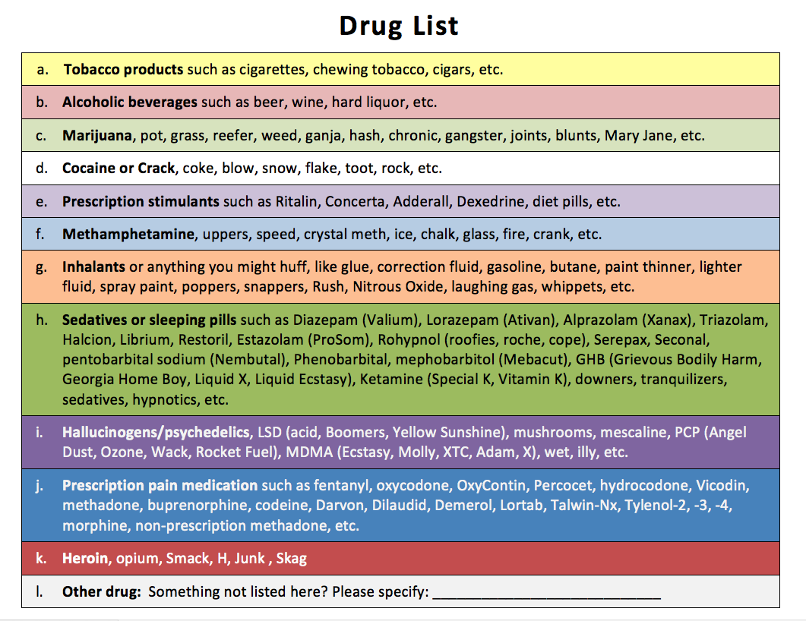
Notes:
Here’s an example of a Drug List you can hand to patients while asking about the various substances so that they can see some of the slang terms used for the drug categories you will ask about.

Slide 47
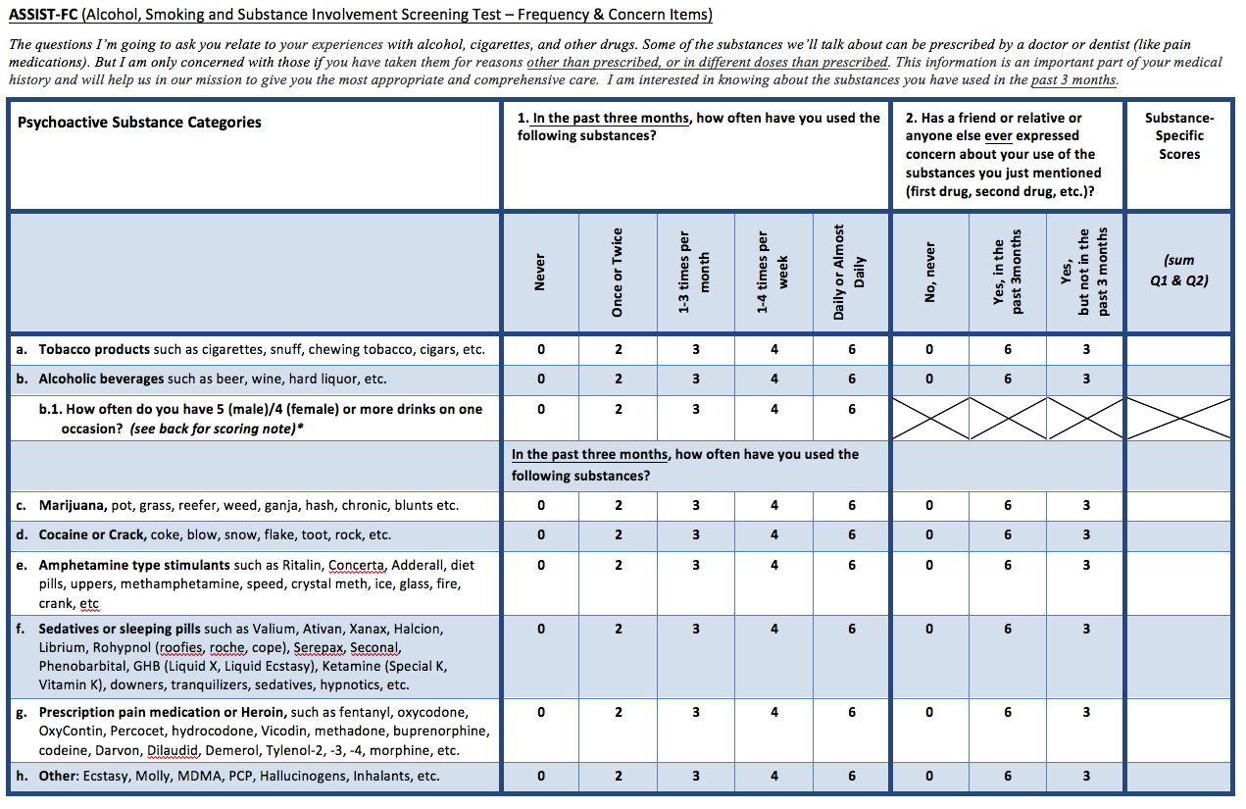
Notes:
Read the questions as written.
Question 1 asks about the frequency of substance use in the past three months, which gives an indication of the substances which are most relevant to current health status.
If the response is ‘Never’ to all of the items in Question 2 end the interview.
For each substance endorsed in Question 1, immediately ask questions 2 for that substance. Then move on to the next substance
Question 2 asks whether anyone has ever expressed concern about the patient’s use of each substance and how recently that occurred.
Concern can come from a partner, parents, children, friends, employer, colleague, doctor, etc.
Question 1b.1. If the patient reports that they drink 5 or more drinks on one occasion (4 for females), a brief intervention is recommended, even if the ASSIST-FC Alcohol Score is classified as Low (0-5)
Highlight that patients engaging in binge drinking are at increased risks for acute harms including injuries, accidents, fights, violence, etc.

Slide 48
ASSIST-FC: Question 1
Frequency of use in the past 3 months
In the past three months, how often have you used the following substances?
Never (0)
Once or twice (2)
1-3 times per month(3)
1-4 times per week (4)
Daily or almost daily (6)
An indication of the substances most relevant to the individual’s current health status
If “Never” to all, end the interview
Notes:
Question 1 asks about the frequency of substance use in the past three months, which gives an indication of the substances which are most relevant to current health status.
If the response is ‘Never’ to all of the items in Question 2 end the interview.
*For each substance endorsed in Question 1, immediately ask questions 2 for that substance. Then move on to the next substance

Slide 49
ASSIST-FC: Question 2
Recency of someone else’s concern, if any, about the individual’s substance use
Has a friend or relative or anyone else ever expressed concern about your use of (the substance you just mentioned)?
No, Never (0)
Yes, in the past 3 months (6)
Yes, but not in the past 3 months(3)
Notes:
Question 2 asks whether anyone has ever expressed concern about the patient’s use of each substance and how recently that occurred.
Concern can come from a partner, parents, children, friends, employer, colleague, doctor, etc.
At this time, have the trainees pair up and practice conducting the ASSIST interview. Make sure they read the introduction!

Slide 50
Scoring the ASSIST-FC
Question 1. An answer should be recorded for each substance category in question 1. If a substance was never used, or has not been used in the past 3 months, “Never” should be checked.
Question 2. An answer should be recorded only for substances the patient reports using in the past 3 months.
For each substance, add up the scores received for Questions 1 and 2.

Slide 51
Assessing Risk Level Using the ASSIST-FC
Alcohol | All Other Substances | Risk Level
0-5* | 0 | Low Risk You are at low risk of health and other problems from your current pattern of substance use.
6-8 | 2-6 | Moderate Risk (Brief Intervention) You are at risk of health and other problems from your current pattern of substance use.
9-12 | 7-12 | High Risk (Brief Intervention + Further Assessment) You may be at high risk of health and other problems from your current pattern of use.
* If the patient reports that they drink 5 or more drinks on one occasion (4 for females), a brief intervention is recommended, even if the ASSIST-FC Alcohol Score is classified as Low (0-5)
Notes:
Question 1b.1. If the patient reports that they drink 5 or more drinks on one occasion (4 for females), a brief intervention is recommended, even if the ASSIST-FC Alcohol Score is classified as Low (0-5)
Highlight that patients engaging in binge drinking are at increased risks for acute harms including injuries, accidents, fights, violence, etc.

Slide 52
PRACTICE: USING THE ASSIST-FC

Slide 53
Example: Lisa
Lisa has come to see her doctor today for her annual physical. The doctor has explained that all patients are now being screened annually for factors that may affect their health. She obtained Lisa’s permission to ask her a few questions.
Here’s what Lisa says about the ASSIST-FC questions:
I’ve never smoked.
I drink a couple times per week to unwind after work. My favorite drink is margaritas!
On “date nights” (every other Saturday), I have more than 4 drinks. We paint the town and Uber home.
No one has ever expressed concern about my drinking.
I tried reefer in college (20+ years ago), but have never used any other drugs.
I use all prescription medication as it is prescribed.

Slide 54
4

Slide 55
What would you do next with Lisa?
Alcohol | All Other Substances | Risk Level
0-5* | 0 | Low Risk You are at low risk of health and other problems from your current pattern of substance use.
6-8 | 2-6 | Moderate Risk (Brief Intervention) You are at risk of health and other problems from your current pattern of substance use.
9-12 | 7-12 | High Risk (Brief Intervention + Further Assessment) You may be at high risk of health and other problems from your current pattern of use.
* If the patient reports that they drink 5 or more drinks on one occasion (4 for females), a brief intervention is recommended, even if the ASSIST-FC Alcohol Score is classified as Low (0-5)
Notes:
Patients scoring in the low risk range for all substances should get positive reinforcement.
Patients scoring in the moderate risk range should receive a brief intervention. For those scoring in the high risk range, the brief intervention should be used to try to encourage the patient to accept a referral to treatment.

Slide 56
Optional screening slides

Slide 57
Words to Avoid and Alternatives
Avoid | Alternatives
Addict, Abuser, Junkie | Person in addiction/substance use disorder
Abuse | Misuse, harmful use, hazardous use, risky use
Clean/dirty (referring to drug tests) | Negative, positive, substance-free, detected
Habit | Substance use disorder, alcohol/drug disease, active addiction
User | Person who misuses alcohol/drugs, person engaged in risk use of substances
Drug | Medication
Replacement/substitution therapy | Treatment, medication, medication-assisted

