Slide 1
Psychoactive substances: effects and risks
Chapter 2

Slide 2
Why Humans Use Drugs
Pleasurable sensations in the brain
Social reinforcement and symbolic value
Genetic predisposition
Certain personality characteristics, such as sensation-seeking and impulsivity
Notes:
One of the most mystifying aspects of drug use is why people use these substances despite knowledge of the social, psychological, legal and health risks involved.
Several explanations have been advanced to explain this phenomenon. What distinguishes psychoactive drugs from other medicinal and nutritional substances, like herbs, fruits or vegetables? One thing is their ability to act on brain mechanisms that affect motivation, coordination, thinking, mood, and, perhaps most importantly, the experience of pleasure. This last characteristic is linked to a fundamental aspect of human behavior and learning, called reinforcement. The neural pathways stimulated by these substances are the same ones affected by other pleasurable behaviors, such as eating a good meal or engaging in sexual activity. Another important reason for drug use is social. Drugs provide social reinforcement because of their learned symbolic value. Drugs represent rebellion against authority, relief from boredom, an escape from reality and recognition by peers, especially among youth. This is why psychoactive substances are especially attractive to young people during the formative period of their growth and development.
Beyond the neurobiological and sociocultural factors involved in drug use, recent advances in psychological research have identified several important mechanisms that help to explain why humans initiate and continue to use these substances. Genetic predisposition may increase the risk for some individuals, as do certain personality characteristics such as risk taking and aggressiveness. Learning disabilities may lead some adolescents to become attracted to drug using peers, and to experience more intense psychoactive effects from drugs. Although drug use is more prevalent among adolescents who have a variety of these risk factors, there are also protective factors that play a role such as a stable and supportive family environment. And the factors that may contribute to the initiation of drug use may not be the same as those that lead some individuals to continue drug use. Chronic use and dependence are part of a complex bio-behavioral syndrome that differs according to the substance and the user’s personal characteristics.

Slide 3
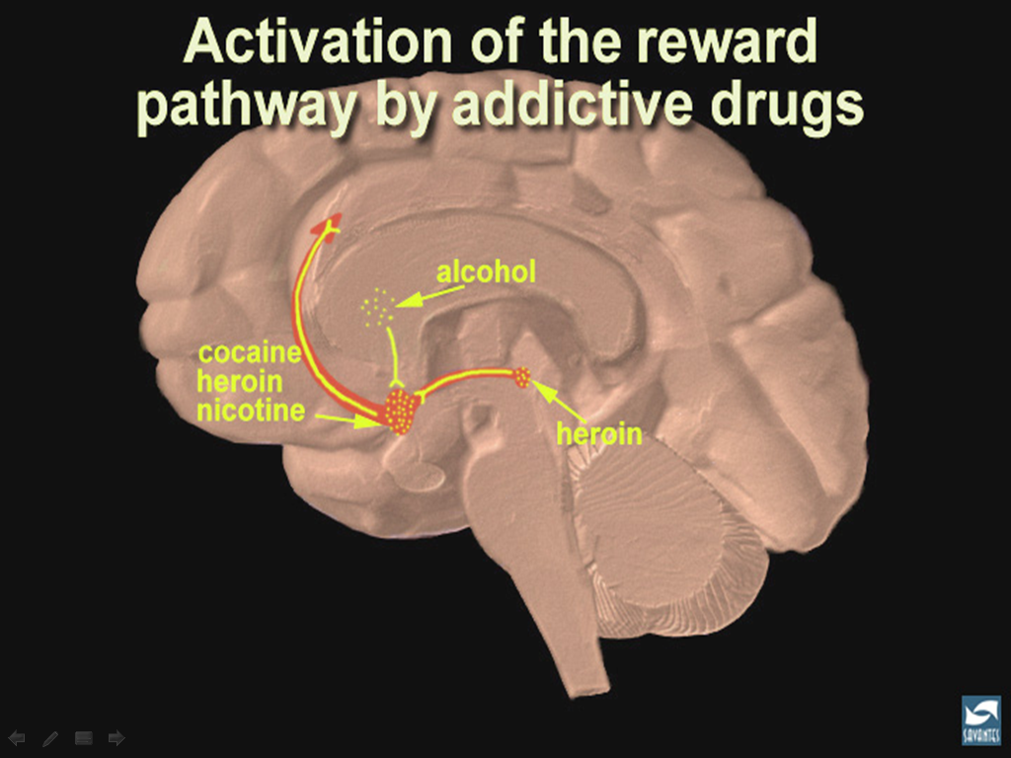
marijuana
Source: NIDA
Notes:
One of the major advances in the understanding of drug use has come from research on the biological mechanisms involved in drug reinforcement. When we use substances, they activate the reward pathways in the brain. The immediate psychoactive and rewarding effects of different substances, particularly their ability to give pleasure and relieve pain, help to explain why animals and humans will repeatedly self-administer drugs despite their negative consequences. Although substances differ with respect to the particular types of neural receptors and neurotransmitters they affect in the brain, there are considerable similarities among them (World Health Organization, 2004).
In general, many psychoactive drugs activate the reward system via increasing dopamine neurotransmission.
In this slide, the reward pathway is shown for several drugs that have addictive potential. Just as heroin or morphine and cocaine activate the reward pathway in the nucleus accumbens, other drugs such as nicotine and alcohol activate this pathway as well. Although each drug has a different mechanism of action, each drug increases the activity of the reward pathway by increasing dopamine transmission. Because of the way our brains are designed, and because these drugs activate this particular brain pathway for reward, they have the ability to be abused.
(https://www.drugabuse.gov/publications/teaching-packets/neurobiology-drug-addiction/section-ii-reward-pathway-addiction)

Slide 4
The Neurobiology of Dependence
Involves the release of the neurotransmitter, dopamine, in the nucleus accumbens region of the brain
Produces pleasurable feelings, positive attitudes, and focused attention
With repeated exposure, compulsive drug-seeking and craving are elicited
Notes:
Drug dependence is a psychobiological syndrome defined within the International Classification of Diseases (ICD-10, World Health Organization, 1992).
By activating emotional and motivational centers of the brain, the drug becomes associated with pleasurable feelings, positive attitudes, and focused attention, all of which increase the likelihood that the experience will be repeated. With repeated exposure, compulsive drug seeking and craving are elicited by the sight, thought or anticipation of the drug, resulting in a preoccupation with the substance to the neglect of other important aspects of living, such as family, work and health.

Slide 5
How Drugs Work
Drug factors:
  Pharmacological properties
  Dose-Response function
  Time-action function
  Drug use history
  Method of use
User Factors
Social Factors
Notes:
The type of drug, size of dose, how drug was taken distribution and absorption, metabolization interactions, etc. all play a role in how drugs effect the body.

Slide 6
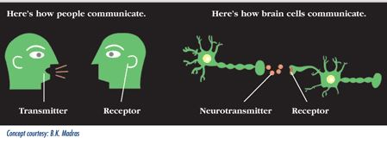
How Drugs Work
Because of their chemical structure, alcohol and drugs have dramatic effects on neurotransmitters in the CNS and can change the way neurons communicate with each other
Notes:
A psychoactive substance affects human behavior by interfering with brain chemistry and neurotransmitter activity. When absorbed into the body, alcohol and drugs interact with the cells and modify the way many cells, organs, and systems function. Because of their chemical structure, they have particularly dramatic effects on neurotransmitters in the central nervous system (CNS).
Some drugs, such as marijuana and heroin, have chemical structures that are similar to neutral neurotransmitters, so they can lock on to and activate receptor cells. Other drugs, such as amphetamine or cocaine, cause neurons to release abnormally large amounts of neurotransmitters, or prevent their reuptake. By interfering with the way neurotransmitters function, drugs and alcohol affect many mental processes and behavior. Things like memory, attention, behavior, perception, and alertness are all changed because of what drugs and alcohol do to the neurotransmitters in the CNS.
When absorbed into the body, drugs interact with and modify cells, organs, and bodily systems by:
Altering the way the body normally functions (increasing, slowing, or enhancing bodily processes, or level or quality of functioning),
Altering the operation of tissues, organs, and systems,
Affecting hormones and enzymes, and
Impacting processes such as digestion, respiration, circulation, and mental functioning.
(NIDA. (2010). Drugs, Brains, and Behavior: The Science of Addiction. Rockville, MD: U.S. Department of Health and Human Services, National Institutes of Health.)

Slide 7
Problems Related to Substance Use
Acute Intoxication | Regular Use
Acute toxic effects including ataxia, vomiting, fever and confusion Overdose and loss of consciousness, Aggression and violence Accidents and injury Unintended sex and unsafe sexual practices Unpredictable behavior | (Substance) Specific physical and mental health problems Tolerance Depression, anxiety, mood swings, irritability Sleep problems Relationship problems Some difficulties with regular activities (job or study) Cognitive problems relating to memory or attention Financial problems Legal problems
Dependent use | Injecting
Marked tolerance & withdrawal symptoms on abstinence Severe physical & mental health probs. Increasingly dysfunctional in daily life Craving & increased desire to use Criminal behavior Usual role obligations not fulfilled Relationship breakdowns Difficult to stop in spite of problems Continued use despite evidence the use is causing harms to the individual | Increased likelihood of: dependence, overdose, psychosis, vein collapse Infection local : abscesses and ulcers systemic: HIV and hepatitis C Stigma
Notes:
This slide shows four mechanisms that are responsible for the problems associated with or caused by substance use:
Acute intoxication
Regular or chronic use
Dependent use
Injection use

Slide 8
Categories Activity
Which drugs fit into which categories?
Tobacco
Alcohol
Marijuana
Cocaine
ATS
Sedatives
Opioids
Hallucinogens
Other
Notes:
OPTIONAL ACTIVITY
Categories Activity – Which drugs fit into which categories ? (Use white board if available and refer to list when speaking about the individual drug categories)
Aim: This activity is meant to check the level of knowledge of the terms used to refer to the different drugs. Check the time available and if you do not have enough time skip it.
Instructions: Ask participants to provide different substances/ terms (including street terms) for each category.

Slide 9
Categories Activity
Tobacco | cigarettes, chewing tobacco, cigars, etc.
Alcohol | beer, wine, liquor, spirits, etc.
Marijuana | marijuana, pot, grass, hash, reefer, etc.
Cocaine | coke, crack, blow, etc.
ATS | Ritalin, Adderall, speed, meth, diet pills, etc.
Sedatives | diazepam, alprazolam, Xanax, benzodiazepines, etc.
Opioids | heroin, morphine, OxyContin, fentanyl, codeine, etc.
Hallucinogens | LSD, acid, mushrooms, PCP, MDMA, Ecstasy, etc.
Other | K2, Spice, kava, khat, steroids
Notes:
[This slide includes some of the terms for each category. Also refer to ASSIST Response Card].
Additional information on Ecstasy: Ecstasy is a street term for a range of drugs that are similar in structure to MDMA (methylenedioxymethamphetamine). Ecstasy is chemically similar to both stimulants and hallucinogens, producing feelings of increased energy, pleasure, emotional warmth, and distorted sensory and time perception.
After this exercise, ask the participants if they know about all these drugs’ effects. Alternatively, call attention to the fact that the list includes both prescription and illicit drugs.

Slide 10
Prescription Drug Misuse and Abuse
Misuse
Abuse
Self-medication
Dose level more than prescribed
Longer duration than prescribed
Used for purposes other than prescribed
Skipping/hoarding doses
Taking medication to get high
Used in conjunction with other meds/alcohol
Notes:
Prescription drug misuse and abuse is the intentional or unintentional use of medication without a prescription, in a way other than prescribed, or for the experience or feeling it causes.
Drug misuse may involve not following medical instructions, but the person taking the drug is not looking to “get high.” For example, if a person isn’t able to fall asleep after taking a single sleeping pill, he or she may take another pill an hour later, thinking, “That will do the job.” Or a person may offer his headache medication to a friend who is in pain. According to FDA, those are examples of drug misuse because the person is trying to treat a condition or symptom, but not according to the directions of a health care provider.
Drug abuse is the use of a medication without a prescription, in a way other than as prescribed, or taking medication to “get high,” as defined by the National Institute on Drug Abuse. The abuse of certain prescription drugs – opioids, central nervous system depressants, and stimulants – can lead to a variety of adverse health effects, including addiction.
Both misuse and abuse of prescription drugs can be harmful and even life threatening to the individual. This is because taking a drug other than the way it is prescribed can lead to dangerous outcomes that the person may not anticipate.

Slide 11
ED Visits Involving Drug Misuse or Abuse, by Drug Combinations, 2011
Drug combinations | ED visits | Percent of ED visits
Total ED visits, drug misuse or abuse | 2,462,948 | 100.0
Illicit drug(s) only | 656,025 | 26.6
Alcohol only (age < 21) (3) | 117,653 | 4.8
Pharmaceutical(s) only | 835,275 | 33.9
Combinations
Illicit drug(s) w/ alcohol | 261,125 | 10.6
Illicit drug(s) w/ pharmaceutical(s) | 247,342 | 10.0
Alcohol w/ pharmaceutical(s) | 257,520 | 10.5
Illicit drug(s) w/ alcohol and pharmaceutical(s) | 88,008 | 3.6
Notes:
Of the ED visits in 2011 that involved drug misuse or abuse, nearly two thirds (64.9%) were associated with a single drug type (illicit drugs, alcohol, or pharmaceuticals). Illicit drugs alone were involved in 26.6 % of drug misuse or abuse visits, pharmaceuticals alone were involved in 33.9%, and alcohol with no other drug (aged 20 or younger only) was involved in 4.8%. The remaining visits (34.7%) involved some combination of illicit drugs, alcohol, and pharmaceuticals.
1,252,500 ED visits, or 50.9 percent, involved illicit drugs;
1,244,872 ED visits, or 50.5 percent, involved nonmedical use of pharmaceuticals; and
606,653 ED visits, or 24.6 percent, involved drugs combined with alcohol.

Slide 12
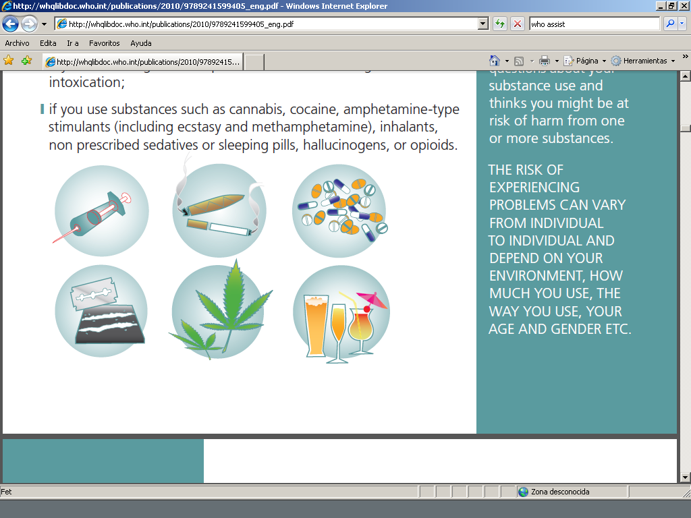
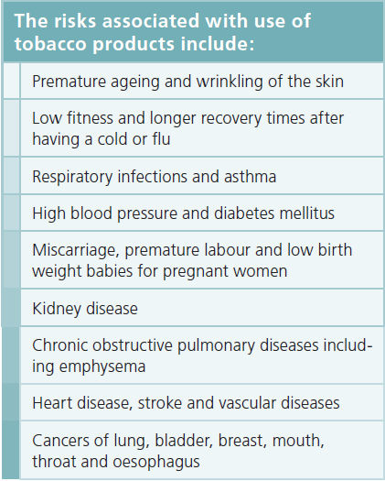
Tobacco
Pharmacological effects
Stimulant and sedative effects
Increase in blood pressure, slight hyperglycemia
Addictive potential comparable to heroin and cocaine
Notes:
Use of tobacco products is a major public health problem and the leading cause of deaths attributable to psychoactive substance use in the US (and globally). Tobacco use leads most commonly to diseases affecting the heart and lungs, with smoking being a major risk factor for heart attacks, strokes, chronic obstructive pulmonary disease (COPD),emphysema, and cancer (particularly lung cancer, cancers of the larynx and mouth, and pancreatic cancer). Cigarette smoking Increases the risk of Crohn's disease as well as the severity of the course of the disease. It is also the number one cause of bladder cancer. The use of tobacco also increases the severity or risk of complications of other health problems such as high blood pressure, diabetes and asthma.
While the majority of people consume tobacco via smoking, use of tobacco products by means other than smoking, such as chewing, or sniffing is also associated with increased risk of diseases. Finally, exposure to second-hand tobacco smoke also increases the risk of health problems among people who do not smoke themselves. Children exposed to second-hand tobacco smoke are at increased risk of a range of health problems such as respiratory infections, allergies and asthma. Pregnant women who smoke are at higher risk of miscarriage, premature labor and having a low birth weight baby.
Additional information related to tobacco and oral health:
Available evidence suggests that the risks of oral diseases increase with greater use of tobacco and that deceasing tobacco use can result in decreased risks of these conditions. Cigarette smokers have an increased risk of oral cancer 2 to 5 times that of nonsmokers whereas cigar smokers are 7 to 10 times more likely to develop oral cancer than nonsmokers. Heavy smokers who drink alcohol heavily have many times the risk of oral cancer as that expected from the independent effects of smoking and alcohol intake.

Slide 13
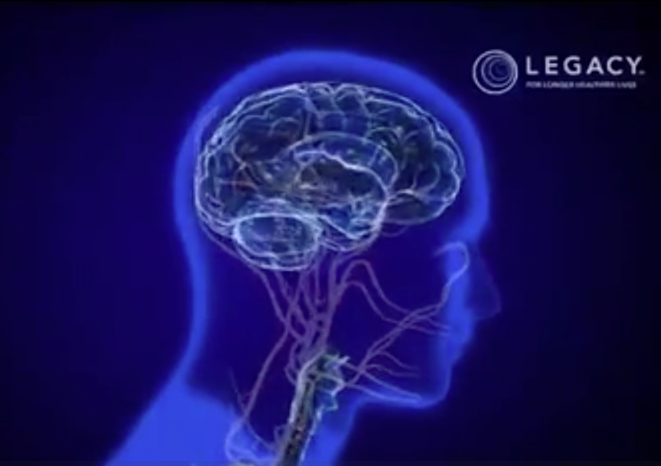
Video Demonstration:
Nicotine’s Effect on the Brain
Legacy Foundation: Nicotine’s Effect on The Brain (0.55)
https://www.youtube.com/v/hk-ak9-UnEA
Notes:
OPTIONAL VIDEO
Legacy Foundation’s Nicotine’s Effect on the Brain
Time: 0:55.
https://www.youtube.com/v/hk-ak9-UnEA

Slide 14
Facts About Cigarette
Smoking in the US
25% of adult Americans smoke
The chief avoidable cause of illness and death
Over 430,000 deaths each year
Known cause of cancer, heart, and lung disease
Annual smoking-attributable cost for medical care is ≈$50 billion
More than 70% of the 50 million smokers have made at least one prior quit attempt and about 46% try to quit each year
Notes:
Recent estimates show that 25 percent of Americans smoke.
Tobacco use has been cited as the chief avoidable cause of illness and death in our society,
It is responsible for more that 430,000 deaths in the U.S. each year. That’s the equivalent of almost 4 jumbo jets crashing a day for a year!
Smoking is a known cause of cancer, heart disease, stroke, and chronic obstructive pulmonary disease, and therefore yields staggering societal costs. The estimated smoking-attributable cost for medical care in 1993 was $50 billion, and the cost of lost productivity and forfeited earnings due to smoking-related disability was estimated at $47 billion per year.
Epi data suggests that more than 70% of the 50 million smokers have made at least one prior quit attempt and about 46% try to quit each year.

Slide 15
Electronic Cigarettes
What We Know
What We Don’t Know
They are not regulated by the FDA
The nicotine inside the cartridges is addictive.
Deliver nicotine to the body through vapor, not smoke
They are composed of a heating element that is rechargeable and battery-operated, a replaceable cartridge that may contain nicotine or other chemicals, and an atomizer that converts the contents of the cartridge into a vapor when it is heated
May discourage use of evidence-based quitting therapies
Safety and efficacy still being researched
  both the CDC and WHO are concerned about the still-unknown long-term biological effects.
What are users actually inhaling?
  ingredients they contain are not always disclosed
Should it be used as a quitting device?
  No scientific studies that prove e-cigs actually help people to quit smoking.
Notes:
OPTIONAL SLIDE: RECOMMENDED FOR DENTAL AND DENTAL HYGIENE STUDENTS
E-cigs contain nicotine:
An e-cig is a battery operated (disposable or rechargeable) device that contains nicotine. The nicotine is turned into a vapor in the e-cig and then inhaled. The vapor looks similar to smoke. E-cigs come in all sorts of sizes and sometimes have flavored nicotine cartridges.
E-cigs aren’t regulated:
E-cigs contain other chemicals besides nicotine, which also get inhaled. Since e-cigs aren’t regulated yet, there’s no way of knowing how much nicotine is in them or what other chemicals they contain. These two things make the safety of e-cigs unclear.
E-cigs haven’t been shown to be effective quit aids:
There haven’t been any scientific studies that prove e-cigs actually help people to quit smoking. The bottom line is that we just don’t know enough about e-cigs, so we don’t recommend that you use them. There are other quit aids, with or without nicotine, that have been proven to be safe and effective at helping people quit smoking.

Slide 16
First-line Medications
Nicotine Replacement Therapy (NRT)
  Patch
  Gum
  Lozenge/mini lozenge
  Nasal Spray
  Inhaler
Non-nicotine
  Bupropion SR (a.k.a. Wellbutrin and Zyban)
  Varenicline (a.k.a. Chantix)
Notes:
OPTIONAL SLIDE: RECOMMENDED FOR DENTAL AND DENTAL HYGIENE STUDENTS
NRT helps reduce withdrawal and cravings. May help with
Mood swings
Alertness
Concentration
Replaces oral aspect of habit (gum, lozenge)
Non-nicotine medications include:
Bupropion: Brain cells that cause drug craving do not activate in the presence of Bupropion
Chantix: May combine with short-acting NRT
Acts at sites in brain affected by nicotine
Blocks effects of nicotine from cigarettes
Monitor for evidence of behavior changes
Not a good choice for patients with psychiatric conditions

Slide 17
Common Questions on NRT
Patch
Can smoking with the patch cause a heart attack?
  No, however not advised and do not use within 2 weeks of MI
Can you put the patch anywhere on the body?
  No, avoid fatty tissue areas; suggest shoulder and upper arm areas
Can a 2 ppd smoker use two patches at the same time?
  Yes, rule of thumb: one patch/pack smoked per day; limit 2
What do I tell a patient complaining of redness/irritation?
  Use hydrocortisone cream
Can the patch get wet (shower)?
  No, do not bathe with the patch
Nicotine Gum
Do you chew the nicotine gum like regular gum?
  No, follow chew/park regimen; avoid swallowing saliva if possible
  Other Comments
  Do not drink coffee before use of NRT
  Do not place the patch on the same part of the body two days in a row
  Check local area for NRT discounts/free trials
Notes:
OPTIONAL SLIDE
21 mg patch provides a 1 ppd smoker 50-60 % of nicotine they’re used to.

Slide 18
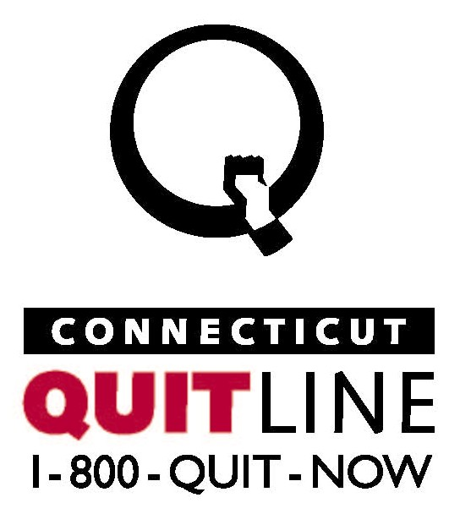
Treatment of Nicotine Addiction
Notes:
OPTIONAL SLIDE
The CT Quitline is a telephone help line offered free of charge that provides cessation counseling, quitting information, and support.

Slide 19

Alcohol
Notes:
Alcohol is one of the most commonly used psychoactive substances in the world.

Slide 20
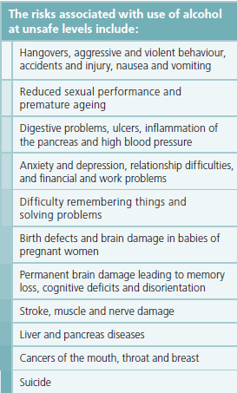
Alcohol: Effects and Risks
Pharmacological effects
Acts as a sedative-hypnotic depressant
Slows down the nervous system
  Lower doses: causes euphoria, relaxation, lowered inhibitions
  Higher doses: causes CNS depression, drowsiness, nausea, impaired motor and sensory function and impaired cognition
Notes:
Alcohol is a central nervous system depressant. It acts at many sites, including the spinal cord, cerebellum and cerebral cortex, and on many neurotransmitter systems. Alcohol is a very small molecule and is soluble in "lipid" and water solutions. Because of these properties, alcohol gets into the bloodstream very easily and also crosses the blood brain barrier.
There are approximately 80,000 deaths attributable to excessive alcohol use each year in the United States. This makes excessive alcohol use the 3rd leading lifestyle-related cause of death for the nation. Harmful alcohol use is also a risk factor for the four main groups of noncommunicable diseases (NCDs) – cardiovascular diseases, cancer, chronic lung diseases and diabetes.
Health Problems include:
Hypertension
Impotence
Depression
Sleeplessness
Falls/accidents
Ulcers
Medication interactions
Fetal alcohol syndrome
Stroke
Periodontal Disease
Oral Cancer
Breast Cancer
Liver dysfunction
Social Problems include:
Traffic accidents
Aggressive behavior; fights/ arguments with family and/ or friends
Family violence
Injuries
Economic costs: lost wages, and medical care expenses
Risky sexual behaviors

Slide 21
What is At-risk Drinking?
2 Patterns of at-risk drinking
  Too many drinks on one occasion
  Too many drinks on a daily or weekly basis
 | Per day | Per Week | Per Occasion
Men | 2 drinks | >14 drinks | >4 drinks
Women and men over 65 years old | 1 drink | >7 drinks | >3 drinks
*National Institute on Alcohol Abuse and Alcoholism
Notes:
At-risk drinking is defined as either:
Too many drinks on a single occasion (more than 3 for women; more than 4 for men) or
Too many drinks on a daily or weekly basis (more than 1 per day for women or 7 per week; more than 2 per day for men; 14 per week).
Different patterns of use (daily or binge) are associated with different types of risks (acute or long-term).
Individuals who drink more than recommended amounts over a number of years are likely to develop problems associated with their long-term use including hypertension, heart disease, stroke, cancers, liver disorders, etc.
Individuals who drink less often but tend to drink large amounts on a single occasion (binge drink) are more prone to acute risks such as car accidents or other injuries, unintended sexual practices, violence and fights, etc.

Slide 22
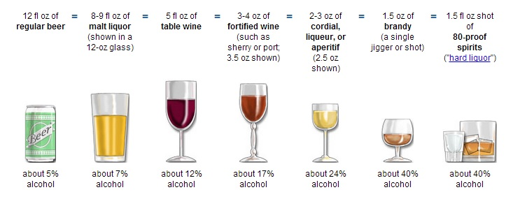
1 US Standard Drink:
14 grams = .6 fluid ounces of ethanol
# ounces X % ETOH
.6
= #standard drinks
Notes:
Risk can be estimated in terms of “standard drinks,” which represent about 14 grams of alcohol per standard serving, such as bottle of beer or a glass of wine.
Many people are surprised to learn what counts as a drink. That’s why it’s important to know how much alcohol different drinks contain.
When asking patients about their alcohol consumption, it is important to know what constitutes a standard drink.
In the Untied States, a standard drink contains 14 grams of pure alcohol or .6 fluid ounces.
So a 12 ounce can of beer containing 5% alcohol is one standard drink:
(12oz. X .05)=.6 of pure ethanol.
Similarly, 5oz. of wine containing 12% alcohol is one standard drink:
(5oz. X .12) = .6
A shot of 80 proof liquor, 1.5oz. X .4 = .6

Slide 23
Harmful interactions
The following slides are specific to alcohol and drug interactions. These are recommended for pharmacy students and prescribers.

Slide 24
Alcohol and Drug Interactions:
How the Body Works
Interactions between medications and alcohol can lead to illness, injury, and even death.
  Factor in ~25% of ED admissions
  An estimated one in five older Americans (19%) may be affected.
Alcohol combined with medicines or other drugs can result in a multiplier effect.
Alcohol may slow down a drug’s absorption by the body, resulting in higher medication levels.
Chronic heavy drinking may increase the number of metabolizing enzymes in the body, reducing the effectiveness of some drugs.
Metabolizing enzymes can change some medications into chemicals that can damage the liver or other organs.
Notes:
OPTIONAL SLIDE
Interactions between medications and alcohol can lead to illness, injury, and even death.
Factor in ~25% of ED admissions
An estimated one in five older Americans (19%) may be affected.
Alcohol combined with medicines or other drugs can result in a multiplier effect.
Alcohol may slow down a drug’s absorption by the body, resulting in higher medication levels.
Chronic heavy drinking may increase the number of metabolizing enzymes in the body, reducing the effectiveness of some drugs.
Metabolizing enzymes can change some medications into chemicals that can damage the liver or other organs.

Slide 25
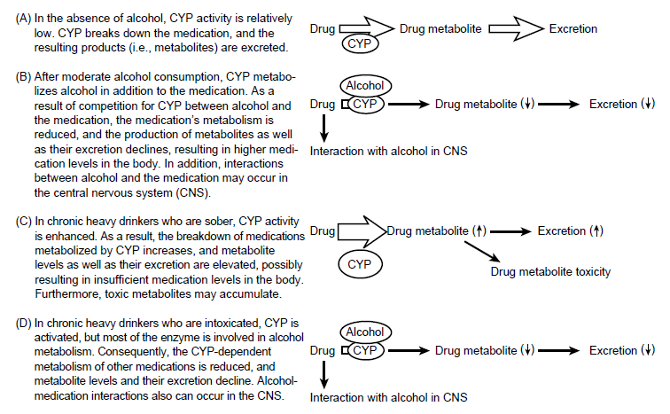
Notes:
CYPs are the major enzymes involved in drug metabolism. Cytochrome P450 enzymes account for 70- 80% of enzymes involved in drug metabolism.
This slide shows potential alcohol-medication interactions involving cytochrome P450 enzymes (CYP):
B) For example, acute intoxication may inhibit the metoblosim of tricyclic antidepressants.
C) For example, study showing an increased absorption of oxymorphone in the presence of alcohol.
D) Alcoholic patients may require higher doses of propofol (exact mechanism of interaction is unknown. In a small study (n=20), alcoholic patients required 30% higher doses of propofol to induce general anesthesia compared to nonalcoholics. Warfarin- Reduced anticoagulant effects in chronic alcoholics.
Warfarin:
Enhanced anticoagulant effects with acute alcohol intoxication.
Reduced anticoagulant effects in chronic alcoholics.
Acute excessive alcohol intake may inhibit warfarin metabolism.
Increase in warfarin metabolism with chronic heavy drinking is likely due to alcohol- induced stimulation of hepatic enzymes.
Acute intoxication with alcohol appears to inhibit pentobarbital metabolism, while chronic alcohol ingestion appears to enhance the hepatic metabolism of pentobarbital.

Slide 26
Alcohol: Drug Interactions
Heart medications → rapid heartbeat and sudden changes in blood pressure
NSAIDs → increase risk of heart attacks, strokes, ulcers and stomach bleeding
Blood-thinning medications → lead to internal bleeding
Acetaminophen → severe liver damage -- including some cases requiring a liver transplant
Opioids → enhanced CNS and respiratory depression
Sedatives and sleeping pills → excessive CNS depression
Tricyclic antidepressants → excessive CNS depression
Antipsychotics → excessive CNS depression
Over-the-counter antihistamines → enhanced CNS depression
Notes:
Examples of commonly used prescription drugs associated with serious alcohol interactions include heart medications, which can cause rapid heartbeat and sudden changes in blood pressure; nonsteroidal anti-inflammatory drugs (NSAIDs), which can increase risk of heart attacks, strokes, ulcers and stomach bleeding; blood-thinning medications, which can lead to internal bleeding; and sleep medications, which can lead to impaired breathing, motor control, and unusual behavior.
Combination of alcohol and opioids, particularly methadone & morphine, have been implicated in fatalities.
One of the most common causes of severe liver damage -- including some cases requiring a liver transplant -- is a combination of the pain reliever acetaminophen (available over the counter as Tylenol and in some prescription drugs) and alcohol. Other serious alcohol interactions are associated with over-the-counter antihistamines- more pronounced in elderly patients

Slide 27
Alcohol: Drug Interactions (continued)
Antidiabetics → Disulfiram-like reaction; enhanced glucose lowering
Anti-infectives → Disulfiram-like reaction; may reduce serum concentration of some antibiotics; increased risk of hepatoxicity; some produce enhanced alcohol effects
Immunosuppressives → facial flushing; increased risk of liver injury with excessive alcohol consumption

Slide 28
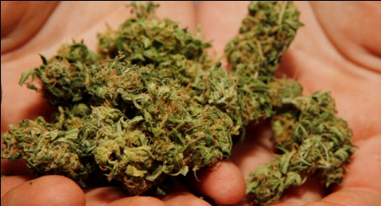
Marijuana
Notes:
Ask the trainees: Does anyone know what the active chemicals are in marijuana? Or why it has such a strong impact on the human body?
Marijuana contains a number of chemicals known as cannabinoids that bind to something called cannabinoid receptors on human brain cells, resulting in nerve cell signaling. More than 100 cannabinoids have been isolated from marijuana, each interacting a bit differently with the brain and the body.
The primary psychoactive ingredient in marijuana is delta-9 tetrahydrocannabinol, more commonly known as THC. THC is:
Fat-soluble; crosses the blood-brain barrier and the placenta
Accumulates in the body’s tissue resulting in long elimination half-life
Acts on the body’s own cannabinoid receptors, present in the central and peripheral nervous system
Marijuana is the most commonly used illicit drug in the United States.

Slide 29
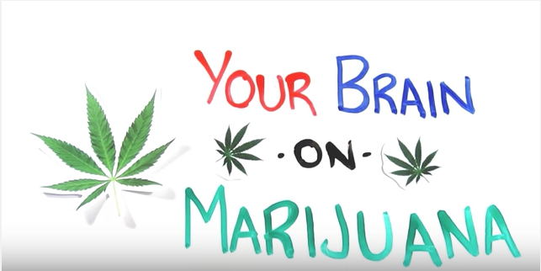
Video Demonstration:
The Effects of Marijuana on the Brain
Your Brain on Marijuana (2:26)
https://www.youtube.com/watch?v=oeF6rFN9org
Notes:
OPTIONAL VIDEO
The Effects of Marijuana on the Brain
Time: 2:26
https://www.youtube.com/watch?v=oeF6rFN9org

Slide 30
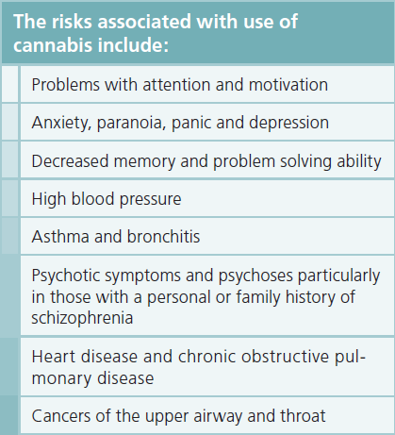
Marijuana: Effects and Risks
Pharmacological effects
Feelings of euphoria, lightness of limbs, increased appetite, tachycardia, and impaired judgment.
Notes:
When a person smokes marijuana, THC quickly passes from the lungs into the bloodstream. The blood carries the chemical to the brain and other organs throughout the body.
A derivation of the plant cannabis sativa, cannabis intoxication produces feelings of euphoria, lightness of limbs, increased appetite, tachycardia, and impaired judgment.
The risks of acute intoxication and chronic use include:
Problems with attention and motivation
Anxiety, paranoia
Depression, decreased memory retention and problem solving ability in chronic users
Lung disease such asthma and bronchitis
Psychotic symptoms
Heart disease and cancer

Slide 31
Content of THC in Marijuana
Over Time
12%
<4%
ElSohly, MA, Mehmedic, Z, Foster, S, Gon, C, Chandra, S, & Church, JC. (2016). Changes in cannabis potency over the last two decades (1995-2014). Analysis of current data in the United States. Biological Psychiatry.
Notes:
The national average of marijuana's THC content has increased from ~4% in 1995 to ~12% in 2014.* Currently, its potency is higher than ever. Researchers have also found that tetrahydrocannabinol (THC) content has risen markedly, whereas cannabidiol (CBD), which many say has therapeutic value, has declined.
As THC content of marijuana increases, so does its potential to cause adverse effects such as paranoia, anxiety and panic attacks, hallucinations, erratic mood swings and aggressive behavior.
Also telling is the huge increase in calls to Poison Control Centers across the country (from 13 calls in 2009 to 9,159 in 2011) by people having such adverse reactions after using “synthetic pot” – plant material sprayed with chemicals developed in labs to study the effects of THC. These chemicals mimic THC by binding to cannabinoid receptors. However, these synthetic chemicals are typically 10 times more potent than THC, which is why they cause more, and more severe, adverse reactions, including heart attacks and seizures.
*Samples in this data were received over time from materials confiscated by the Drug Enforcement Administration

Slide 32
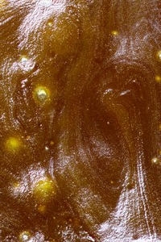
Concentrates
Generally contain a higher % of THC
Use some type of solvent to extract the THC.
  2 most common types of solvents used in the extraction process are butane or CO²
Butane Honey Oil or Butane Hash Oil is a golden resin created by placing dried and ground marijuana into a special PVC filter. Butane gas is shot in through one end of the filter while the other end is placed in a bowl full of water. The filter spews out the fresh oil in to the cold water where it sinks to the bottom.
‘Dabbing’ = Users dab concentrate onto a heated surface, which in turns vaporizes the concentrate which is then inhaled (better sit down!)
Notes:
OPTIONAL SLIDE
Oil is what is usually used in vape pens, such as the open vape. BHO, or butane honey oil, is very common. Recently CO2 honey oil has gained popularity, as it poses no issues for lingering solvents in the concentrates.
Dabbing
You may hear the term 'dabbing'. Dabbing is a technique for consuming concentrates. You place a 'dab' of concentrate onto a heated surface, which in turns vaporizes the concentrate which is then inhaled -heated on the end of a knife or pin and inhaled. Think of it as a sophisticated way of hot knifing. Be warned, dabbing can get you to level 10 baked, and it is easy to over consume, so best left to the experienced users.

Slide 33
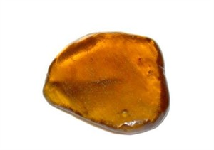
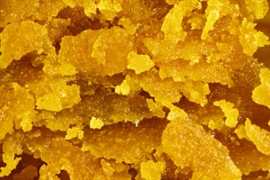
Concentrates (continued)
Shatter
Wax
Refined version of BHO
Semi-transparent, usually with a yellow or amber color
Very potent, and can be upwards of 90% THC
Created by whipping hash oil during the purging process
Notes:
OPTIONAL SLIDE
Shatter is a refined version of BHO, which typically involves multiple steps to extract all the plant matter and solvents. These steps usually involve a pressure vacuum. Shatter is semi-transparent, usually with a yellow or amber color. It is usually a thin cake, which ‘shatters’ when you break a piece off, hence the name. Shatter is very potent, and can be upwards of 90% THC.
Wax is created by whipping hash oil during the purging process. It is sometimes referred to as earwax, due to its similar consistency. Wax is easier to handle than oil, and the % of THC between the two are similar.

Slide 34
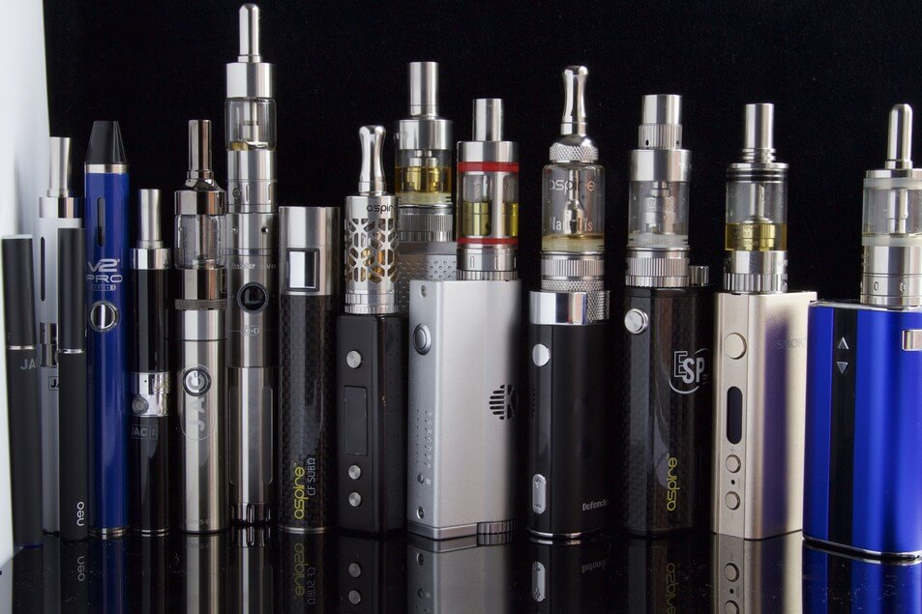
Vapor Pens
Cost $100-$200
Potency varies
Higher percentage of THC
No odor. Similar to electronic cigarettes
Pen-style vaporizers contain 100-150 hits
Some can be recharged and refilled
Notes:
OPTIONAL SLIDE
All concentrates can be used in vaporizer pens. Vapor pens are similar to electronic cigarettes in that they can be used to heat and smoke hash oil or THC with no odor. This is a fairly new method of using THC and while those who are involved in using THC may know about it, people who work with youths should become familiar with it in order to identify those whose use may not be obvious because of the lack of the odor.

Slide 35
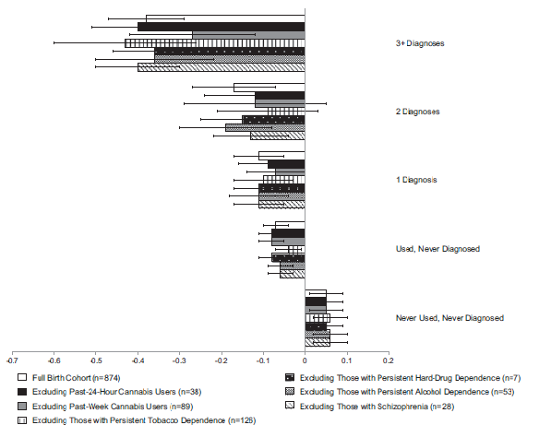
Mj dependent 3+ yrs
Mj dependent 2 yrs
Average IQ change:
“Never used”
  99.8 to 100.6
“Mj dependent 3+ yrs”
  99.7 to 93.9
Mj dependent 1 yr
Used, never diagnosed
Never used
Notes:
Marijuana also affects brain development. When marijuana users begin using as teenagers, the drug may reduce thinking, memory, and learning functions and affect how the brain builds connections between the areas necessary for these functions. Marijuana’s effects on these abilities may last a long time or even be permanent.
For example, a study showed that people who started smoking marijuana heavily in their teens and had an ongoing cannabis use disorder lost an average of eight IQ points between ages 13 and 38. The lost mental abilities did not fully return in those who quit marijuana as adults. Those who started smoking marijuana as adults did not show notable IQ declines.
Non-users had on average increased their IQ by around one point. And even after setting aside the heaviest users, a decline of a few IQ points from their childhood value was still seen in less heavy users who had started in their teens.
(www.pnas.org/cgi/doi/10.1073/pnas.1206820109)

Slide 36
Regular marijuana use during adolescence found to increase risk 2 to 5 times of developing psychosis, schizophrenia, anxiety, and depression in adulthood.
Notes:
Marijuana use has been associated not only with drops in IQ, but also psychotic disorders, anxiety disorders and depression. A number of recent studies have found an association between marijuana use during adolescence and mental health disorders.
Some critics correctly point out that these studies can only document association, which is not necessarily linked to causation, and that is true. New and larger studies are attempting follow large groups of individuals over time to see if there is a significant difference in those who use marijuana over time versus those who don’t.
We also know something about the cannabinoid system which allows us to hypothesize a mechanism, and both imaging and functional imaging studies are corroborating our findings.
(https://www.drugabuse.gov/publications/research-reports/marijuana/there-link-between-marijuana-use-psychiatric-disorders)

Slide 37
Contraindications of Marijuana Use
Absolute contraindications
  Acute psychosis and other unstable psychiatric conditions
Relative contraindications
  Severe cardiovascular, immunological, liver, or kidney disease, especially in acute illness
  Cannabis may exacerbate arrhythmia or a history of arrhythmias
    can increase the risk of angina (Frost et al., 2013)
    can cause an acute increase in blood pressure (Frost et al.,2013).
Notes:
OPTIONAL SLIDE

Slide 38
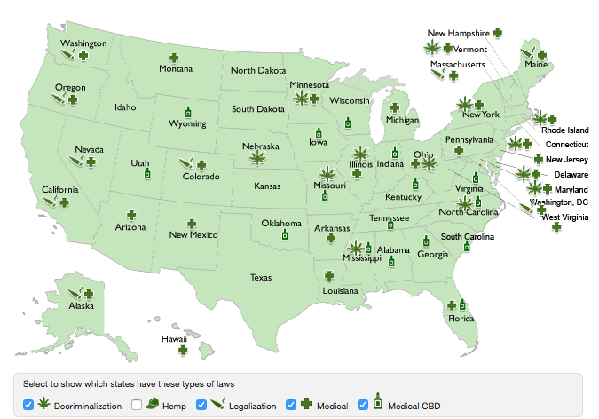
State Laws Regarding Marijuana Use: Updated 8/1/17
Notes:
OPTIONAL SLIDE
Drugged Driving: Every state has DUID (driving under the influence of drugs) legislation on the books.
Legalization: Whereas many states (AK, CA, CO, DC, ME, MA, NE, OR, WA) have passed laws allowing for the personal possession and consumption of cannabis by adults. Generally this means a policy that supports a legally controlled market for marijuana, where consumers can buy marijuana for personal use from a safe legal source
Medical Marijuana: Nearly all states have some form of Medical Marijuana (or CBD-specific) law enacted that removes state-level criminal penalties on the use of medical marijuana by patients who are diagnosed with a debilitating illness.
Cannabis remains a Schedule I substance under federal law as of 2015.
http://norml.org/laws

Slide 39
Suggested Message
Communicate the risk while honestly acknowledging the uncertainties that remain
  people with psychosis or a first degree relative with psychosis avoid using cannabis
  one in seven people who use cannabis report unpleasant, psychotic-like symptoms
  discourage people (especially youth) from using cannabis daily or near daily

Slide 40
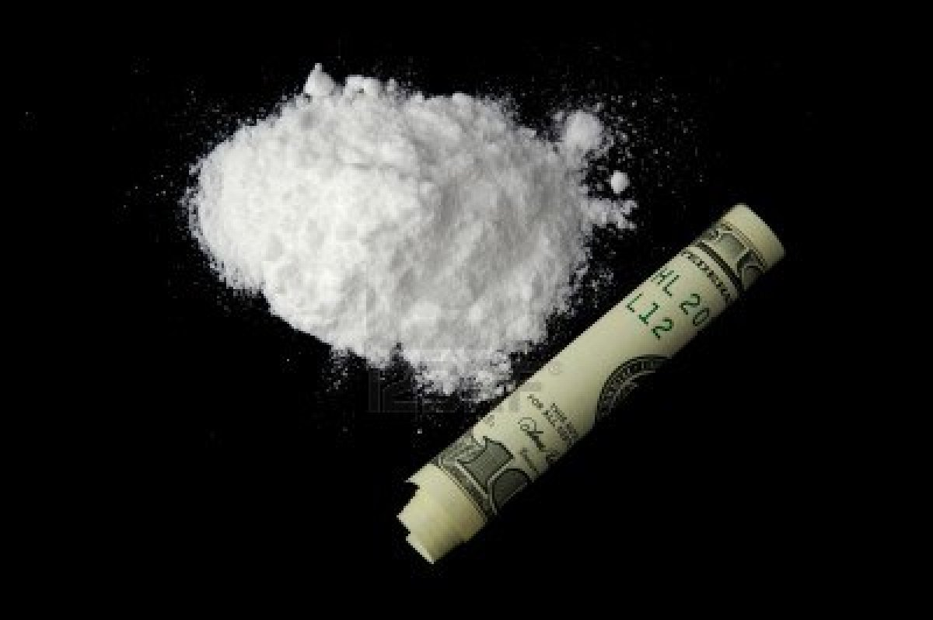
Cocaine/Crack
Notes:
Cocaine is a drug extracted from the leaves of the coca plant. It is a potent brain stimulant and one of the most powerfully addictive drugs.
The basic difference is that crack is a form of cocaine that has been chemically changed so it can be smoked, rather than snorted. Cocaine is a white crystalline powder and “crack” is cocaine that has been processed with ammonia or sodium bicarbonate (baking soda) and water into a freebase cocaine — chips, chunks or rocks. Since crack requires a relatively smaller amount of cocaine, it is cheaper to produce and therefore much more accessible to a greater number of people than pure cocaine.
Cocaine can be snorted or dissolved in water and injected. Crack can be smoked.
Double whammy = cocaine and alcohol together. Using cocaine and alcohol in the same session is relatively common- This mixture is the most common two-drug combination that results in drug-related death.

Slide 41
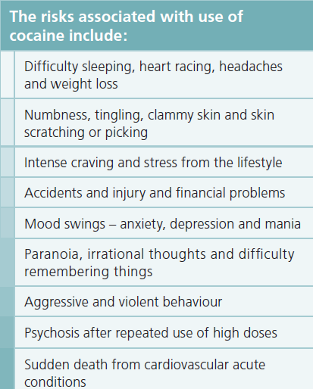
Cocaine: Effects and Risks
Pharmacological Effects
Feelings of elation, exaggerated feelings of confidence
Acute toxic reactions include hypertension, cardiac arrhythmias, auditory and visual hallucinations, seizures
Notes:
When snorted or injected, these substances cause immediate feelings of pleasure and elation, and exaggerated feelings of confidence. They can be highly addicting.
The risks associated with the use of cocaine include: Difficulty sleeping, intense craving, mood swings, paranoia, aggressiveness, psychotic reactions and heart attacks.

Slide 42
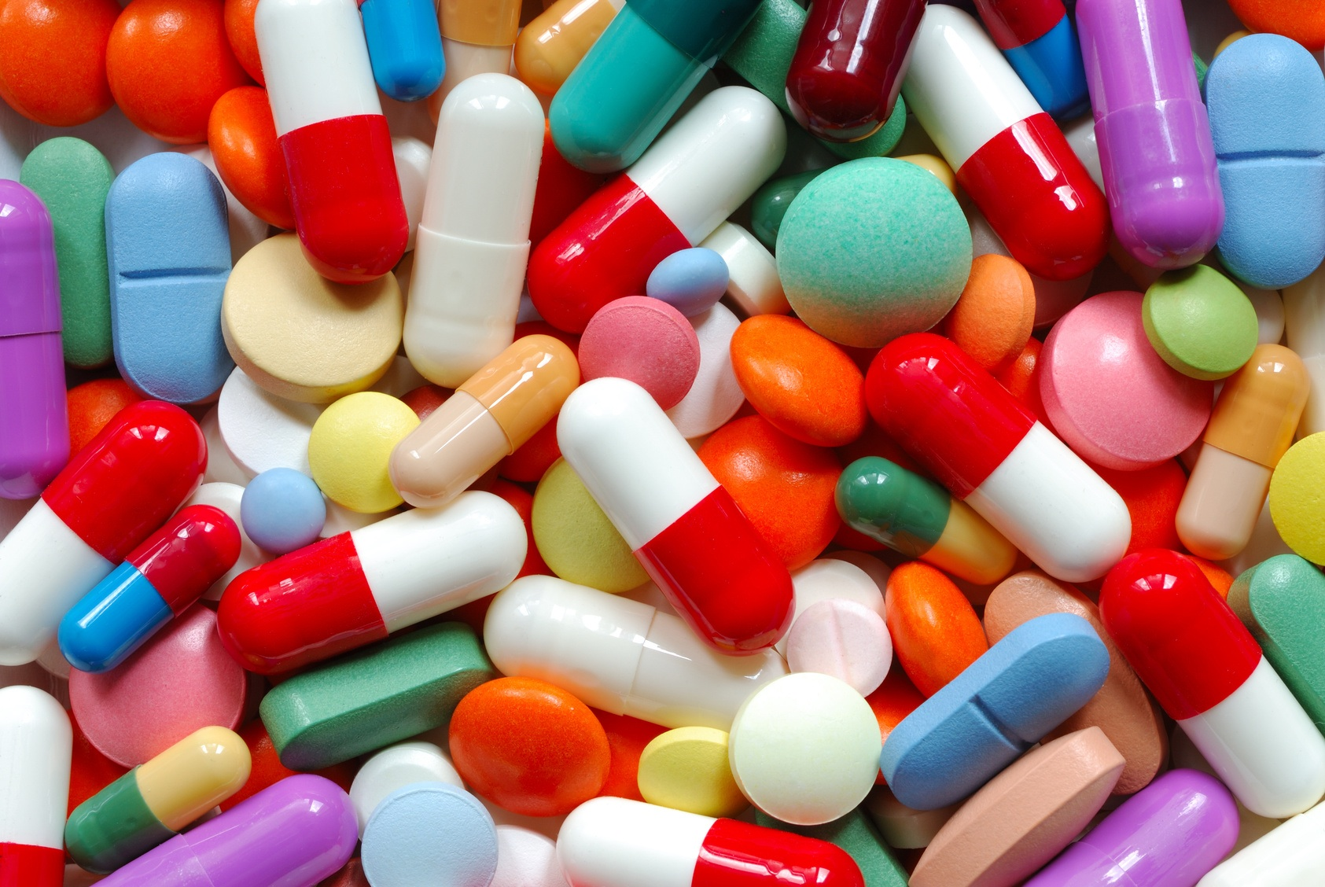
Amphetamine-type Stimulants (ATS)
Notes:
Stimulant medications including amphetamines (e.g., Adderall) and methylphenidate (e.g., Ritalin and Concerta) are often prescribed to treat children, adolescents, or adults diagnosed with attention-deficit hyperactivity disorder (ADHD). Prescription stimulants are sometimes abused however—that is, taken in higher quantities or in a different manner than prescribed, or taken by those without a prescription. Because they suppress appetite, increase wakefulness, and increase focus and attention, they are frequently abused for purposes of weight loss or performance enhancement (e.g., to help study or boost grades in school; see box). Because they may produce euphoria, these drugs are also frequently abused for recreational purposes (i.e., to get high).
When taken as prescribed, these medications can help a lot of people. Unfortunately, they are too often abused by being taken in doses and/or in ways other than intended, or by being used by someone for whom they were not prescribed. Prescription stimulants are powerful drugs, and when they are abused there can be serious health consequences, including dependence.
Like all stimulant drugs, prescription stimulants increase levels of dopamine in the brain. Dopamine (as previously mentioned) is a neurotransmitter associated with pleasure, movement, and attention.

Slide 43
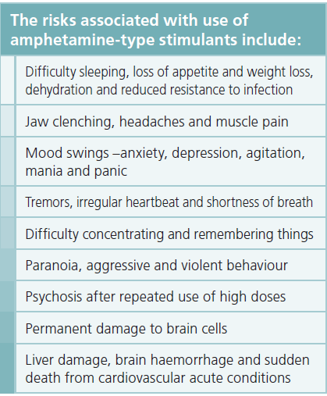
Amphetamine-type Stimulants: Effects and Risks
Pharmacological Effects
Euphoria, anorexia, nausea, vomiting, insomnia, abnormal behavior such as aggression, grandiosity, hyper-vigilance, agitation, and impaired judgment
Notes:
Amphetamines are a diverse group of synthetic substances whose effects include euphoria, anorexia, insomnia and abnormal behavior such as aggression, grandiosity, hyper-vigilance, agitation, and impaired judgment.
Physical Health:
Irregular heartbeat or heart failure; Reduced appetite, malnutrition, weight loss
Tremor, loss of coordination; Nervousness; Increased risky behavior (injecting, unsafe sex); Reduced immunity to infection;
Mental Health:
Insomnia; Mood swings; Irritability, anxiousness, restlessness; Delirium, panic, paranoia, impulsiveness; Aggression; Irrational thoughts; Intense drug cravings
Dependence: Stimulants can be addictive in that individuals begin to use them compulsively. Taking high doses of some stimulants repeatedly over a short time can lead to feelings of hostility or paranoia. Additionally, taking high doses of a stimulant may result in dangerously high body temperatures and an irregular heartbeat. There is also the potential for cardiovascular failure (heart attack) or lethal seizures.
Chronic use can lead to permanent brain damage, psychosis, paranoid schizophrenia, delusions of grandeur.
https://www.drugabuse.gov/publications/drugfacts/stimulant-adhd-medications-methylphenidate-amphetamines

Slide 44
Special Populations
Used more frequently by female adolescents than male adolescents
Used for weight loss, to stay awake or perform better on exams
Mixing with other antidepressants can cause high BP, or irregular heart rate
Notes:
OPTIONAL SLIDE

Slide 45
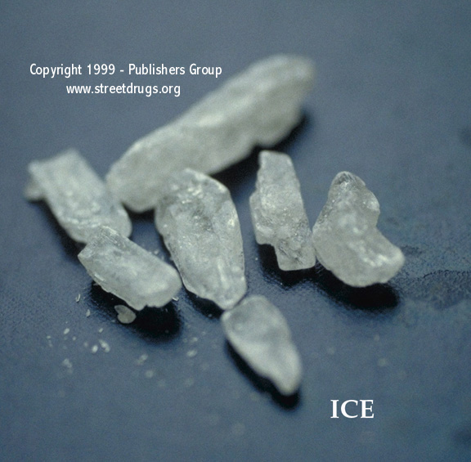
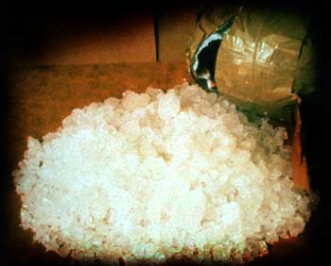
Methamphetamine: Effects and Risks
Pharmacological Effects
Flash of euphoria, then prolonged energy
Aggression, violence, psychotic behavior
Associated with high risk sexual behavior, e.g., unprotected sex, multiple partners
(Source: Mansergh et al., 2006)
Notes:
OPTIONAL SLIDE
Methamphetamine (meth) is a highly addictive stimulant that affects the central nervous system. Meth is one of the fastest growing illicit drug problems in the world. Meth produces a euphoric “high” that is almost instantaneous when the drug is smoked or injected. The half-life of meth is approximately 8-12 hours. The physical effects of meth include increased blood pressure, body temperature, heart rate, physical activity, and wakefulness. Negative effects include hypertension, headaches, cardiac arrhythmia, increased anxiety, insomnia, aggression, and visual and auditory hallucinations.
Increased HIV and hepatitis B and C transmission are consequences of increased methamphetamine abuse, not only in individuals who inject the drug, but also in non-injecting methamphetamine abusers. Among injection drug users, infection with HIV and other infectious diseases is spread primarily through the re-use of contaminated syringes, needles, or other paraphernalia by more than one person. However, regardless of how it is taken, the intoxicating effects of methamphetamine can alter judgement and inhibition and lead people to engage in unsafe behaviors.
(NIDA Research Report - Methamphetamine Abuse and Addiction: NIH Publication No. 06-4210, September 2006. Available on the web at http://www.nida.nih.gov/ResearchReports/methamph/Methamph.html)

Slide 46
Drug Interactions with ATS, MDMA and Cocaine
  Antidepressants → kidney failure, heart attack, stroke, extremely high blood pressure and overheating
  SSRIs→ may produce symptoms of serotonin toxicity
Antipsychotics → inhibits the antipsychotic
Antihypertensives → therapeutic effect may be counteracted.
Anticonvulsants → Methamphetamine, MDMA and cocaine lower the seizure threshold, and may cause seizures
Alcohol → Can mask alcohol’s effect on the body; produce greater increases in blood pressure; increase risk of cardiovascular toxicity
  Combines with cocaine to form a third substance, cocaethylene, that intensifies cocaine's euphoric effects but may increase the risk of sudden death.
    most common two-drug combination that results in drug-related deaths
Notes:
OPTIONAL SLIDE
Antidepressants: All psychostimulants have the potential to interact adversely with antidepressants based on serotonergic, noradrenergic and pharmacokinetic mechanisms.
Serotonergic drugs: A range of serotonergic drugs have the potential to interact with psychostimulants, especially MDMA, to produce symptoms of serotonin toxicity.
Antipsychotics: All antipsychotics antagonise the effects of dopamine at the D2 receptor. Concurrent use of psychostimulants and antipsychotics may reduce the efficacy of either agent. The actual clinical outcome will vary with the doses of each agent. It is likely that this effect is more pronounced with methamphetamine.
Anticonvulsants: Methamphetamine, MDMA and cocaine lower the seizure threshold, and may cause seizures. They should be avoided in individuals with seizure disorders. Of these drugs, cocaine poses the greatest risk for drug-induced seizures. Concurrent use of cocaine and carbamazepine may lead to large elevations in blood pressure and heart rate, although this effect is not consistently reported.
Ethanol: Concurrent use of ethanol and psychostimulants may reduce the subjective effects of ethanol, and produce greater increases in blood pressure than when either drug is taken alone. Stimulants do not reverse ethanol-related performance deficits. Alcohol may slow methamphetamine metabolism and may increase serum concentrations of MDMA by 9-15%; the mechanism of these changes is unclear. Concurrent use of alcohol and cocaine use may increase risk of cardiovascular toxicity which may result from the formation of an active, ethanol-induced metabolite, cocaethylene, which is more reinforcing than cocaine, and potentially more toxic.
Combines with cocaine to form a third substance, cocaethylene, that intensifies cocaine's euphoric effects but may increase the risk of sudden death. According to the NIDA, this drug-drug interaction is the most common two-drug combination that results in drug-related deaths

Slide 47
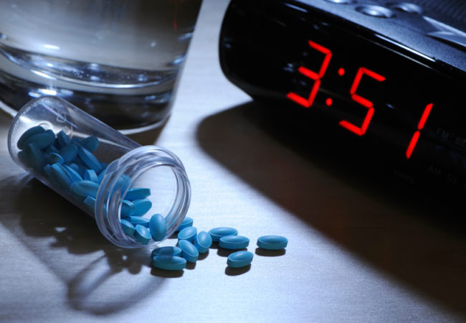
Sedatives and Sleeping Pills
Notes:
Drugs used commonly for their therapeutic efficacy in health care are also commonly misused/ abused (e.g. barbiturates, benzodiazepines, other sedatives).

Slide 48
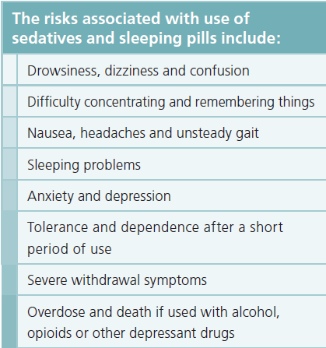
Sedatives: Effects and Risks
Pharmacological Effects
Muscle relaxation, calmness, sleep
Impaired concentration, memory, coordination
Slurred speech, drowsiness, unsteady gate
Notes:
The sedative/sleeping pills are a group of substances that induce muscle relaxation, calmness, and sleep, slowing down body activity by depressing central nervous system.
They can also lead to impaired concentration, memory, and coordination. Other effects include slurred speech, drowsiness, and unsteady gate. depression, withdrawal symptoms and overdose.
When used in combination with alcohol, health effects include further slows heart rate and breathing, which can lead to death.

Slide 49
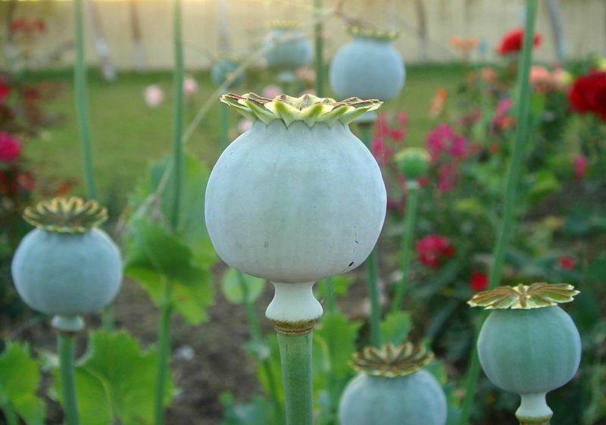
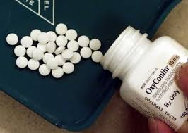
Opioids
Opiates
Notes:
Opiates come from the poppy flower (morphine, codeine, opium, heroin)
Opioids are a synthetic version of opiates. They include pain killing drugs such as Vicodin, Codeine, Oxycontin.

Slide 50
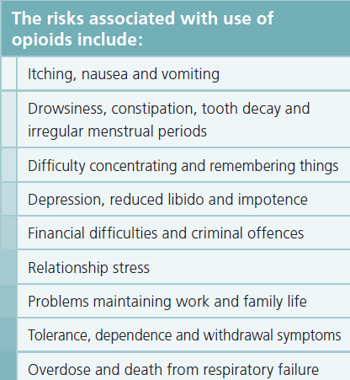
Opioids: Effects and Risks
Pharmacological Effects
Relieve pain, produce euphoria
Induce respiratory depression, drowsiness, and impaired judgment
Notes:
Opioids are a generic term applied to alkaloids from the opium poppy, or similar synthetic substances, including heroin, morphine, codeine, methadone and OxyContin. They have the capacity to relieve pain, produce euphoria and induce respiratory depression, drowsiness, and impaired judgment. There has been a large increase in the production, transportation and consumption of opioids, mainly heroin.
The risks associated with the use of opioids include:
Itchiness, nausea and vomiting during withdrawal
Drowsiness, constipation and tooth decay
Difficulty with concentration and memory
Financial, legal, social, and family problems
Physical dependence and overdose risk

Slide 51
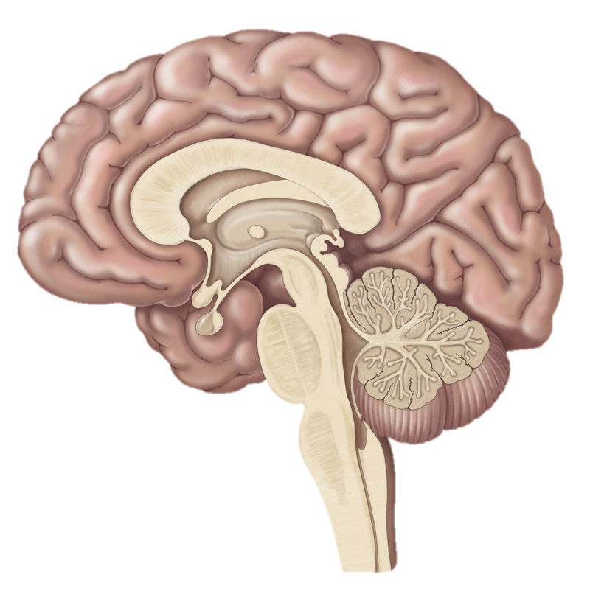
Opioid Neurobiology
Limbic System
Prefrontal Cortex
PREFRONTAL CORTEX: Executive Functions
LIMBIC SYSTEM:
Pleasure, reward. This area is responsible for development of addiction.
BRAIN STEM:
Respiration; Cough Suppression
SPINAL CORD:
Analgesia
Brain Stem
Spinal
Cord
Notes:
OPTIONAL SLIDE
The mu-opioid system is very dynamic. Individuals with tissue damage expose receptors on the spinal cord; when available opioids preferentially bind there. An excessive dose of opioids, or opioids given to someone who is not in pain will result in activation of the cerebral cortex and limbic system causing the pleasurable experience but also priming the brain for addiction. If a large excess of opioids are taken they will bind to receptors on the brain stem, resulting in respiratory arrest.
Individuals in pain can tolerate MUCH HIGHER doses of opioids without intoxication or overdose than those who are not in pain. Treating those in pain with opioids is safe as long as the dose is monitored. People who are getting high from their dose are receiving too large a dose and should be cut back.
(https://www.sciencedaily.com/releases/2007/10/071014163647.htm)

Slide 52
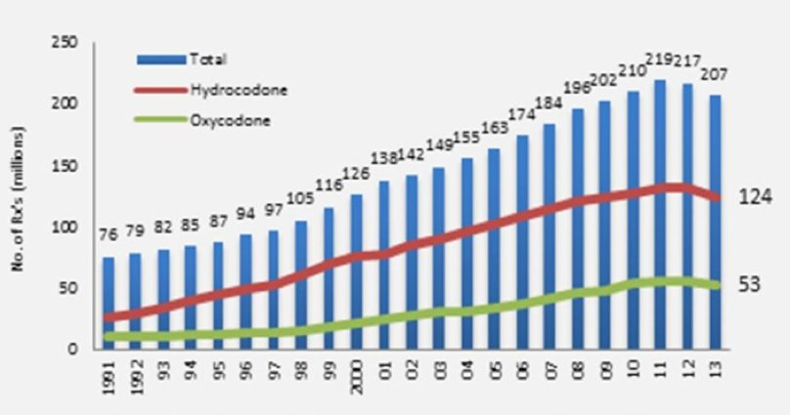
Increase in Opioid Prescriptions, 1991-2013
No. of Rx’s (millions)
1991 1992 1993 1994 1995 1996 1997 1998 1999 2000 2001 2002 2003 2004 2005 2006 2007 2008 2009 2010 2011 2012 2013
Volkow ND. America’s Addiction to Opioids: Heroin and Prescription Drug Abuse. Natl. Inst. Drug Abus. 2014.
Available at: http://www.drugabuse.gov/about-nida/legislative-activities/testimony-to-congress/2014/americas-addiction-to-opioids-heroin-prescription-drug-abuse.
Notes:
More than 2 million people in the United States suffer from substance use disorders related to prescription opioid pain relievers. The terrible consequences of this trend include overdose deaths, which have more than quadrupled in the past decade and a half. The causes are complex, but they include overprescription of pain medications. In 2013, 207 million prescriptions were written for prescription opioid pain medications (nearly threefold increase in 22 years from 76 million to 207 million opioid prescriptions).
(http://www.drugabuse.gov/about-nida/legislative-activities/testimony-to-congress/2014/americas-addiction-to-opioids-heroin-prescription-drug-abuse)

Slide 53
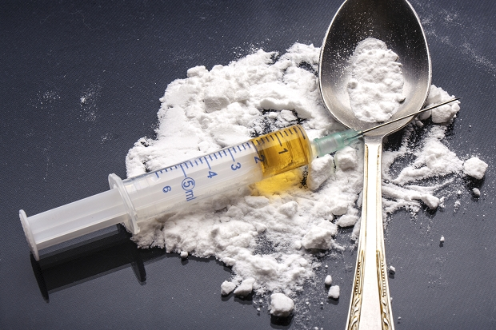
Heroin: Effects and Risks
Very rapid delivery of morphine to the central nervous system
Relatively inexpensive
Increased risk of death due to unknown potencies and tolerance
Increased risk of STIs due to injection
Snorting or smoking as practical alternatives to injecting
Notes:
Heroin is one of the most commonly used opioids that is often seen after the misuse of prescription drugs has been occurring for some time.
Highly addictive (painful withdrawal symptoms without the drug coupled rolling euphoria on the drug)
Increased risks of STI’s due to injection.
The shared use of injection equipment has caused increased risks of death due to unknown potencies and tolerance

Slide 54
Heroin Epidemiology
Substance Abuse and Mental Health Services Administration (SAMHSA) (2014). Substance Use and Mental Health Estimates from the 2013 National Survey on Drug Use and Health: Overview of Findings
Notes:
Heroin use in the US has increased dramatically in the last 10 years.
(graph shows use among individuals aged 12 or older)

Slide 55
Opioid-related Overdose Deaths in CT, by Age
Notes:
1,912 opioid-related overdose deaths from January 2012 through September 2015 attributed to accidental overdose of any opioid -- that includes illegal drugs, such as heroin, as well as prescription drugs, such as Oxycodone.
Data are derived from an investigation by the Office of the Chief Medical Examiner which includes the toxicity report, death certificate, as well as a scene investigation.

Slide 56
Opioids: Drug Interactions
Benzodiazepines, alcohol, other opioids and other sedatives →
  Alcohol and sedatives interact with heroin synergistically to produce greater respiratory depression
    Hypotension, profound sedation or coma may occur
  More likely to trigger a fatal heroin overdose compared to heroin use alone. If such combinations are unable to be avoided, heroin users should be advised to use smaller doses of heroin in the presence of other
  Antihistamines may increase risk of overdose
MAOIs →
  May result in hypotension and exaggeration of the CNS and respiratory depressant effects
Notes:
OPTIONAL SLIDE
Benzodiazepines, alcohol, other opioids and other sedatives: alcohol and sedatives interact with heroin synergistically to produce greater respiratory depression. Hypotension, profound sedation or coma may occur. Research indicates that heroin used in combination with benzodiazepines, alcohol or sedative mediation is more likely to trigger a fatal heroin overdose compared to heroin use alone. If such combinations are unable to be avoided, heroin users should be advised to use smaller doses of heroin in the presence of other individuals who are able to monitor for, and respond to, signs of overdose. It is unclear whether less potent sedatives such as antihistamines or valerian are able to increase risk of overdose.
One possible reason for interactions involving opioids could be that morphine and pethidine in particular reduce ‘gastro-intestinal motility’ (the process by which food is moved through the gut). This in turn could decrease the rate of absorption of other drugs taken by mouth.

Slide 57
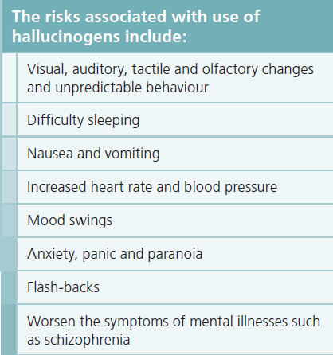
Hallucinogens: Effects and Risks
Pharmacological Effects
Feelings of euphoria/ dysphoria, mixed mood changes, altered perceptions, visual illusions
Adverse effects include panic reactions, flashbacks, mood disorders
Notes:
OPTIONAL SLIDE
Hallucinogens are a group of natural and synthetic substances that produce feelings of euphoria/dysphoria, mixed mood changes, altered perceptions, and visual illusions. Hallucinogens can be found in some plants and mushrooms (or their extracts) or can be human-made.
Research suggests that hallucinogens work at least partially by temporarily disrupting communication between brain chemical systems throughout the brain and spinal cord.
Specific short term effects include:
increased blood pressure, breathing rate, or body temperature
loss of appetite
dry mouth
sleep problems
mixed senses (such as "seeing" sounds or "hearing" colors)
Adverse effects include panic reactions, flashbacks, and mood disorders.
Risks include unpredictable behavior, mood swings, anxiety attacks, panic disorder and flash-backs.
https://www.drugabuse.gov/publications/drugfacts/hallucinogens.

Slide 58
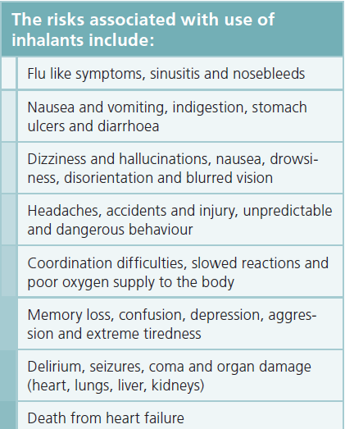
Inhalants: Effects and Risks
Pharmacological Effects
Belligerence, hallucinations, lethargy, psychomotor impairment, euphoria, impaired judgement, dizziness, slurred speech, tremors, muscle weakness, unsteady gate, coma
Notes:
OPTIONAL SLIDE
Signs of intoxication include belligerence, hallucinations, lethargy, psychomotor impairment, euphoria, impaired judgement, dizziness, slurred speech, tremors, muscle weakness, unsteady gate, stupor, and coma.
Risks to health include headaches, memory loss, delirium, seizures and heart failure.

Slide 59
Ecstasy (MDMA): Effects and Risks
Pharmacological Effects
Risks
Hallucinogenic effects
Increased tactile sensitivity
Decreased inhibitions
Difficulty learning/remembering
Hyperthermia (overheat), dehydration
Cardiac or liver toxicity, renal failure
Neurotoxicity
Exhaustion
Notes:
OPTIONAL SLIDE
3,4-methylenedioxy-methamphetamine (MDMA) is a synthetic drug that alters mood and perception (awareness of surrounding objects and conditions). It is chemically similar to both stimulants and hallucinogens, producing feelings of increased energy, pleasure, emotional warmth, and distorted sensory and time perception.
High doses of MDMA can affect the body’s ability to regulate temperature. This can lead to a spike in body temperature that can occasionally result in liver, kidney, or heart failure or even death.
https://www.drugabuse.gov/publications/drugfacts/mdma-ecstasymolly

Slide 60
“Other”
Bath salts
K2 or Spice
Synthetic stimulants
Snorted, orally, smoked, injected
Agitation, insomnia, depression, paranoia, delusions, reduced motor control, reduced ability to think clearly
Rapid heart rate, nosebleeds, chest pains, nausea, and vomiting
Mixture of herbs, spices or shredded plant material sprayed with a synthetic compound
Increased heart rate and blood pressure, heart palpitations, pale skin, constant coughing, feelings of nausea or actual vomiting, tremors or seizures.
Loss of concentration and control, agitation, violence, paranoia, a feeling of alienation/ disassociation, panic attacks, psychotic episodes
Notes:
OPTIONAL SLIDE
Bath salts is the informal "street name" for a family of designer drugs which have effects similar to amphetamine and cocaine The white crystals resemble legal bathing products like Epsom salts, and are called bath salts but chemically have nothing to do with actual bath salts.
Spice: 3-5 minute onset and the duration of the high is 1-8 hours.
Experts point out that due to the variation in chemical additives used in Spice, K2, and other synthetics, users don’t know exactly what they’re getting in each packet and the effects can therefore be unpredictable.

Slide 61
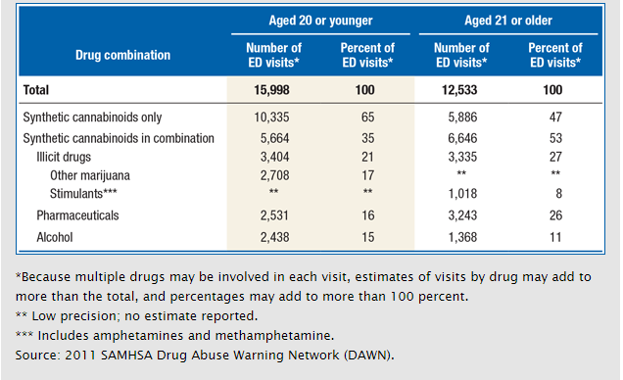
ED Visits Involving Synthetic Cannabinoids Only or in Combination with Other Substances, by Age Group: 2011
Notes:
OPTIONAL SLIDE
Among patients aged 20 or younger, no other substances were combined with synthetic cannabinoids in about two-thirds (65%) of ED visits related to their use; among patients aged 21 or older, 47% of visits involved synthetic cannabinoids only.
Synthetic cannabinoids were combined with illicit drugs in 21% of visits among patients aged 20 or younger and in 27% of visits among patients aged 21 or older.
In 2011, synthetic cannabinoids were combined with pharmaceuticals in 16 percent of visits among patients aged 12 to 20 and in 26 percent of visits among patients aged 21 or older.

