Slide 1

Motivational Interviewing Steps and Core skills

Slide 2
Learning Objectives
At the end of the session, you will be able to—
  Identify MI basic steps.
  Identify MI core skills.
  Demonstrate and practice MI using core skills.

Slide 3

Motivational Interviewing Steps

Slide 4

Four Steps of the MI Process
  Engage
  Focus
  Evoke
  Plan

Slide 5

Four Steps of the MI Process (continued)
Engage
Express empathy
Ask questions
Use affirmations
Support autonomy

Slide 6

Four Steps of the MI Process (continued)
Focus
Reflecting
Summarizing
Developing discrepancies

Slide 7

Four Steps of the MI Process (continued)
Evoke
Motivation
Concerns

Slide 8
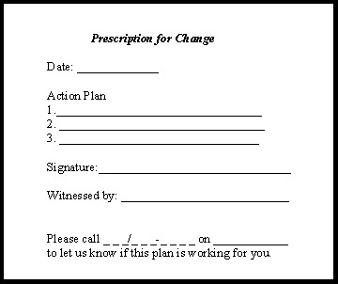
Four Steps of the MI Process (continued)
Plan
Raise the subject
Support self-efficacy
Address elements of change

Slide 9
Video Demonstration

Slide 10

Motivational Interviewing Core skills

Slide 11

Core MI
Open-ended questions
Affirmations
Reflections
Summaries

Slide 12
Open-Ended Questions
Using open-ended questions—
Enables the patient to convey more information
Encourages engagement
Opens the door for exploration

Slide 13

Open-Ended Questions (continued)
What are open-ended questions?
Gather broad descriptive information
Require more of a response than a simple yes/no or fill in the blank
Often start with words such as—
  “How…”
  “What…”
  “Tell me about…”
Usually go from general to specific

Slide 14

Open-Ended Questions (continued)
Why open-ended questions?
  Avoid the question-answer trap
    Puts patient in a passive role
    No opportunity for patient to explore ambivalence

Slide 15

Open-Ended Questions (continued)
Why open-ended questions?
  Opportunity to explore ambivalence

Slide 16
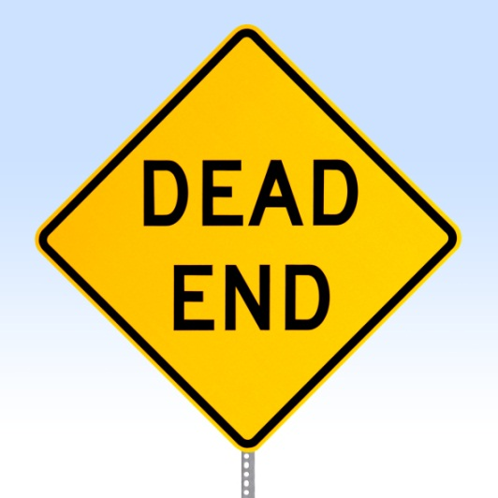
Closed-Ended Questions
Present Conversational Dead Ends
Closed-ended questions typically—
Are for gathering very specific information
Tend to solicit yes-or-no answers
Convey impression that the agenda is not focused on the patient

Slide 17
Exercise
Turning closed-ended question into an open-ended one.
Do you feel depressed or anxious?

Slide 18
Affirmations
What is an affirmation?
Compliments or statements of appreciation and understanding
  Praise positive behaviors
  Support the person as they describe difficult situations

Slide 19

Affirmations (continued)
Why affirm?
Support and promote self-efficacy, prevent discouragement
Build rapport
Reinforce open exploration
(patient talk)
Caveat
Must be done sincerely

Slide 20
Affirmations May Include:
Commenting positively on an attribute
  You are determined to get your health back.
A statement of appreciation
  I appreciate your efforts despite the discomfort you’re in.
A compliment
  Thank you for all your hard work today.

Slide 21
Reflective Listening
Reflective listening is one of the hardest skills to learn.
“Reflective listening is a way of checking rather than assuming that you know what is meant.”
(Miller and Rollnick, 2002)

Slide 22

Reflective Listening (continued)
Involves listening and understanding the meaning of what the patient says
Accurate empathy is a predictor of behavior change

Slide 23

Reflective Listening (continued)
Why listen reflectively?
  Demonstrates that you have accurately heard and understood the patient
  Strengthens the empathic relationship

Slide 24

Reflective Listening (continued)
Why listen reflectively?
  Encourages further exploration of problems and feelings
    Avoid the premature-focus trap
  Can be used strategically to facilitate change

Slide 25
Levels of Reflection
Simple Reflection—stays close
  Repeating
  Rephrasing (substitutes synonyms)
Example
Patient: I hear what you are saying about my drinking, but I don’t think it’s such a big deal.
Clinician: So, at this moment you are not too concerned about your drinking.

Slide 26
Levels of Reflection (continued)
Complex Reflection—makes a guess
  Paraphrasing—major restatement, infers meaning, “continuing the paragraph”
Examples
Patient: “Who are you to be giving me advice? What do you know about drugs? You’ve probably never even smoked a joint!
Clinician: “It’s hard to imagine how I could possibly understand.”
***
Patient: “I just don’t want to take pills. I ought to be able to handle this on my own.”
Clinician: “You don’t want to rely on a drug. It seems to you like a crutch.”

Slide 27
Levels of Reflection (continued)
Complex Reflection
  Reflection of feeling—deepest
Example
Patient: My wife decided not to come today. She says this is my problem, and I need to solve it or find a new wife. After all these years of my using around her, now she wants immediate change and doesn’t want to help me!
Clinician: Her choosing not to attend today’s meeting was a big disappointment for you.

Slide 28
Double-Sided Reflections
A double-sided reflection attempts to reflect back both sides of the ambivalence the patient experiences.
  Patient: But I can't quit smoking. I mean, all my friends smoke!
  Clinician: You can't imagine how you could not smoke with your friends, and at the same time you're worried about how it's affecting you.
  Patient: Yes. I guess I have mixed feelings.

Slide 29
Summaries
Periodically summarize what has occurred in the counseling session.
Summary usages
  Begin a session
  End a session
  Transition

Slide 30
Summaries (continued)
Strategic summary—select what information should be included and what can be minimized or left out.
Additional information can also be incorporated into summaries—for example, past conversations, assessment results, collateral reports, etc.

Slide 31
Summaries (continued)
Examples
  “So, let me see if I’ve got this right…”
  “So, you’re saying… is that correct”
  “Make sure I’m understanding exactly what you’ve been trying to tell me…”
Double sided reflections are often highly effective as summaries to illustrate ambivalence.

Slide 32
Learning Exercise

Slide 33
Exercise
OARS in practice

Slide 34
Conclusion
In this session, you have learned the steps and core motivational interviewing skills.
In the next session, you will use these core skills plus selected tools that help patients better understand their competing priorities and ambivalence to change—to resolve their ambivalence and increase motivation for behavior change.

