Slide 1
Alcohol Policy and Adolescent Drinking: Using Science in the Public Interest
Module 4
Post Policy Adoption:
Key Elements for Implementation

Slide 2
Policy adoption
Essential Elements
Implementing the core components of the policy
Ensuring the policy is enforced
Carrying out the evaluation of policy impacts

Slide 3
First things first
Policies require public support
For passage
For enforcement
To deter post-passage efforts to repeal the policy

Slide 4
Implementation: Step 1
Get the Policy Right in the First Place
Get the organization responsible for enforcement involved in the policy development early on…
Do your homework to be confident there are no legal barriers to enforcement
Be sure there are enforcement resources included in the policy

Slide 5
Implementation: Step 2
Combine “Soft” and “Hard” Approaches
Public awareness of the policy and it’s enforcement is important
Clearly defined sanctions for policy violations

Slide 6
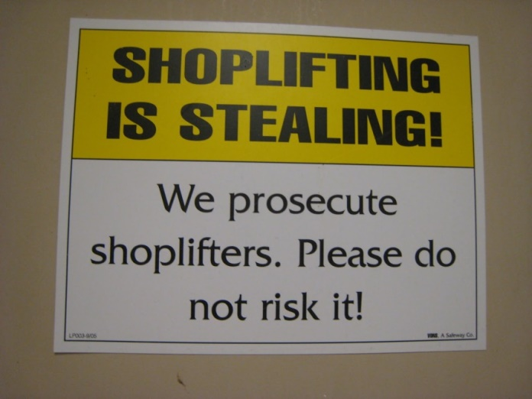
Implementation: Step 2 (cont.)
Deterrence Theory
Legal threat of punishment encourages or prevents behavior
Punishment must be perceived as:
Certain
Swift
Having appropriate severity

Slide 7
Implementation: Step 2 (cont.)
Example of Hard Approaches
DUI Enforcement
Administrative per se laws
Anti-plea bargaining laws
Mandatory penalties for first offense
Open container laws
Mandatory breath tests
Sobriety Checkpoints

Slide 8
Implementation: Step 3
Educate and Build Awareness of the Policy and Enforcement Efforts
Public awareness supports deterrence
Perceived risk of getting caught
Belief that sanction will be levied
Public awareness should be on-going

Slide 9
Implementation: Step 4
Monitoring Effectiveness and Enforcement
Clearly defined and codified compliance regulations
Identify what organizations have a role in the enforcement
Be clear on who does what
Ensure adequate resources and capacity
Clearly identified organizational roles
Political support
Alcohol: No Ordinary Commodity | An advocate’s user guide

Slide 10
Implementation: Step 5
Evaluation
Identify how you will know of the policy is having desired impacts
Establish agreed upon measures
Decide how information will be collected

Slide 11
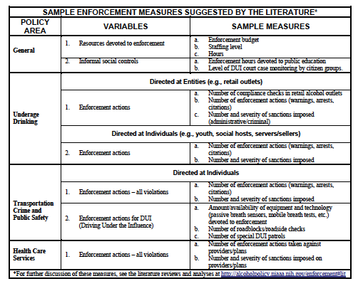
Implementation: Step 5
Examples

Slide 12
Activity
At your table discuss a policy you have been involved with passing that has weak/no enforcement
Consider which of the steps may be part of the reason
Consider other possible reasons enforcement is not happening

Slide 13
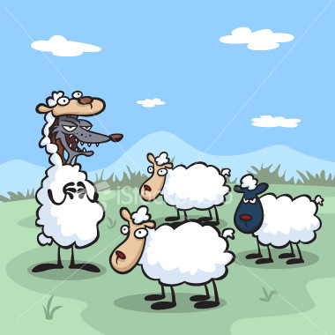
Use caution
Industry Involvement and Self-regulation
To work with the industry or not…..it depends
Depends on level of shared interest and shared outcomes
Self-regulation is largely ineffective

Slide 14
The role of advocates
Public Health Advocates are Essential
Use of media to publicize enforcement efforts
Support organizations participating in enforcement…provide “political cover”
Hold enforcement entities accountable

