Slide 1
Surviving and Thriving: Resilience-Building in Academia
Cassandra Holinka, PsyD
Clinical Psychologist & Assistant Professor
Jessica Meyer, Ph.D.
Clinical Psychologist & Associate Professor

Slide 2
Today’s Objectives
Consider the difference between getting through stress and developing resilience
Reflect on when you have the mental and emotional capacity to do each
Identify four ways to approach any problem
Take a deeper dive into specific skills
Discuss some common topics of interest in the workplace

Slide 3
What is resilience?
Ability and tendency to “bounce back” from a setback
Adapting effectively in the face of adversity, trauma, tragedy, threats, or significant stress
Markers:
Capacity to make and carry out realistic plans
Positive view of self and confidence in strengths
Communication and problem-solving skills
Capacity to manage strong feelings and impulses

Slide 4
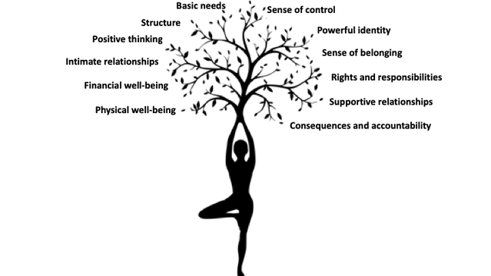
What is resilience?
“12 resources to nurture resilience” by Michael Ungar

Slide 5
Orienting Oneself to Dealing with Problems/Stressors

Slide 6
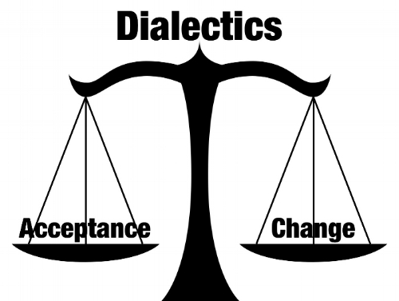
4 Ways to Approach a “Problem”/Stressor
Solve it.
Change the way you feel about it.
Tolerate or accept it.
Stay miserable, stuck.

Slide 7
1. Solve it.
Identify specific problem to be solved.
Identify your goal in solving the problem.
Brainstorm lots of solutions.
Choose a solution you think is likely to work.
Try it out.
Evaluate.
(Adapted from Marsha Linehan’s DBT)

Slide 8
2. Change the way you feel.
Check out what you’re thinking.
Can you make any changes or shifts here?
Evidence for/against?
Based on habit or fact?
Leaving out pieces of the story?
All-or-nothing, or extremes?
“Should,” or other “rules?”
Is there an action you can take that will change the way you feel, or at least the intensity of the feeling?
Use humor.
Funny movie/story

Slide 9
3. Tolerate or accept it.
Use language to shift thinking and distress levels.
“I notice the thought that…”
“In this moment, my mind thinks…”
“My anxious brain says…”
“The inner critic is at it again with…”
Self-validation
“In this moment, I feel…”
“It makes sense that I feel… given…”
“These feelings/thoughts/situation can be here.”
Formal/informal mindfulness practice

Slide 10
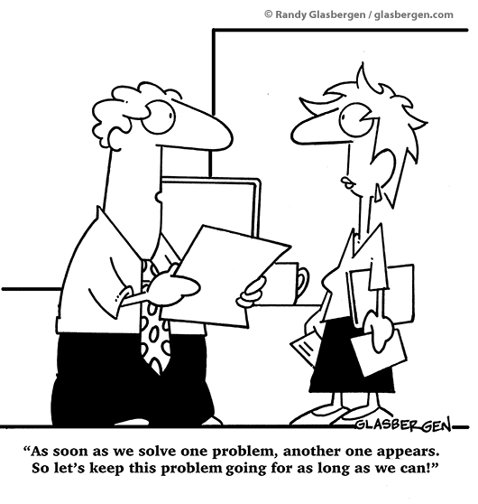
4. Stay miserable, stuck.

Slide 11
A Deeper Look at Specific Skills

Slide 12
Acceptance Strategies
Mindfulness
Mindfulness in Academia: Living with Intentionality to Values and Time
Gratitude Practice
Self Compassion & Self Acceptance
Relaxation Practice – 4-7-8 Breath

Slide 13
Mindfulness

Slide 14
What is Mindfulness
According to Jon Kabat-Zinn, “Mindfulness means paying attention in a particular way; on purpose, in the present moment, and non judgmentally."
Being in the present moment
One-mindfully
With a Nonjudgmental manner – not falling prey to our own prejudices, opinions, and projections
Developing familiarity with one’s mind
Learning to be in control of your own mind, instead of letting your mind be in control of you

Slide 15
Evidence for Mindfulness
Many studies show mindfulness associated with:
Lower stress levels, greater ease/well being
Improved frustration tolerance
Improved cognitive functioning
Increased immune functioning
Lower BP
Less reactivity/conflict
Reduced chronic pain

Slide 16
Research: Benefits of Mindfulness in Medicine
30 primary care clinicians participated in an abbreviated mindfulness course
(Fortney, Luchterhand, Zakletskaia, Zgierska, Rakel, 2013)
9 months post-intervention, lower scores in:
Burnout
Depression
Anxiety
Perceived Stress

Slide 17
Let’s Practice….
3 Steps to Meditation:
1. Sit with back upright, alert, yet comfortable
2. Focus on your breath, body or other object of attention
3. When you get lost elsewhere, bring your attention back to the breath.

Slide 18
Brief mindful breaks
1. Check-Ins with Yourself - “Where are You Now?”
What are my thoughts?
How are my thoughts affecting my actions at work?
What are my emotions?
Where do I feel this in my body?
Come back to the present moment, the breath or body, whenever you realize you are caught up in thoughts or emotions

Slide 19
Mindfulness in Academia
When stressed or feeling time pressure, mindfulness can be helpful to facilitate working with intentionality
Take Mindful Pauses to:
Work One-Mindfully
Ask yourself if this is how you want to be using your time, and what function or value it is serving
Identify your Values, and be willing to be flexible with them and to sacrifice some for the sake of others

Slide 20
Gratitude

Slide 21
Gratitude practice
Shifts our negative bias in thinking to be more balanced
Practice perceiving positive events that occur in everyday professional/personal life and not taking them for granted
Log at end of day what went well or what you learned. Minimum 5 things per week.
Benefits including better sleep, fewer symptoms of illness, less depression, and more happiness/psychological well being
http://greatergood.berkeley.edu/article/item/tips_for_keeping_a_gratitude_journal

Slide 22
Self Compassion

Slide 23
What is self compassion?
Self-compassion is about finding a kinder and friendlier way to relate to yourself. Self compassion pauses are aimed at fostering a new, more gentle and loving perspective on your struggles and places in which you get down on yourself.
This is opposed to ignoring internal suffering and/or being self-critical.
Self-Compassion is not self-pity. Self-pity tends to emphasize egocentric feelings of separation from others and exaggerate the extent of personal suffering. Self-compassion allows one to see the related experiences of self and other without these feelings of isolation and disconnection.

Slide 24
What does self compassion feel like?
Self-compassion entails being warm and understanding toward ourselves when we suffer, fail, or feel inadequate, rather than ignoring our pain or engaging in self-criticism.

Slide 25
Why is self compassion important?
Self-compassion yields a number of benefits, including lower levels of anxiety and depression.
Self-compassionate people recognize when they are suffering and are kind to themselves at these times, which reduces their anxiety and related depression.

Slide 26
Self-Compassion Break
Think of a situation in your life that is difficult, that is causing you stress. Call the situation to mind, and see if you can actually feel the stress and emotional discomfort in your body.
Now, say to yourself:

Slide 27
1. This is a moment of suffering
This is suffering.
This hurts.
This is stress.

Slide 28
2. Suffering is a part of life
Suffering is universal.
Other people feel this way. I’m not alone. We all struggle in our lives.
Now, put your hands over your heart, feel the warmth of your hands and the gentle touch of your hands on your chest.

Slide 29
3. May I be kind to myself
You can also ask yourself, “What do I need to hear right now to express kindness to myself?” Is there a phrase that speaks to you in your particular situation, such as:
May I give myself the compassion that I need; May I learn to accept myself as I am; May I forgive myself; May I manage this stressful situation with greater ease and peace.

Slide 30
Change Strategies

Slide 31
Relaxation Practice

Slide 32
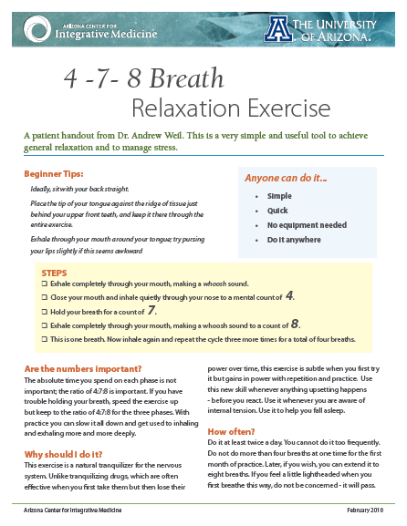
4-7-8 Breath

Slide 33
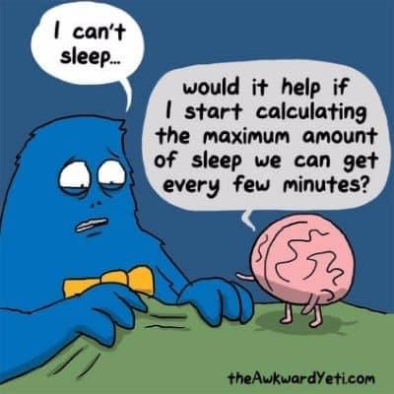
Reducing Emotional Vulnerability

Slide 34
Reducing Emotional Vulnerability
Accumulate positive emotional experiences in the short and long-term
Build mastery
Work and non-work related
Take care of your body
Treat physical illness, eat well, exercise, sleep hygiene, etc.
Schedule your “worry time”

Slide 35
Common Topics of Interest

Slide 36
Work-Life Balance
Two parts:
Role engagement
Minimal role conflict

Slide 37
Work-Life Balance
What exactly do you mean by work-life balance?
Tendency to become fully engaged in each role
Equal time, attention, and involvement in each
Equal amounts of satisfaction in each
Balanced involvement and satisfaction in each

Slide 38
Work-Life Balance
There is not perfect equilibrium, and even the term work-life balance must be interpreted against a backdrop of gender, education, economic status, and other social issues. Much of the popular advice on work-life balance has focused on women and the challenges of child-rearing or other care-taking roles and work. Other articles assume the privilege of independence in decision-making about work and ignore the challenge of work as absolute economic necessity—paycheck to paycheck. Company or organizational norms also affect an individual’s definition of work and commitment to hours, place, and tasks. Some still think they can “do it all.” Language molds the creation of reality and the perception of reality and is important to framing an issue.
Libby V. Morris in The Conundrum of Work-Life Balance

Slide 39
Work-Life Balance
What feels right to you?
What are your values?
What are your needs in this moment?
- Comparisons
- Need for conformity
- Self-judgment
- Expectation for consistency
- Mindful self check-ins
- Self-respect, “pushback”
- Self-compassion/validation
- Flexibility

Slide 40
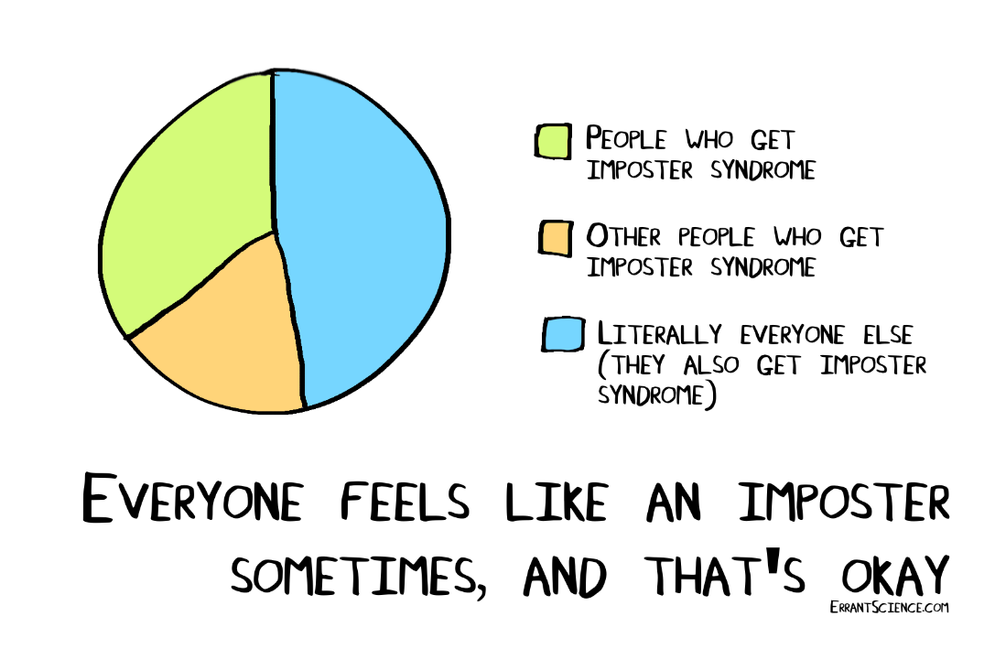
Imposter Syndrome
Pattern of behavior wherein people doubt their abilities and have persistent fear of being exposed as a fraud

Slide 41
Imposter Syndrome
Who is particularly susceptible to imposter syndrome?
Women and minority groups
Women tend to do well in merit-based environments, but…
Structural barriers are higher for women (e.g., exclusion from collaboration, radar of search committees, & other career advancement opportunities)
Those with high trait perfectionism
Those who link their self-worth with achievement

Slide 42
Imposter Syndrome
When is imposter syndrome particularly likely to flare up?
Taking on something new
Promotion/moving “up” a step
Receiving recognition

Slide 43
Imposter Syndrome
How to manage through it
Talk with mentors
Find ways to honor your skills/expertise
Do NOT feed the inner critic
Reflect on your values
E.g., Achievement, recognition versus personal growth, humility
“This, OR that” to gain some flexibility
E.g., “They probably chose me because there were no other applicants.”
“… or they chose me because it’s clear I can do the job.”
Remember that I.S. may be more a function of culture and environment than some inner shortcoming

Slide 44
Communication Strategies
Identify your top priority:
Getting some specific objective met
Enhancing/protecting a relationship
Enhancing/protecting your own self-respect
Keep the conversation simple and direct with DEAR script:
Describe
Express
Assert
Reinforce
Mindfully
Assertively
Save
negotiation

Slide 45
Communication Strategies
Utilizing validation with others
Stay awake, pay attention
Accurately reflect back
Read between the lines
State how what they think/feel makes sense
Genuineness

Slide 46
Resources
Center for Mindful Self-Compassion:
https://centerformsc.org/
The Positive Psychology Center at UPenn:
https://ppc.sas.upenn.edu/
Self Compassion (Dr. Kristin Neff)
https://self-compassion.org/
American Psychological Association
https://www.apa.org/

Slide 47
