Slide 1
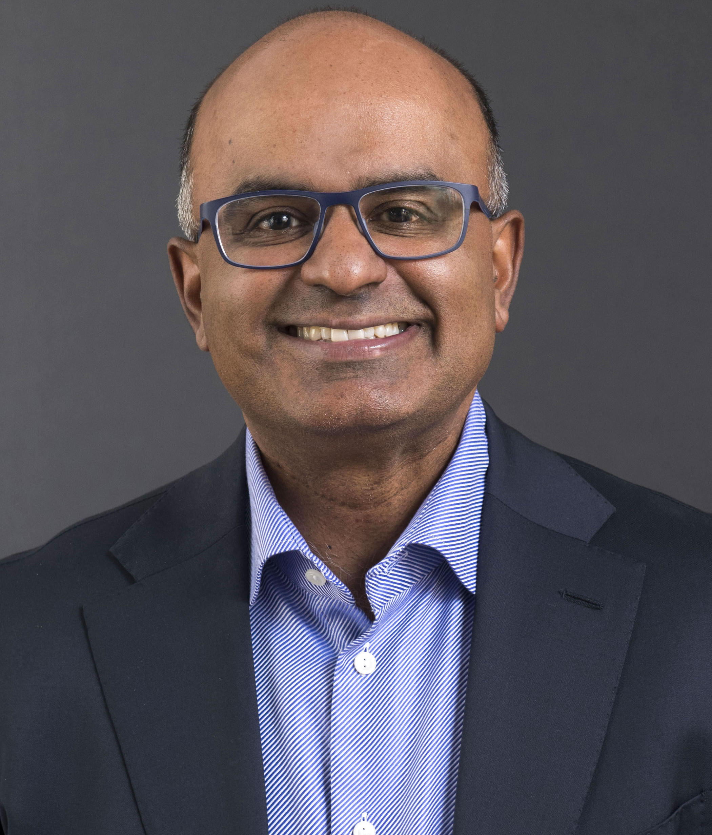
UConn Physician-Scientist Career Development Virtual Colloquium
“From reading the genome for risk to rewriting it for cardiovascular health”
Sekar Kathiresan, M.D.
CEO of Verve Therapeutics
Sekar Kathiresan is co-founder and CEO of Verve Therapeutics and serves on the company’s board of directors. He is a preventive cardiologist who has made groundbreaking discoveries of cardioprotective genetic mutations, which confer resistance to cardiovascular disease. Prior to joining Verve, he served as director of the Massachusetts General Hospital (MGH) Center for Genomic Medicine and was the Ofer and Shelly Nemirovsky MGH Research Scholar. He also served as director of the Cardiovascular Disease Initiative at the Broad Institute and was professor of medicine at Harvard Medical School. His research laboratory focused on understanding the inherited basis for blood lipids and myocardial infarction and using these insights to improve preventive cardiac care. Among his scientific contributions, he has helped highlight new biological mechanisms underlying heart attack, discovered mutations that protect against heart attack risk, and developed a genetic test for personalized heart attack prevention.
Date: Monday, March 29, 2021
Time: 5:00pm
Location: Webex link
Presented by the Office of Physician-Scientist Career Development
For further information contact Christa Veno, Center for Molecular Oncology, 860-679-7640

