Slide 1
Discovering What’s Next:
Navigating the Transitions of Retirement

Slide 2
Agenda
Importance of Social Connection
Types of Relationships
Social “Convoys”
Questions to Consider
Tips for Healthy Relationships

Slide 3
Importance of Social Connection
Social support is a key factor in resilience
Loneliness and isolation have been linked to a host of health issues
Social engagement promotes mental acuity and cognitive health
Staying socially connected promotes belonging and strengthens self-worth
Strong support networks are associated with a healthier and longer life

Slide 4
Types of Relationships
Family – spouse/partner, children, parents, siblings, grandchildren, extended family
Work – boss, colleagues, mentors, customers/patients, work friends
Friends – lifelong friends, close friends, social group friends, acquaintances, neighbors, activity/interest group connections
Others – pets, religious affiliations, professionals (doctors, lawyers, financial planners, etc.), business or volunteer relationships

Slide 5
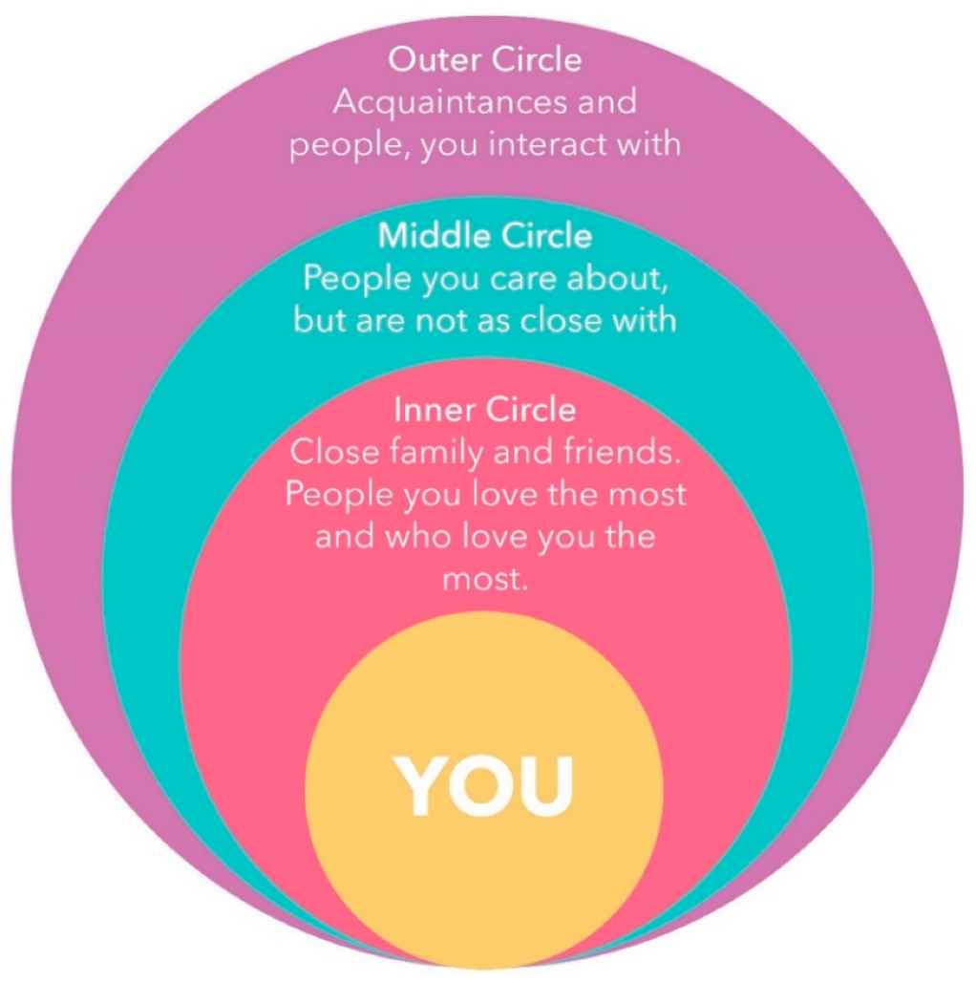
Concept of a Social “Convoy”
“Convoys” are meant to provide protection and mutual support.
One’s social “convoy” is the group of people who accompany us on the journey of life.
This social grouping is a critical element of well-being at every stage of development.
The makeup of the social convoy may change over time.
One critical point about convoys is that they set out together — they don’t just meet up at the end of the journey. It is important to build and maintain social convoys throughout life.
Adapted from Retirement and Family Relationships: An Opportunity in Late Life, Lorraine Dorfman, Generations, 2002

Slide 6
Questions to consider
How will retirement affect your various relationships? What are the potential benefits/challenges?
Timing of retirement – do you and your partner plan to retire at the same time? If not, how might that affect the adjustment?
Retirement “personality” – how will you handle it if you and your loved ones have a different style (i.e. one is an Adventurer, the other an Easy Glider)?
Where do you want to live in retirement? How will that affect your social “convoy”?
What are your/your family’s expectations regarding caregiving (i.e. babysitting grandchildren, caring for an elderly parent)?
How might the emotional adjustment to retirement affect your relationships?
Are there any current or anticipated health issues that may create stress?

Slide 7
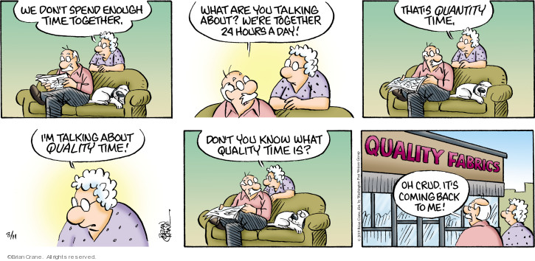
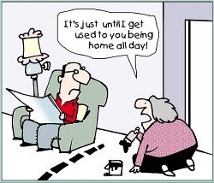
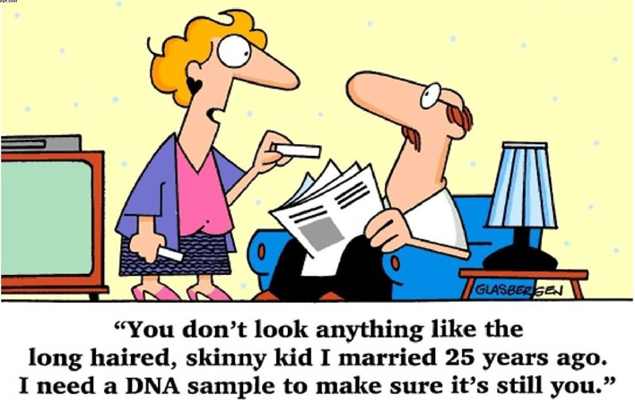
Tips for Healthy Relationships
Plan ahead and discuss expectations
Communicate respectfully and honestly
Set boundaries/strive for balance
Honor differences and work towards compromise
Be flexible and expect change
Do your best to support each other
Be patient with yourself and your loved ones

Slide 8
EAP Contact Information
Call 860-679-2877 or 800-852-4392
Email: uchc_eap@uchc.edu
Website: h.uconn.edu/eap
Hours: 8:00am – 5:00pm
After business hours, if the situation is urgent, call the main number and follow the instructions. You will be connected to the on-call EAP counselor.
State of CT Retirement Website:
https://www.osc.ct.gov/rbsd/stateretire.htm

Slide 9
Books
1001 Fun Things to Do in Retirement, Mike Bellah (2022)
How to Retire Happy, Wild, and Free: Retirement Wisdom That You Won't Get from Your Financial Advisor, Ernie J. Zelinski (2009)
How to Retire Happy: The 12 Most Important Decisions You Must Make Before You Retire, Stan Hinden (2005)
Keys to a Successful Retirement: Staying Happy, Active, and Productive in Your Retired Years Fritz Gilbert (2020)
Retirement Your Way: The No Stress Roadmap for Designing Your Next Chapter and Loving Your Future Gail M. McDonald and Marilyn L. Bushey (2019)
Retiring? Your Next Chapter Is about Much More than Money Ted Kaufman and Bruce Hiland (2021)
Revitalizing Retirement: Reshaping your Identity, Relationships, and Purpose Nancy K. Schlossberg (2009)
The Couple's Retirement Puzzle: 10 Must-Have Conversations for Creating an Amazing New Life Together Roberta Taylor and Dorian Mintzer (2014)
The Retiring Mind: How to make the Psychological Transition to Retirement by Robert P. Delamontagne PhD (2011)
Thriving Throughout Your Retirement Transition, Retirement Coaches Association (2020)
Too much Togetherness: Surviving Retirement as a Couple Miriam Goodman (2011)
Winning at Retirement: A Guide to Health, Wealth & Purpose in the Best Years of Your Life Patrick Foley and Kristin Hillsley (2018)

