Slide 1
Stress Debrief : Riding the Second Wave

Slide 2
Where are we now?
People have been faced with high levels of stress for a prolonged time
After the initial crisis, we adjusted to some extent to our “new normal”
Resurgence of cases may cause us to re-experience emotions and trauma related to first wave
Our usual coping mechanisms have been interrupted and there are additional stressors and challenges
Many are feeling tired, frustrated and burned out and are struggling to regroup
Though there is promise of a vaccine, the future/endpoint is still relatively uncertain

Slide 3
What people are saying…
Living alone: "I was managing ok in the beginning of this but after 8 months, I miss the connection with my work family."
Essential worker: "I find myself wishing I had a job that enabled me to work from home; I’m afraid that I am putting my spouse and children at risk."
Parent of school-aged kids: “I worry that I take my stress out on my kids.. It's so hard balancing the help they need with my work responsibilities.”
Senior: "My grandkids haven't been able to visit since last Christmas."
Employee with elderly parent in skilled nursing facility: "My mom has dementia and doesn't understand why I can't visit. She has declined so much these last few weeks."
Healthcare worker: "I find myself feeling angry. People complain about wearing a mask and do not seem to realize the risk I place myself in daily."

Slide 4
What the research is showing…
Increased rates of depression, anxiety, substance use disorders and trauma-related symptoms
Interpersonal/domestic violence has increased by 20%
Groups who have been most impacted include:
Adolescents/Young Adults (ages 13-23)
Racial/Ethnic Minorities
Essential Workers
Unpaid Adult Caregivers
Individuals with history of mental health issues
Sources: APA Stress in America 2020: A National Mental Health Crisis, CDC.gov, “Considerations of the Impacts of COVID-19 on Domestic Violence in the United States”
Bright, Burton, Kosky October 2020

Slide 5
What is helping you to cope?
You can’t stop the waves, but you can learn to surf.
Joseph Goldstein

Slide 6
What you can do…
Maintain social connections
Take it one day, one moment at a time
Focus on what you can control
Rest, Nutrition, Exercise
BREATHE (Mindfulness/Relaxation)
Humor
Creative outlets
Prayer/spiritual practices
Volunteer
Others?

Slide 7
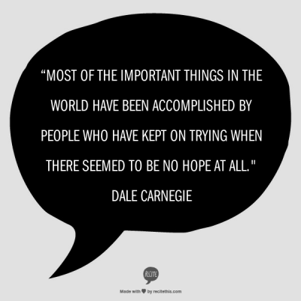
What can we learn?
It can be helpful to consider the personal growth that can result from this crisis…such as a reassessment of what is important and an opportunity to be more appreciative of others.

Slide 8
UCONN EAP Contact Information
Call 860-679-2877 or 800-852-4392
Email: uchc_eap@uchc.edu
Website: h.uconn.edu/eap
Hours: 8:00am – 5:00pm
After business hours, if the situation is urgent, call the main number and follow the instructions. You will be connected to the on-call EAP counselor.

