Slide 1
Workplace Diversity & Inclusion
UConn Health EAP

Slide 2
What Does Your Workplace Value?

Slide 3
How Diverse is Your Universe?
Red – Caucasian/White
Orange – Black (African, AA, Caribbean, etc.)
Green – Hispanic/Latin
Pink – Asian/Pacific Islander
Purple – Other/Multiple Races
Black – More than a decade older/younger
Blue – Has a disability
Light Blue – Different sexual/gender ID than you
http://intercultural-learning.eu/Portfolio-Item/how-diverse-is-your-universe/

Slide 4
What Is Diversity?
Diversity is the range of human differences, including but not limited to race, ethnicity, gender, gender identity, sexual orientation, age, social class, physical ability or attributes, religious or ethical values system, national origin, and political beliefs.
https://www.ferris.edu/htmls/administration/president/diversityoffice/definitions.htm

Slide 5
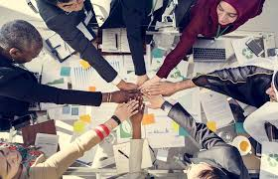
What Is Inclusion?
Inclusion, refers to the efforts used to embrace those differences. It describes how much each person feels welcomed, respected, supported and valued. Inclusion is about seeing employees’ whole selves, recognizing that their differences make them uniquely qualified to contribute to the organization.
https://www.paycom.com/resources/blog/difference-between-diversity-and-inclusion-and-why-you-need-both/

Slide 6
Diversity vs. Inclusion?
Diversity
Inclusion

Slide 7
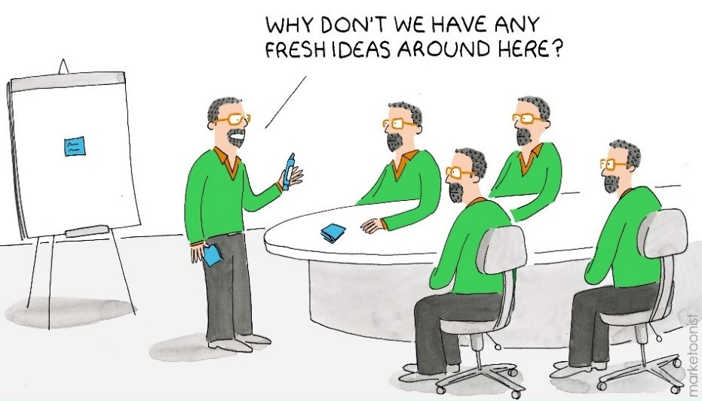
What Are The Benefits Of Diversity & Inclusion?
Easier to Recruit/Retain Employees
Employee Performance Increases
Better Decision Making
Faster Problem Solving
Increases Innovation
Happier Employees
Happier Clients and Customers
Increases Profits
http://www.deettajones.com/7-surprising-benefits-of-diversity-and-inclusion/
https://www.talentlyft.com/en/blog/article/244/top-10-benefits-of-diversity-in-the-workplace-infographic-included

Slide 8
What Happens If You Don’t Have Both???

Slide 9
Barriers to Inclusion
Barriers and Pitfalls to Achieving Inclusion

Slide 10
https://www.youtube.com/watch?v=2g88Ju6nkcg

Slide 11
DANGER! Microaggressions
Microaggression = “Casual Degredation”
Microassault – overt discrimination, name calling
Microinsult – unconscious insult demeaning a person’s identity
Microinvalidation – communications that negate or nullify a marginalized person’s experience
https://www.youtube.com/watch?v=ho_WW7M5E3A
https://www.youtube.com/watch?v=9bqtfRKZkRE
https://www.slideshare.net/EPIPNational/epip-and-lupita-gonzalez-microaggressions-webinar

Slide 12
DANGER: Unconscious Bias
Name Bias
Halo effect/Horns effect – liking or disliking one aspect of a person and generalizing to other areas
Gender Bias – labels for women (bossy vs. leader), meeting times, networking times
Confirmation Bias – having a belief and looking only at information that supports it
Bropropriating – one person has an idea that’s ignored and later another person has same idea and its celebrated
Height Bias – Average male CEO’s are 3 inches taller than the average male
https://lattice.com/library/how-to-reduce-unconscious-bias-at-work

Slide 13
DANGER: Monoculture
Lack of Diversity
One right way of doing things
We’ve always done it this way
If it worked for me, it will work for you
Newcomers expected to assimilate rather than encouraged to bring new ideas
Hiring authority looks for sameness, who will ‘fit in’ and be ‘like us’
https://www.cio.com/article/3222866/how-to-keep-culture-fit-from-killing-workplace-diversity.html

Slide 14
Moving Forward

Slide 15
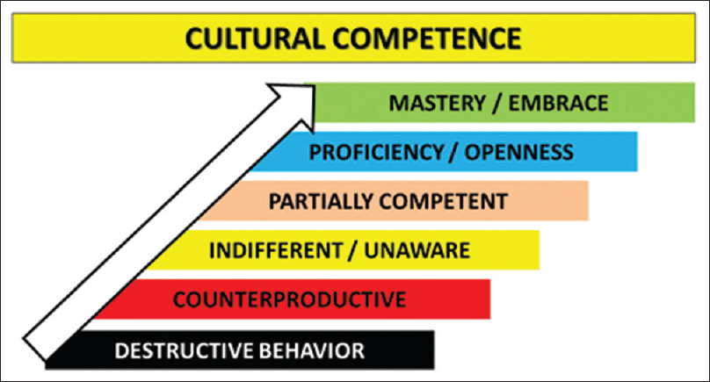
Moving Towards Mastery
http://www.ijciis.org/viewimage.asp?img=IntJCritIllnInjSci_2017_7_4_188_219948_f3.jpg

Slide 16
Qualities of an Inclusive Workplace
VALUES the individual and group differences among workers
Respects and acknowledges differences without stereotyping
Employees are judged by actions and outcomes, rather than the opinions of others. Rules are consistent for all
Accepts and embraces change
Learning environment – mentoring offered as a strength, mistakes seen as opportunities for future growth
Diversity and inclusion is a way of life
Open communication; transparent policies and procedures
https://www.mdanderson.org/content/dam/mdanderson/documents/about-md-anderson/careers/diversity-and-inclusion/ten-characteristics-of-an-inclusive-organization.pdf

Slide 17
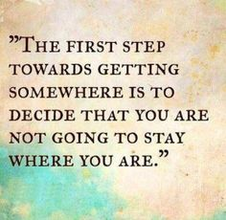
How To Get There…
Recruitment Strategies
Withholding names on resumes
Ensuring a diverse interview panel
Advertise openings in diverse media
Evaluate job descriptions for bias
Branding
Consider website, photos, messaging on jobs boards’ and the impression it makes
Advertise diversity and inclusion goals in your marketing
https://trainingindustry.com/magazine/sept-oct-2017/inclusive-workplace-practices/
http://www.greenhouse.io/blog/10-tips-to-kickoff-your-diversity-recruitment-initiative
https://www.forbes.com/sites/forbescoachescouncil/2017/08/29/want-diversity-15-recruiting-tactics-to-attract-a-wider-range-of-candidates/#12c38d2f2144

Slide 18
Pay, Promotions and Titles
Diversity in Upper Management?
Equal Pay and Titles
Ensure promotion criteria is known and based on competencies
Connect Diversity and Inclusion to performance measurements
Goal Setting
Leaders and Managers create a strategic plan to develop diversity/inclusion initiatives
Identify under-represented groups
Create an Employee Resources Group and use employee surveys to drive goal setting
Create benchmarks, timeframes and expectations for accountability
Dedicate staff to monitor progress
https://govinfo.library.unt.edu/npr/library/workforce-diversity.pdf

Slide 19
Policies and Procedures
Clear policies regarding complaint procedure, harassment and retaliation
Policies that promote work-life balance and respect religious and cultural needs
Education and Training
Beyond annual diversity or cultural competency: cover topics such as relationship building, perspective taking, unconscious bias, conflict, disability inclusion, etc.
Plan to meet regularly at all levels
Establish an employee mentoring program
https://www.eeoc.gov/eeoc/initiatives/e-race/bestpractices-employers.cfm
https://govinfo.library.unt.edu/npr/library/workforce-diversity.pdf

Slide 20
https://business.linkedin.com/talent-solutions/blog/diversity/2017/50-ideas-for-cultivating-diversity-and-inclusion-in-the-workplace

Slide 21
Thank You

