Slide 1
Stress Management
UConn Health Employee Assistance Program
Karen Annis, LCSW

Slide 2
Learning Objectives:
What is Stress?
Healthy vs. Unhealthy
Mental, Physical, Behavioral Characteristics
Effects of Stress
Unhealthy Stress Management and Warning Signs
How to Cope and Where to Seek Help

Slide 3
What Is Stress?

Slide 4
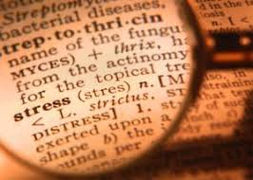
The balance between what you have to do and the resources with which you have to do it.
The mind and body’s reaction to a real or imagined threat, event, or change.
Something that threatens the body’s state of equilibrium or homeostasis.
A state of psychological tension or strain.

Slide 5
Healthy vs. Unhealthy Stress
Eustress
Positive stress
Challenges that can contribute to growth and development
Motivating
Can improve performance
Can increase self confidence
Examples: completing a project, buying a house, running a 5K, speaking in public
Distress
Pressures that are perceived to be difficult or insurmountable
Has a negative effect on person’s physical or emotional state
Person feels ill-equipped to meet demand
Decreases performance
Examples: illness, relationship problems, financial strain

Slide 7
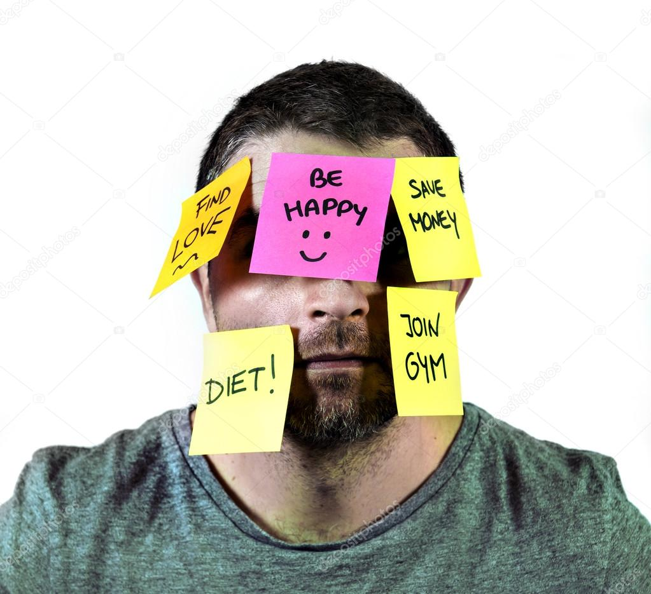
What Makes Something Stressful?
Situations with Strong Demands
Situations that are Imminent
Life Transitions
Ambiguity
Desire-ability
Control-ability

Slide 8
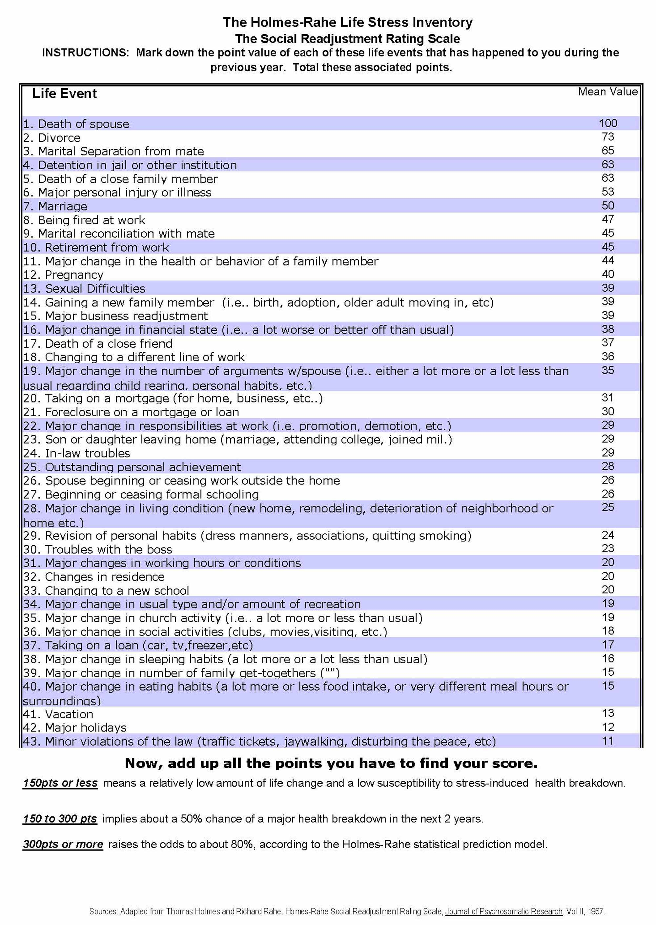
Are Your Life Stressors Adding Up?
What’s Your Score?
150 or less: Relatively low amount of life chance and low susceptibility to stress induced health breakdown.
150-300: Implies about a 50% chance of major health breakdown within 2 years.
Over 300: Raises the odds to 80%
https://www.stress.org/test/the-holmes-rahe-life-stress-inventory

Slide 9
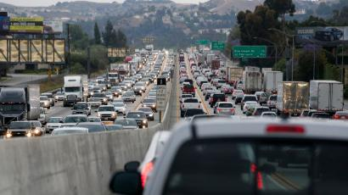
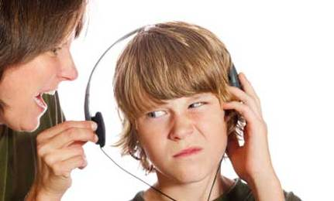
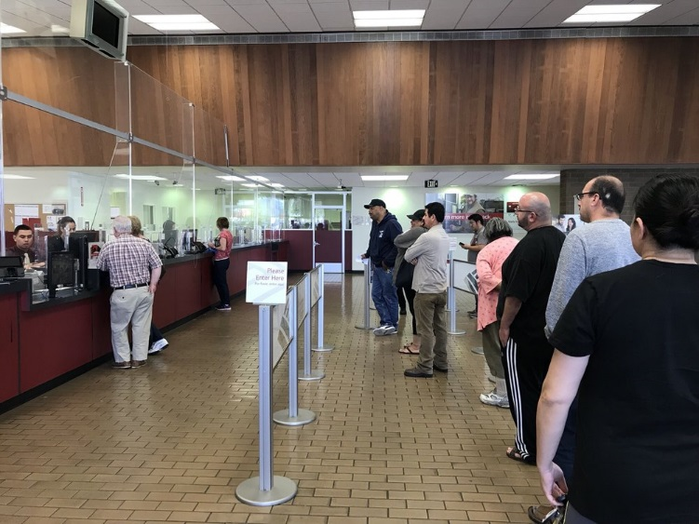
Daily Hassles Count Too!
Traffic
Running Late
Misplacing phone or keys
Long Lines
Argument with a partner
Parent/Child conflict

Slide 10
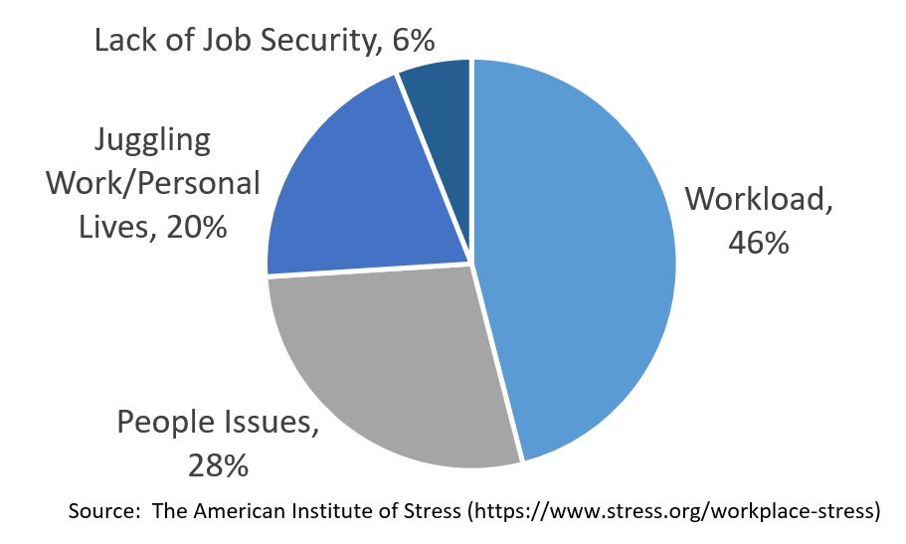
Causes of Work Related Stress
Long Hours
Heavy Work Load
Changes within the Organization
Lack of Job Security
Office Politics
Poor/Inadequate Supervision
Lack of Decision Making and Control
Lack of Acknowledgement

Slide 11
Effects of Stress

Slide 13
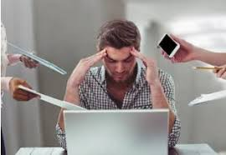
Impact in the Workplace
Increased Tardiness or Absenteeism
Increased personnel turnover
Decreased performance/productivity
Increased mistakes
Decreased quality of work
Increased unsafe work practices/accidents
Increased complaints from clients/customers
Increased anger and violence
Increased cost to company

Slide 14
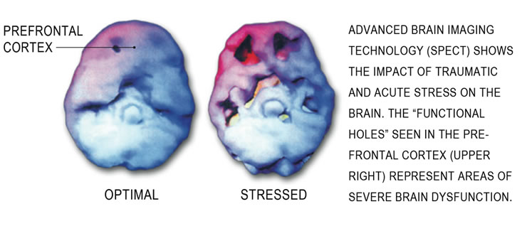
Stress’s Long Term Effects

Slide 15
When Stress Is Too Much

Slide 16
Unhealthy Ways To Manage Stress
Procrastinating
Denying/Avoiding Problems
Zoning Out (large amounts of time with TV, internet, etc.)
Not Sleeping/Sleeping Too Much
Overeating/Not Eating
Withdrawing from Activities, Family and Friends
Lashing Out in Anger or Violence
Substance Use

Slide 17
Troubled Employees: Warning Signs Can Include…
Change in behavioral patterns
Temper Tantrums/Outbursts
Frequency and Intensity of Behaviors are Disruptive to the Workplace
Blaming Others
Complaints of Unfairness
Stalking/Unreciprocated Romantic Interest/Obsessions
Property Destruction
Social Isolation
Holds Grudges
Sudden/Unpredictable Change in Energy Level
Swearing/Inappropriate Statements
History of Violence

Slide 18
What To Do? (and not do)
DO…. DON’T….
Report as soon as you become concerned Be accusatory or harsh
Get supervisors/HR involved Attempt to diagnose the problem
Focus on the specific concerns Intervene on your own
Be consistent with company policy Violate an employee’s confidentiality/ADA rights
Ensure everyone’s safety
Use EAP!

Slide 19
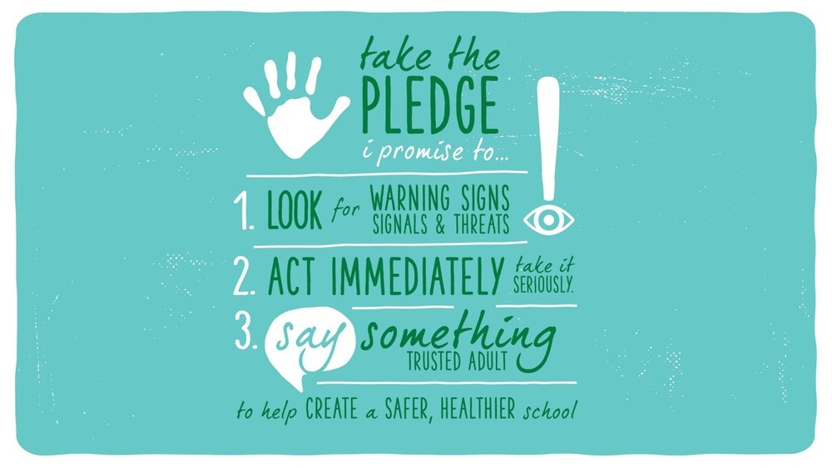
“The time to deal with a potentially serious problem is when the issue is first noticed,” said Janet Flewelling, director of human resource operations for Insperity, a provider of HR and business performance solutions.
“If you are concerned that the situation could become volatile and the well-being of the individual or others is jeopardized, you should seek assistance from your supervisor or HR immediately,” Flewelling added. “You cannot sit idly by and watch a co-worker hurt himself, cause a threat to others and/or damage the organization.”

Slide 20
How to Cope with Stress

Slide 21
How to Build Resilience Tackle Challenges!
Be Assertive
Respect Yourself and Others
Accept Responsibility for Your Actions
Actively Seek to Resolve Differences
Ask for What You Want
Be Disappointed if your “Want” is Denied without Losing Self Confidence
Stop Relying on Others’ Approval

Slide 22
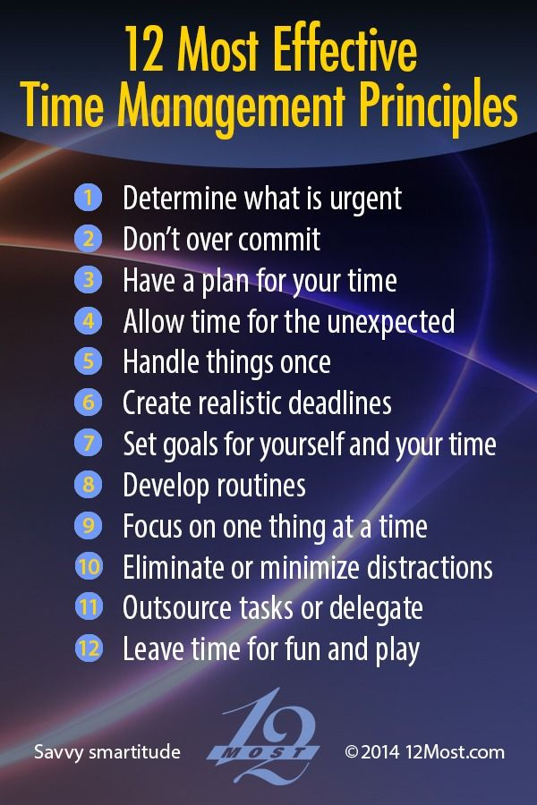
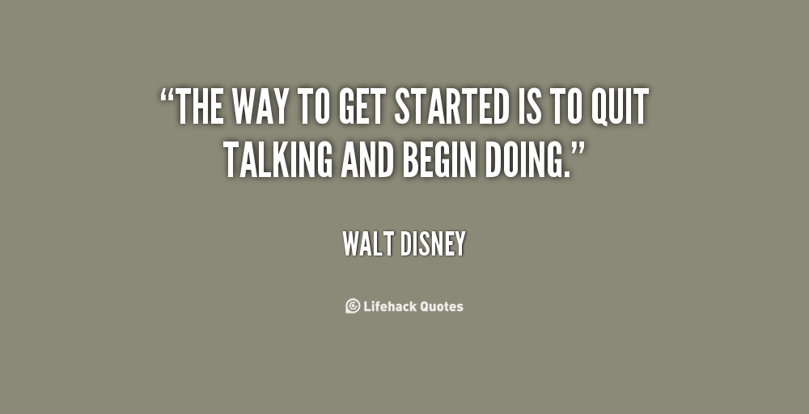
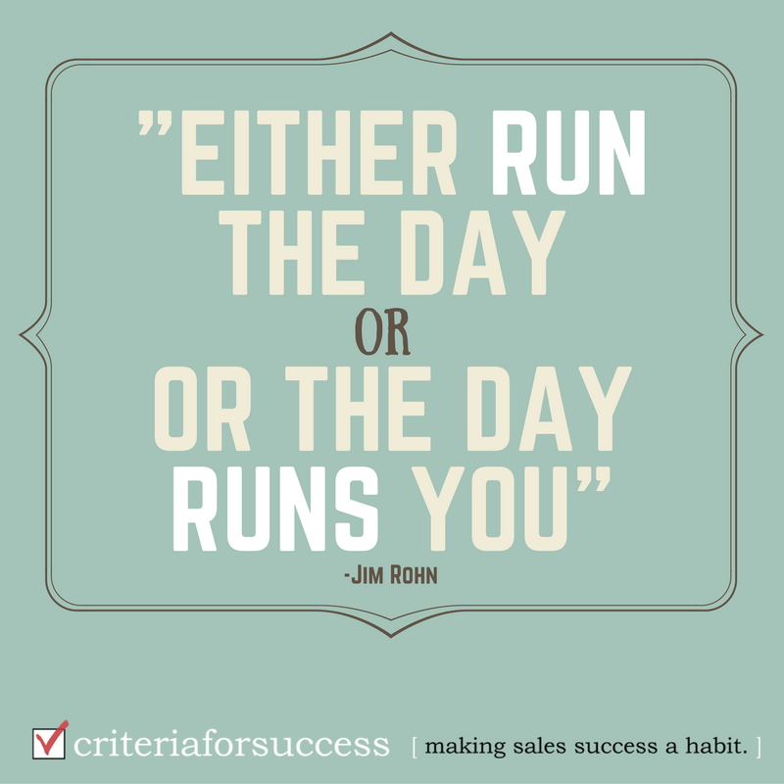
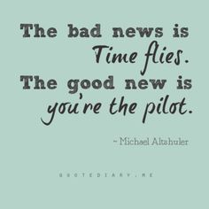
Organize and Manage Your Time

Slide 23
https://www.youtube.com/watch?v=4ixkeBWPhdI#action=share

Slide 24
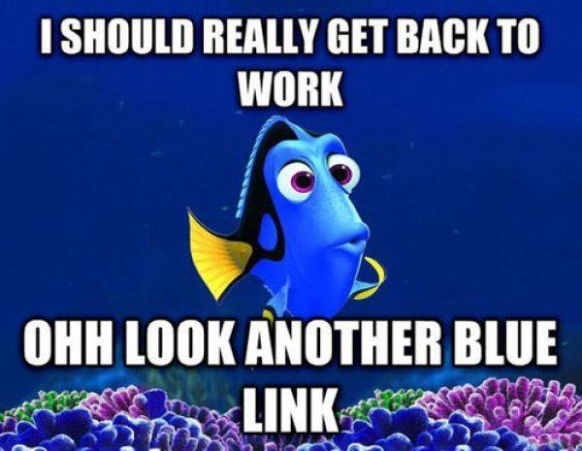
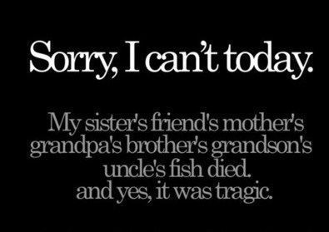
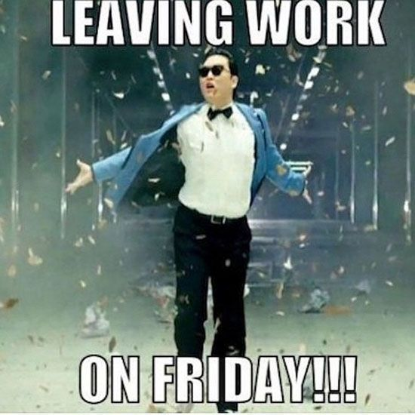
Use Humor
A Good Laugh….
Stimulates your heart, lungs and muscles and increases endorphins released from your brain.
Cools down your stress response, decreases your heart rate and blood pressure.
Can improve your immune system
Decreases pain
Increases personal satisfaction
Improves Mood

Slide 25
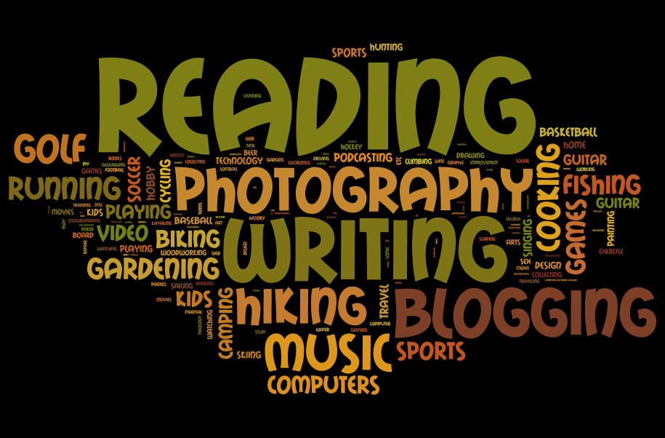
Divert, Distract and Find Meaning
In the Short Term…
Taking a time out or stepping away from the problem
Gives you a chance to ‘catch your breath’ and think more logically
Doesn’t solve the problem, but can reduce your stress level
In the Long Term…
Finding Meaningful Activities and Hobbies
Provides a “break with a purpose”
Enhances eustress and feelings of excitement
Increases social connections
Minimizes effects of chronic stress and staves off burnout
Health benefits include lowered blood pressure and decreased likelihood of depression

Slide 26
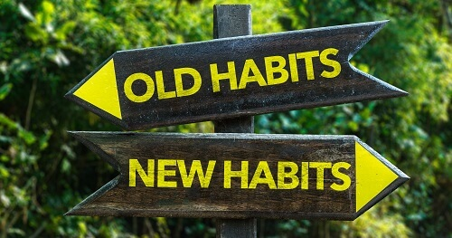
Practice Healthy Self Care Habits

Slide 27
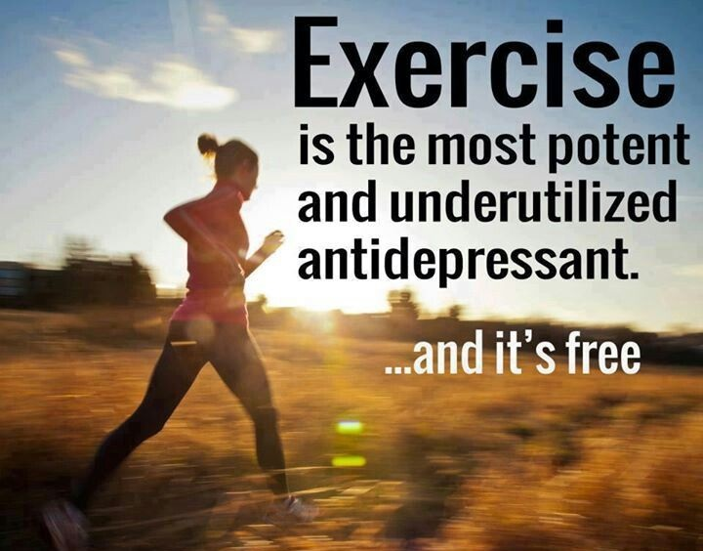
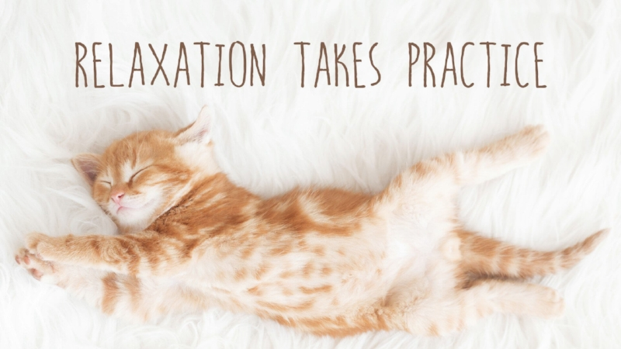
Exercise and Relax
Deep Breathing
Guided Imagery
Mindfulness
Stretch
Meditation
Journaling
Music
Muscle Relaxation

Slide 28
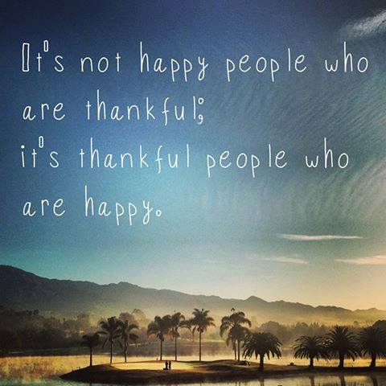
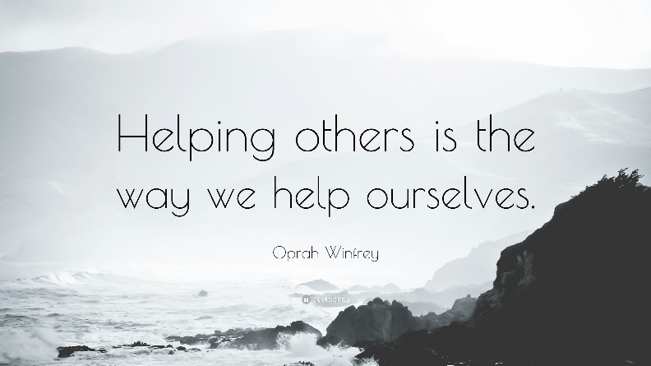
Practice Gratitude and Giving Back
Service to Others:
Decreases risk of depression
Gives a sense of purpose
Increases eustress
Helps meet others and fosters new relationships
Helps decrease stress
Increases physical and mental activity
Increases life expectancy
Gratitude:
Improves physical and emotional health
Opens to the door to more and better relationships
Increases self esteem
Improves sleep
Improves empathy and reduces aggression
Increases mental strength

Slide 29
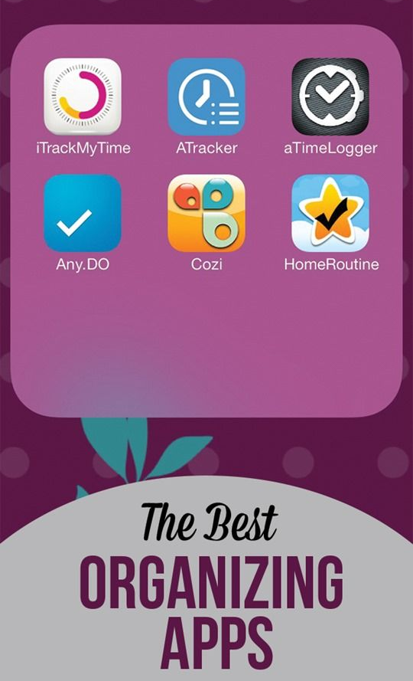
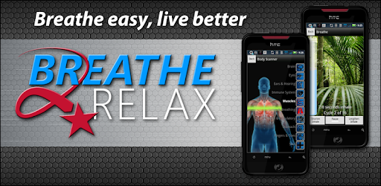
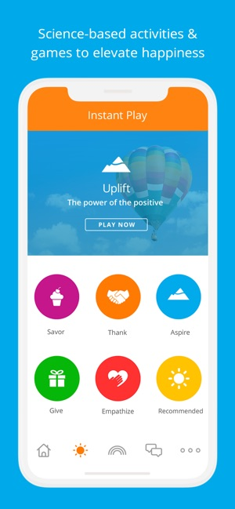
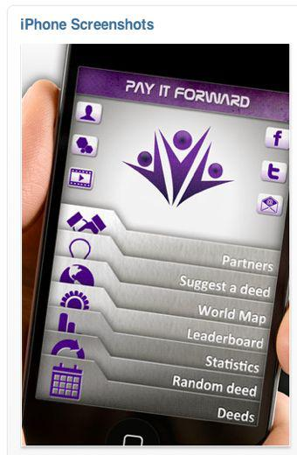
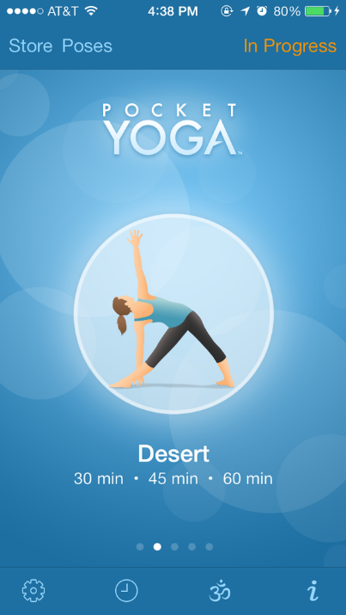
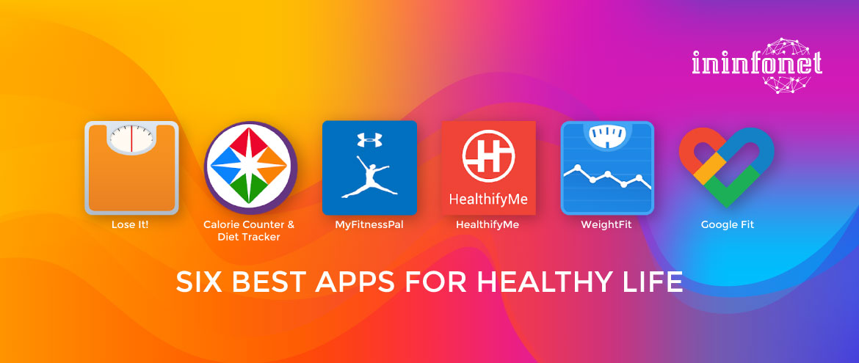
There’s an App For That!

Slide 30
Increase Support
Enlist Family and Friends
Utilize colleagues and supervisory support
Employee Assistance Program
Free and Confidential
Affiliates Statewide
Brief Counseling and Help Connecting to Long Term Support
To speak to a counselor,
call 860-679-2877
or
800-852-4392
(Connecticut toll-free)

Slide 32
References
5 Ways Humor Reduces Stress and Anxiety. Psychology of Humor. http://www.psychologyofhumor.com/2017/04/19/5-ways-humour-reduces-stress-and-anxiety-guest-article-by-marcus-clarke/
7 Scientifically Proven Benefits Of Gratitude. Psychology Today. https://www.psychologytoday.com/us/blog/what-mentally-strong-people-dont-do/201504/7-scientifically-proven-benefits-gratitude
10 Traits of Emotionally Resilient People. Psychology Today. https://www.psychologytoday.com/us/blog/design-your-path/201305/10-traits-emotionally-resilient-people
11 Daily Habits of People Who Don’t Get Stressed. Bustle.Com. https://www.bustle.com/articles/159102-11-daily-habits-of-people-who-dont-get-stressed
17 Highly Effective Stress Relievers. Very Well Mind. https://www.verywellmind.com/tips-to-reduce-stress-3145195
Avoiding Burnout: Maintaining a Healthy, Successful Career. Mind Tools. https://www.mindtools.com/pages/article/avoiding-burnout.htm
Don’t Let Life’s Hassles Become Stressors: Learn to Cope with Everyday Stresses. Psychology Today. https://www.psychologytoday.com/us/blog/cutting-edge-leadership/201210/don-t-let-life-s-hassles-become-stressors
Gomperts, R. Recognizing and Managing Stress. Stanford. http://med.stanford.edu/content/dam/sm/hrg/documents/training/RecognizingandManagingStress.ppt
Helping People, Changing Lives: The 6 Health Benefits of Volunteering. Mayo Clinic Health System. https://mayoclinichealthsystem.org/hometown-health/speaking-of-health/helping-people-changing-lives-the-6-health-benefits-of-volunteering
How Does Stress Affect the Body? Even Daily Hassles Can Hurt Your Health. University Health News. https://universityhealthnews.com/daily/stress-anxiety/how-does-stress-affect-the-body-even-daily-hassles-can-hurt-your-health/
Let’s Manage Our Stress. Slideshare. https://www.slideshare.net/chandanahewa/lets-manage-our-stress-ppt-chandana-j-hewawasam-costi-share
Managing Stress. National Alliance on Mental Illness. https://www.nami.org/Find-Support/Living-with-a-Mental-Health-Condition/Managing-Stress
Stress and Life Events. Simply Psychology. https://www.simplypsychology.org/SRRS.html
Stress Management. Trio Workshop. https://slideplayer.com/slide/6875379/
Stress vs. Anxiety: How to tell the Difference. Vertical Health, LLC. https://www.psycom.net/stress-vs-anxiety-difference
The Importance of Hobbies for Stress Relief. Very Well Mind. https://www.verywellmind.com/the-importance-of-hobbies-for-stress-relief-3144574
Violence in the Workplace: Warning Signs. Canadian Center for Occupational Health and Safety. https://www.ccohs.ca/oshanswers/psychosocial/violence_warning_signs.html
What to do When an Employee’s Behavior Changes: SHRM: Better Workplaces, Better World. https://www.shrm.org/resourcesandtools/hr-topics/employee-relations/pages/employeebehaviorchanges.aspx
Work Stress. Slideshare. https://www.slideshare.net/bishwa/stress-in-work-presentation

