Slide 1
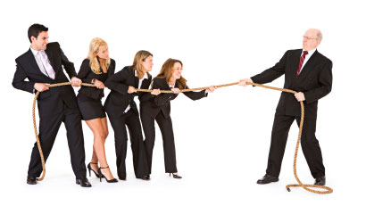
Managing Conflict
Kelly Huffman, LPC, CEAP
Employee Assistance Program
Notes:
1

Slide 2
Agenda
Introduction
Overview of Conflict
Conflict Management Styles
Tips for Resolving Conflict
Summary
Notes:
2

Slide 3
Conflict
Definition: Fight, battle, struggle, controversy
Conflict can be internal, interpersonal, inter-group, or intra-group.
While conflict may be uncomfortable, much of the conflict we have is healthy.
It is not conflict that tears people apart, it is the way in which conflict is handled.

Slide 4
Why is Conflict a Problem?
Creates stress and tension in the workplace that leads to lowered productivity
Interferes with effective teamwork (i.e. others feel as if they must take sides)
Can lead to unprofessional behavior in front of customers and colleagues
If ignored, conflict can escalate into behaviors which violate policies on harassment and workplace violence

Slide 5
Goals of Conflict Management
Helping all parties to feel heard and respected
Increased tolerance and valuing of differences
Reducing aggressive, passive, covert or manipulative behavior
Making clear decisions
Helping to arrive at an agreement with the best possible outcome for everyone

Slide 6
Tip of the Iceberg
CONFLICT
Goals
Styles
Past experience with conflict
Past experience with this person
Values
Worldviews

Slide 7
Conflict Management Styles

Slide 8
In small group:
Describe the approach this animal represents.
What are the advantages/disadvantages of this style?
When might be an appropriate time to use this style?
Which style might be most challenging for you to work with? What could you do to work better with this style?

Slide 9
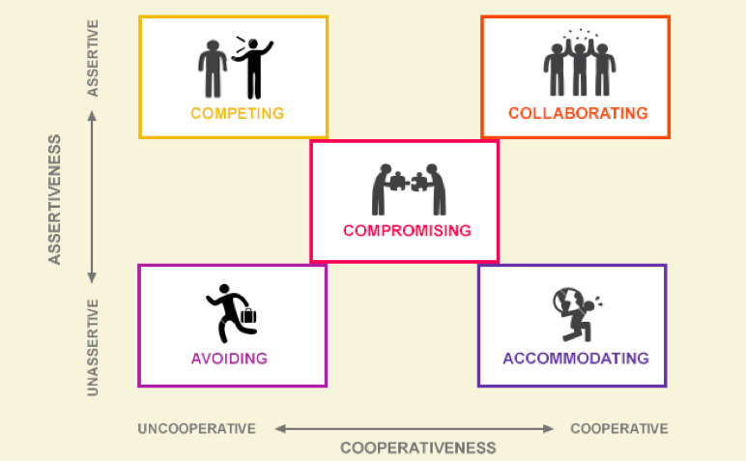
Five Styles of Conflict Management
Thomas-Kilmann Conflict Instrument

Slide 10
Which one is best?
There is no BEST way to handle conflict. Every situation is different and therefore may require a different response.
“Two heads are better than one.” (Collaborating)
“Kill your enemies with kindness.” (Accommodating)
“Split the difference.” (Compromising)
“Leave well enough alone.” (Avoiding)
“Might makes right.” (Competing)

Slide 11
Communication
Communication is the process used to send and
interpret messages so that they are understood.
Many conflicts can be resolved with respectful communication

Slide 12
Elements of Communication
Words (7%)
Tone/Volume/Tempo(38%)
Body Language (55%)
It’s not what you say, it’s how you say it!

Slide 13
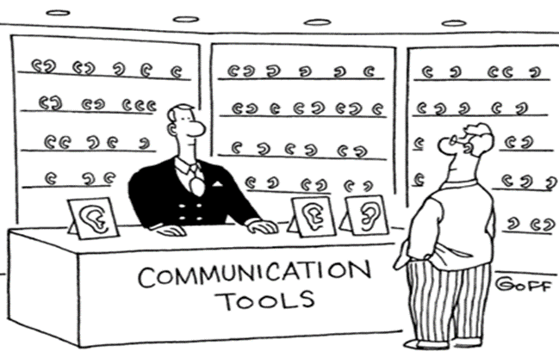
Validation, then Resolution
Basic human need: I am of worth, my feelings matter, and someone really cares about me
If you take time to validate someone’s experience, it will likely make your interaction much more positive
Requires excellent listening skills

Slide 14
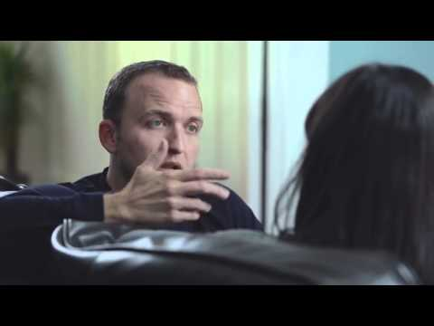

Slide 15
Assertive Problem Solving
Assertive
Expressing
Mutual Solution
Finding
Listening
3-Part “I” Message
1. Behavior
2. Feeling
3. Effects
“When I See…I Feel…Because…”
Or “I Feel…When…and I Need….”
Notes:
15

Slide 16
Guidelines for Giving and Receiving Feedback
Giving Feedback
Use “I” statements
Be specific
Address one issue at a time
Be honest
Consider time and place
Focus on behavior, not person
Give both positive and constructive feedback
Be aware of your non-verbal messages
Receiving Feedback
Listen actively (make eye contact, resist distractions, etc.)
Acknowledge/encourage the speaker
Observe non-verbal cues
Ask questions for clarification
Check out your understanding
Seek to understand before being understood
Notes:
16

Slide 17
Proactive versus Reactive Language
REACTIVE
You
Have to
Need
You make me
They are getting me
They cause it to be
Can’t
Should have
Ought to
PROACTIVE
I
Choose to
Want
I make me
I am getting (myself)
I let it be
Won’t
Didn’t
Want to

Slide 18
Positive Language
Instead of…
Try this…
No, I can’t do that. Can’t you see I’m busy??
Why are you asking me? Carol is just sitting around.
The support staff should have done that. It’s not my problem.
There’s nothing I can do.
Stop taking out your stress on me. I can only do so much in one day.
Sarah is so lazy. She never helps us out when we need her.
I’ll be glad to do that as soon as I finish with…
Would you mind checking to see if Carol has time to help you? I’m involved in …. right now.
Let me see how we can get that done. We’ll talk with the secretaries later.
There must be something we can do.
It’s really busy today. Can we take a few minutes to prioritize what needs to be done?
Sarah, I would really appreciate it if you volunteered to help when we are busy.

Slide 19
Use Safety Net Phrases
“This is obviously very important to you.”
“Here’s what we can do.”
“I’m sorry you feel this way.
“Let’s take a break and think this through before figuring out next steps.”
“Perhaps we need to agree to disagree.”

Slide 20
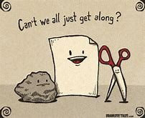
Fouls in Conflict
Putting down the other person
Threatening
Bossing
Making excuses
Blaming
Getting even
Name calling
Not taking responsibility for your own behavior
Not listening
Bringing up the past
Physical contact i.e. hitting, pushing
Notes:
20

Slide 21
Trouble Words
Threatening others by saying “if” followed by “you.”
Blaming and shaming others by asking “why” followed by “can’t, won’t or don’t.”
Using “never, ever, or always” to describe other people’s behavior.
Making global statements about a person’s character by saying “you” followed by a negative noun, adjective, or phrase.

Slide 22
The Conflict Escalator
Every behavior leads to either a step up or a step down the conflict escalator.
Behavior that makes the conflict worse will take it another step up the escalator.
Every step up the conflict escalator has feelings that go with it.
As the conflict escalates, so do the feelings.
No one gets on the escalator empty handed. They always have a suitcase.
That’s the baggage they bring to the conflict.
The higher you go on the escalator, the harder it is to come down.

Slide 23
Coming down the Conflict Escalator
C
A
P
S
C=Cool Off/Take a Time Out
A=Agree to Work It Out
P=Share Point of View
S= Brainstorm Solutions

Slide 24
Helpful Attitudes in Conflict Management
Accept that conflict is normal.
Take responsibility for your own feelings and behaviors.
Treat everyone with respect, even if you don’t like their behavior.
Try to understand the other person’s side by listening carefully and hearing them out.
Understand that avoiding conflict can be more stressful than confronting it.
Notes:
24

Slide 25
Alone we can do so little;
Together we can do so much.
Helen Keller

