Slide 1
Leading Others Through Change

Slide 2
Agenda
Overview of Change
Change versus Transition
Teams in Transition
Approach to Change
Summary

Slide 3
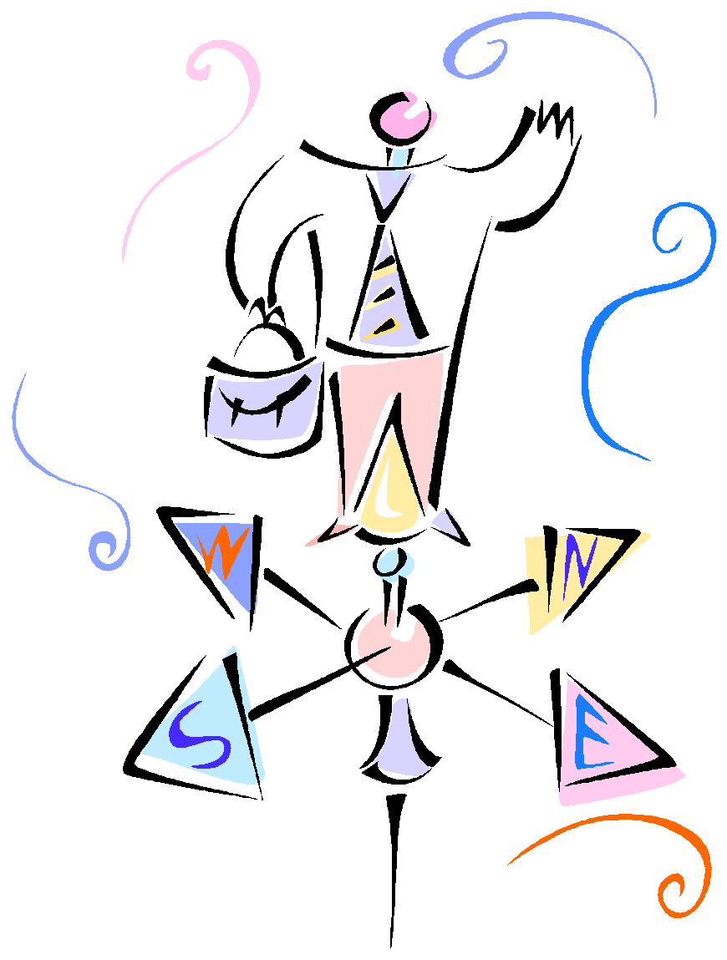
Change . . .
Part of life
Impossible to avoid
Creates stress
Involves both loss and growth
Can be a crisis and an opportunity

Slide 4
Change versus Transition
Change is situational and is external to us
i.e. new job/boss, marriage, death of a loved one, divorce, birth of a child, downturn in economy, move to a new place, illness
Transition is the process of adapting to the change

Slide 5
Think about the times you’ve moved
How long did it take for you to move your “stuff” from point A to point B?
How long did it take you to feel at home?
Change is an event; Transition is a process

Slide 6
Common Reactions to Change
Denial
Resistance
Isolation
Sadness
Detachment
Anger
Interpersonal conflicts
Communication issues
Insecurity
Loss of Control
Decreased motivation
Wish for things to go back to how they were
Reactions to change are individual and depend on a variety of factors, such as life experience, personal values, cultural background, gender influences, personality style, and stage of life

Slide 7
Dynamics of Change
No matter how exciting or necessary the change….
There is a sense of Loss
No matter how skilled people are….
There is a sense of Confusion and Uncertainty
To varying degrees and at various stages….
Expect Resistance
No matter how carefully the change was implemented ...
People will feel a loss of control

Slide 8
Losses Associated with Change
Loss of the Known and Tried
Loss of Control
Loss of Structure
Loss of Predictable/Comfortable
Loss of Future
Loss of Attachments
Loss of Turf
Loss of Meaning
Loss of Future

Slide 10
Reflecting/Anticipating Changes
Identify workplace changes that have occurred over the past year
Staffing
Roles/responsibilities
Quantity of work
Type/methods of work
Technological changes
Challenging events
Celebrations/accomplishments
What changes do you anticipate in the next 6 months?

Slide 11
Teams in Transition
Just as each person has his/her own individual reaction to change, the team is going through a similar transition
The four main stages of teams in transition are:
Denial, Resistance, Exploration, and Commitment
People on the team may be in different stages at the same time

Slide 12
Denial
Employees attempt to deny or minimize the impact of the change
Signs of denial may include people avoiding the topic, going through the motions, pretending nothing is happening
You may hear:
“They don’t really mean it”
“They’ll go back to the old way”
“It’s no big deal; everything will be fine”

Slide 13
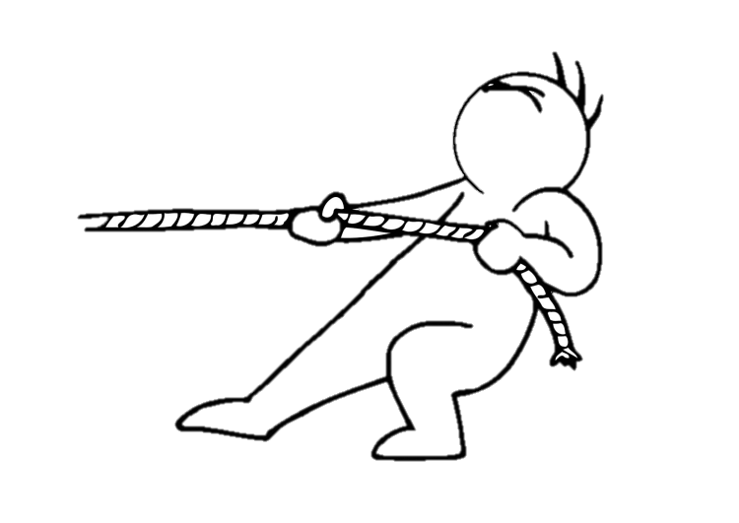
Resistance
Denial is often followed by a period of resistance, when things seem to get worse, and people may feel increasingly apprehensive and irritated
Signs of Resistance may include mistakes, careless work, anger, low energy, distraction
You may hear:
“They can’t do this to me! It isn’t fair!”
“This should never have happened.”
“I’m afraid I won’t be able to do this”

Slide 14
Exploration
People begin to shift to a more positive, optimistic phase and feel more confident that they will survive the change. They feel more motivated to explore new possibilities
Signs of Exploration may include confusion, increased training, trying new things
You may hear
“I’ve got an idea to try.”
“Maybe this will work out after all.”
“This works better than the old way.”

Slide 15
Commitment
In this final stage, a new sense of cohesion starts to emerge. People are ready to work together to create new stability. There is a sense of pride in having mastered the challenge
Signs of Commitment may include independent decision making, cooperation and improved teamwork
You may hear:
“We’ve come a long way.”
“How can we work together on this?”
“We’re going to be the best team around.”

Slide 16
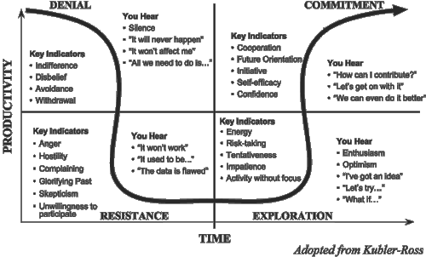

Slide 17
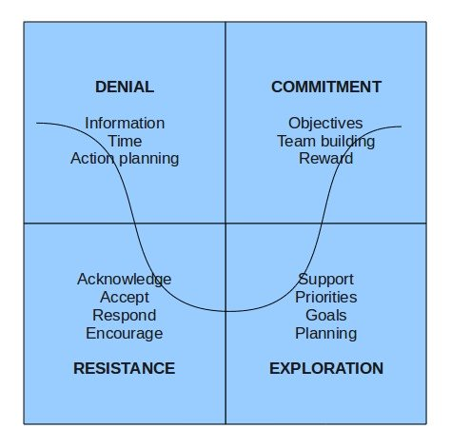
What employees need in each stage…

Slide 18
Helping Employees Through Change
Provide information – Communicate, communicate, communicate!
Explain how the change fits into the overall mission
Ask for questions, concerns, feelings, opinions
Resist becoming defensive
Be visible and involved
Look for opportunities for employee input
Recognize individual differences
Be patient!

Slide 19
What to Avoid
Autocratic behavior
Avoiding employees
Dismissing other’s concerns
Rah! Rah! Jumping ahead too quickly
Assuming others will react the same way you do to change
Ignoring your own needs
Going it alone

Slide 20
As you face changes in your life…
Look at what’s ending and acknowledge your losses
Understand and try to accept that there will be periods of uncertainty and heightened emotion
Look to your experience in dealing with change in the past to help deal with present changes
Adopt the attitudes and behaviors that can help you move forward in a positive direction
Identify what you can control and what you cannot
Choose to take action on the things you can, and let go of the things you can’t

Slide 21
Remember. . .
Smooth seas do not make skillful sailors.
~African Proverb

