Slide 1
Dealing with Difficult Behaviors
Employee Assistance Program

Slide 2
Agenda
Overview of Difficult Behavior
Common Types of Difficult Behavior
Tips for Handling
EAP as a resource
Summary/Questions

Slide 3
Challenges in Managing People
Conflict is a natural part of life
Avoiding conflict usually makes things worse
Managers spend 20-40% of their time on interpersonal issues
Requires skill and patience!

Slide 4
What is Difficult Behavior??
Difficult…hard to endure, comprehend, satisfy, manage, persuade
Usually ingrained and inflexible
Repeated, patterns of behavior which interferes with relationships
Matter of Perception…difficult or different??

Slide 5
What Causes Difficult Behavior??
Learned Behavior, has been reinforced
Person doesn’t know any other way to get needs met (need to be in control, recognized, valued, etc.)
Unaware of how behavior affects others
The cause may not always be clear

Slide 6
Types of Difficult Behavior
Aggressive/hostile
Negative/pessimistic
Withdrawn/passive
Opinionated and defensive
Overly agreeable but does not deliver

Slide 7
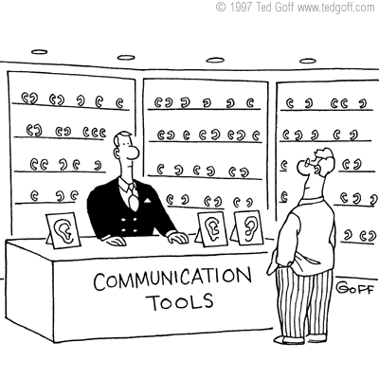
Addressing Behavior
Be honest and direct
Be specific
Be aware of your non-verbal messages
Listen carefully
Validate their point of view

Slide 9
Addressing Behavior
Stay focused
Talk about their strengths
Ask open-ended questions
Describe your expectations
Close/document the meeting
Follow HR policies

Slide 10
Dealing with Anger: De-Escalate
Move to a quiet, more private area
Keep your voice even/calm
Express your desire to work on the issue
Refrain from:
Minimizing the concern
Patronizing/talking down
Ramping up/yelling
Becoming defensive

Slide 11
Assertive Problem Solving
Mutual Solution
Finding
Assertive
Expressing
Listening
Use a three part “I” Message
1. Describe behavior of concern. Connect to work performance/environment.
2. Explain how the behavior makes you feel
3. Explain the effects of the behavior and express what you need from the person
“When I See…I Feel…Because…”
Or “I Feel…When I See…and I Need….”
“When you come in late for our staff meetings, I feel frustrated, because it delays the meeting or I have to repeat things to you later. I’d really like for you to be on time for the meetings. How can we resolve this issue?”
Notes:
11

Slide 12
Safety Net Phrases
“This is obviously very important to you.”
“Here’s what we can do.”
“I’m sorry you feel this way.
“Let’s take a break and think this through before figuring out next steps.”
“Perhaps we need to agree to disagree.”

Slide 13
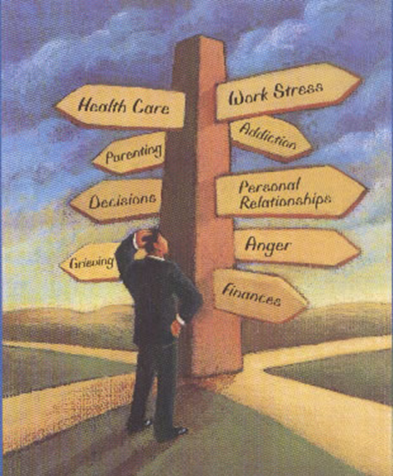
What the EAP Offers
Service for any problem
Free, confidential counseling
Quick, convenient appointments
Availability to family members
Consultation/Training for Managers

Slide 14
Types of Referrals
Self-referrals: employees call the EAP for assistance on their own.
Management referrals:
Informal – Manager or Supervisor suggests the EAP when aware that an employee is going through a difficult situation. The employee does not have performance or attendance issues.
Formal – Manager or Supervisor refers an employee during the course of a discussion about performance or attendance problems.

Slide 15
Signs and Symptoms
Attendance
Quantity of work
Quality of work
Concentration/Memory
Work Relationships
Mood/Behavior
Safety

Slide 16
Steps for a Formal Referral
Observe
Document
Discuss
Refer*
Follow-up
*If you have made a formal referral to the EAP, please call us and let us know. For formal referrals, we will let you know whether the employee contacts us and keeps his/her EAP appointments

Slide 17
Summary
Take steps to address behaviors that affect work performance
Remember everyone has certain strengths; be sure to acknowledge those: “Catch em doing something right”
Treat everyone with respect, even if you don’t like their behavior
Model the behavior and attitude you expect from others
Seek support/guidance when necessary

