Slide 1
Coping with Change
Subtitle

Slide 2
Learning Objectives
Defining Change
Identifying the Emotional States of Change
Learning why we resist Change
Understanding Change vs. Transition
Coping and Resilience Building

Slide 3
What Is Change

Slide 4
Change....
Is a normal part of everyone’s life
Makes things more difficult in the short run
Disrupts our comfort zone
Can undermine our need to feel valued or in control
Involves both loss and growth
Is normal to resist
Can be an opportunity for immense growth

Slide 5
Emotional Stages Of Change
Subtitle

Slide 6
Immobilization
Difficulty Focusing
Nothing seems to ‘sink in’
Feelings of Disbelief
Not knowing what to do next

Slide 7
Denial
“This Will Never Happen”
“They might start this, but it will never be implemented”
“I won’t really have to do this”
Ignoring discussions pertaining to change
Not participating
Focusing on the way things were
Fearing the future

Slide 8
Anger
Inability to see anything positive about the change
Sharing negative perceptions publicly or privately
Resistance
Strained relationships
Communication Problems
Illnesses, Accidents, Mistakes
Decrease in productivity
Blames others

Slide 9
Reluctant Acceptance and Exploration
Beginning to ask questions about future and how we fit
Increased participation and information sharing
Accepting the change is inevitable
Shifting away from feeling victimized
Change is a reality to be faced, rather than a danger to be avoided

Slide 10
Commitment and Growth
Sees positive attributes to the change
Feels a sense of accomplishment
Support resource to others going through a similar change
Identifying new opportunities that may arise as a result of the change

Slide 11
Why We Resist….
Lack of Information: We don’t see the need for change
Confusion: Unclear how to change/lack direction
Loss: We don’t want to lose power, security or comfort
Fear of Inadequacy: We are afraid we can’t do what is needed
Overwhelm: Feels like change is too big and we won’t be successful
We Fear Losing:
‘Turf’
Status
Power
Responsibility
Entitlement
Meaning or Purpose
Structure and Routine
Control, Choice
Relationships, group memberships
Familiarity

Slide 12
Change Versus Transition
Change is situational and is external to us
i.e. new job/boss, marriage, death of a loved one, divorce, birth of a child, immigrating to a new country, downturn in economy, move to a new place, illness, etc.
Transition is the process of adapting to the change

Slide 14
Coping In Times Of Change

Slide 15
Coping with Change Exercise

Slide 16
Ask Yourself…
Why am I resisting this change? What’s my biggest fear?
Have I ever experienced something like this before? How did I get through it then?
What do I need to do now to manage this change?
What can I control?
What is out of my control?
What do I need to learn?

Slide 17
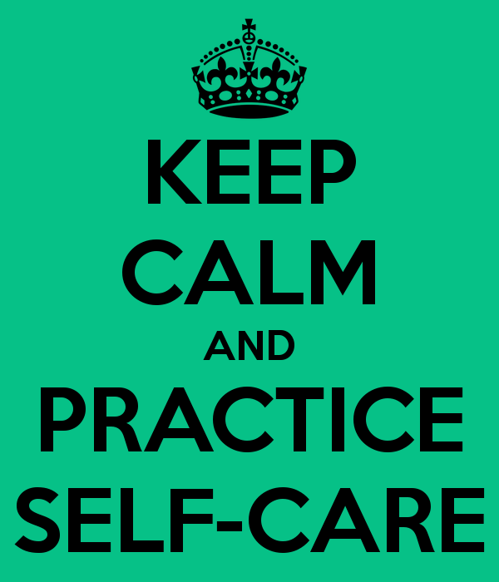
Practice Self Care
Maintain good habits – exercise, rest, nutrition, relaxation
Connect with your support network
Take a break from the change
Use Humor
Keep a journal
At the end of each day, focus on something positive that happened

Slide 18
Building Resilience
Self Assurance:
Seeing the world as complex and challenging but filled with opportunity
Positive self perception
Confidence in ability to meet challenges
Personal Vision
Knowing what you believe in & what you want to accomplish
Being hopeful in adversity
Having a purpose which carries you forward
Flexibility
Sensitive to the need to change
Able to shift gears in response to what is happening
Remaining true to yourself while making room for others’ ideas

Slide 19
Building Resilience
Organized
Creating structure and methods for achieving goals
Setting realistic goals for yourself and others
Managing tasks with calm and clarity of purpose
Problem Solver
Thinking critically and creatively
Collaborating with others
Anticipating setbacks and planning for missteps
Viewing failures as opportunities for future growth
Interpersonal Competence
Demonstrating empathy for others
Displaying self-awareness, self control, and social awareness
Ability to laugh at oneself
Ability to forgive others

Slide 20
Building Resilience
Socially Connected
Can reach out to others for support and problem solving
Can build bridges and develop common ground
Contributes to the welfare of others – giving of yourself
Proactive
Focusing on actions you can take rather than waiting for others to act
Asks for information
Expresses needs and concerns in a positive way
Generates a list of personal options in times of change
Assessed personal skills and future needed skills that could be developed

Slide 21
Self Assessment
What Characteristics of Resilience do I Recognize in Myself?
What Characteristics Would I Like to Cultivate?
What Qualities Can I Apply as Part of My Current Action Plan?
What Self Care/Coping Skills Could Help Me Move Forward?

Slide 22
Growth In Change
Subtitle

Slide 23
Adaptation and Growth – How Will I Know When I’m There?
More willing to take a risk and try something new
Higher energy level, feeling more positive
Better attitude/morale
Envisioning the future and its possibilities
Renewed productivity
Increased feelings of pride
Decreased stress
“Let’s see what can be done about this”
“I have some ideas about how this could go”
“This might be a good thing after all”
“I think I can make this work if I…”

Slide 25
To Summarize, When Things Change….
Look at what’s ending and acknowledge your losses
Understand and try to accept that there will be periods of uncertainty and heightened emotion
Look to your experience in dealing with change in the past to help deal with present changes
Realize the attitudes and behaviors that can help you move forward in a positive direction
Identify what you can control and what you cannot
Choose to take action on the things you can, and let go of the things you can’t

Slide 26
Struggling with change? The EAP can help!
Manage emotional conflicts, feelings and grief regarding change.
Assist you in finding coping strategies, ways to increase resilience and to thrive!
Be a resource to help you make a successful transition through change!
Remember the eap is:
Confidential
Available at no charge
Available to you and your immediate family members
To Make a Confidential Appointment, Call: 860-679-2877

Slide 28
References
Blackman, Andrew. 10 Tips for Dealing with Difficult Changes in Work & Life. Tuts+. December 31, 2018. https://business.tutsplus.com/tutorials/dealing-with-changes--cms-32333
Hartley, Jeanne. Personal Change. Slideserve. https://www.slideserve.com/cullen-head/personal-change
Russell, Jeffery. Developing Your Resilience. Slideshare. November 24, 2009.
The 7 Emotional Phases Employees Go Through During Change. LaMarsh Global. December 12, 2018.
https://insights.lamarsh.com/the-7-emotional-phases-employees-go-through-during-change

