Slide 1



Dealing with Difficult Behaviors
Employee Assistance Program

Slide 2


Facts about Difficult Behavior
Usually ingrained and inflexible
Is frequently learned, repeated, patterned behavior
Matter of perception
Often a defense for fear, feeling out of control, feeling disrespected

Slide 3
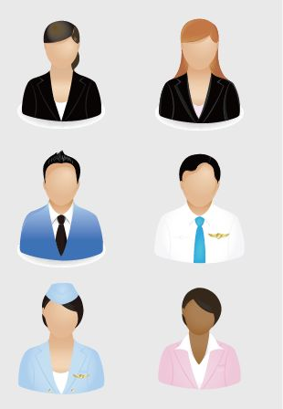
Why are some people difficult?
They don’t know what to expect in a situation
They feel ignored
They feel they are being treated unfairly or rudely
They feel that they have no control over a situation
They feel no one cares
They feel that you don’t care
They feel afraid

Slide 4

Common Types of Behaviors of “Difficult People”
Angry/Hostile -responds in anger, sarcasm
Bullies – intimidating, aggressive
Complainers- gripe about things they don’t like, but rarely try to change the situation
Silent types - don’t say much; rarely say more than “yes” or “no”

Slide 5
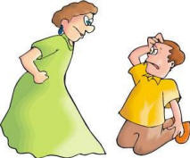
Common Types of Behaviors of “Difficult People”
Passive Aggressive - seem to agree with everyone, but don’t do what they say they will
Naysayers– always negative, respond to new ideas with “that won’t work”
Procrastinators- stall, unable to make a decision

Slide 6

Common Types of Behaviors of “Difficult People”
Know-it-Alls - are condescending and full of themselves
Backstabbers – underground communicators, gossip, water cooler conversations “indirect”
Gunny Sackers- hold “laundry list” past resentments, then fight about everything in past, laundry list of complaints

Slide 7
Who is the most difficult for you?
Consider the type of person you have the most difficulty with. How do you feel when and/or act when dealing with this person?
Reflect about the type of person that has the most difficulty with you. What are some of the cues that this person is frustrated with about your style?

Slide 8
Dealing with Difficult Behaviors
Angry/Hostile Behavior
Strategies:
Reframe hostility as fear to depersonalize it.
Remain calm and polite. Keep your own temper in check. Use “reflective listening”.
Don’t disagree, and build on what has been said.
Maintain eye contact while you speak.
Always allow the other person a graceful retreat a way from the interaction.

Slide 9
Dealing with Difficult Behaviors
Demanding/Bullying Behavior
Strategies:
Be Prepared (research, anticipate questions etc. ).
Deflect the attack.
Stand firm and hold your ground, verbally and visually. Try and use the person’s name.
Remember, when the bully is done talking, the conversation is over (in their eyes).

Slide 10
Dealing with Difficult Behaviors
Complainer Behavior
Strategies:
Try to hear them out and get them involved in reaching resolution.
Listen openly-use active listening techniques.
Don’t pass judgment. Make sure you understand
the complainer’s point of view.
Engage them in the problem solving process.
Determine the mutual desired outcome.

Slide 11
Dealing with Difficult Behaviors
Silent Behavior
Strategies:
Ask them the steps that are necessary to solve this problem.
Be patient with the silence and wait for their response.
Silence may be uncomfortable.

Slide 12
Dealing with Difficult Behaviors
Passive Aggressive Behavior
Strategies:
Make it clear that disagreement is ok.
Ask for help in solving the problem.
Stay focused and be careful not to challenge too strongly.
Value and encourage any differences.
Respectfully listen to their input “That’s a good point. I hadn’t thought about that”.
Remember this type of behavior may indicate the person’s greatest discomfort is interpersonal conflict.

Slide 13

Dealing with Difficult Behaviors
Naysayer Behavior
Strategies:
Highlight benefits of the change.
Support the resistance.
Redirect to the sought after goal.

Slide 14

Dealing with Difficult Behaviors
Procrastinator Behavior
Strategies:
Assign clear task responsibility with deadlines.
Break larger project into smaller steps and measure progress on these goals.
Maintain regularly scheduled supervision sessions.
Assign specific leadership tasks to this person with accountability for results.

Slide 15
Dealing with Difficult Behaviors
The Know It All
Strategies:
Be prepared and make sure you have your facts right.
Practice active listening including paraphrasing to confirm your understanding.
Try not to be confrontational. Explore options with them.
Be careful. .. “Know It All’s” can take criticism personally and go on the attack.
Deal with this person alone, when possible. Ego is the Know-It-All’s main asset.

Slide 16
Dealing with Difficult Behaviors
Backstabber
Strategies:
Remember, they are usually not interested in a direct confrontation. Be direct when the behavior takes place.
Use declarative statements to verify or acknowledge your perception of the remark: “That sounded like a dig to me”. Then move on.
Don’t fight back. If the tactic was a sarcastic remark, try not to respond in kind. Remember it takes two to keep the conflict going.

Slide 17

Dealing with Difficult Behaviors
Gunny sackers
Strategies:
Stay focused on the problems to be addressed.
Talk about the problem, issue, etc. not the person.
Keep redirecting to the subject at hand. Communicate on one point at a time.
Resist temptations to get off the subject even issues that seem related can be distracting.

Slide 18
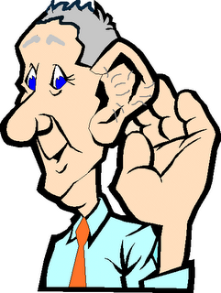
Other Tips on Dealing with Difficult Behavior
Use Active listening techniques
Give your full and undivided attention.
Use their name.
Face and look at the person.
Listen.
Remain neutral.
  Reflect what you heard; get confirmation that the message you received is correct.

Slide 19

Other Tips (cont.)
Assertive Communication
Use “I” statements.
Focus on behavior, not person.
Clearly, honestly and directly describe behavior of concern.
Express your needs and expectations.
Establish clear limits and consequences.
Be aware of your non-verbal messages.

Slide 20

Other Tips (cont.)
Use “Safety Net” Phrases
  “This is obviously very important to you.”
  “Here’s what we can do.”
  “I’m sorry you feel this way. What can we do to change that?”
  “Perhaps we need to agree to disagree.”

Slide 21
Other tips (cont.)
Use the “feel, felt, found” technique
  “I think I understand how you feel.”
  “Other people have told me they felt that way too.”
  “I’ve felt that way too when…”
  And “what they found … “what I found was ...”
Change the physical setting
  Offer a drink of water.
  Move to a quiet and private area.
  Ask person to sit down.

Slide 22
Summary
Each person is responsible for their own behavior.
Everyone is someone’s difficult person at one time or another.
Remember everyone has certain strengths; try to focus on those rather than the difficult behaviors.
Accept what you can’t change; change what you can; know the difference.

Slide 23


Resources
Dealing with People You Can’t Stand
Dr. Rick Brinkman and Dr. Rick Kirschner
Thank You for Being Such a Pain
Mark Rosen, PhD
Dealing with Difficult People
Roberta Cava
The Complete Idiot’s Guide to Dealing with Difficult Employees
Robert Bacal

Slide 24
For more information, contact…
UCHC Employee Assistance Program
Elizabeth Robinson, Manager
robinson@nso.uchc.edu
or call 860-679-2877
Ct toll free: 800-852-4392

