Slide 1
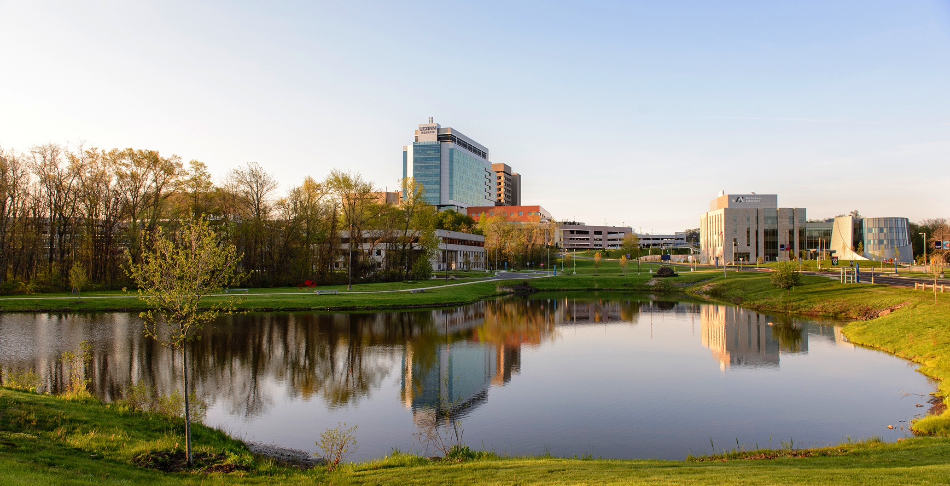
PhD Completion Workshop
January 13, 2025

Slide 2
Degree Requirements
Earn the minimum number of required course and research credits
Have an overall GPA of at least 3.0
Complete non-credit milestones (Plan of Study, General Exam, Dissertation Proposal)
Research accomplishments (advisory committee)
Pass the public defense
Submit the written dissertation

Slide 3

Steps to Graduation
A helpful step-by-step guide
  https://registrar.uconn.edu/graduation/doctoral-degrees/

Slide 4
Registration in the Final Semester
If you complete within a semester, you must still maintain full-time registration in the Graduate School
  At least 6 credits per semester for a Graduate Assistant (GA)
  At least 9 credits per semester for a T32/90 or F30/31 student
  Consult your AoC for their journal club guidelines in the final semester
If you complete before the 10th day of the spring 2025 or fall 2025 semester, do not enroll in classes for that semester

Slide 5
Dissertation Proposal
The Dissertation Proposal is a brief description of your project
Approvals are required for animal subjects (IACUC), human subjects (IRB) and/or human stem cells (SCRO)
Instructions are found on our Graduate School Student Page in the “For All Graduate Students” section under “Milestones/Completing Your Degree”. The form is found under “Graduate School Forms”
  https://health.uconn.edu/graduate-school/current/
The approved Dissertation Proposal and Form must be filed in the UConn Registrar’s office by the time you announce the Public Defense date

Slide 6
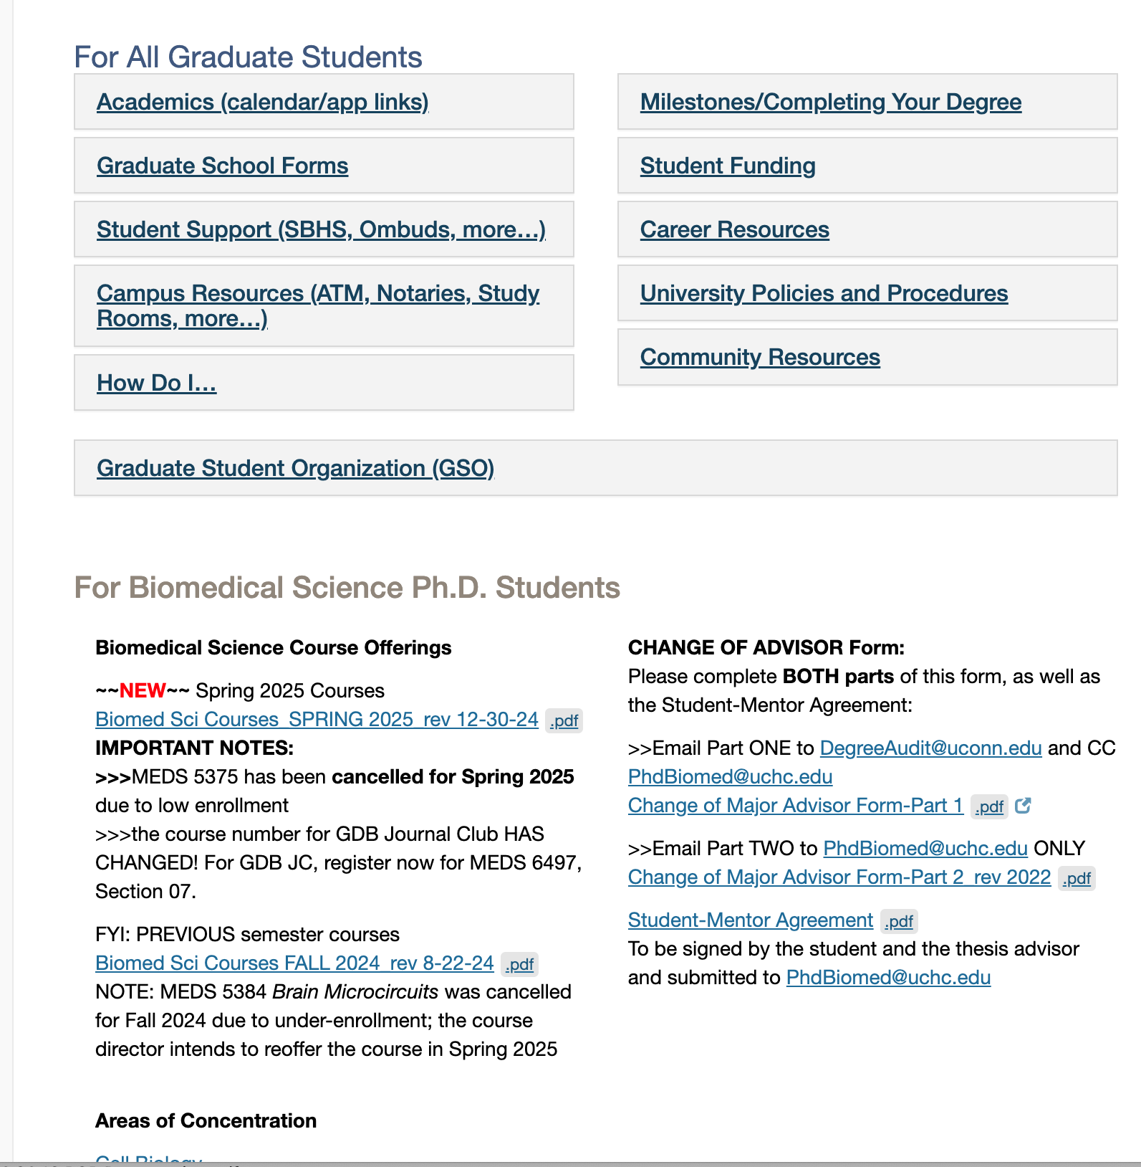

Slide 7
Notations for Dissertation Proposal
Completed – You’re all set
In Progress – Something may still be needed (such as approvals for animals, stem cells, human subjects) or it still has to be reviewed

Slide 8
Dissertation Specifications
Instructions for preparing the written dissertation
  https://registrar.uconn.edu/graduation/doctoral-degrees/#dissertation-information

Slide 9
Final Examination (Public Defense)
After the private defense, announce the public defense in the University Events Calendar at least 2 weeks in advance, Step 6 at https://registrar.uconn.edu/graduation/doctoral-degrees/
When posting the defense, make it sharable and/or add UConn Health Graduate School as an additional calendar for posting

Slide 10
Final Examination (Public Defense)
At least 5 faculty members including all members of the Advisory Committee must attend the public defense
The public defense can be in person, hybrid or virtual (consult with your advisor and AoC)
The dissertation and public defense are approved using a single, online webform Defense and Final Thesis/Dissertation Approval

Slide 11
Degree Conferral Dates
May, August, December
Each has a deadline for submission of dissertation and final paperwork
Consult the Academic Calendar for these dates

Slide 12
Commencement
There is only one commencement ceremony (May)
You are invited to walk at the ceremony if you are a:
  A December 2024 graduate
  A May 2025 graduate
  A prospective August 2025 graduate*

Slide 13
What is Your Completion Date?
The day you submit your dissertation and final paperwork
If completing within an academic semester, file a Request for an Alternate Completion Date form in the “Forms for All Graduate Students” section on https://grad.uconn.edu/forms/ listing the date of submission of your dissertation and final paperwork as your completion date
If completing during the winter intersession or summer, your completion date will automatically be the date you submit your thesis and final paperwork. Therefore, do not file an alternate completion date form.

Slide 14
International Students
Please contact the international office well in advance of graduation to apply for OPT
You will need to need to indicate a completion date in the OPT paperwork

Slide 15
Your GA
Your GA will end on your completion date (the day you submit your dissertation)
Please notify Charley Rowland as soon as possible when you know what the submission date will be, and notify him again on the date of submission
  Notifying Charley after the fact may result in an overpayment that you must return to the university

Slide 16
Final Graduate Assistant Payments
The final GA paycheck will be issued 2 weeks and 1 day after the last day of the pay period in which you complete.
  It will be for the number of days from the first day of the pay period in which you complete up to and including your completion date
A hardcopy (paper) check will be mailed to your mailing address on file in the Human Resources record; the last check will not be direct deposited

Slide 17
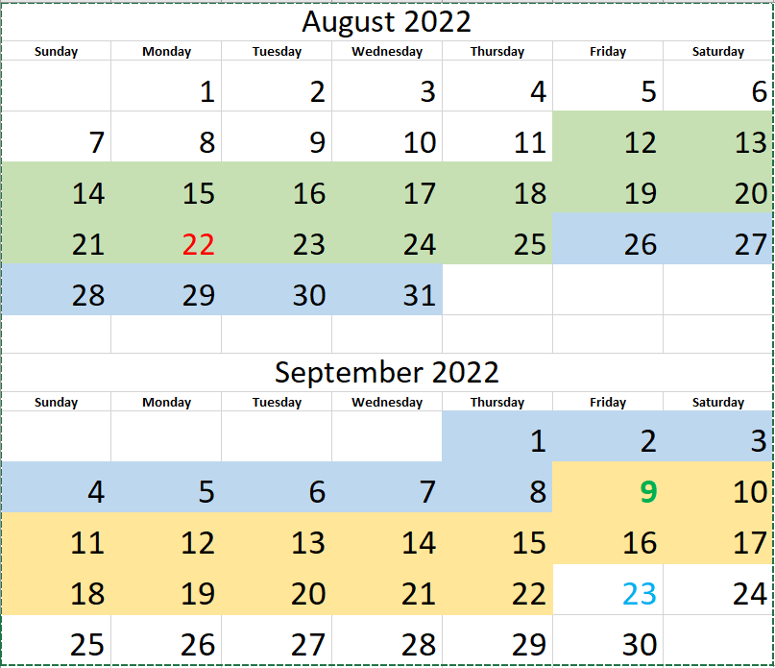

Slide 18
Starting Paycheck – Example
Three pay periods shown: 8/12 – 8/25, 8/26 – 9/8, and 9/9 – 9/22
First day on payroll (start of Orientation): 08/22/2022
First paycheck received: 9/9/2022 (for 4 days, 8/22 – 8/25)
First full paycheck received: 09/23/2022 (for 2 weeks, 08/26 – 09/08)

Slide 19
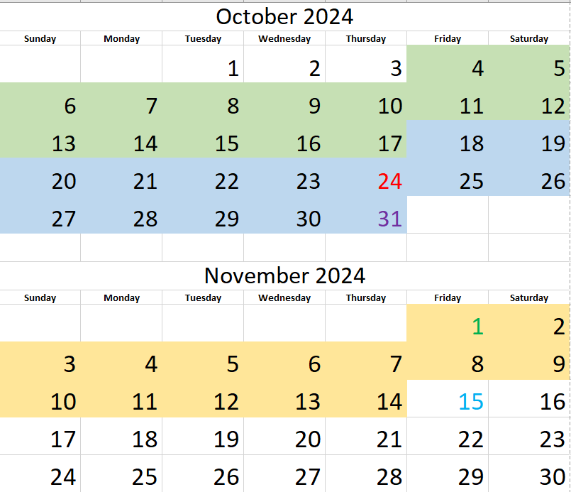

Slide 20
Ending Paycheck – Example
Three pay periods shown: 10/4 – 10/17, 10/18 – 10/31, and 11/1 – 11/14
Last day on payroll (submission date): 10/24/2024
Last paycheck mailed (paper check to mailing address): 11/15/2024 for 5 days 10/18 – 10/24
Last day covered under the Graduate Assistant Health Plan: 10/31/2024
COBRA Notice mailed from Anthem after the last paycheck on 11/15/2024

Slide 21
Mailing Address
Keep your mailing address up-to-date in the Student Admin System
If you move, update your mailing address promptly
  In the Student Administration System
  With Human Resources
  With your department administrator

Slide 22
A Few Other Things
If you are at JAXGM, please discuss your completion plans with Sarah Wojiski (sarah.wojiski@jax.org)
Please complete the electronic exit interview form on the Student page https://health.uconn.edu/graduate-school/current/
Contact Dr. Kream directly at kream@uchc.edu if you wish to schedule an in-person exit interview

Slide 23
Approvals for Non-Credit Milestones
All members of a student’s advisory committee must provide an original signature in one of the ways (signatures may be on different pages and/or come from multiple faculty emails)
  Wet ink (signed, scanned and emailed to jenn.horan@uconn.edu)
  Electronic signatures
  Email
Do not submit any hard copies to the Registrar’s Office

Slide 24
Electronic Signatures
Attach completed document in an email to the advisory committee members and copy jenn.horan@uconn.edu
Electronic signatures can be via DocuSign or an Adobe Verified Signature
Approvals typed with a Microsoft font should be accompanied by a reply all email noting advisor’s approval

Slide 25
Email Approval
Attach completed document in an email to the advisory committee members, copy jenn.horan@uconn.edu and request that the committee reply all on their approval
Approval emails must come from the advisor’s university email
External advisors should reply all from their university email

Slide 26
Helpful Hints
Save copies of all forms and materials you submit
Check your transcript often for completion of milestones and missing grades
Reach out to your advisor and instructors if you are missing grades
Carefully review the instructions for preparing the dissertation
Be familiar with the completion steps and submission deadlines
Read your emails for any changes to processes

Slide 27
Degree Completion Letter
Students who have accepted a post-doctoral fellow position (or job) are required to show proof of completion doctoral degree program requirements before the beginning of employment.
During the degree audit process, you can request an “enrollment verification letter including the completion date and the degree conferral date” by sending an e-mail request to jenn.horan@uconn.edu.
This request is submitted after submission of your dissertation and is usually received within 7 to 10 business days after the request is made.

Slide 28
Helpful Links
Academic Calendar
  https://registrar.uconn.edu/academic-calendar/
Forms
  https://grad.uconn.edu/forms/
  https://health.uconn.edu/graduate-school/current/
Steps to Graduation
  https://registrar.uconn.edu/graduation/doctoral-degrees/

Slide 29
You have lots of support
The Graduate Office
Advisors and mentors
Stephanie Rauch, Student Affairs Officer rauch@uchc.edu
Charley Rowland, UConn Health Bursar Representative chrowland@uchc.edu
UConn Health Registrars, registrar@uchc.edu
Kailtin Dornenburg, UConn Health International Office dornenburg@uchc.edu
Megan Petsa, UConn Director of Graduate Student Admin Support, megan.petsa@uconn.edu
Jenn Horan, UConn PhD degree auditor, jenn.horan@uconn.edu

