Slide 1
Biomedical Science PhD Program Information Session 2024

Slide 2
Biomedical Science is a UConn Graduate School Program
The University of Connecticut is a community of scholars and researchers committed to integrity, freedom of inquiry and intellectual pursuit, respect for individuals and the rights of others, and tolerance for both individual differences and differing points of view
(UConn Graduate Catalog)

Slide 3
Over 900 Students on the UConn Health Campus
Biomedical Science (PhD, dual degree)
Public Health (MPH, PhD)
Clinical and Translational Research (MS)
Dental Science (MS)
Graduate certificate programs
MD program
DMD program

Slide 4
Biomedical Science Program Learning Objectives
Demonstrate broad and discipline-specific scientific knowledge
Develop and apply critical thinking skills to conceive, perform and evaluate the results of independent research
Acquire professional skills to effectively communicate research questions, experimental approaches and results
Conduct research and academic work with the the highest ethical standards

Slide 5
Biomedical Science Areas of Concentration
Biomedical Science is an “umbrella” program - students select a major advisor and an area of concentration after the first year
Cell Biology
Genetics & Developmental Biology
Immunology
Molecular Biology & Biochemistry
Neuroscience
Skeletal Biology & Regeneration
Systems Biology

Slide 6
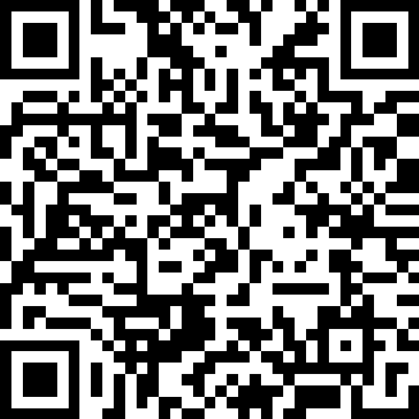
Research Themes
Cell Biology
Reproduction, cancer, vascular and cardiovascular biology
Genetics & Devel Biology
Genomics, RNA processing, signal transduction, aging
Immunology
Cancer immunology, infectious diseases, autoimmunity, metabolism
Molecular Biology & Biochemistry
Cancer, computational biology, microbiology, structural biology
Neuroscience
Synaptic plasticity, sensory systems, regeneration, glial biology, visual system
Skeletal Biology & Regeneration
Bone, cartilage, regeneration, fracture repair, biomaterials, mineralization
Systems Biology
Modeling, optical imaging, omics analysis, signal transduction, cytoskeletal dynamics

Slide 7
The Jackson Laboratory for Genomic Medicine
Genetics
Genomics
Cancer biology
Bioinformatics
Computational Biology
https://www.jax.org/personalized-medicine/the-jackson-laboratory-for-genomic-medicine

Slide 8
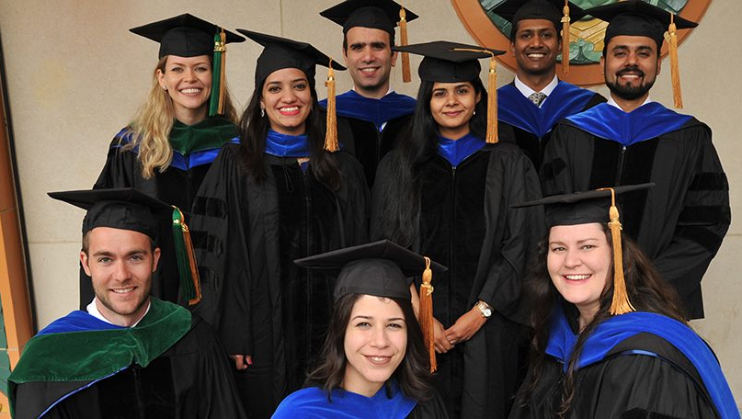
Academic Requirements and Milestones
At least 30 course credits (15 with a master’s)
At least 15 research credits
General Examination
Dissertation proposal
Dissertation and public defense

Slide 9
Program Structure
Year 1
Coursework
First Year Graduate Experience Course
Year 2
Advanced Coursework
Begin Dissertation Research
Years 3…
Dissertation Research
Public Defense and Written Dissertation
General Examination
Publications and Presentations
Responsible Conduct in Research

Slide 10
First Yeat Graduate Experience Course
Block 1
August – September
Area of Concentration Exploration
Block 2
September – December
Lab Rotation 1
Block 3
January – March
Lab Rotation 2
Block 4
March – May
Lab Rotation 3
Graduate Seminar
Graduate Seminar
Graduate Seminar
Graduate Seminar

Slide 11
Program Outcomes
~5.5 years time to degree
~3-4 publications
~4 conference presentations

Slide 12
Financial Support
12-month graduate assistantship currently at $39,100
Waiver of tuition; fees paid on your behalf
Excellent health and dental insurance plans
Funds to attend scientific meetings and short courses
Continuing support contingent on satisfactory progress

Slide 13
Career and Professional Development
Communications skills
CV and resume preparation
Conflict management
Career talks

Slide 14
Student Wellness
Student Behavioral Health Service
Free, confidential counseling for UConn Health students
Wellness Center
Exercise machines, free weights, showers, etc for students, faculty and staff

Slide 15
Graduate School - Diversity, Equity and Inclusion

Slide 16
Application and Admissions
All applications are submitted through the SLATE portal
Application fee is $75
Application deadline is December 1, 2024, for Fall 2025 matriculation

Slide 17
Application Components
Transcripts from all programs
English proficiency (international applicants)
Personal Statement
CV/Resume
3 Letters of recommendation
Interview (if selected)
GRE tests are not required

Slide 18
Admissions process
Faculty from each area of concentration serve on the admissions committee
Each application is reviewed by members of the admissions committee
Selected applicants are invited for virtual interviews
After interviews, selected applicants are offered admissions with funding

Slide 19
Admission Metrics
Cumulative GPA of 3.0 for the most recent degree
English proficiency for international applicants
100 on the TOEFL iBT, or
7.0 on the IELTS Academic test, or
120 on the Duolingo, or
68 on the PTE

Slide 20
Admissions Considerations
Research Experience technical skills, presentations, publications
Personal Attributes curiosity, resilience, teamwork
Academic Preparation grades, coursework
Program Fit research interests, community

Slide 21
Admissions Considerations
Academic Preparation grades, coursework

Slide 22
Admissions Considerations
Research Experience technical skills, presentations, publications

Slide 23
Admissions Considerations
Personal Attributes curiosity, resilience, teamwork

Slide 24
Admissions Considerations
Program Fit research interests, community

Slide 25
Helpful tips
Personal Statement – be clear and concise; express your motivation for seeking the PhD and articulate your research experiences
CV/Resume – present a well-organized, concise summary of your education, training and experiences
Letters of Recommendation – seek letter writers who know your research capabilities

Slide 26
Application Timeline
Application Deadline – December 1
Initial Review – December
Virtual Interviews – January/February
Final Decisions – February/March
Accepted Student Days – March

Slide 27
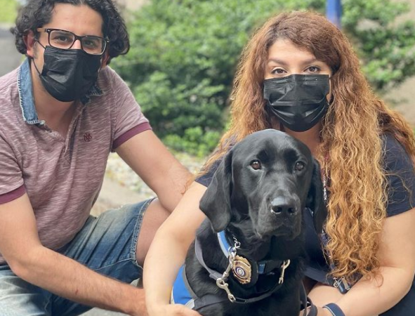
Visit our website for information
BiomedSciAdmissions@uchc.edu

