Slide 1
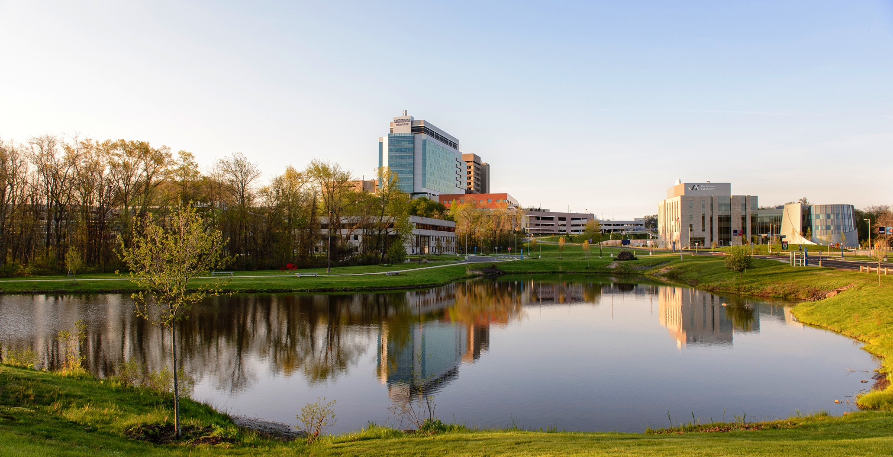
PhD Completion Workshop January 22, 2024

Slide 2
Registration in the Final Semester
If you complete within a semester, you must still maintain full-time registration in the Graduate School
At least 6 credits per semester for a Graduate Assistant
At least 9 credits per semester for a T32 or F30 student
Consult your AoC for their journal club requirement in the final semester
If you complete before the 10th day of the fall or spring semester, do not enroll in classes for that semester

Slide 3
Steps to Graduation
Helpful step-by-step guide
https://registrar.uconn.edu/graduation/doctoral-degrees/

Slide 4
Degree Requirements
Completion of all required coursework on the Plan of Study
A sufficient number of course and research credits
An overall GPA of at least 3.0
Completion of all non-credit milestones (Plan of Study, General Exam, Dissertation Proposal)
Completion of the public defense
Submission of the dissertation

Slide 5
PhD Non-Credit Milestones
Documented on your transcript
Plan of Study
General Examination
Dissertation Proposal

Slide 6
Dissertation Proposal
The Dissertation Proposal must be filed in the UConn Registrar’s office by the time you announce the Public Defense date
Brief description of your research project
Approvals are needed for any animal subjects, human subjects or human stem cells (IACUC, IRB or SCRO)
Approvals of the proposal include your Advisory Committee and the GPC Chair (review committee)
Instructions are posted on our Graduate School Current Student Page in the “For All Graduate Students” section under “Forms”
https://health.uconn.edu/graduate-school/current/

Slide 7
Notations for Dissertation Proposal
Completed – You’re all set
In Progress – Something may still be needed (such as approvals for animals, stem cells, human subjects) or it still has to be reviewed

Slide 8
Dissertation Specifications
Instructions for preparing the written dissertation
https://registrar.uconn.edu/graduation/doctoral-degrees/#dissertation-information

Slide 9
Final Examination (Public Defense)
After the private defense, announce the public defense in the University Events Calendar at least 2 weeks in advance, Step 6 at https://registrar.uconn.edu/graduation/doctoral-degrees/
When posting the defense, be sure to make the event sharable and/or add UConn Health Graduate School as an additional calendar for posting

Slide 10
Final Examination (Public Defense)
At least 5 faculty members including all members of the Advisory Committee must attend the public defense
The public defense can be in person, hybrid or virtual (consult with your advisor and AoC)
The dissertation and public defense are approved using a single, online webform Defense and Final Thesis/Dissertation Approval

Slide 11
Degree Conferral Dates
May, August, December
Each has a deadline for submission of dissertation and final paperwork
Consult the Academic Calendar for these dates

Slide 12
Commencement
There is only one commencement ceremony (May)
You are invited to walk at the ceremony if you are a:
May degree conferral
Previous December degree conferral
Prospective August degree conferral

Slide 13
What is Your Completion Date?
The day you submit your dissertation and final paperwork
If completing within an academic semester, file a Request for an Alternate Completion Date form in the “Forms for All Graduate Students” section on https://grad.uconn.edu/forms/ listing the date of submission of your dissertation and final paperwork as your completion date
If completing during the winter intersession or summer, your completion date will automatically be the date you submit your thesis and final paperwork. Therefore, do not file an alternate completion date form.

Slide 14
International Students
Please contact the international office well in advance of graduation to apply for OPT
You will need to need to indicate a completion date in the OPT paperwork

Slide 15
Your GA
Your GA will end on your completion date (the day you submit your dissertation)
Please notify Charley Rowland as soon as possible when you know what the submission date will be, and notify him again on the date of submission
Notifying Charley after the fact may result in an overpayment that you must return to the university

Slide 16
Final Graduate Assistant Payments
The final GA paycheck will be issued 2 weeks and 1 day after the last day of the pay period in which you complete.
It will be for the number of days from the first day of the pay period in which you complete up to and including your completion date
A hardcopy (paper) check will be mailed to your mailing address on file in the Human Resources record; the last check will not be direct deposited

Slide 17
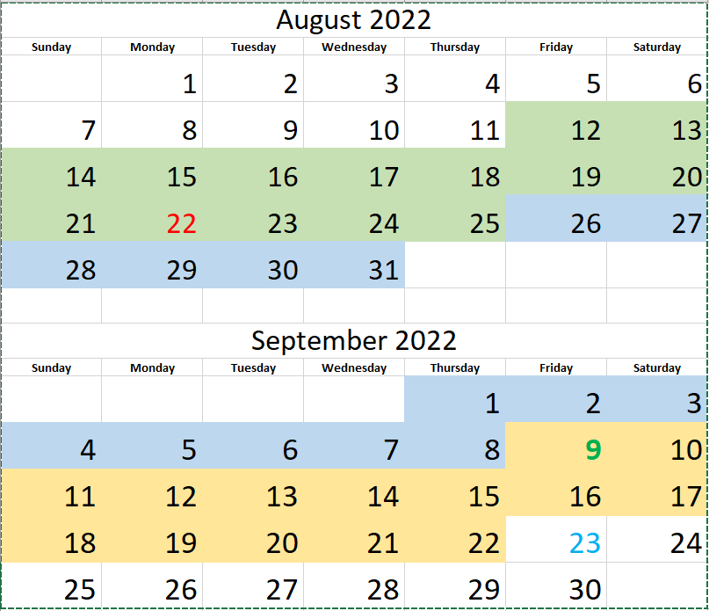

Slide 18
Starting Paycheck – Example
Three pay periods shown: 8/12 – 8/25, 8/26 – 9/8, and 9/9 – 9/22
First day on payroll (start of Orientation): 08/22/2022
First paycheck received: 9/9/2022 (for 4 days, 8/22 – 8/25)
First full paycheck received: 09/23/2022 (for 2 weeks, 08/26 – 09/08)

Slide 19
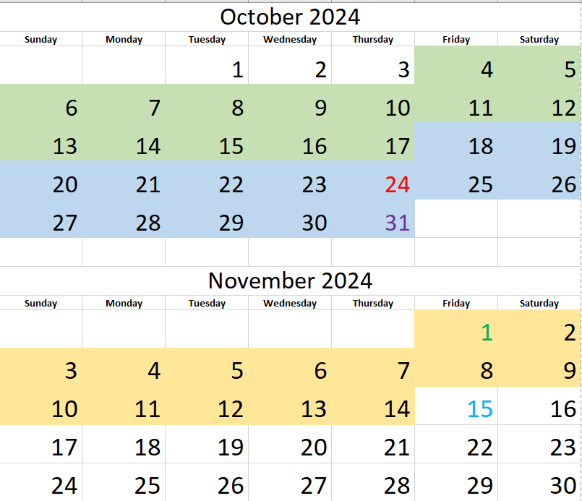

Slide 20
Ending Paycheck – Example
Three pay periods shown: 10/4 – 10/17, 10/18 – 10/31, and 11/1 – 11/14
Last day on payroll (submission date): 10/24/2024
Last paycheck mailed (paper check to mailing address): 11/15/2024 for 5 days 10/18 – 10/24
Last day covered under the Graduate Assistant Health Plan: 10/31/2024
COBRA Notice mailed from Anthem after the last paycheck on 11/15/2024

Slide 21
Mailing Address
Keep your mailing address up-to-date in the Student Admin System
If you move, update your mailing address promptly
In the Student Administration System
With Human Resources
With your department administrator

Slide 22
A Few Other Things
If you are at JAXGM, please discuss your completion plans with Sarah Wojiski (sarah.wojiski@jax.org)
Please complete the electronic exit interview form on the Current Student page https://health.uconn.edu/graduate-school/current/
Contact Dr. Kream directly at kream@uchc.edu to schedule an in person exit interview

Slide 23
Approvals for Non-Credit Milestones
All members of a student’s advisory committee must provide an original signature in one of the ways (signatures may be on different pages and/or come from multiple faculty emails)
Wet ink (signed, scanned and emailed to jenn.horan@uconn.edu)
Electronic signatures
Email
Do not submit any hard copies to the Registrar’s Office

Slide 24
Electronic Signatures
Attach completed document in an email to the advisory committee members and copy jenn.horan@uconn.edu
Electronic signatures can be via DocuSign or an Adobe Verified Signature
Approvals typed with a Microsoft font should be accompanied by a reply all email noting advisor’s approval

Slide 25
Email Approval
Attach completed document in an email to the advisory committee members, copy jenn.horan@uconn.edu and request that the committee reply all on their approval
Approval emails must come from the advisor’s university email
External advisors should reply all from their university email

Slide 26
Helpful Hints
Save copies of all forms and materials submitted to the registrar or degree auditor
Check your transcript often for completion of milestones and missing grades
Reach out to your advisor and instructors if you are missing grades on your transcript
Carefully review the instructions for preparing the dissertation
Be familiar with the completion steps and submission deadlines
Read your emails for any changes to processes

Slide 27
Helpful Links
Academic Calendar
https://registrar.uconn.edu/academic-calendar/
Forms
https://grad.uconn.edu/forms/
https://health.uconn.edu/graduate-school/current/
Steps to Graduation
https://registrar.uconn.edu/graduation/doctoral-degrees/

Slide 28
You have lots of support
The Graduate Office
Advisors and mentors
Stephanie Rauch, Student Affairs Officer rauch@uchc.edu
Charley Rowland, UConn Health Bursar Representative chrowland@uchc.edu
Becky Straub, UConn Health Registrar, rstraub@uchc.edu
Kailtin Dornenburg, UConn Health International Office dornenburg@uchc.edu
Megan Petsa, UConn Director of Graduate Student Admin Support, megan.petsa@uconn.edu
Jenn Horan, UConn PhD degree auditor, jenn.horan@uconn.edu

