Slide 1
BR15: I’m a Great Coordinator! How Can I Share My Ideas?
Martha Wilkie Melissa Demetro
Program Manager Program Coordinator
GME Office GME Office

Slide 2
Disclosure
No conflicts of interest to report

Slide 3
Session Outline
Introduction
Coordinator Training and Mentoring
Tracking (numbers, vacation time, resident stipend, scholarly activity, demographics)
Resident wellness
We want to hear your ideas during this session!

Slide 4
About Us
Martha Wilkie
▫ GME Office Program Manager
▫ Previous coordinator for Radiology
Melissa Demetro
▫ GME Office Program Coordinator
▫ Previous program assistant for
GI and IM

Slide 5
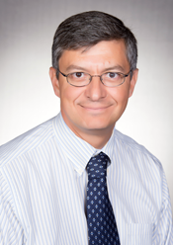
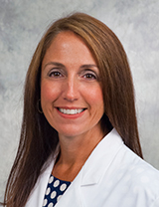
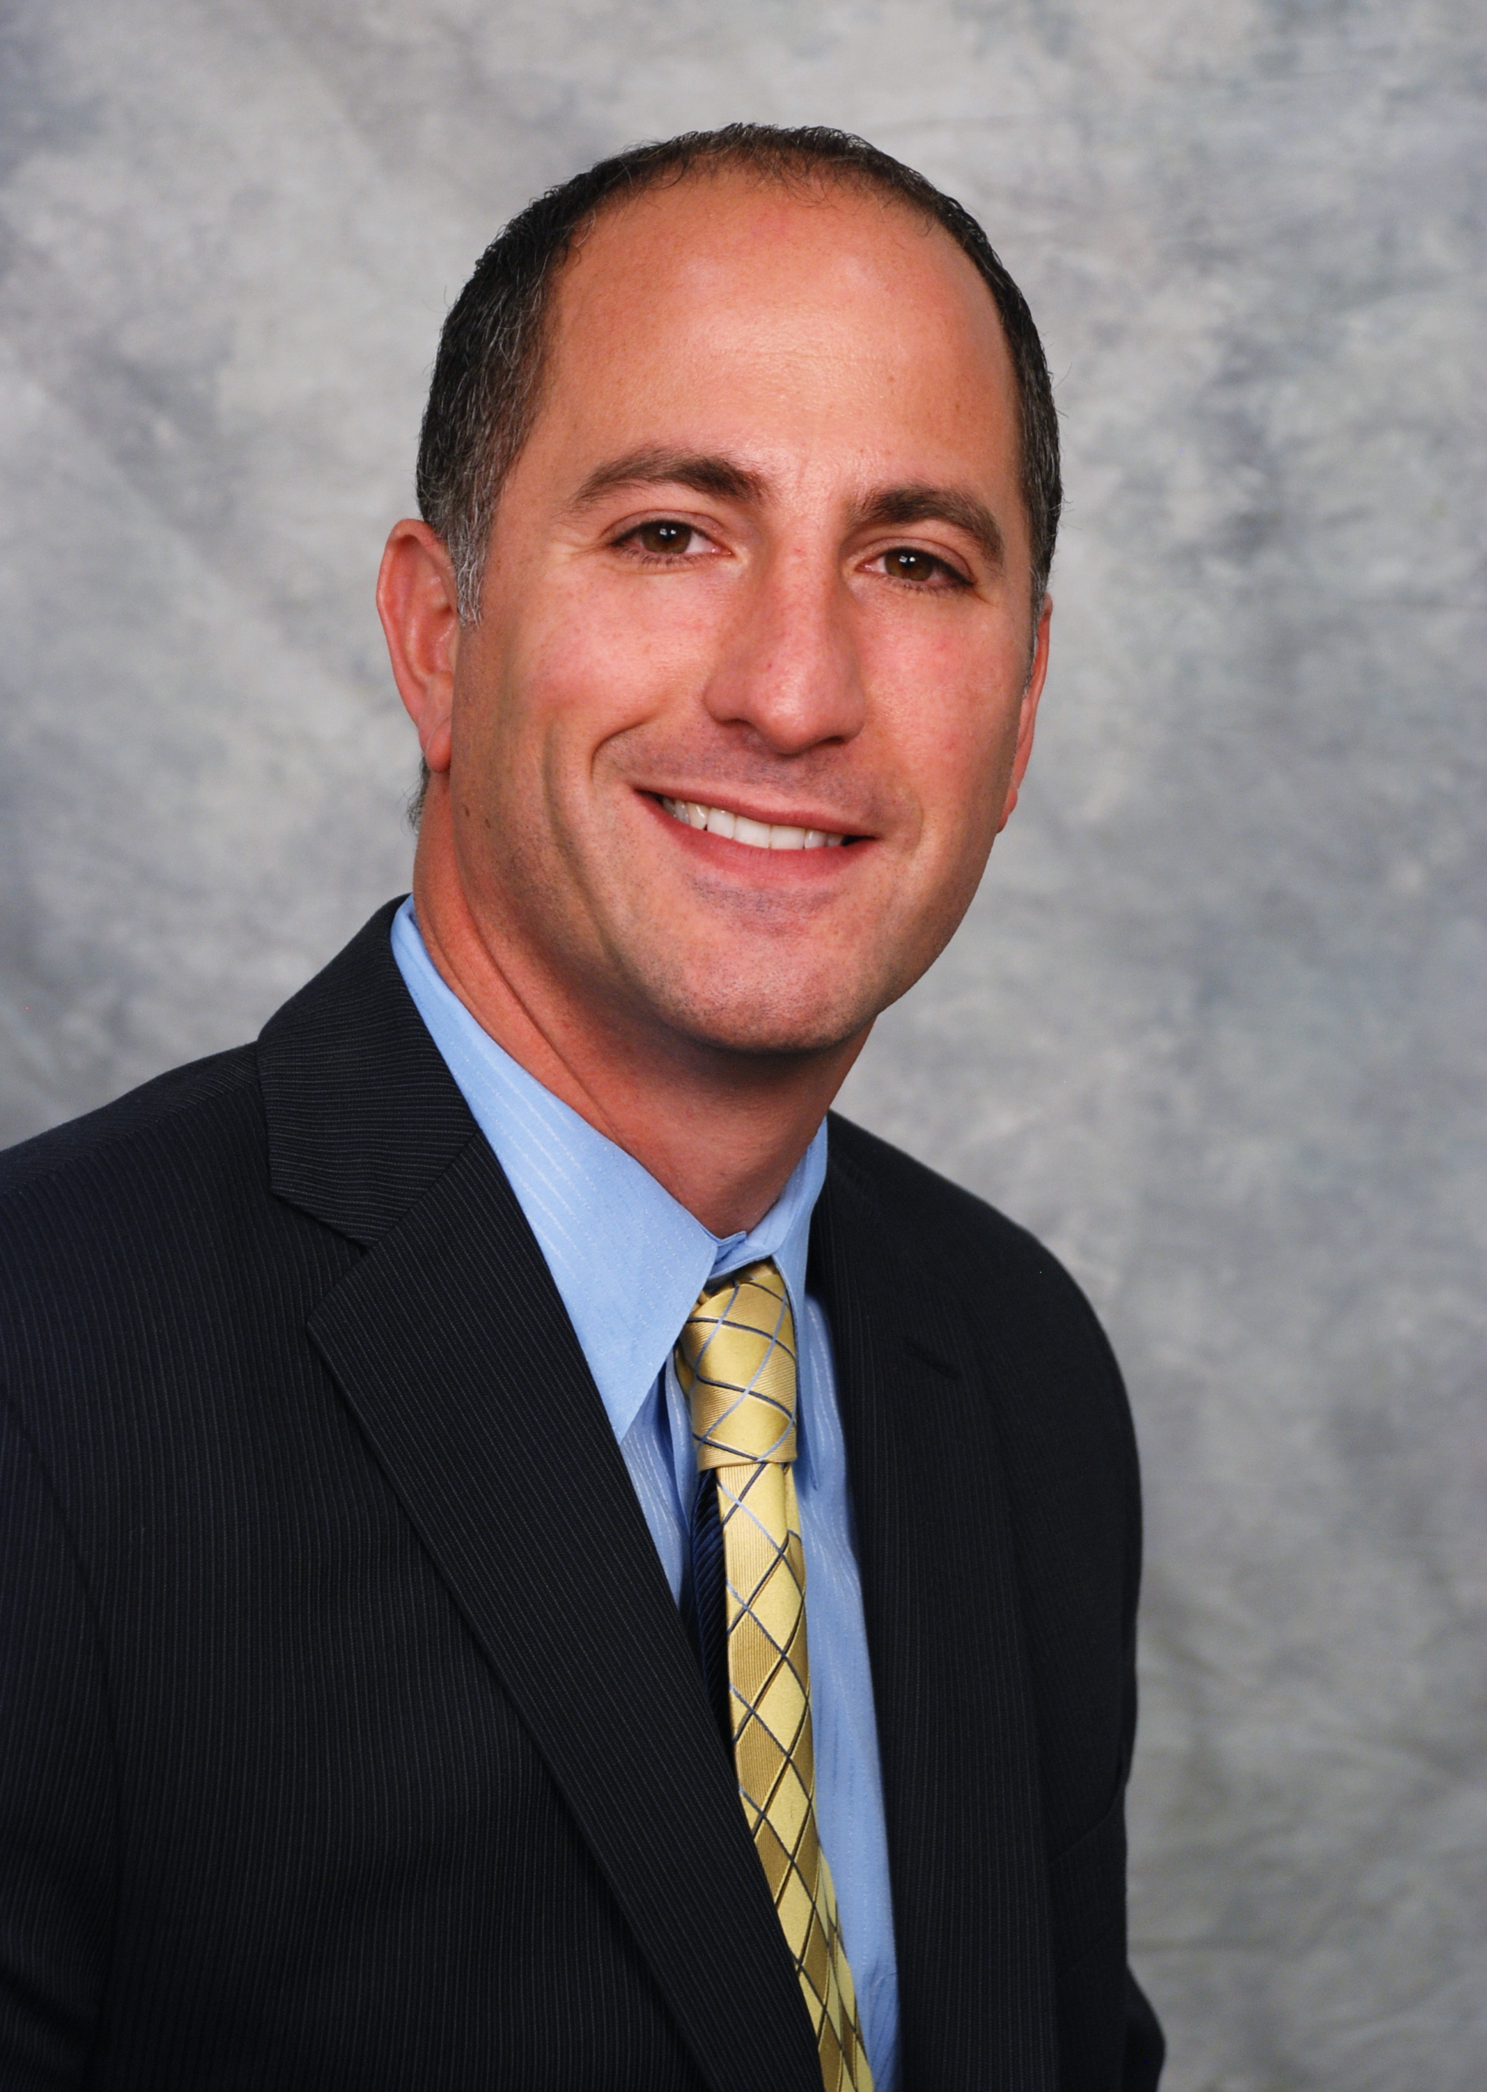
Also in our GME Office…
Dr. Kiki Nissen, MD, FACP
Associate Dean for GME
Dr. Steven Angus, MD
DIO
Dr. Wendy Miller, MD, FACP
Assistant DIO
Mark Siraco
Director of GME Finance

Slide 6
Also in our GME Office…
Kathy Mikulak
Administrative Program Assistant
Jill Goldsmith
Program Coordinator
Bethany Dumez
Administrative Program Assistant

Slide 7
Our Programs
20 Residency Programs
40 Fellowship programs
665 residents and fellows
Rotating at upwards of 25 sites, but 5 main hospitals

Slide 8
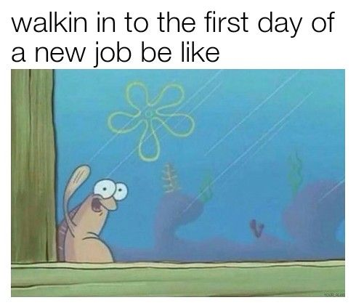
Coordinator Training & Mentoring
New coordinators meet with the GME office staff when they start

Slide 9
Coordinator Training & Mentoring
Martha discusses what GME is, what the ACGME is, common program requirements vs. program requirements, FMLA
Mark discusses finance, specifically book and travel allowances for residents
Melissa discusses our online residency management system (MyEvaluations)

Slide 10
Coordinator Training & Mentoring
Coordinator timeline
▫ Institutional dates and deadlines
▫ Editable, so coordinator can add program-specific dates
▫ Coordinator Timeline is on our website

Slide 11
Coordinator Training & Mentoring
One-on-one mentoring with veteran coordinators

Slide 12
Coordinator Training & Mentoring
Coordinator Blackboard page
Quarterly Coordinator meetings
GMEC coordinator representative

Slide 13
Coordinator Training & Mentoring
Did your GME office train you when you started?
What was the most helpful thing someone trained you on when you started?
What do you wish someone taught you when you started?
Maybe you can start a coordinator group for your state

Slide 14
Tracking
“Numbers”
Vacation/Time Off
Resident stipend/travel allowance
Scholarly Activity
Demographic Information

Slide 15
Tracking Numbers
Our GME office tracks controlled substance, Medicare, and CT-specific numbers
Initially, we had residents complete their own enrollments
We sent detailed instructions with screenshots, but there were still difficulties

Slide 16
Tracking Numbers
Now, the GME office enrolls everyone
Tedious to complete multiple applications for 225 incoming residents every year, but saves time in the long run

Slide 17
Tracking Numbers
Do you enroll your residents on a program level? Or GME office level? Or do they complete their own enrollments?

Slide 18
Tracking Vacation
Done at the program level
Vacation tracking template (this template is available on our website)

Slide 19
Tracking Vacation
Do you have a vacation tracking template? For a large program?
Or do you have a different way of tracking vacation time?

Slide 20
Tracking resident stipend
Done at both the program level and GME office level
Programs use their own preferred method to track
Most coordinators have a separate spreadsheet for each resident and/or a separate spreadsheet for each academic year

Slide 21
Tracking resident stipend
GME office uses one larger spreadsheet to track all book and travel expenses for all programs and residents . This template is available on our website

Slide 22
Tracking resident stipend
How do you track resident expenditures?
Does your GME office also track resident expenses?

Slide 23
Tracking Scholarly Activity
Done at both the program level and GME office level
Most programs use the scholarly activity-tracking template provided by the ACGME

Slide 24
Tracking Scholarly Activity
However, our GME office tracks research (resident, fellow, and faculty) for all of our programs
We use a spreadsheet similar to the resident expenditure spreadsheet

Slide 25
Tracking resident scholarly activity
Do you have a different way of tracking resident scholarly activity? What about faculty scholarly activity?

Slide 26
Tracking Demographics
Hard to track demographic information for current and previous residents/fellows, based on the sheer magnitude of information
We have had over 7,000 graduates since we began in the 1970s

Slide 27
Tracking Demographics
We initially started tracking data in an Excel spreadsheet

Slide 28
Tracking Demographics
Then we switched to an Access database

Slide 29
Tracking Demographics
We are still not happy with our method of tracking resident demographics
What does your program use to track this information?
Does your GME office use something different than you do?

Slide 30
Resident Wellness
Addressed at both the program level and the GME office level
First, we will discuss what we have done for resident wellness via the GME office

Slide 31
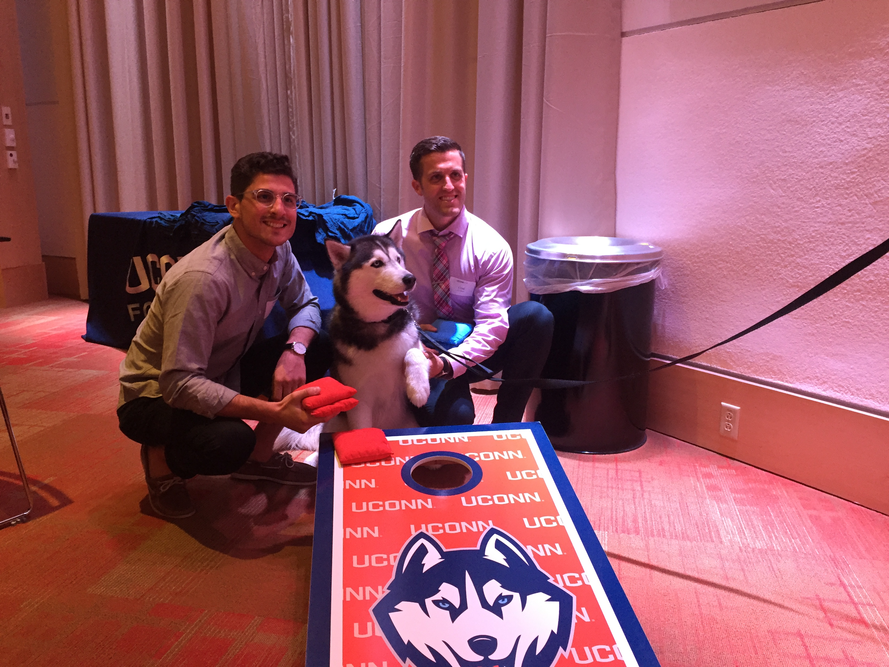
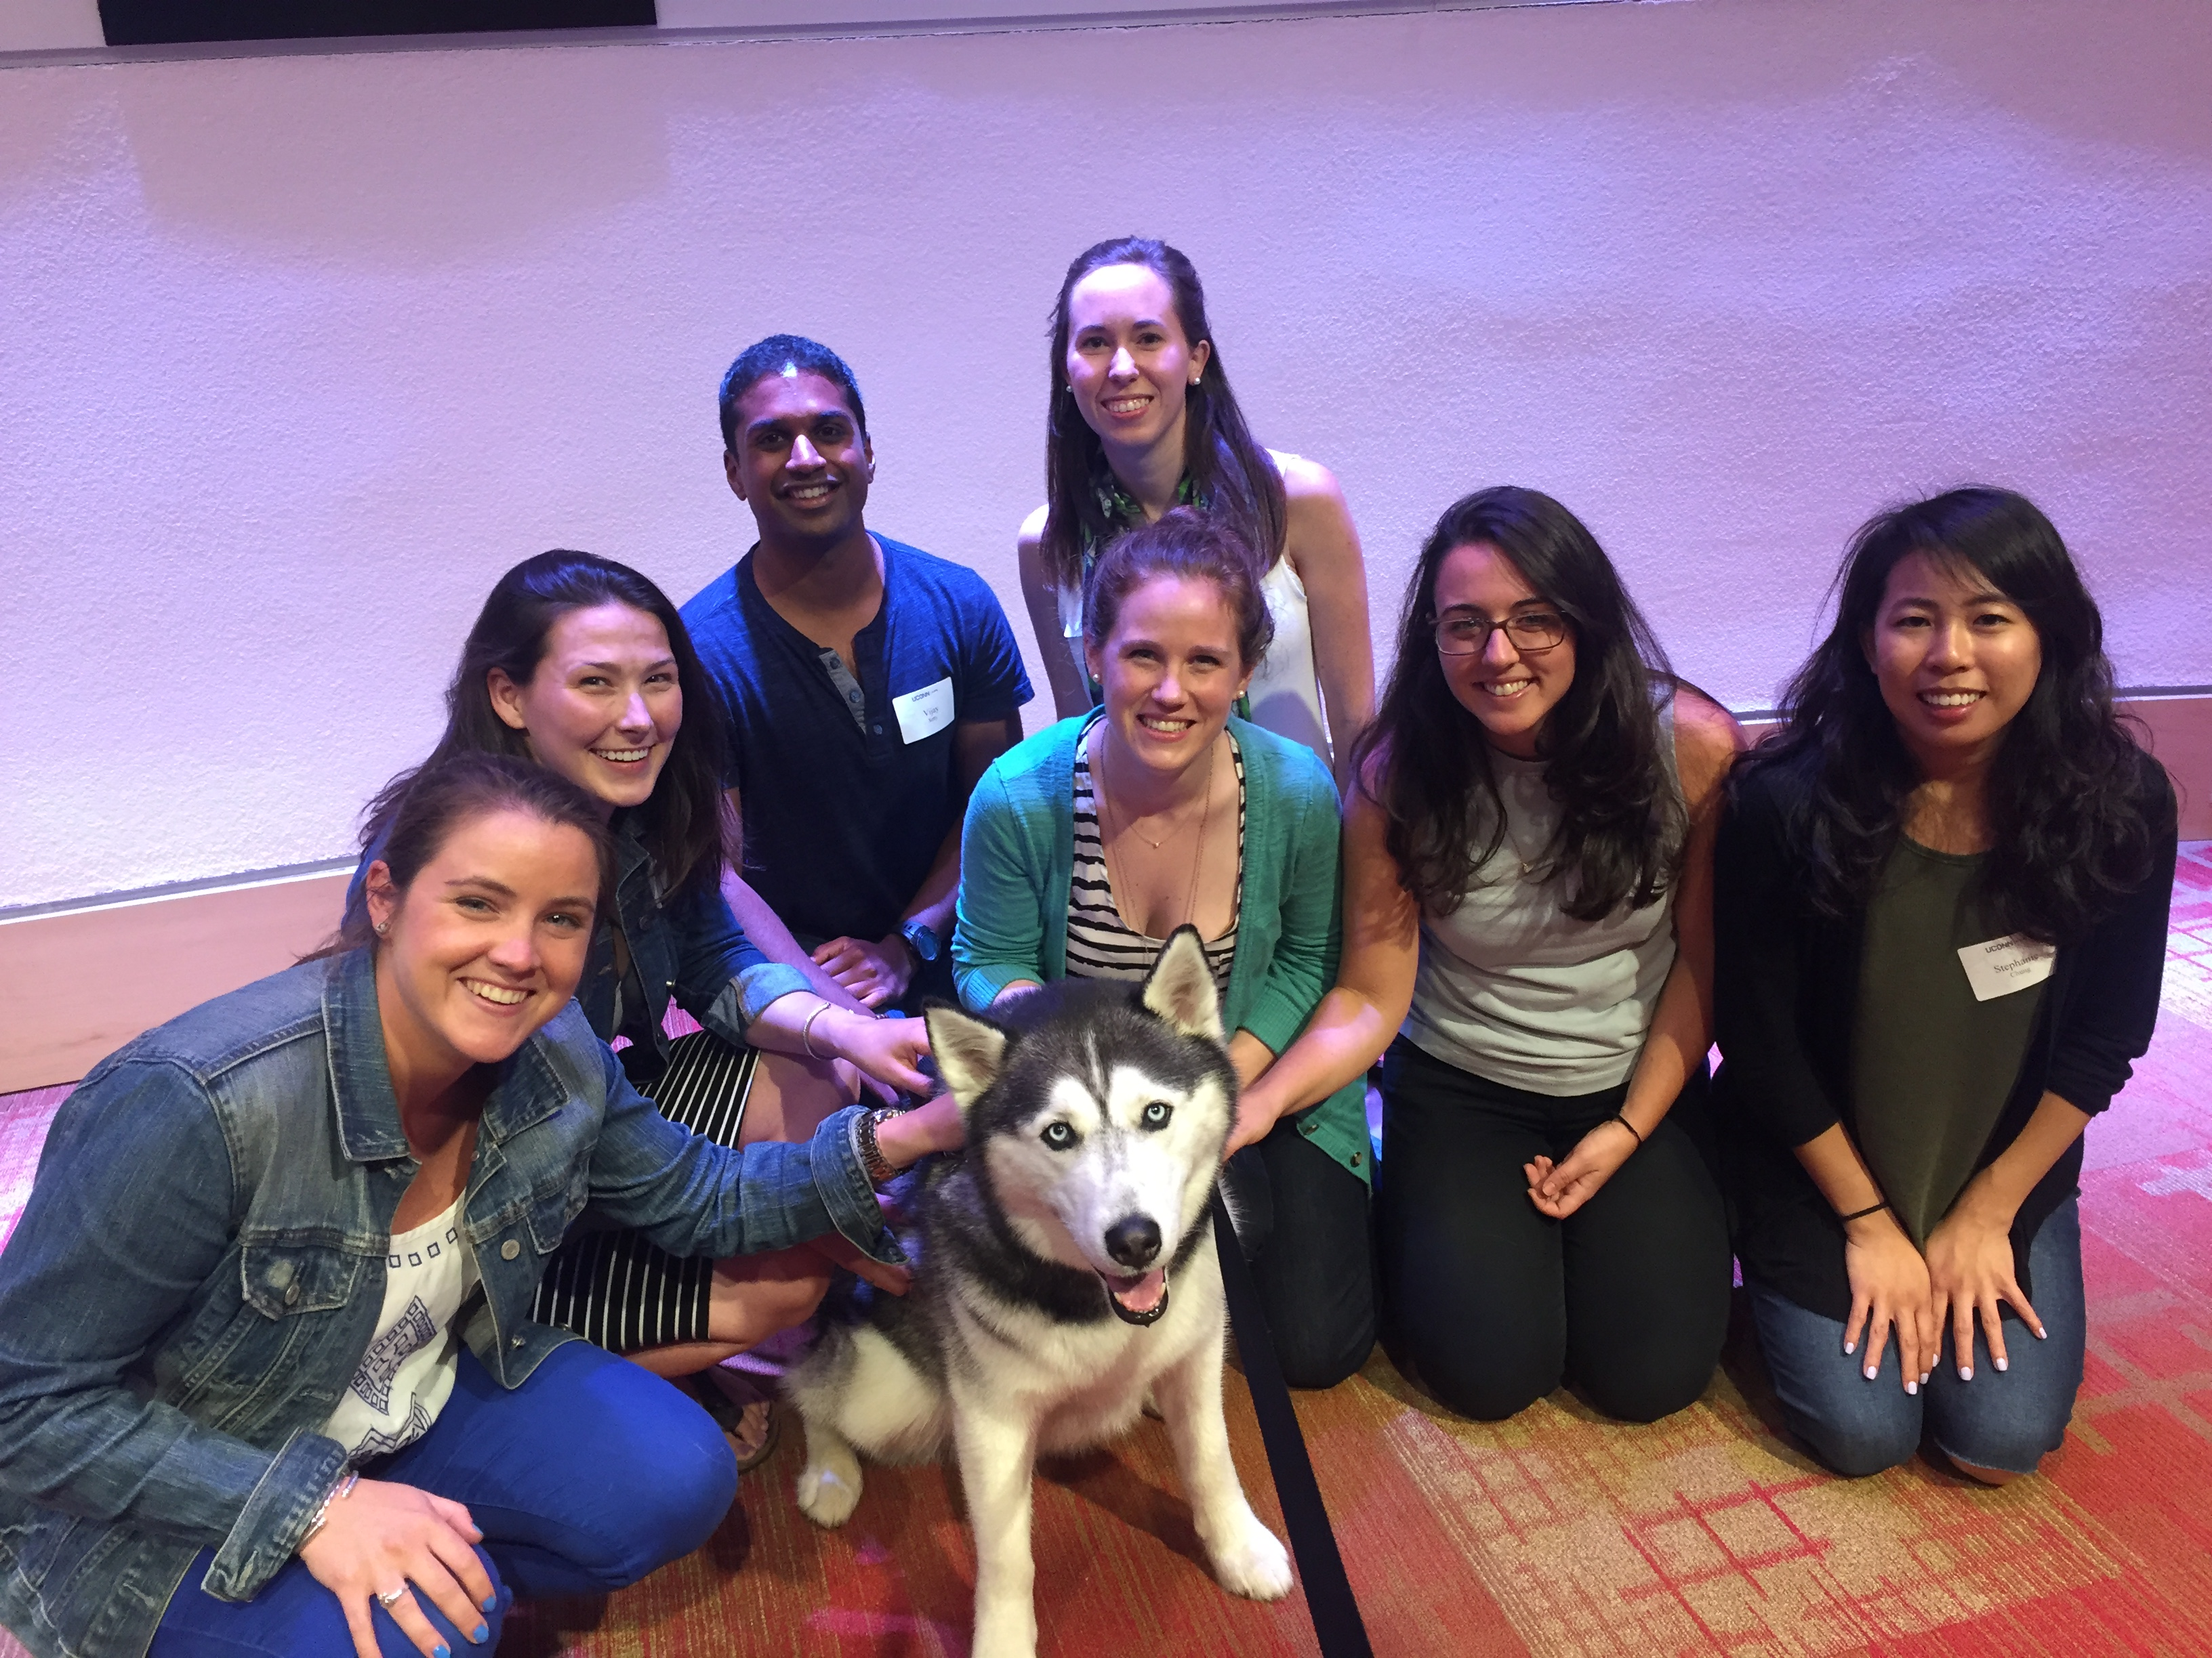
Welcome Picnic
For incoming residents/fellows, program directors, and program coordinators

Slide 32
GME Office Facebook

Slide 33
GME Quarterly Newsletter

Slide 34
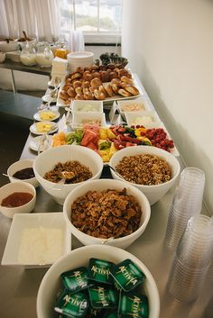
Resident Appreciation Week

Slide 35
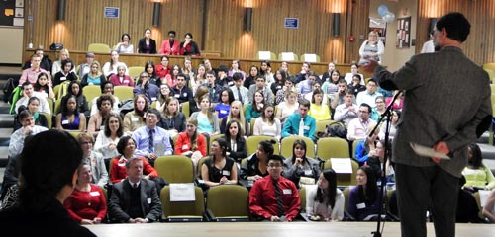
Resident Town Hall

Slide 36
University Sports

Slide 37
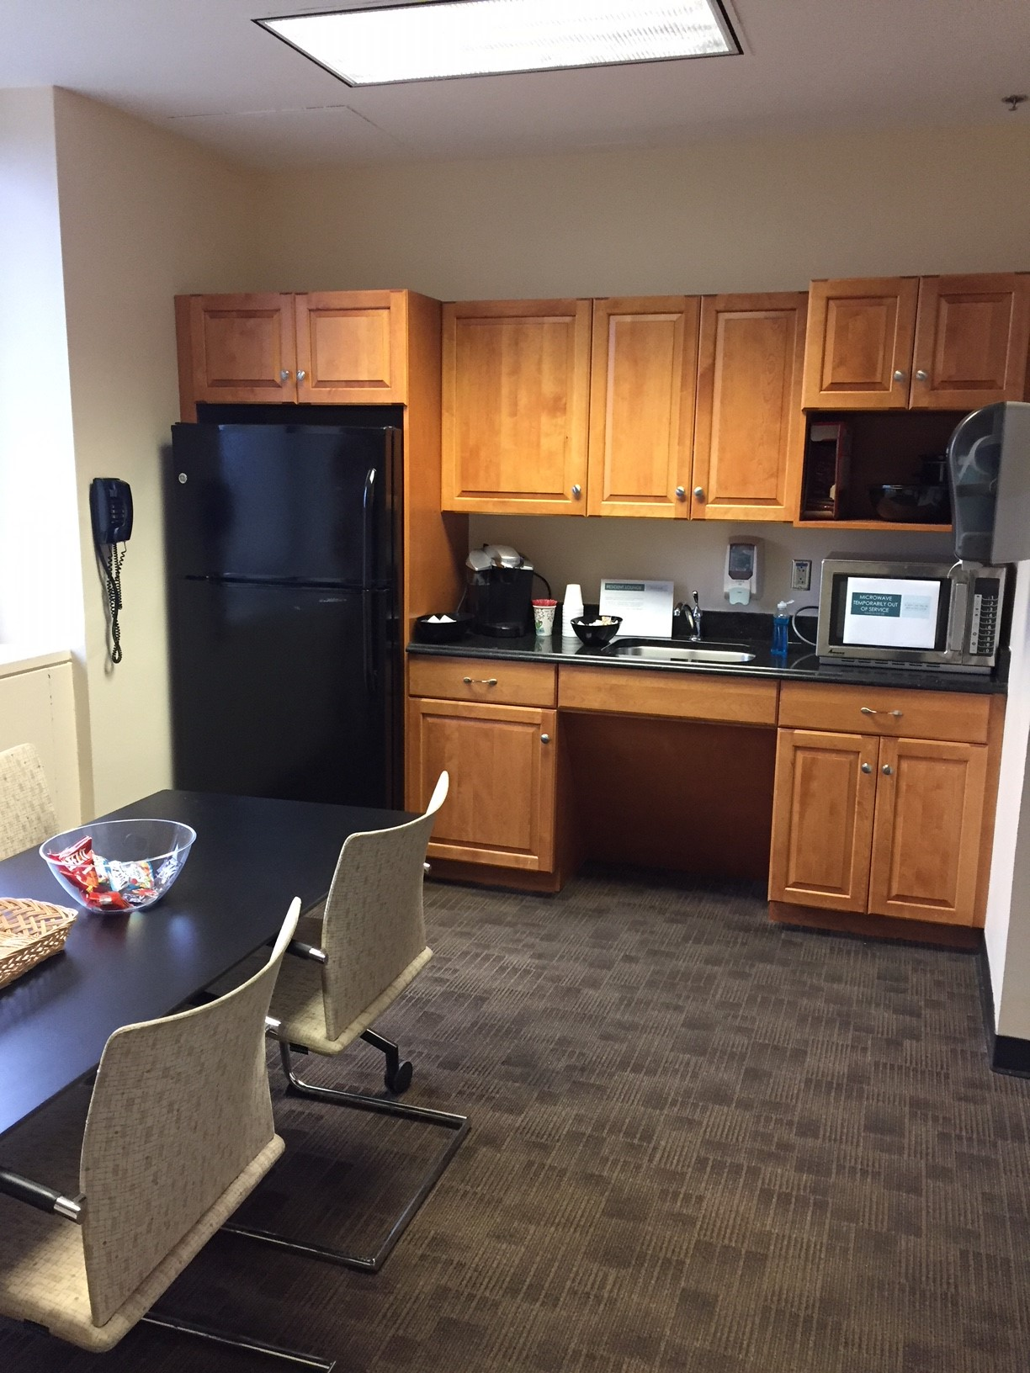
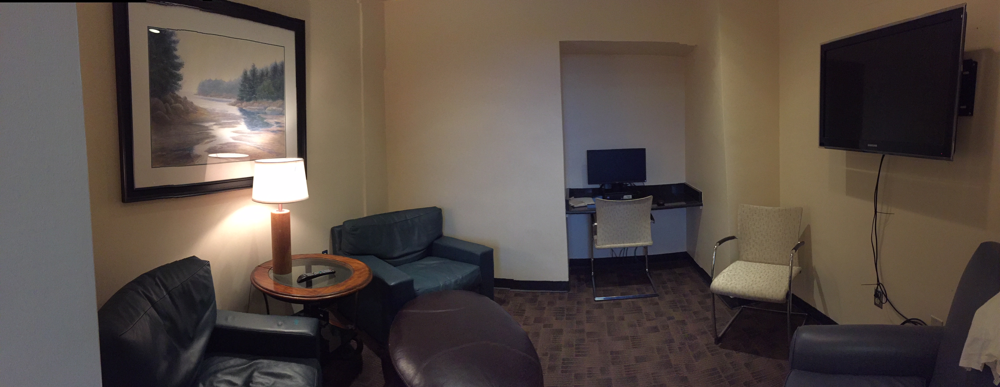
Resident Lounge

Slide 38
Resident Birthdays

Slide 39
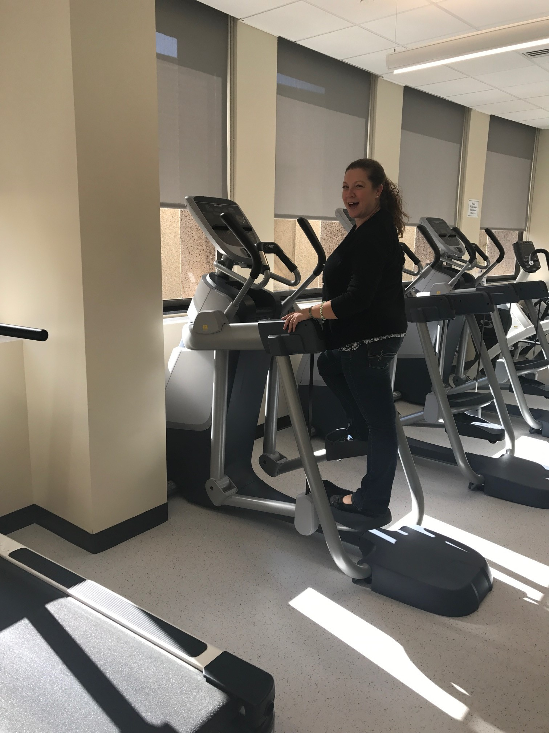
Wellness Center

Slide 40
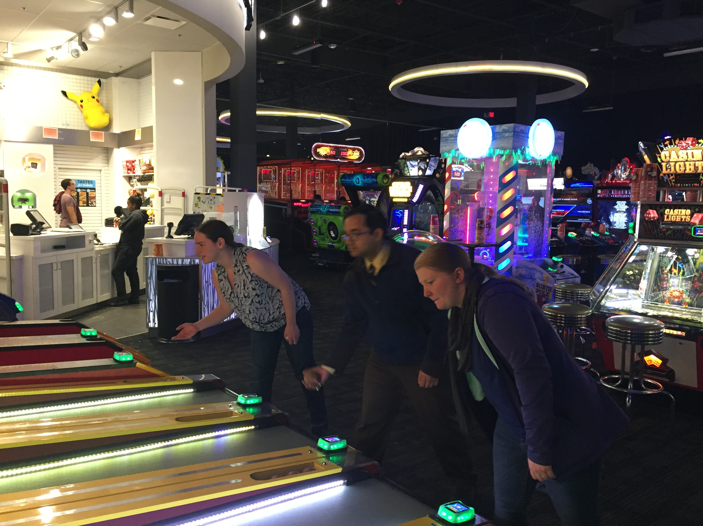
Dave & Buster’s

Slide 41
Dinner at Comedy Club

Slide 42
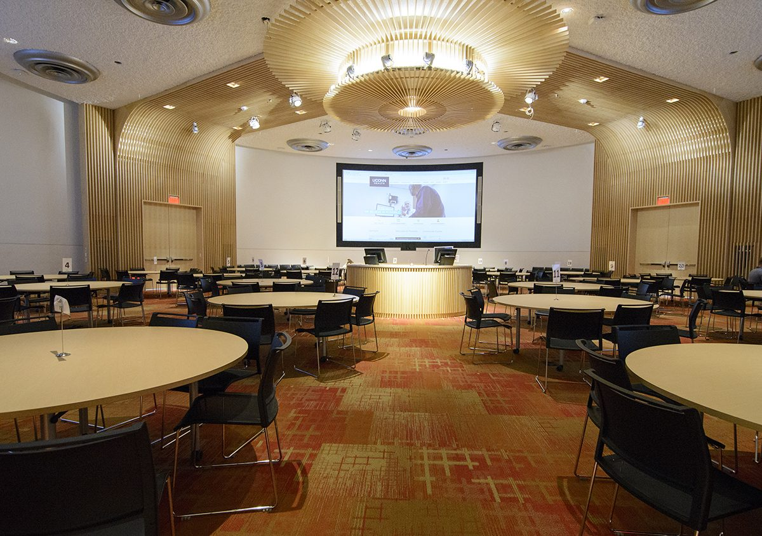
Movie Mondays - FAIL

Slide 43
Coffee Cup - FAIL

Slide 44
Resident Wellness
Does your institution sponsor wellness activities at the GME office level?

Slide 45
Resident Wellness
Now we will discuss wellness at the program level

Slide 46
Wellness during didactic sessions

Slide 47
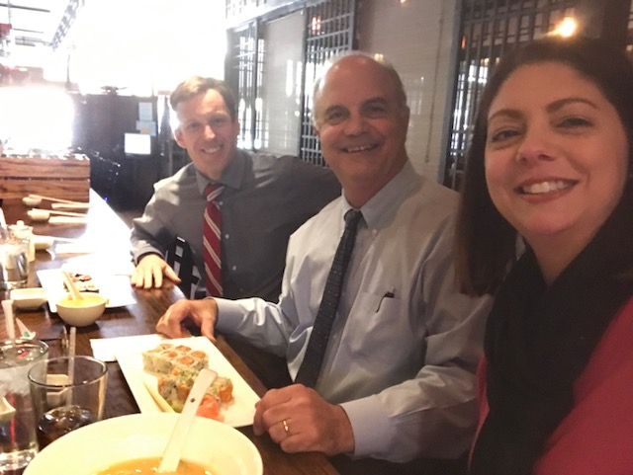
Weekly Luncheons

Slide 48
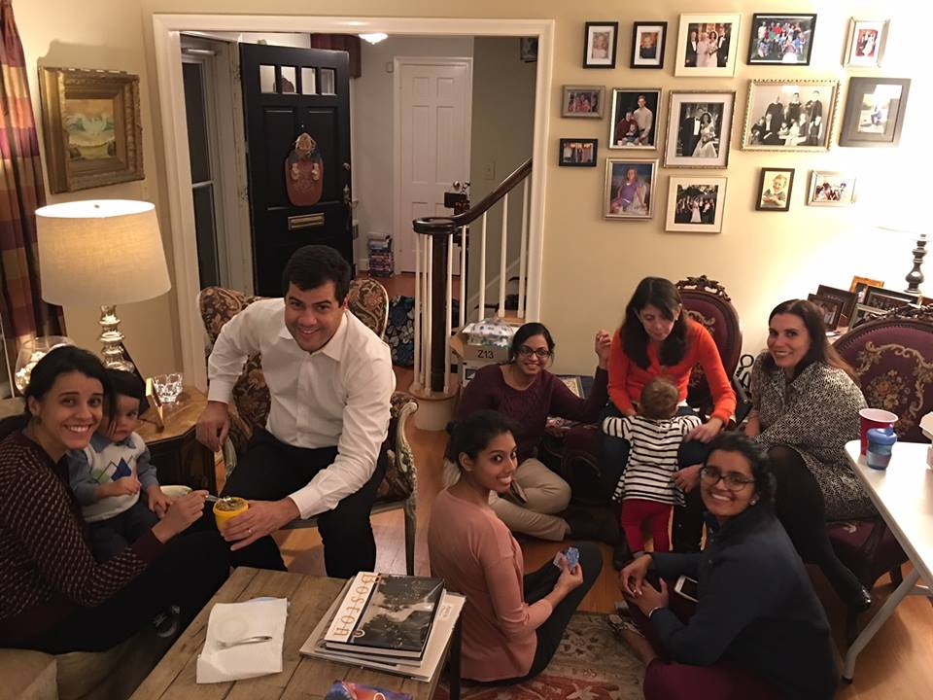
Wellness Chief

Slide 49
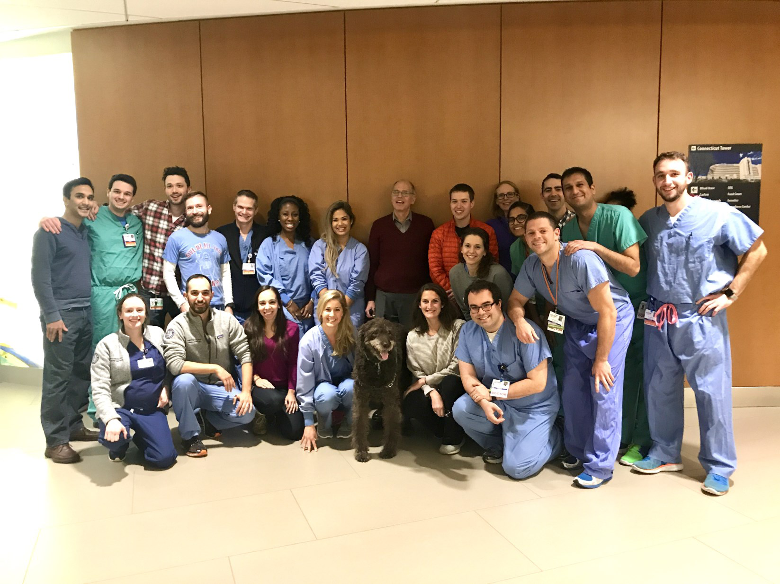
Cocoa!

Slide 50
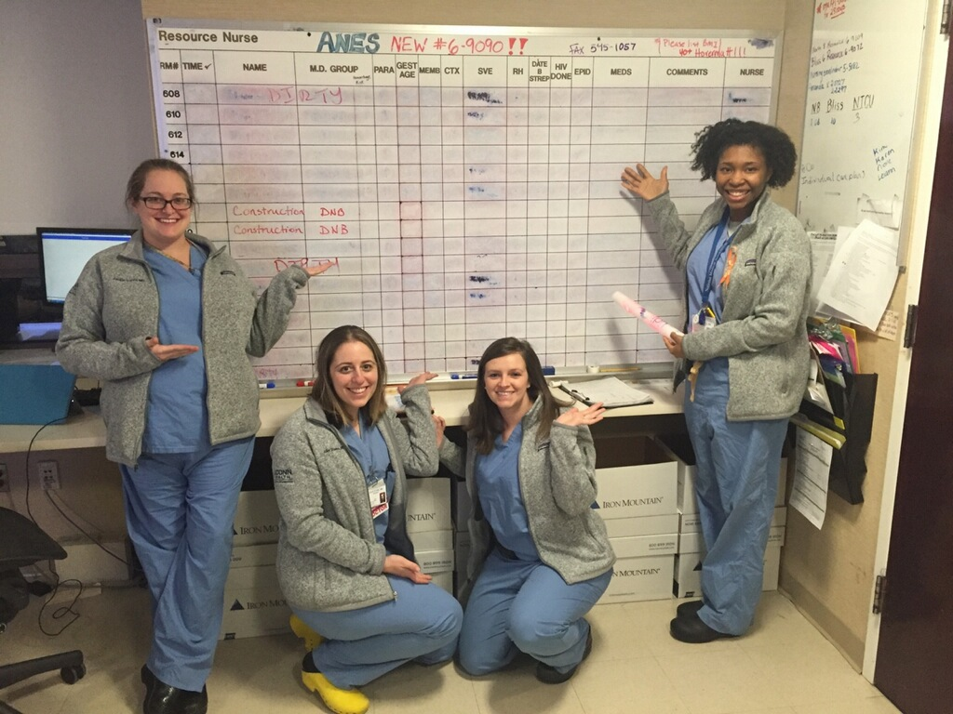
Matching Gear

Slide 51
Other Activities

Slide 52
Resident Wellness
What does your program do for wellness activities?
Any barriers you have encountered? Attendance? Financial?

Slide 53
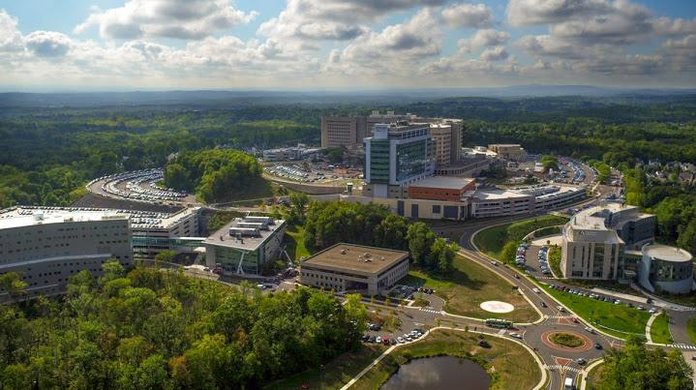
Thank you!

