Slide 1

NHGRI Meeting
April 2, 2023 – April 4, 2023
Salt Lake City, Utah

Slide 2
Monica Dave iPSC-derived primitive syncytium: a model of developmental senescence
Monica Davé^{1,2}, Zukai Liu^{1,2}, Brian Hoffmann³, Paul Robson^{1,2}
¹Department of Genetics and Developmental Biology, UConn Health Center, Farmington, CT
²The Jackson Laboratory for Genomic Medicine, Farmington, CT
³The Jackson Laboratory for Mammalian Genetics, Bar Harbor, ME
Peri-implantation failure of fertilized human embryos is common, yet poorly understood. To study this stage of development in vivo is unethical, leading to a black box concealing the reasons why many couples struggle to pass the implantation stage of development even when in vitro fertilization controls for other factors. To address fundamental questions about the mechanisms of implantation that might also underlie embryo mortality, human-based in vitro models are necessary, but currently lacking. Primitive syncytium (PrSyn) is an extra-embryonic trophoblast cell type which emerges from the trophectoderm of the blastocyst during implantation. Our lab has developed a protocol to differentiate human induced pluripotent stem cells (iPSCs) to PrSyn, which will be utilized to elucidate the role of PrSyn during implantation. Further, PrSyn exhibits a senescent transcriptional signature, though little has been described about developmental senescence since senescence is typically associated with aging. Our lab seeks to utilize the iPSC-derived PrSyn as a model of developmental senescence. This novel model is accessible and quick to achieve, with differentiation to PrSyn occurring within 6 days. Bulk-RNA sequencing results suggest a senescent signature in PrSyn via the increased expression of various senescence-associated genes. To further confirm the senescent phenotype of PrSyn and utility of this model for studying senescence, we also conducted immunofluorescence staining and secretome analysis. Results from these analyses confirm senescent markers are present in PrSyn and there is a senescence associated secretory phenotype (SASP) in PrSyn. Additionally, the results confirm that PrSyn secretes human chorionic gonadotropin, an important hormone present during implantation. From this combination of transcriptome, secretome, and immunofluorescence data, we conclude that iPSC-derived PrSyn is a good model to investigate developmental senescence and its role in human implantation.

Slide 3
Eden Francoeur
Segmental duplication-mediated rearrangements in diverse mouse genomes
Eden Francoeur^{1,2}, Ardian Ferraj^{1,2}, Peter A. Audano², Parithi Balachandran², Christine R. Beck^{1,2}
¹Department of Genetics and Developmental Biology, UConn Health
²The Jackson Laboratory for Genomic Medicine
Segmental duplications (SDs) are amongst the most rapidly evolving regions of mammalian genomes, and often contain genes. SDs make up over 5% of both human and mouse genomes and are large (>1kb), highly homologous sequences (>90% similarity) that are present in multiple copies. Prior studies show that SDs mediate rearrangements in humans and mice that result in large structural variants (SVs) that are responsible for human diseases; These rearrangements have been shown to be implicated in sensory, behavioral changes, and reproductive success differences. Inbred mice are an ideal model to study how SD-mediated rearrangements contribute to both genotypic and phenotypic variation as genetically diverse reference populations are readily available, the evolutionary pressure in captivity is smaller, and there is a plethora of phenotypic abnormalities linked to genotype. SD-mediated rearrangements are less understood in mice than in human genomes and the extent to which SDs recombine diverse mice is unknown. We predicted regions of the mouse reference genome that are susceptible to SD-mediated rearrangement based on parameters from the literature and determined that 22-24% of direct and indirect SDs can recombine using our predetermined criteria. In parallel, we examined orthogonal datasets of short-read sequencing, long-read sequencing, and optical mapping from 10 diverse strains, and generated a catalog of SD-mediated SVs. With our predictions and experimentally determined SD-mediated variants, we are investigating how SDs affect the landscape of variation and gene expression in mouse strains, and how the requirements for SD-mediated recombination vary within and between species. From this, we have identified 9 inversions, 155 duplications, and 321 deletion variants. Interestingly, we find there is a significant enrichment for LINE transposable elements flanking SDs in mice, analogous to human SDs where Alu elements are enriched at the flanks.

Slide 4
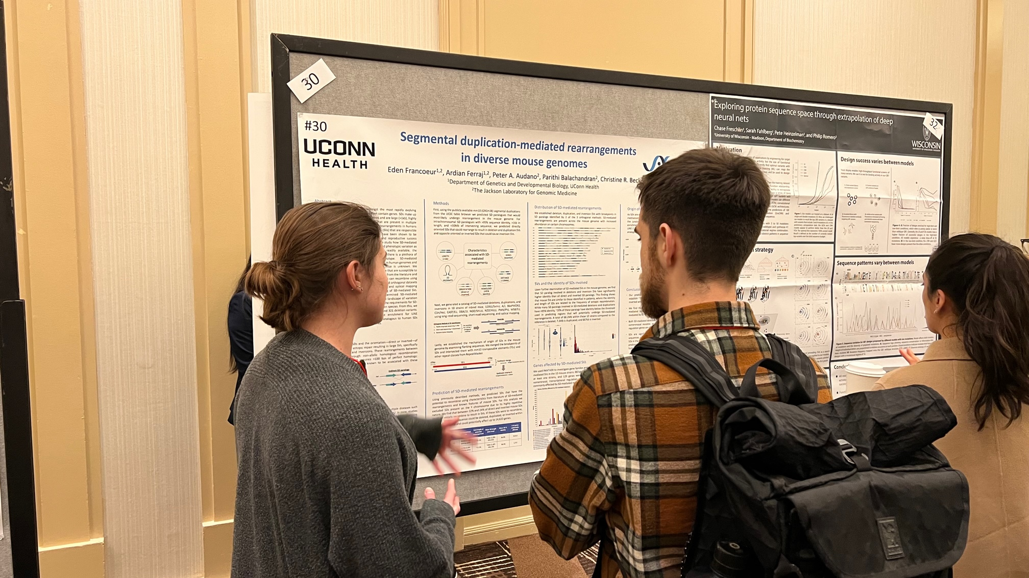

Slide 5
Mian Horvath
Transcriptional Profiling of 3D Lower Airway Tissue Culture Model Exposed to Genetically Diverse Microbes
Mian Horvath^{1,2}, Elizabeth Fleming¹, Ruoyu Yang^{1,2}, José Fachi³, Diana Cadena Castaneda¹, Megan Callendar¹, Matthew Coxe¹, Marco Colonna³, Karolina Palucka¹, Julia Oh¹
¹ The Jackson Laboratory, Farmington, CT, USA
² University of Connecticut Health, Farmington, CT, USA
³ Washington University School of Medicine, St Louis, MO, USA
Respiratory viral infections are a major international public health concern, but there are few therapies. One contributor to respiratory health and immune defense is the respiratory microbiome, making it an attractive target. However, the interactions between different microbes and the host are poorly understood due to extensive biodiversity. My goal is to characterize how microbial colonization of the respiratory tract affects host epithelial gene expression. My hypothesis is that different respiratory tract-associated microbial isolates will cause unique transcriptional changes in the host epithelium and that those transcriptional changes will result in altered response to viral infections. Genetically diverse respiratory tract derived microbes were applied to tracheal/bronchial air-liquid interface (ALI) tissue cultures, which are a 3D epithelial tissue culture model. Bulk RNA-seq of the ALI cultures revealed gene expression changes in innate immunity and barrier integrity pathways. Phylogenetically similar microbes did not necessarily induce similar gene expression changes. A subset of the microbes will be selected for co-infection with influenza in ALI cultures. Quantity of infection will be tracked using fluorescence microscopy. We anticipate that some microbes will protect against influenza infection while others will increase infection. Future steps include dual RNA-seq of host and microbe, metabolomics, and cytokine assays to elucidate how the microbes are inducing gene expression changes in the host. Single cell sequencing and fluorescent in-situ sequencing will allow us to determine cell type specific responses to microbial colonization. Characterization of the effects of different microbial species and strains on the respiratory epithelium will allow us to elucidate biomarkers for infection susceptibility/progression and provides an attractive target for modulation.

Slide 6
Christopher Pathoulas
Single nucleus endothelial cell sequencing in acute rejection of human cardiac transplants
Christopher Pathoulas¹, Amy Kimble¹, Omar Omar¹, Giulia Protti^{2,3}, Ryan Lau⁴, Gregory Fishbein⁴, Matteo Pellegrini⁵, Patrick Murphy¹*, Nicole M Valenzuela⁴*
University of Connecticut Health Center, Farmington, CT
Institute for Quantitative and Computational Biosciences, University of California, Los Angeles, Los Angeles, CA
Department of Biotechnology and Biosciences, University of Milano-Bicocca, Milan, Italy
Department of Pathology and Laboratory Medicine, David Geffen School of Medicine, University of California, Los Angeles, Los Angeles, CA
Department of Molecular, Cell and Developmental Biology, University of California, Los Angeles, Los Angeles, CA
*authors contributed equally
Bulk RNA analyses of endomyocardial biopsies from cardiac transplants identified a diagnostic signature of rejection. Such signatures can improve diagnosis, reveal mechanistic insight, and support the development of novel therapeutics. Cardiac endothelial cells (EC) form an interface with the host immune system and play an important role in immune cell recruitment. However, their specific contribution to rejection has not been investigated. Here, we develop methods for the single nuclei analysis of EC from frozen biopsy remnants, to study EC-specific gene expression changes during rejection of cardiac allografts.
Using murine cardiac tissue to model frozen tissue remnants, we developed an antibody-based method for isolating and hash-tagging EC nuclei from frozen tissue biopsies. We applied these methods to a set of five cardiac transplant cases with sequential biopsies in the UCLA Translational Pathology Core Laboratory biorepository. Cases include both stable and rejected grafts. Combining our method with a published 10x NEAT-Seq (Nuclear protein Epitope abundance, chromatin Accessibility and the Transcriptome) provided longitudinal EC transcriptional changes from the same patients before and after rejection.
Using flow cytometry, we found that free-oligo hashtags remained bound to nuclei during processing, providing a cheap and effective solution for combination of many samples. Erg-based antibody enrichment also effectively enriched EC transcripts. Application of these methods to human biopsy remnants allowed for the extraction of an average of 1800 Erg+ nuclei per frozen tissue sample of <5mg. Using Erg+ cells isolated from 9 samples, UMAP clustering and cell type analysis identified ~1700 EC nuclei. Comparative analysis of these EC nuclei during rejection revealed upregulation of canonical pathways in graft rejection, including the “Interferon Gamma Response.”
These data demonstrate the feasibility of high through-put multi-omics on archived frozen endomyocardial transplant biopsies. Our approach increases the resolution of EC transcription and pinpoints an interferon signature of rejection to ECs.

Slide 7
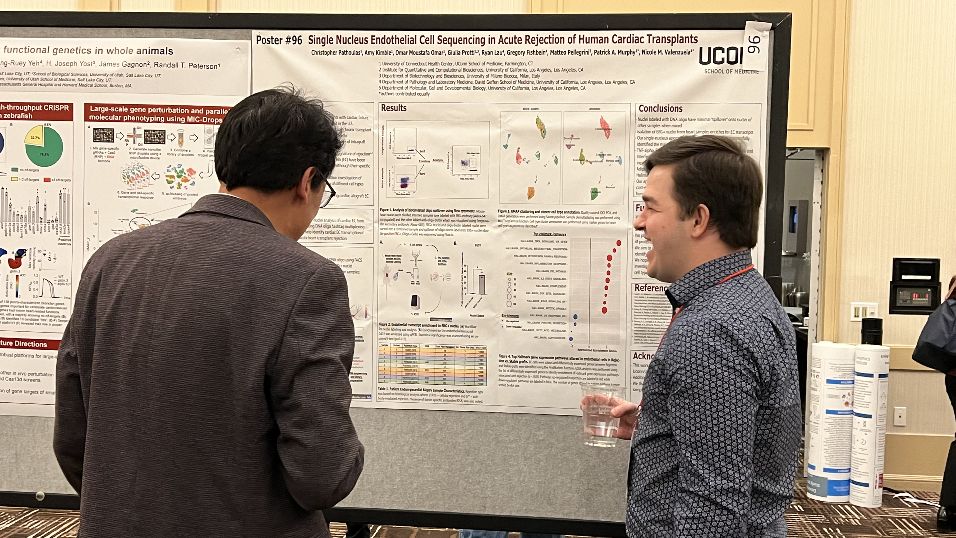

Slide 8
Elizabeth Szabo
Functional Analysis of Variants of the MSH6 Mismatch Repair Gene
Elizabeth Szabo, Emily Blackburn, Alexander Radecki, Abhijit Rath, Christopher Heinen
Lynch syndrome (LS) is a hereditary condition that increases patients’ lifetime risk of cancer, primarily colorectal cancer. LS is caused by germline mutations in mismatch repair (MMR) genes, MLH1, MSH2, MSH6, and PMS2. Identification of these mutations is important in LS diagnosis in order to guide treatment plans and preventative care for patients’ and their families. However, the consequences of some variants in these genes are not immediately obvious, granting them classification as variants of uncertain significance (VUS). Half of known variants in the MMR gene MSH6 are VUS and, thus, the goal of my project is to provide evidence for a subset of these variants to help better determine their pathogenic significance. Laboratory functional analysis to determine whether these variants disrupt MMR function in human cells can provide important evidence toward this goal. We will be validating and calibrating functional assays for MSH6 variants, which our lab have previously validated for MMR genes MSH2 and MLH1. This will be done using known MSH6 pathogenic and benign controls. We will then test 35 MSH6 VUS identified in patients as reported in the InSiGHT database, ClinVar database, and current literature. We are using CRISPR gene editing to recreate these variants in the endogenous MSH6 loci in human embryonic stem cells (hESC). Using these edited hESC lines we are examining the impact of the variants on RNA and protein stability, repair of DNA microsatellites, which is a hallmark of normal MMR function, and induction of the MMR-dependent DNA damage response. With this compilation of data, we will convert the results into a quantitative Odds of Pathogenicity value. This Odds of Pathogenicity score can be used by expert variant interpretation committees to help readily reclassify these variants, and provide a clearer diagnosis for these suspected Lynch syndrome patients.

