Slide 1


The UConn/Jax-GM Training Program in Genomic Science
2nd Annual Trainee and Mentor Retreat
November 16, 2022

Slide 3
1st Annual Trainee and Mentor retreat
November 2021
From left, front row: Christine Beck, Eden Francoeur, Chris Heinen, Paul Robson, Isolde Bates, Maria Deconti. From left, back row: Brent Graveley, Monica Dave, Charles Lee, Rachel Gilmore, Stormy Chamberlain, Rachel Cohn, Ming Xu

Slide 4
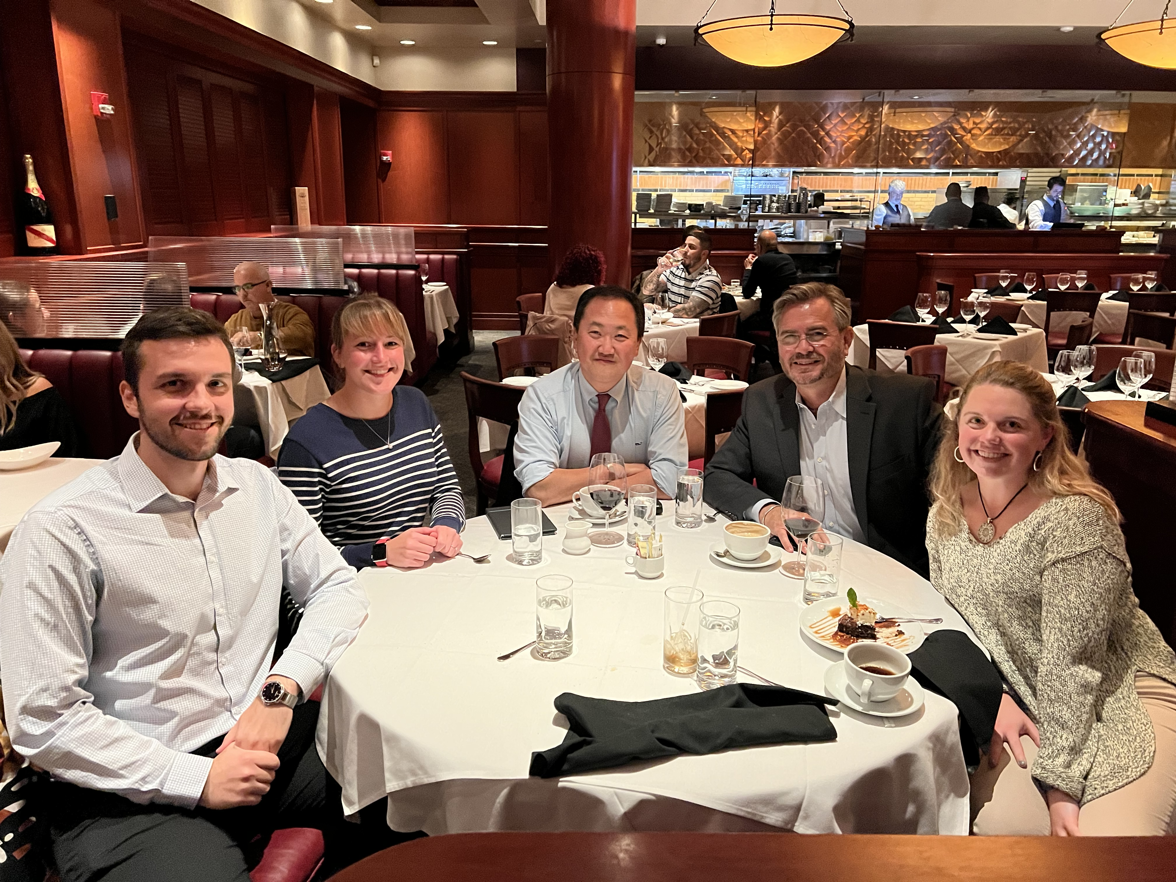
1st T32 Graduates 2022
From left: Ardian Ferraj, Rachel Cohn, Charles Lee, Brent Graveley, Rachel Gilmore

Slide 5
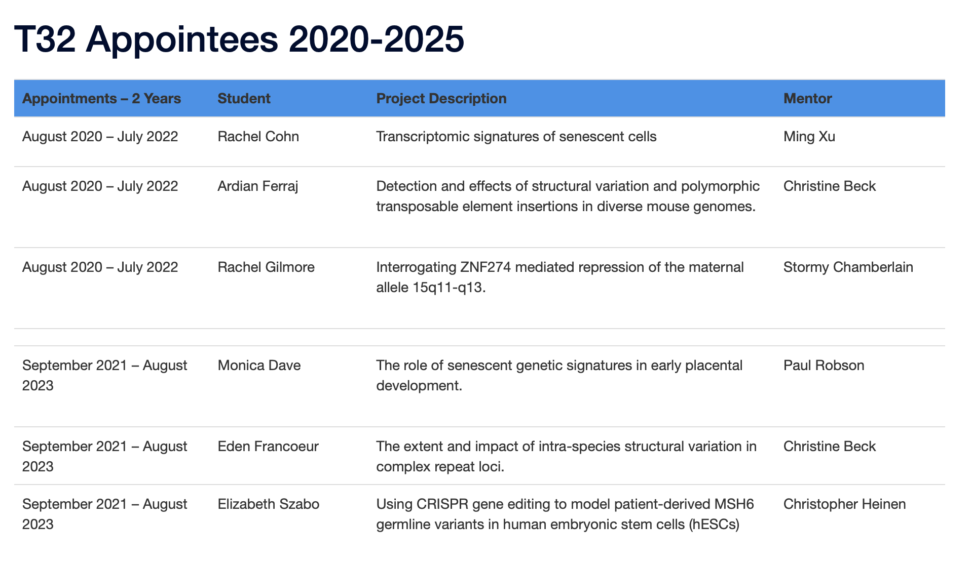

Slide 6
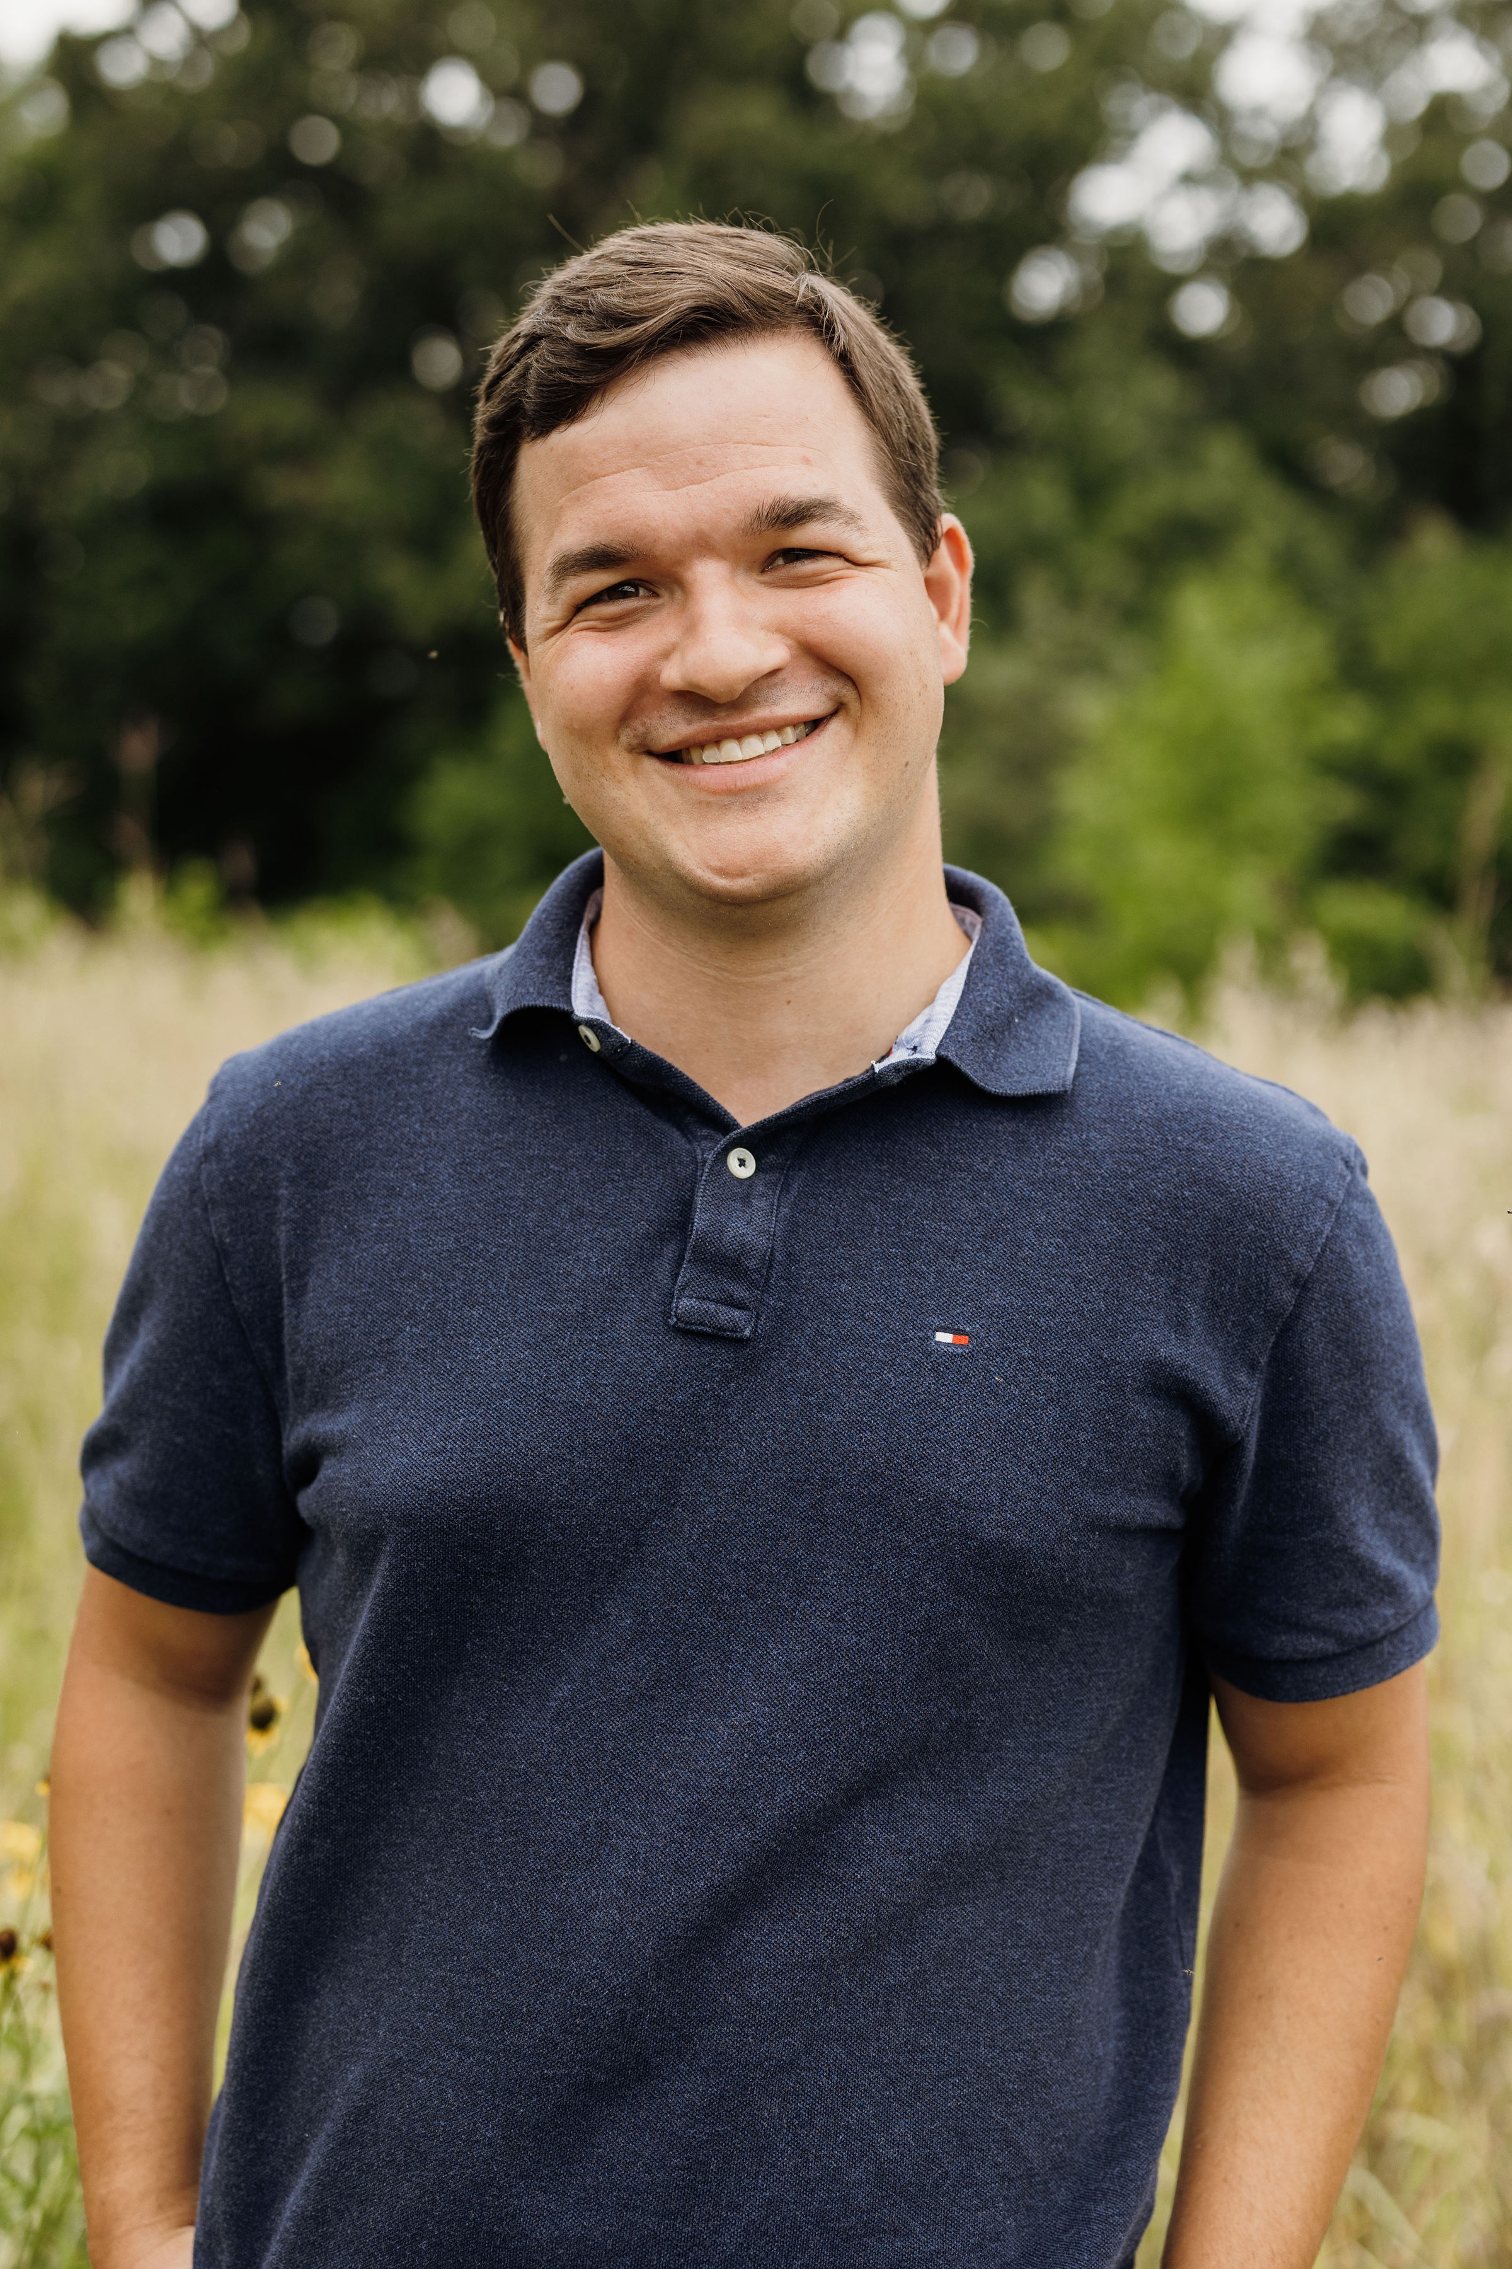
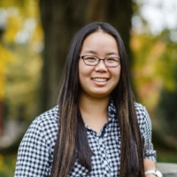
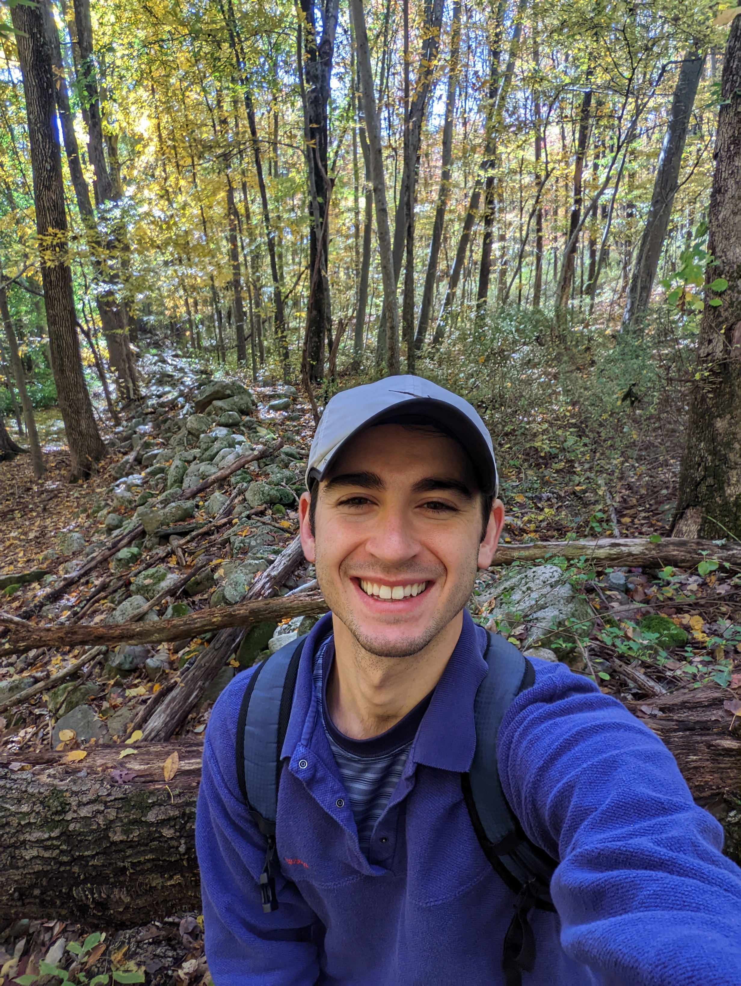
New T32 Appointees September 2022
Christopher Pathoulas
Murphy Lab
Mian Horvath
Oh Lab
Billy Joe Huggins
Rogina Lab

Slide 7
NHGRI Research Training and Career Development
Annual Meeting
April 2-4, 2023; Salt Lake City, UT
The National Human Genome Research Institute (NHGRI) provides both institutional and
individual funding to help scientists develop their skills as researchers and professionals.
Our programs offer opportunities at the undergraduate, postbaccalaureate, graduate,
postdoctoral and faculty levels. This has created a large, diverse, multi-disciplinary
community of researchers.
The Annual Meeting is a venue for trainees supported by NHGRI in the fields of genomic
sciences, genomic medicine, and ethical, legal and social implications (ELSI) research
to present their research and form collaborations with other trainees and established
researchers from training programs across the United States.
These three-day meetings accommodate 300 to 400 attendees and involve a mix of
plenary presentations and concurrent peer-reviewed platform, panel and poster
presentations.
February 1, 2023: Deadline for Registration
March 16, 2023: Deadline for hotel reservation at the Group Rate
March 22, 2023: Deadline to submit poster

Slide 8
Biology of Genomes
May 10-14, 2022; Cold Spring Harbor
Abstract Deadline: February 18, 2022
Topics:
Population Genomics
Evolutionary & Non-Human Genomics
Complex Traits & Microbiome
Functional Genomics & Epigenetics
Computational Genomics
Cancer & Medical Genomics
Developmental and Single Cell Genomics
Ethical Legal & Social Implications

Slide 9
T32 Annual Retreat Agenda
November 16, 2-4 PM (400 Farmington Avenue)
2:00 – 2:05 PM Opening remarks – Dr. Brent Graveley
2:05 – 2:11 PM Opening remarks – Dr. Charles Lee
2:12 – 2:16 PM Mian Horvath (Sept. 2022)
2:17 – 2:19 PM Q&A
2:20 – 2:24 PM Billy Huggins (Sep. 2022)
2:25 – 2:27 PM Q&A
2:28 – 2:32 PM Christopher Pathoulas (Sept. 2022)
2:33 – 2:35 PM Q&A
2:36 – 2:45 PM Monica Dave (Sept. 2021)
2:46 – 2:48 PM Q&A
2:49 – 2:58 PM Eden Francoeur (Sept. 2021)
2:59 – 3:01 PM Q&A
3:02 – 3:11 PM Elizabeth Szabo (Nov. 2021)
3:12 – 3:14 PM Q&A
3:15 – 3:23 PM Rachel Cohn (T32 Graduate)
3:24 – 3:26 PM Q&A
3:27 – 3:35 PM Ardian Ferraj (T32 Graduate)
3:36 – 3:38 PM Q&A
3:39 – 3:47 PM Rachel Gilmore (T32 Graduate)
3:48 – 3:50 PM Q&A
3:51 – 4:00 PM General Discussion, Closing Remarks, Photo

