Slide 1
Holmes Program Partnership with
ECIPC-E

Slide 2
Who is AACTE?
Established in 1948, AACTE is the leading voice in educator preparation.
AACTE’s member institutions and programs prepare the greatest number of professional educators in the United States and its territories, including teachers, counselors, administrators, and college faculty. These professional educators are prepared for careers in PK-12 classrooms, colleges and universities, state and governmental agencies, policy institutes, and non-profit organizations.
The AACTE alliance of colleges and universities and educator preparation programs collaborates with members and partners to advance the field of education by prioritizing diversity, equity and inclusion, and engaging in research-based inquiry, advocacy, and innovative practice. We do this through a number of programs and initiatives, most notably our Holmes Program, Annual Meeting, Washington Week, Leadership Academy, Research Reports & Briefs, Policy & Advocacy, Webinars, and more.
AACTE has released its latest membership tool, a one-page profile that shares members’ statistics and much more, including strategic priorities, educational offerings, and professional development opportunities.

Slide 3
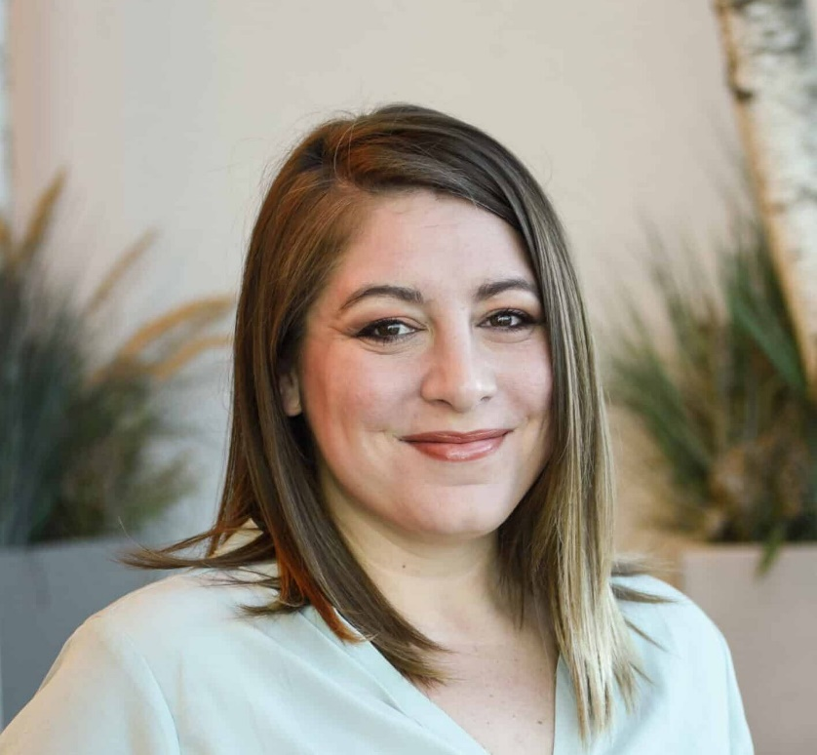
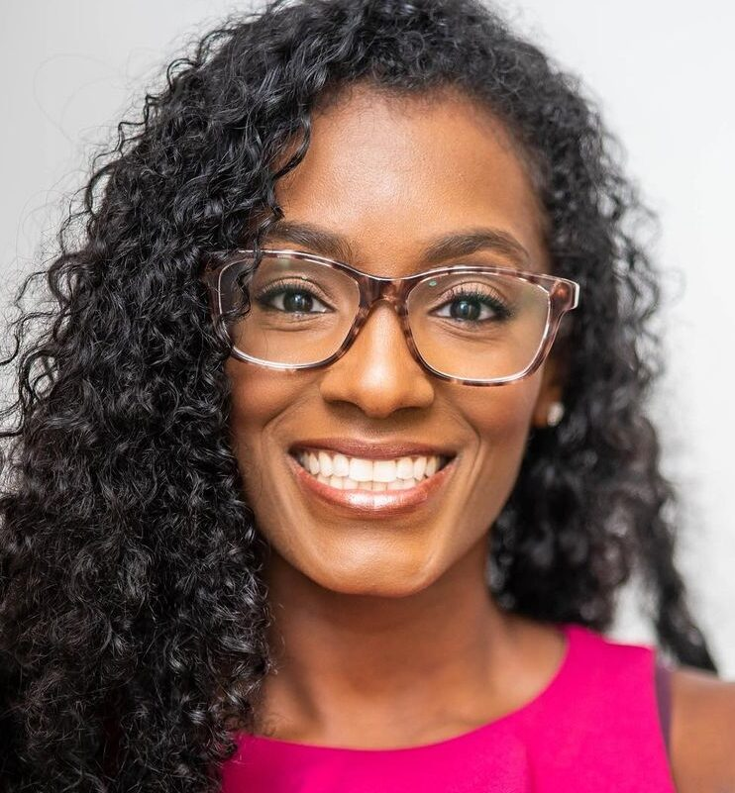
Holmes Program National Office
The AACTE Holmes Program supports students who self-identify as racially and ethnically diverse and are pursuing graduate degrees in education at AACTE member institutions.
Founded in 1991 for doctoral students, the Holmes Program now provides mentorship, peer support, and professional development opportunities
Doctoral and post-doctoral students (Learn more)
Master’s students (Learn more)
Participation in the Holmes Program is open to all AACTE member institutions; AACTE charges no additional fee to enroll.
Sponsoring institutions are responsible for supporting their Holmes scholars according to the participation requirements. Each institution’s Holmes Program Coordinator, a faculty member, carries out these responsibilities.
The Holmes National Office staff support the Program Coordinators and the program at a national level, including but not limited to:
Recruiting and enrolling new programs
Organizing, funding, and evaluating Holmes national office programming (in-person conferences, virtual professional development, stakeholder operations meetings, etc.)
Supporting the sustainment and scaling of the Holmes Program nationally
Collaborating with the Holmes community to develop and distribute innovative best practices for the program and field.
Holmes Program Director
Nicole Dunn, MBA
Director of Program Administration
Holmes Program Oversight
Shari Baker, Ed.D
Vice President of Professional Learning and Growth

Slide 4
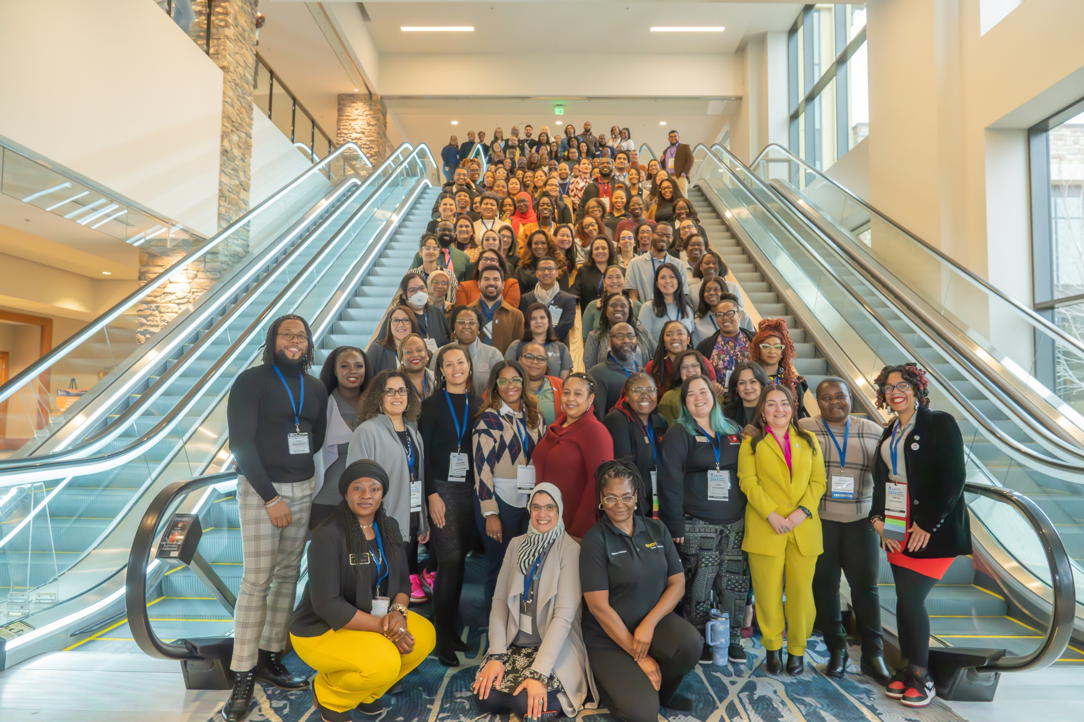
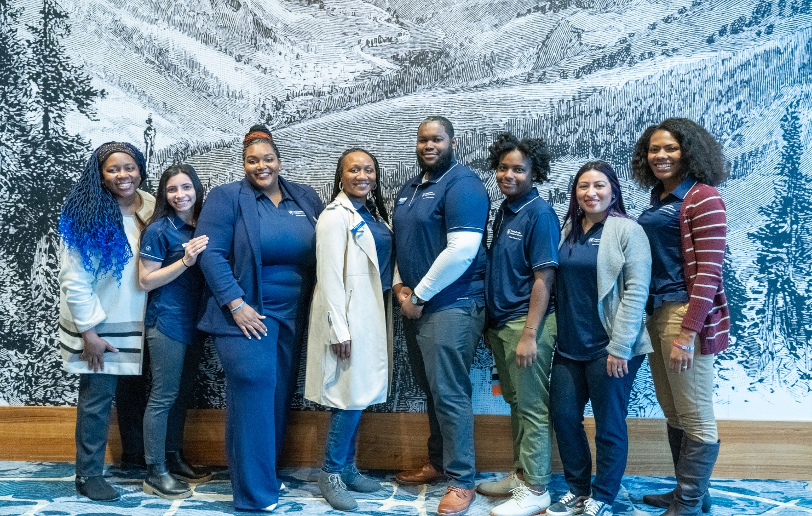
Holmes Institutions and Scholars
Currently, there are 68 Higher Education Institutions with active Holmes Programs and growing! These institutions represent a variety of institutional types
Any institution may launch a Holmes Program if they are an AACTE member.
Institutions have autonomy over their recruitment, selection processes, and program budgets, which often determine the size of their programs.
Some programs, established for over 10 years, sustain a cohort of twenty or more scholars, while others aim for a modest cohort of five or fewer scholars.
Most programs have begun their first cohort with 1-4 scholars.
Currently, Over two hundred Holmes scholars across the nation
80% Doctoral, 15% Masters, 5% Post-Doc
Scholars come from a range of concentrations, including education leadership,
early childhood, special education, curriculum & instruction, and more.
We recommend recruiting Doctoral scholars entering their 2nd year
Penn State Holmes Program, 2024 Holmes Preconference
2024 Holmes Preconference

Slide 5
Participation requirements for launching and maintaining a Holmes Program
Review the participation requirements linked here carefully.
AACTE always sets up an interest call with prospective Holmes Programs to ensure they understand the requirements before we invite them to submit applications. Email Nicole Dunn (ndunn@aacte.org)
The most notable requirements are:
AACTE Membership
Scholars must serve at least a 2-year tenure (*new)
We encourage a 3-year minimum tenure and recommend recruiting scholars entering their second-year
Scholars must attend:
Holmes Preconference annually
Washington Week at least once during their tenure
Optional offerings include:
Holmes Scholar Leadership Council
Holmes Quarterly Virtual PD
Journal of Teacher Education Holmes Fellowship
ECIPC-E Cohort
Pathways into Holmes leadership (Holmes PAC, AACTE committees)
Alumni networks (NAHSA)
A Holmes Program Coordinator must be identified and is required to
Manage operations and on-campus professional development and mentoring.
Attend quarterly virtual meetings
Accompany their scholars to the Holmes Preconference
Estimated Cost Per Scholar = $2,500 per year

Slide 6
AACTE partners with ECIPC-E, funded by the U.S. Department of Education, to improve outcomes for infants and young children with disabilities. Goals:
Build comprehensive personnel development systems for early childhood intervention.
More skilled early childhood leaders and practitioners are needed for children birth to 5 years old.
AACTE's role:
5-year sub-awardee.
Provide mentorship, professional development, and financial support to doctoral students of color in early childhood and early childhood special education.
Recruitment:
A cohort of twelve Holmes Scholars pursuing doctorates in early childhood special education recruited per year. To be eligible you must be enrolled (or show active steps towards enrollment) into your institution’s Holmes program and be one of the following:
Enrolled in an ECSE doctoral program
Enrolled in a ECE doctoral program with a concentration, career goal, or research focus in special education
Enrolled in a SPED doctoral program with a concentration, career goal, or research focus in early childhood
Currently recruiting for Year 2
Holmes Scholars who are interested should review the ECIPC-E and Holmes Partnership FAQ before applying.
Application contact: Nicole Dunn at ndunn@aacte.org.
Partnership outcomes:
Support scholarship and professional development both with
Monthly virtual PD provided by AACTE and its field partners
$2,200 stipend per year cohort member to use towards additional Early Childhood Special Education professional development.
Produce a report on the national landscape of early childhood and special education programs.
Analyze trends in program numbers and graduates vs. demand for professionals with support from cohort scholars
Include analysis of states with legislated funding and successful models for recruitment and retention of early childhood professionals.

Slide 7
Benefits of the Holmes ECIPC-E Cohort
For Holmes Scholars ECSE Doctoral Candidates
Membership in the larger Holmes community of over 200 current scholars, 70 program coordinators, hundreds of alumni, dean-alike groups, and more.
$2,2000 in professional development funds that support their ECSE research and career goals (cost-reimbursable).
A community with a diverse cohort that meets virtually at least monthly and in-person twice yearly. We also maintain an online community and listserv.
Access to monthly virtual professional development with the nation’s leading experts and innovators on ECSE curated specially for this program.
Access to AACTE’s national office and member benefits.
For Institutions
The Holmes Program can be a customizable tool to support your ed prep program’s DEIB goals by recruiting, retaining, and creating the belonging of master's and doctoral students of color to your college.
The professional development stipend offered by the ECIPC-E cohort program can
Entice early childhood special education students to launch or apply to your Holmes program
***many programs launch with only 1-2 scholars
support the associated costs to support those Holmes scholars within the cohort as required by the participation requirements.
Access to AACTE’s national office and member benefits.

Slide 8
Pathways to the Holmes ECIPC-E Cohort The best first step is usually to email Nicole Dunn (ndunn@aacte.org)
I am a Doctoral Candidate focusing on Early Childhood Special Education
Yes
My institution is an AACTE Member
I am a Dean or faculty member interested in launching a Holmes Program
No
Your area of study does not align with this program’s intended outcomes
My institution is an AACTE member
Yes
I am enrolled at an institution with an active Holmes Program
Yes > Scholars apply to ECIPC-E Cohort
No/Unsure > email Nicole Dunn
No > Email Nicole Dunn who will explain membership, discuss options for next steps.
*** You will need the support of your Dean and a sponsoring faculty member who can serve as a Holmes Program Coordinator.
Yes > Email Nicole Dunn to set up a Holmes interest meeting
Become AACTE member
No > Email membership@aacte.org
and cc Nicole Dunn.
Email Nicole Dunn to set up a Holmes interest meeting
Recruit ECSE doctoral scholars
I am a Program Coordinator or supportive faculty interested in recruiting ECSE candidates into our institution’s current Holmes Program
Onboard your new scholars per Holmes standard onboarding processes
Scholars apply to ECIPC-E Cohort
Review the Holmes/ECIPC-E FAQ and requirements to guide your recruitment and selection processes (Email Nicole Dunn as needed)
Recruit and onboard ECSE doctoral scholars
Scholars apply to ECIPC-E Cohort
Recruit and onboard ECSE doctoral scholars
Scholars apply to ECIPC-E Cohort

