Slide 1
An Introduction
Initial Practice-Based Professional Standards for Early Interventionists/Early Childhood Special Educators (EI/ECSE)
Notes:
Today we will review the 2020 Initial Practice-Based Professional Standards for Early Interventionists/Early Childhood Special Educators. Yes, it is a long title so as we move forward we will refer to them as EI/ECSE Standards. Today we will look at the importance of having standards, the themes that connect them, and the standards themselves.
[This PowerPoint presentation was designed by the DEC Personnel Preparation Committee (PPC) EI/ECSE Standards Products Development Workgroup. The PowerPoint is meant to provide an initial introduction and overview of the EI/ECSE professional preparation standards. These presenter notes are meant to guide presenters. They include the vital information that should be provided as an introduction to the EI/ECSE standards.]

Slide 2
Objectives
Define EI/ECSE Standards
Discuss the rationale for and development of the EI/ECSE Standards
Identify themes associated with the EI/ECSE Standards
Provide an overview of the knowledge and skills included in the EI/ECSE Standards
Identify uses for the EI/ECSE Standards
Share resources for understanding and using the EI/ECSE Standards

Slide 3
MILO
Multiple, Individualized Learning Opportunities

Slide 4
What are the EI/ECSE Standards?
The knowledge, skills, and dispositions professionals need to practice competently.
Notes:
The EI/ECSE Standards define the unique and essential knowledge, skills, and dispositions required of early intervention/early childhood special education professionals at the completion of an initial educator preparation program. The standards are applicable across the early childhood age-range (B-8), settings, and child support needs. There are 7 content standards plus a field/clinical experience standard for a total of 8 standards.

Slide 5
Why EI/ECSE Standards?
Prepare the EI/ECSE workforce to support positive outcomes for children and families
Specify the knowledge and skills IHE programs must include in programs of study
Notes:
A high-quality workforce is essential to ensuring positive outcomes for children and families. Developing agreed upon standards helps identify how educator preparation programs, and professional development and technical assistance providers can help ensure such a workforce. The standards can be used to develop and revise curriculum, learning activities, and field experiences for educators. Therefore, the standards can help ensure recipients of EI/ECSE services receive competent care aligned with outcomes that families want for their child and family. Additionally, because the standards identify the unique knowledge areas for EI/ECSE professionals, they help identify where and how practitioners can collaborate with others to better serve children and families.
Finally, the standards reflect the required knowledge and skills that EI/ECSE educator preparation programs at institutes of higher education must align with when seeking CAEP accreditation. CAEP is an independent organization that aims to support excellence in educator preparation through accreditation of educator preparation programs that reflect certain established quality standards. CAEP accreditation requires that programs show alignment with the standards across their curriculum and assessment measures. Whether a preservice program seeks CAEP accreditation or some other accreditation, it is useful for preparation programs to align their curriculum with the knowledge and skills reflected by these standards to help ensure their pre-service educators receive adequate preparation.

Slide 6
How Were the Standards Developed?
ECPC & DEC Partnership
OSEP Funding for Facilitation/TA and Meeting Space
CEC/DEC task force which used:
Iterative Process
Established Resources
Public Input and Feedback
By the Field – For the Field
Notes:
The EI/ECSE standards reflect the best available empirical evidence in EI/ECSE as well as current supporting legislation and the wisdom and experience of the field. DEC, with support from CEC and the Early Childhood Personnel Center (ECPC) convened an Early Intervention/Early Childhood Special Education Standards Development Task Force that included professionals in a variety of roles, including institute of higher education (IHE) faculty, researchers, professional development and technical assistance providers, and accreditation specialists. Individuals on the task force also came from a variety of backgrounds and experiences. The taskforce used multiple sources of information, literature, and resources throughout the iterative standards development process in order to represent the specialized knowledge and skills required of beginning EI/ECSE professionals. The standards are informed by guiding principles found in the DEC Recommended Practices (DEC, 2014) and NAEYC Developmentally Appropriate Practices (DAP) (Copple & Bredekamp, 2009). The development process was also informed by previous sets of standards, including those of CEC and NAEYC, as well as by the InTASC Core Teaching Standards and CAEP Elementary Education standards. Additional resources consulted in developing each standard also included the DEC Specialty Sets within the CEC standards, CEC's High Leverage Practices (McLeskey et al., 2017), professional association position statements and codes of ethics, research studies, and descriptions of practice in recent literature.
Public input and feedback was solicited at multiple points during the standards development process and through multiple means, including in-person listening sessions at national conferences, an online webinar, and a survey. The task force reviewed all public feedback and documented how they incorporated the input throughout the standards development process.
A more detailed discussion of the standards development process can be found in the ECPC Data Report 7 at https://ecpcta.org.

Slide 7
Six Themes within the Standards
Families as partners in decision making
Respect for diversity
Equity for all children and families
Individually, developmentally, age, and functionally appropriate intervention, and instruction
Partnerships, collaboration, and team interaction
Multi-faceted use of technology and interactive media
Notes:
There are six themes that are common across all the standards. The themes reflect underlying values and priorities in the EI/ECSE field.
First, families should be seen as partners in decision making, meaning that educators should collaborate with families in ways that strengthen family capacity, support family priorities, and promote children's development and learning.
Additionally, all EI/ECSE educators should demonstrate respect for the diversity of cultural and linguistic backgrounds, and socioeconomic conditions of families, staff, and programs. Additionally, EI/ECSE educators should respect the many ways children may develop and approach children and families in strengths-based ways, regardless of their cultural or linguistic backgrounds, socioeconomic conditions, or developmental delays and disabilities.
Relatedly, EI/ECSE educators should help advance equity for all children and families, with an emphasis on supporting children and families’ full access to, participation in, and support from programs and professionals. Supporting equity requires educators to be cognizant of the ways that children and families may differ in their support needs and be willing and able to provide supports in line with their expertise in individualized ways, including considerations of children and families’ culture, language, socioeconomic status, or other identities or backgrounds. Finally, supporting equity entails educators advocating for the inclusion and belonging of young children with disabilities and their families, particularly those who may be experiencing disadvantages due to their race, culture, language, socioeconomic status, nationality, sexuality, or other identities and backgrounds.
The fourth theme is that EI/ECSE educators provide individually, developmentally, age, and functionally appropriate intervention and instruction based on sound knowledge of each child's and each family's assets, needs, and preferences for services.
Next, it is important that EI/ECSE educators recognize that partnerships, collaboration and team interaction are essential to effective service provision. EI/ECSE professionals should collaborate with families and other professionals to support the availability and quality of services for children and families. That requires using various team structures and processes for collaboration within and across programs and service systems.
Finally, the last theme is that EI/ECSE professionals should use multi-faceted technology and interactive media to support and enhance education and communication at every level of program practices. Technology and interactive media is also be helpful when used by children, families, and staff.
Two of these themes -families as partners in decision-making & partnerships, collaboration, and team interaction -are both themes across the standards and stand-alone standards, reflecting their centrality to EI/ECSE practice. Partnering with families is Standard 2 and the use of collaboration and teaming processes is Standard 3.
You can find three statements that align with several of these themes on the DEC Standards website -they explain how the standards support inclusion, technology, and respect for cultural and linguistic diversity.

Slide 8
How do you see these themes in your work?
Families as partners in decision making
Respect for diversity
Equity for all children and families
Individually, developmentally, age, and functionally appropriate intervention, and instruction
Partnerships, collaboration and team interaction
Multi-faceted use of technology and interactive media
Notes:
How do you see these themes play out in their specific role or work?
Why do you think they are important?

Slide 9
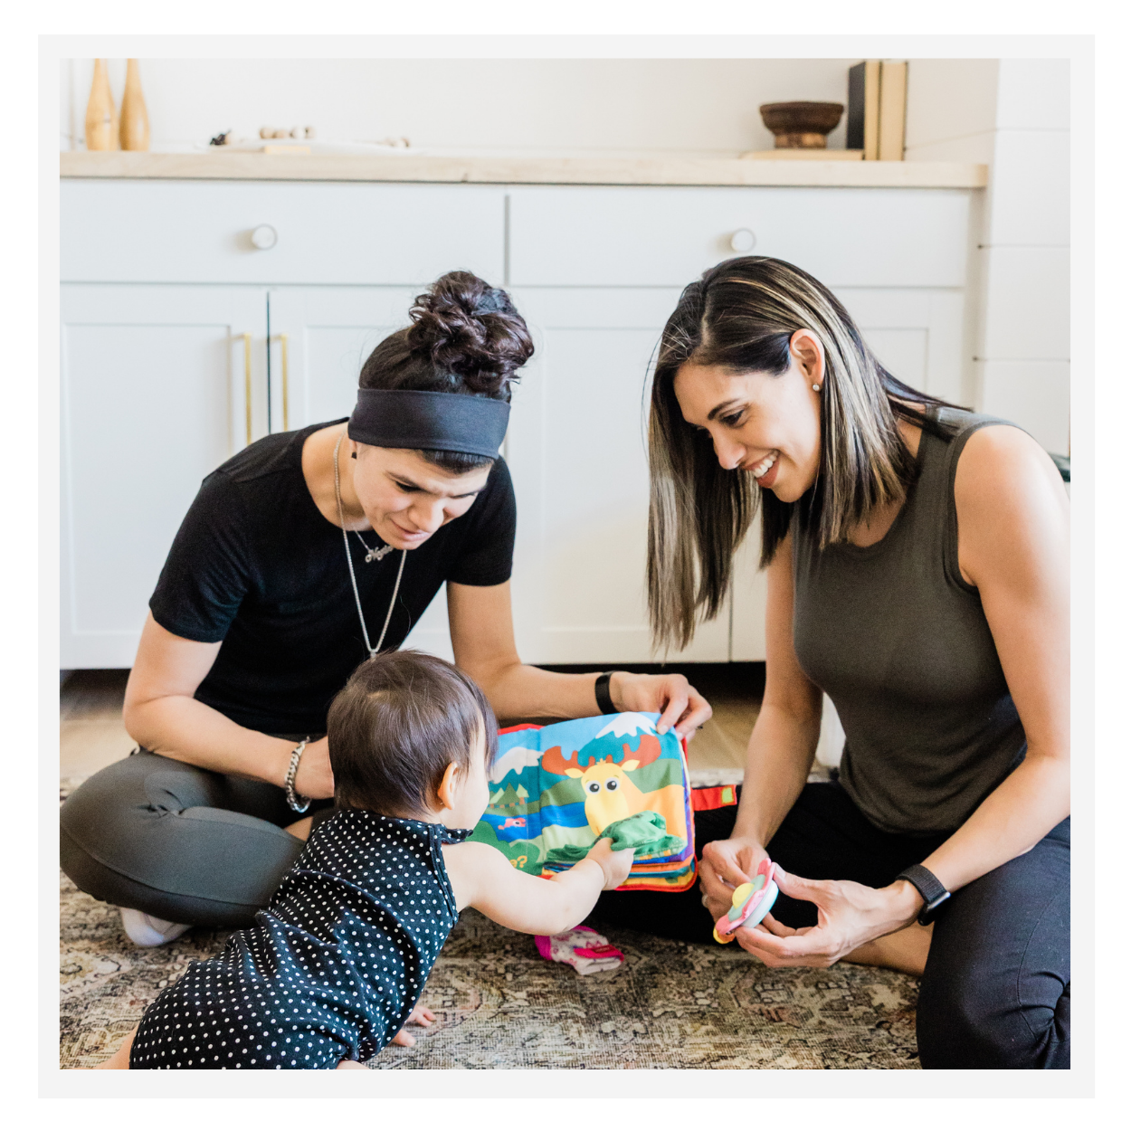
Examples of Themes
Notes:
Here are a few examples to illustrate the application and importance of the themes across the standards and EI/ECSE practice.

Slide 10
Families as Partners in Decision-Making
Standard 2: Partnering with Families
Families are essential sources of knowledge about their children during assessment processes (Standard 4.4)
Families should contribute to decisions about curriculum & individualized supports (Standard 5.1; Standard 6.1)
Notes:
Partnering with families is so important that it is both a theme and a stand-alone standard - Standard 2. The importance of partnering with families when making decisions is reflected in all standards. For example, educators should collaborate with families and recognize them as an important source of knowledge about their children throughout the process of selecting, implementing, and interpreting assessments to determine eligibility, develop child and family-based outcomes/goals, plan for interventions and instruction, and monitor progress, as described in Standard 4.4 (Standard 4, component 4). EI/ECSE professionals should also partner with families when identifying curriculum and learning opportunities because families can offer important information about children’s abilities and support needs, and should be included in decisions about what their children learn and how they should be supported. That is reflected in Standard 5.1 (Standard 5, component 1), which states that professionals should partner with families to design and facilitate meaningful learning opportunities, and Standard 6.1 (Standard 6, component 1), which states that professionals should partner with families to identify systematic, responsive, and intentional evidence-based practices.

Slide 11
How can you support EI/ECSE professionals’ ability to partner with families?
Notes:
How do you support EI/ECSE professionals’ ability to partner with families in your role or work? Participants can share resources, learning activities or assignments, field experience activities, etc. (discussion or, if the presentation is delivered online, participants can use a chat function).

Slide 12
Respect for Diversity
Understand development occurs within a social, cultural, & linguistic context; refrain from deficit perspectives (Standard 1.2)
Select assessment tools that are culturally- and linguistically- appropriate (Standard 4.1)
Partner with families in ways that are culturally- and linguistically-responsive (Standard 2.1)
Notes:
Again, all EI/ECSE professionals should demonstrate respect for the diversity of cultural and linguistic backgrounds, and socioeconomic conditions of families, staff, and programs. Additionally, EI/ECSE educators should respect the many ways children may develop and approach children and families from a strength-based perspective.
In the standards, we see the importance of respecting diversity and how that informs practice in all of the standards. EI/ECSE educators should recognize that development happens within a social, cultural, and linguistic context, which is apparent in Standard 1.2 (Standard 1, component 2). For example, the language of a child who is a dual language learner develops differently from a child who is monolingual. Those differences should not be viewed as deficits or as a disability. Additionally, EI/ECSE educators should pay attention to children’s and families’ strengths, cultural values and priorities when trying to understand the child’s abilities and support needs. Some differences in development between the child’s abilities and educator expectations may be because of cultural differences that shape how the family supports their child’s development and what their expectations and priorities are.
Respect for diversity is also important when selecting assessment tools. Standards 4.1 (Standard 4, component 1) emphasizes that EI/ECSE educators should select assessment tools and methods that are culturally- and linguistically-appropriate in order to get an accurate picture of the child’s and families’ support needs. When educators understand that, they may select assessment tools that have been translated to the child or family’s home language, mode and style of communication, and/or use an assessment that accounts for differences in development when a child is a dual language learner or comes from a certain cultural background. The educator should also make sure to select assessment tools that have been normed on a population that is similar to the child in terms of their racial, social, and cultural background.
As a final example (though this themes shows up in other standards), EI/ECSE professionals should be careful to partner with families in ways that are culturally- and linguistically-responsive and affirming, as addressed in Standard 2.1 (Standard 2, component 1). This may mean having conversations with families about what respectful and good communication looks and sounds like to them, and interacting with them accordingly. It also means that educators should respect and follow a family’s priorities for their children’s development, even if the educator disagrees, as long as it is not found to be harmful to the child. When educators respect diversity, it is important that they approach all families from a strength-based perspective that recognizes that all families want the best of their children, even if they support them in ways that are different from the educator ideas.

Slide 13
How can you support EI/ECSE professionals’ respect for diversity and ability to be culturally responsive?
Notes:
How do you support EI/ECSE professionals’ respect for diversity and their ability to be culturally responsive? Participants can share resources, learning activities or assignments, field experience activities, etc. (discussion or, if the presentation is delivered online, participants can use a chat function).

Slide 14
Notes:
We’re going to shift to reviewing the actual standards. There are 7 content standards and one field/experience clinical standard for a total of 8. The standards are built upon the underlying foundational themes previously discussed, which are elevated within and integrated across all standards.
Each standard has two or more components for a total of 27 components across the standards. The components align with the standard statement and further explain the standard. Each component has a supporting explanation that discusses actual application with examples of the component in a preservice preparation program or professional development content.
[As you shift into the individual standard slides, make sure to pause for questions and check for understanding after each standard slide. You can also ask participants to share ideas about how they support the knowledge and skills reflected in each standard at the end of each slide.]

Slide 15
Standard 1: Child Development and Learning
Emphasizes using knowledge of child development and learning, including:
relevant theoretical perspectives
developmental sequences, and individual differences in development and learning based on biological and environmental conditions
etiologies, characteristics, and individual differences across a range of abilities
implications for assessment, curriculum, instruction, and intervention
Notes:
Standard 1, Child Development and Learning, has four components. Standard 1 emphasizes the importance of knowledge of relevant theoretical perspectives (e.g., Piaget, Vygotsky), developmental sequences, and individual differences in development and learning based on biological and environmental conditions. It also addresses etiologies , characteristics, and individual differences across a range of abilities, including developmental delays and disabilities, and their impact on development and learning. A key aspect of Standard 1 is educators being able to apply and translate knowledge about child development and early learning to assessment, curriculum, instruction, and intervention.

Slide 16
Standard 2: Partnering with Families
Focuses on using knowledge of:
family systems theory, family-centered practices, and family capacity building practices
strategies to support clear and comprehensive communication
strategies to identify family strengths and priorities, and engage families as active team members
Notes:
Standard 2, Partnering with Families, has three components. Standard 2 focuses on using knowledge of family systems theory and family-centered practices to build partnerships with families, apply family capacity building practices to support informed decision-making and advocacy, and engage families as active team members in planning and implementing assessment, intervention, instruction, and transition. Collaboration with families should be culturally- and linguistically-responsive, be based on family strengths, priorities, and concerns, and promote family competence, confidence, and advocacy.

Slide 17
Standard 3: Collaboration and Teaming
Centers around:
applying teaming and collaboration models, skills, processes, and strategies
using collaboration strategies that are evidence-based and culturally and linguistically responsive
collaboratively developing individualized plans, including transition plans
Notes:
Standard 3, Collaboration and Teaming, has three component. Standard 3 centers around applying teaming and collaboration models (e.g., interdisciplinary, transdisciplinary) , skills, processes, and strategies (e.g., coaching, consultation) with families and other professionals (e.g., physical therapists, speech/language therapists) to engage in individualized intervention and transition plan development. Collaboration strategies should be evidence-based, appropriate to a task, and culturally- and linguistically-responsive to team members, including families.

Slide 18
Standard 4: Assessment Processes
Reflects the importance of:
understanding assessment purposes
choosing appropriate assessment tools and methods
administering, interpreting, sharing, and utilizing assessment results
collaborating with families and other professionals during & after assessment processes
Notes:
Standard 4, Assessment Processes, has four components. Standard 4 reflects the importance of understanding assessment purposes (e.g., eligibility, identifying appropriate assessments), and choosing and administering appropriate informal and formal assessment measures and methods that are reliable and valid. It also addresses interpreting, documenting, and sharing assessment results using a strength-based approach when collaborating with families to determine eligibility, develop child and family-based outcomes/goals, plan intervention/instruction, and monitor progress.

Slide 19
Standard 5: Application of Curriculum Frameworks in the Planning and Facilitation of Meaningful Learning Experiences
Focuses on:
understanding and applying curriculum frameworks that address developmental and content domains
designing and facilitating equitable and meaningful learning opportunities
planning learning experiences in natural and inclusive environments
Notes:
Standard 5, Application of Curriculum Frameworks in the Planning and Facilitation of Meaningful Learning Experience, has two components. Standard 5 focuses on understanding and applying curriculum frameworks that address developmental and content domains (e.g. literacy, numeracy) to create and facilitate high quality, equitable, meaningful, and culturally responsive learning opportunities across natural and inclusive environments. This standard emphasizes the importance of developing learning experiences that are challenging, developmentally appropriate, and universally designed.

Slide 20
Standard 6: Using Responsive and Reciprocal Interactions, Interventions, and Instruction
Addresses planning and implementation of evidence-based practices, with fidelity, and in partnership with families and other professionals, including:
systematic, responsive, and intentional practice
embedded instruction
practices to promote social and emotional competence, and play
data-based decision making
Notes:
Standard 6, Using Responsive and Reciprocal Interactions, Interventions, and Instruction, has seven components. Standard 6 addresses planning and implementing systematic, responsive, evidence-based practices, with fidelity and in partnership with families and other professionals. This standard emphasizes designing natural and inclusive learning environments to integrate a range of evidence-based practices, including flexible and embedded instruction, practices to promote social and emotional competence, and opportunities for young children to learn play skills and engage in meaningful play independently and with others. EI/ECSE professionals should be able to implement interactions, interventions, and instruction with sufficient intensity and types of support across activities, routines, and environments to promote child learning and development and facilitate access, participation, and engagement in natural environments and inclusive settings. Finally, this standard emphasizes that EI/ECSE professionals should use data-based decision making in planning, implementing, and adapting intervention and instruction.

Slide 21
Standard 7: Professionalism and Ethical Practice
Captures the importance of:
engaging in professional activities and reflective practices
accessing evidence-based information for professional growth
advocating for improved outcomes for children, families, and the profession
understanding and adhering to ethical and legal policies and procedures
Notes:
Standard 7, Professionalism and Ethical Practice, has four components. Standard 7 captures the importance of engaging in professional activities and reflective practices; accessing evidence-based information for professional growth; advocating for improved outcomes for children, families, and the profession; and understanding and adhering to ethical and legal policies and procedures.

Slide 22
Field and Clinical Experience Standard
Field and clinical experiences are:
sequenced to facilitate increasing responsibilities
based on licensure, reflecting a range of ages (B-3, 3-5, 5-8), abilities, natural and inclusive settings
supervised by qualified professionals
Notes:
In addition to the seven content standards, professional associations may also include a standard that provides guidance on field work and more intensive clinical experiences (e.g., internships, student teaching). This standard does not have components, however, it does have a supporting explanation that explains its core guidelines.
The EI/ECSE Field and Clinical Experience Standard reflects the ways field experiences should be designed and supported to help EI/ECSE professionals link EI/ECSE research and theory to practice. Field experiences should provide rich, scaffolded, developmental, and graduated experiences with increasing responsibilities for prospective early interventionists and early childhood special educators. The licensure should determine what age bands, child abilities, and settings field and clinical experiences take place in. In particular, clinical experiences should take place in the same age ranges covered by the license. If the license covers all three early childhood age ranges, the program must provide clinical experiences in at least two of the three age ranges and a field experience in the third age range. Field and clinical experiences should be supervised by qualified professionals who have expertise and experience in serving young children with disabilities and their families in the role that for which the EI/ECSE professional is being prepared.

Slide 23
Using the EI/ECSE Standards
Apply for accreditation,
Develop/revise initial preservice program curricula/programs of study,
Design professional development systems to build on/compliment preservice preparation, and
Provide guidance for certification/licensure requirements.
Notes:
As the nationally validated professional standards for early interventionists and early childhood special educators, DEC policy views these standards as having multiple purposes/applications.
Higher education programs submitting for accreditation through the Council for Accreditation of Educator Preparation Programs (CAEP) must align their initial preparation programs of study with these standards. The EI/ECSE Standards may be used for this purpose beginning in spring 2021. All initial preparation programs seeking CAEP accreditation must use these standards beginning in winter/spring 2023. All standards and components must be reflected in the program of study.
As the national professional standards in EI/ECSE, the expectation is that all higher education preservice programs preparing early interventionists and early childhood special educators align their curriculum/program of study with the knowledge and skills reflected in these standards.
The EI/ECSE Standards provide guidance for professional development content and technical assistance. PD/TA providers can ensure they are supporting EI/ECSE professionals’ continued growth in the knowledge and skills represented by the standards.
The EI/ECSE Standards can also provide guidance for the development of states’ certification/licensure standards for the preparation of EI/ECSE professionals. States may adopt the EI/ECSE Standards as their state standards or crosswalk the standards with their state standards to ensure EI/ECSE professionals are being prepared in these essential knowledge and skills.
Depending on the audience, the presenter should pose a reflection/discussion question asking how the participants could use the standards in these ways based on their role and work. For example, if the audience is primarily IHE faculty, the presenter should ask them what it may look like to use the standards to develop or revise their program curriculum? How might they do that? If the audience is mixed, the presenter may ask participants what using the standards for multiple/all these purposes may look like.]

Slide 24
Resources
DEC EI/ECSE Standards Website: Initial Practice-Based Professional Standards for Early Interventionists/Early Childhood Special Educators (EI/ECSE)
Early Childhood Personnel Center (ECPC)
Notes:
Multiple resources can be found at each of these sites to assist higher education faculty and professional development providers in using the EI/ECSE standards. In addition, resources should be beneficial as individuals advocate for state and local policies that adhere to the EI/ECSE Standards.
The first link will take you to the DEC web page for the EI/ECSE standards. That page includes more information about how the standards were developed and resources you can use for pre-service preparation and in-service PD that applies the standards. For example, the webpage includes the knowledge bases for the standards, which describe key literature that supports the standards, program evaluation rubrics, and concrete examples of learning activities that EI/ECSE professionals can engage in to gain the knowledge and skills reflected in the standards.
The second link will take you to the ECPC website. ECPC is an OSEP-funded technical assistance center that supports pre-service preparation in EI/ECSE. Their website includes a variety of curriculum development resources, including crosswalks juxtaposing the EI/ECSE standards with the DEC recommended practices and NAEYC ECE personnel preparation standards, sample syllabi based on the standards, case studies, a curriculum planning tool, and a curriculum module for each of the seven content standards.
Make sure to check out these great resources and more are to come!
Are there any additional questions about the EI/ECSE personnel preparation standards, the ways you can use them, or resources to support their use?

Slide 25
CEC Accreditation w/Equity
https://exceptionalchildren.org/accreditation
NAEYC Accreditation
Early Learning Program Accreditation
https://www.naeyc.org/accreditation/early-learning-program-accreditation

