Slide 1
Leading Change in Institutions of Higher Education to Advance Early Childhood Intervention Programs of Study

Slide 2
Mary Beth Bruder
will set the stage for us

Slide 3
What we will do together today
Learn about each other and the HBCUs and MSIs you represent
Divide into affinity groups of HBCUs and MSIs to explore opportunities and challenges in the early childhood education and intervention space
Explore the concepts of leadership and leaders and differentiate between the two
Listen and share … lessons of the journey leading change in HBCUs and MSIs
Identify the adaptive challenges and work of leadership and leading change in HBCUs and MSIs in general and to advance new programs of study in particular

Slide 4
Introductions in 3 minutes…
or less
Share:
your name
what state, tribal nation, or territory in which you reside
your HBCU or MSI affiliation
Respond to this question:
Other than this amazing venue, what is your primary motivation to participate in this early childhood intervention systems change opportunity for HBCUs and MSIs?

Slide 5
Small Group Dialogue
What are the primary benefits to you see in starting or expanding an early childhood education or early childhood intervention program of study at you HBCU or MSI?
Consider the current socio-cultural, political, and economic environments in your HBCU or MSI and state/territory. What are the primary challenges you envision to gain “buy in,” and support to start or expand an early childhood education or early childhood intervention program of study?

Slide 6
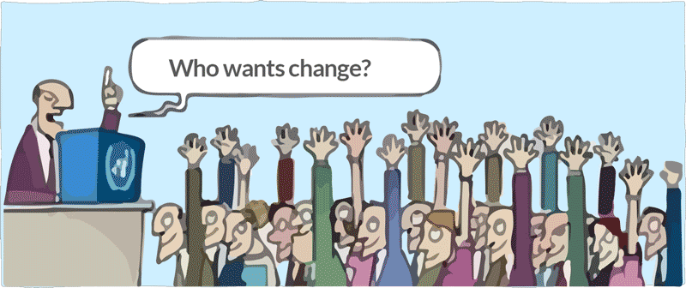
One reason why change is so hard

Slide 7
Assuming the role of leader to effect change

Slide 8
Think about …
How do you see yourself as a leader?
How do you see yourself in leadership?
Slide Source:© 2024 - Georgetown University National Center for Cultural Competence

Slide 9
1, 2, 4 FOR ALL
Take 4 minutes to respond to the questions
Pair up with a partner and share your thoughts with each other.
Try someone you don’t know or don’t know well. 4 minutes
Get into groups of 4 (pair with a pair) and share. Look for similarities and differences. What are you learning about yourself and others?
All ─ come back together and offer one insight from your quad.
Adapted from Change Matrix
Slide Source:© 2024 - Georgetown University National Center for Cultural Competence

Slide 10
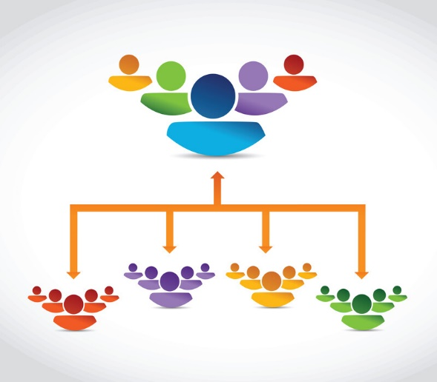
Exploring leadership and leaders and differentiating between the two
leader
Slide Source:© 2024- Georgetown University National Center for Cultural Competence

Slide 11
Differentiating Leadership, Management, & Advocacy
Slide Source:© 2024- Georgetown University National Center for Cultural Competence

Slide 12
Leadership is NOT …
Management
Authority
Advocacy
Slide source: © Georgetown University Leadership Academy, National Center for Cultural Competence

Slide 13
Leadership is different than management
Managers
Managers manage things.
Managers are needed to improve and maintain the status quo
Leaders
Leaders lead people.
Leaders are needed in times of change and transformation.
Understanding the difference is one of the first steps to understanding one’s role as a leader.
Slide source: © Georgetown University Leadership Academy, National Center for Cultural Competence

Slide 14
Leadership is different than advocacy
Advocacy
Leadership
Provides focus and attention
Tells
Argues
Persuades
Provides focus and attention
Brings people together
Mobilizes resources
Asks and reflects
Slide source: © Georgetown University Leadership Academy, National Center for Cultural Competence

Slide 15
Leadership is a set of personal attributes, qualities, and skills either intuitive and/or acquired that rouses and motivates others (Northouse, 2001). One can demonstrate leadership by position and by influence ─ both are necessary to advance equity in HBCUs and MSIs.
Source: Adapted from Goode & Jackson. NCCC CLC Leadership Academy
Slide Source:© 2024 Georgetown University National Center for Cultural Competence

Slide 16
Assertion-
Anyone can be a leader at any time and in any context.
A leader:
is a person who inspires and engenders trust in others;
uses and shares power to achieve a desired outcome or goal;
is conscious and aware of the influence of cultural values, beliefs, and behaviors─ their own, those of others, and those embedded in the fabric of society and its institutions; and
is an in influential person.
Change always takes place within the socio-cultural, political, and economic environment.
Leadership for change in HBCUs and MSIs requires the capacity to identify and effectively address the adaptive challenges ─ for self and for others.
Source: Adapted from Goode & Jackson. NCCC CLC Leadership Academy
Slide Source:© 2024- Georgetown University National Center for Cultural Competence

Slide 17
Advancing Change in HBCUs and IHEs
Personal or individual and organizational or institutional change requires the capacity to differentiate between and meet the challenges of both technical and adaptive work.
Slide Source:© 2024 - Georgetown University National Center for Cultural Competence

Slide 18
Equity within the Context of Personal and Organizational Change
technical challenge
vs.
adaptive challenge
Does making progress require
changes in people’s values, attitudes,
and behaviors?
Reference: Heifetz, R.A. (1994). Leadership Without Easy Answers. Cambridge, MA: The Belknap Press of Harvard University Press
Slide Source:© 2024 - Georgetown University National Center for Cultural Competence

Slide 19
Differentiating Technical and Adaptive Work
TECHNICAL WORK
Perspectives are aligned
Definition of the problem is clear
Solution to and implementation to address the problem is clear
Primary responsibility for organizing the work lies with the formal or appointed leader
ADAPTIVE WORK
Legitimate yet competing perspectives
Definition of the problem is unclear
Solution and implementation require learning
Primary locus of responsibility is not the formal or appointed leader
Reference: Heifetz, R.A. (1994). Leadership Without Easy Answers. Cambridge, MA: The Belknap Press of Harvard University Press
Slide Source:© 2024 - Georgetown University National Center for Cultural Competence

Slide 20
TECHNICAL WORK | ADAPTIVE WORK
Establishing an early childhood education and intervention work group | Doing the ongoing work of an equity or EDI work group Establishing a clear and compelling vision Staying the course to achieve stated goals & objectives to achieve personal and institutional change Ensuring access to resources (personnel & fiscal) Responding to the dynamics of difference yet maintaining a cohesive group Engaging all voices including the “indispensable opposition” and naysayers
Developing subject matter and curricula content inclusive of early childhood education and intervention | Ensuring faculty and staff embrace the principles of equity in their respective roles and responsibilities Pedagogy Practice Scholarship Research Community engagement Mentoring Recruitment
Slide Source:© 2024 - Georgetown University National Center for Cultural Competence
Notes:
Large group

Slide 21
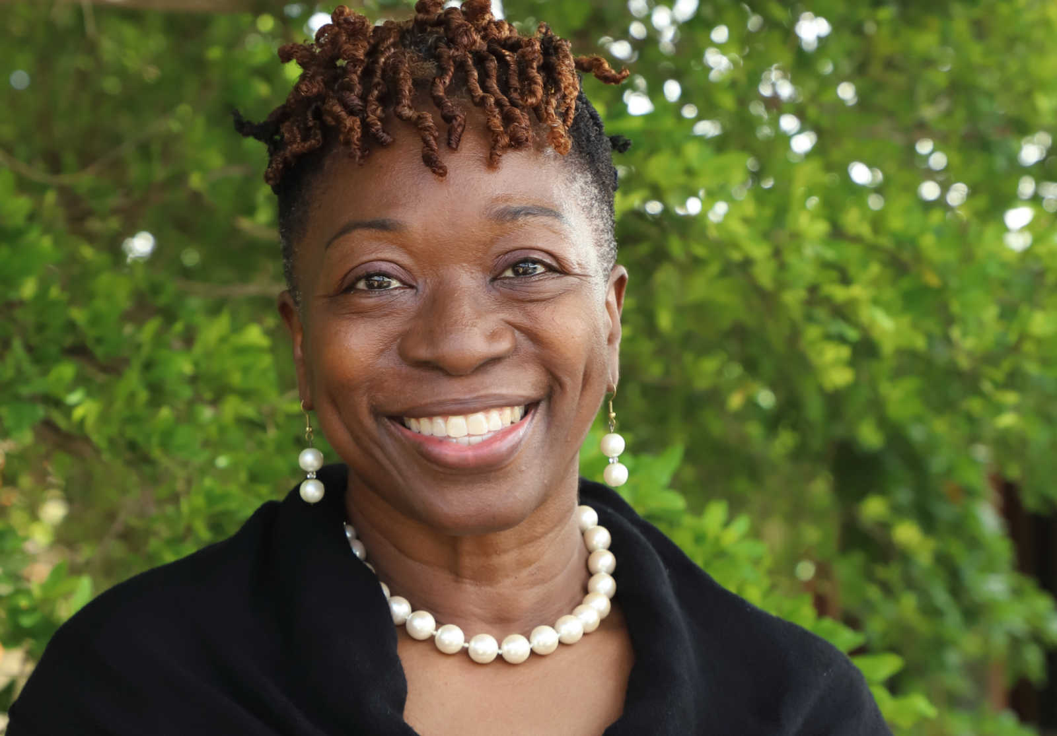
Listening and Sharing… Leading Change in IHEs
The road ahead is rarely straight!
Lydia Ocasio-Stoutenburg, PhD
Karen Brown, Ph.D.

Slide 22
College, School, Department
Buy-in and investment of: Faculty Staff Students Communities and their members Dedicated leadership
University
Visible high-level leadership Dedicated fiscal resources Institutional policy and structural change initiatives
Small Group Dialogue
What is the socio-cultural and political environment in which you are advancing change in your HBCU or MSI?
How will you address the adaptive challenges that will invariably come your way?
Slide Source:© 2024 - Georgetown University National Center for Cultural Competence

Slide 23
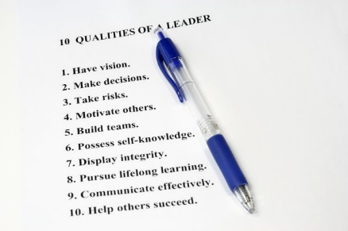
YOU ARE LEADING
WITH OR WITHOUT
Model the way
Inspire a shared vision
Challenge the process
Enable others to act
Encourage the heart
Five Practices of Exemplary Leadership ♦ Leadership Practices Inventory
Get on the balcony
Identify the adaptive challenge
Regulate distress
Maintain disciplined attention
Involve all of the people in the work
Protect all voices
Heifetz, R. (1996). Leadership without Easy Answers.
FORMAL
AUTHORITY
WHEN YOU
Slide Source:© 2024 - Georgetown University National Center for Cultural Competence

Slide 24
What are one-two outcomes you want
as result of your participation in this change opportunity?

Slide 25
Georgetown University National Center for Cultural Competence
http://nccc.georgetown.edu
cultural@georgetown.edu
The content of and this PowerPoint presentation are copyrighted and are protected by Georgetown University's copyright policies.
Permission is granted to use this PowerPoint presentation in its entirety and/or individual slides for non-commercial purposes if:
the material is not to be altered and
proper credit is given to the author(s) and to the National Center for Cultural Competence.
Permission is required if the material is to be:
modified in any way
used in broad distribution.
To request permission and for more information, contact cultural@georgetown.edu.

