Slide 2
Purpose of ECiPC-Equity
To increase the capacity of institutions of higher education, professional organizations, states, territories, and tribal nations
To prepare and support a diverse and competent workforce
Who will change the historic and current conditions that systemically inhibit
The delivery of equitable early childhood intervention to each and every child and their family.

Slide 3
If you treat an individual as he is, he will stay as he is,
but if you treat him as he ought to be, and could be,
he will become what he ought to be and could be.
~ Goethe

Slide 4
Early Childhood Intervention
refers to therapeutic (excluding drug or surgical manipulation) or educational intervention…
of a planned nature aimed at eliminating a current or anticipated deficiency in a target population.
(Bricker, Bailey, & Bruder, 1984, p. 374)

Slide 5
The Science of Learning
Notes:
SOURCE: Levitt (2009)

Slide 6
Science of Learning
The brain is adaptable and can be influenced by positive experiences;
The brain is vulnerable and can be harmed by negative experiences

Slide 7
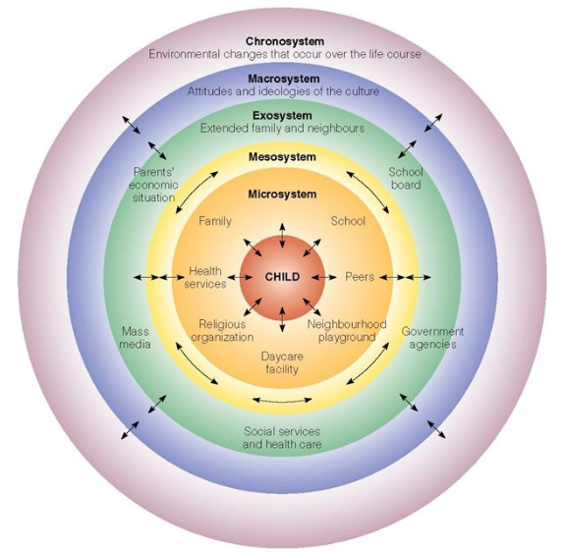
Source from Bronfenbrenner, U. (1992). Ecological systems theory. In R. Vasta (Ed.), Six theories of child development:
Revised formulations and current issues (pp. 187–249). Jessica Kingsley Publishers.

Slide 8
Education for All Handicapped Children Act of 1975
1975 - The U.S. Congress passed P.L 94-142 the landmark federal policy for the education of children with disabilities, ages 3–21, the Education for All Handicapped Children Act of 1975
P.L. 94-142, established a free appropriate public education (FAPE) by September 1,1980 for all eligible 3–21-year-old children with disabilities
Law was voluntary for states but required that if a state applied for and accepted funding under the law, it must ensure a free, appropriate public education to all children with disabilities, ages 6–18, in the least restrictive environment and according to a written Individualized Education Program (IEP)

Slide 9
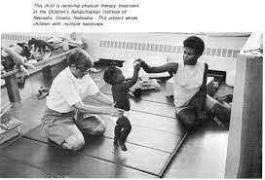
EHA Requirements For Young Children - 1975
P.L. 94-142 contained a provision limiting the “mandate” to children 3–5 and 18–21 years of age
Unless state policy provided public education for children 3–5 or 18–21, the state did not have to provide it for children with disabilities in the age range
Most states did not provide public education to children 3–5
P.L. 94-142 provided financial incentives to states to provide preschool education to children with disabilities younger than age six through preschool incentive grants

Slide 10
Personnel in Early Childhood Intervention
Special Educators
Speech-Language Pathologists and Audiologists
Occupational Therapists
Physical Therapists
Psychologists
Social Workers
Nurses
Nutritionists
Family Therapists
Orientation and Mobility Specialists and
Pediatricians and other Health Care Providers

Slide 11
Intervention Services
Special education/instruction
Speech pathology and audiology
Occupational therapy
Physical therapy
Psychological services
Case management services
Medical services only for diagnostic or evaluation purposes
Early intervention, screening, and assessment services
Vison services
Health services necessary to enable the infant or toddler to benefit from the other early intervention services
Social work services
Assistive technology devices and assistive technology services
Transportation and related costs that are necessary to enable an infant or toddler or the infant’s or toddler’s family to receive early intervention services

Slide 12
ECI: Developmental Systems Approach
Exit
System
Pass
Periodic
Review
Concern
Risk
No
Pass
Yes
Monitoring
Program
Monitor?
No
Start
Screening
Program or
Referral
Point
of
Access
Delay
Disability
Comprehensive
Interdisciplinary
Assessment
Early
Intervention
Program
Eligible?
Yes
Enter Early
Intervention
Program
Assessment
of
Stressors
Concern
Risk
Biological
Risk
Environmental
Risk
Developmental profile
Diagnostic/etiologic
information
General recommendations
Preliminary
Intervention
Program
Information needs
Interpersonal and
family distress
Resource needs
Confidence threats
No
Enter Preventive
Intervention
Program
Preliminary
Intervention
Program
Family characteristics
Develop and
Implement
Comprehensive
Program
Monitoring
and
Outcome
Evaluations
Transition Planning
Resource supports
Social supports
Information and services
Progress toward goals and objectives
Re-assessment of stressors
Comprehensive interdisciplinary
assessment or re-assessment
(from Guralnick, 2001, Infants and Young Children)

Slide 13
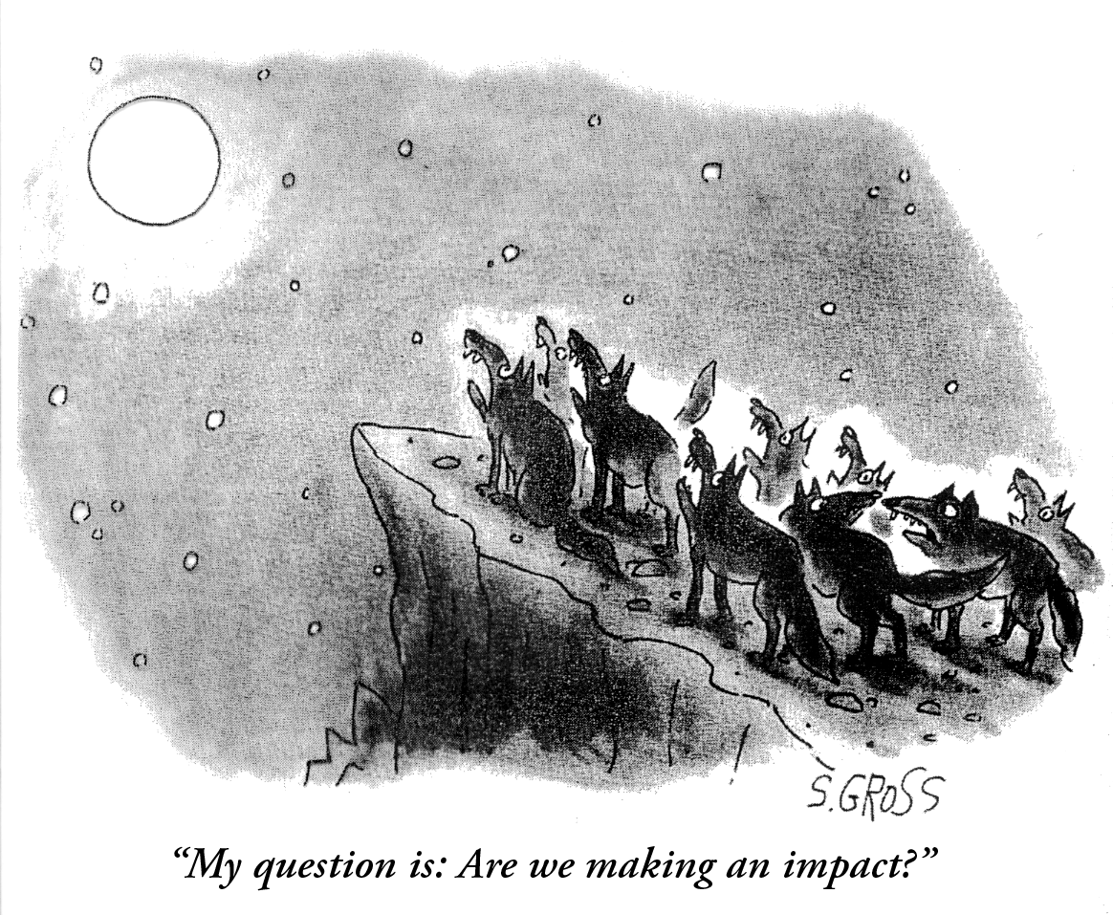

Slide 14
If the Child and Family Outcomes are the Dependent Variables
Personnel Are the…………

Slide 15
a) Independent Variable
b) Dependent Variable
c) Mediator
d) Moderator
e) All of the Above

Slide 16
Conclusion
Personnel Can Have a Powerful Impact....
or NOT

Slide 17
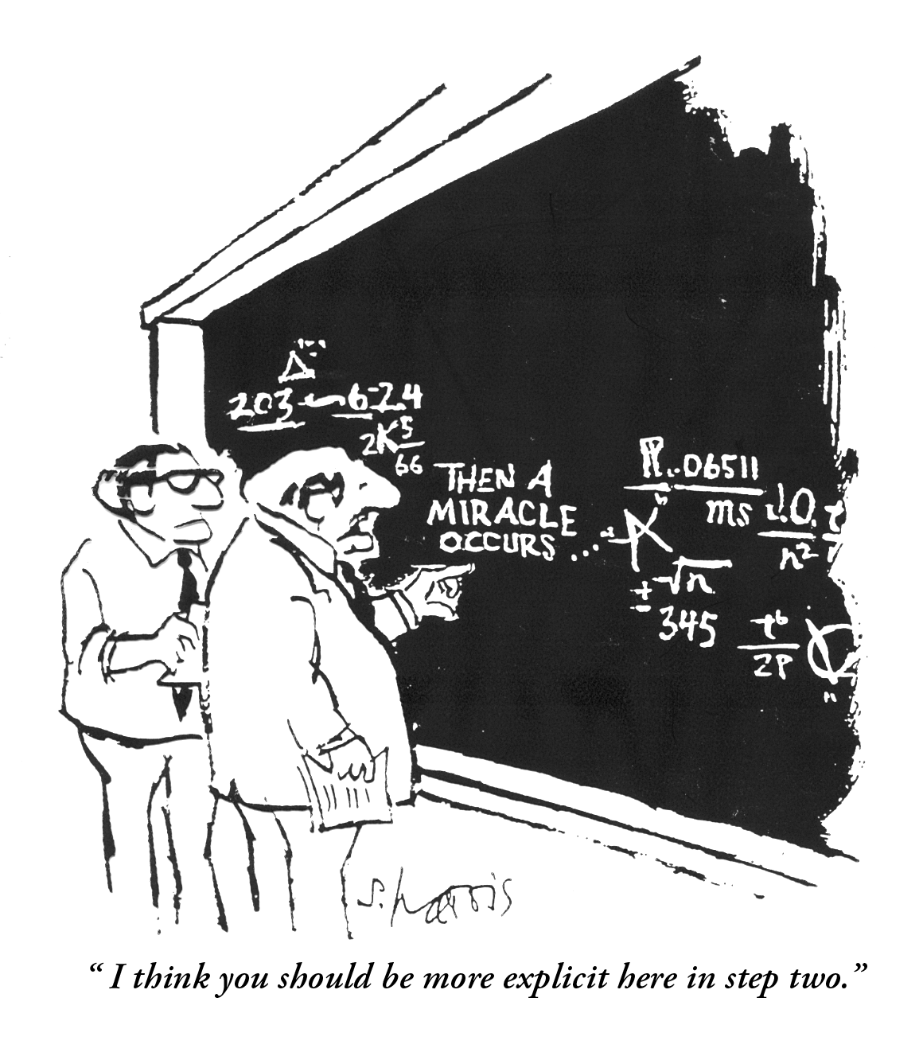

Slide 18
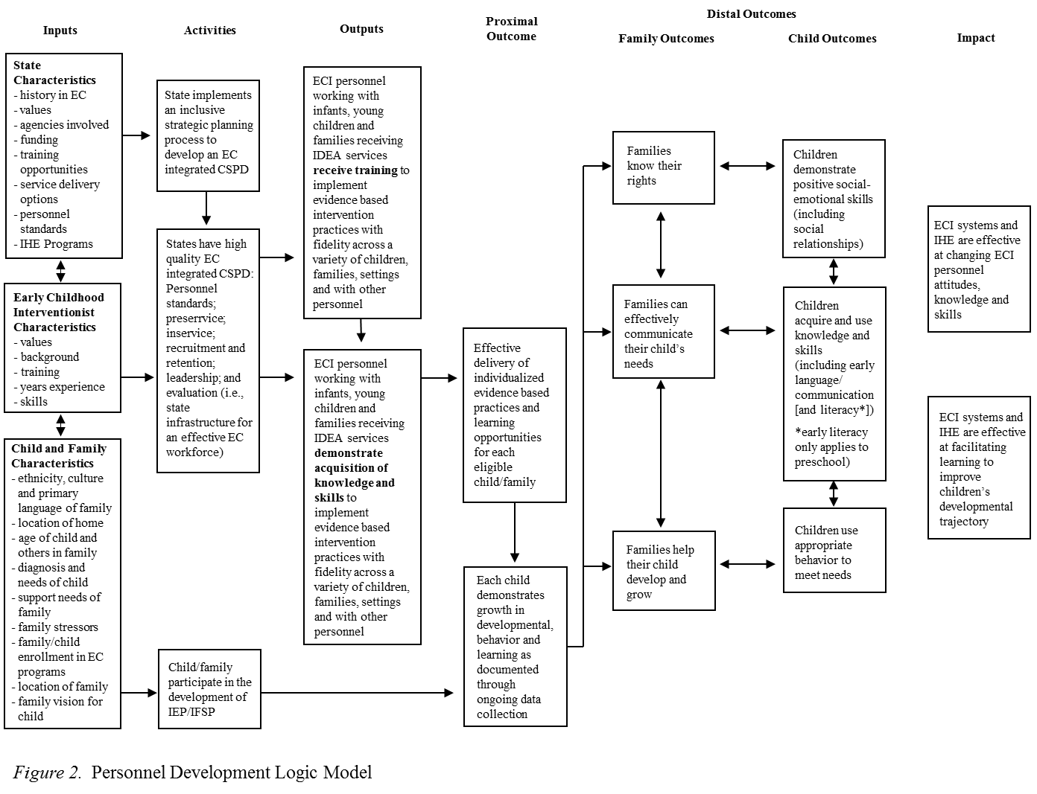
Personnel Development Logic Model

Slide 19
If we want improved outcomes for infants and young children with disabilities and their families…….
More ECI faculty, leaders, and practitioners have the requisite ECI philosophy attitudes, beliefs, knowledge and skills
Improved outcomes for children and families
Improved effectiveness of ECI services and supports
Theory of Action

Slide 20
Personnel/Workforce Effectiveness and Impact Depends on……..
Philosophy, Attitude and Beliefs
Knowledge
Skill

Slide 21
ECI Philosophy, Attitudes and Beliefs
Family Centered Practices
Team Based Service Delivery
Inclusive and Natural Learning Opportunities

Slide 22
Philosophy, Attitudes, Beliefs Depend on….
Family
Society
Background Characteristics
Values
History
Experience
Education
Peers
Motivation

Slide 23
DEC EI/ECSE Standards
Child Development and Early Learning
Partnering with Families
Collaboration and Teaming
Assessment Processes
Application of Curriculum Frameworks in the Planning of Meaningful Learning Experiences
Using Responsive and Reciprocal Interactions, Interventions, and Instruction
Professionalism and Ethical Practice
Field and Clinical Experiences

Slide 24
Help Wanted: EI/ECSE Workforce Needs: A National Survey
Friedman-Krauss, A. H., Barnett, W. S., Jost, T., & Garver, K. (2023). Early Intervention and Early Childhood Special Education National Workforce Survey Results. Research Report. New Brunswick, NJ: National Institute for Early Education Research.
In collaboration with the Early Childhood Personnel Center.

Slide 25
Purpose
To provide information about the status of the Early Intervention (EI) and Early Childhood Special Education (ECSE) workforce.

Slide 26
Sample: All but 2 states; DC and 2 Territories
Total Respondents: 4610
EI Providers: 2962
ECSE Related Service Providers: 1105
ECSE Teachers: 962

Slide 27
Sample
 | All Respondents | EI Providers | ECSE RSPs | ECSE Teachers
Suburban | 46.58 | 47.67 | 44.34 | 43.24
Rural | 31.49 | 27.77 | 37.19 | 40.23
Urban | 21.93 | 24.59 | 18.46 | 16.53

Slide 28
Definitions of the Workforce

Slide 29
Demographic Mismatch
The EI/ECSE workforce is comprised of White (89%), non-Hispanic/Latina (94%) females (97%) who speak only English (85%), with an average age of 45.

Slide 30
Qualified Workforce
84% of all respondents held a certification or license.
58% for the early childhood years.
37% for the lifespan.

Slide 31
Low Compensation
Of those who reported a salary, the two most frequently reported salary categories were $50,000 to $59,000 and $60,000 to $69,000.
Those with higher educational attainment tended to earn higher salaries.

Slide 32
Plans to Leave the Field
40% of respondents reported they are likely or very likely to leave the EI/ECSE workforce in the next 5 years.
25% reported looking for a new job outside the EI/ECSE field in the last 6 months.

Slide 33
Levels of Stress
One-quarter (27%) of ECSE Teachers reported severe or potentially dangerous levels of stress.
Nearly one-fifth of ECSE Related Service Providers reported severe or potentially dangerous stress levels.
14% of EI Providers reported severe or potentially dangerous stress levels.

Slide 34
Need for More Professional Development
Types, content, and hours of available professional development varied widely across respondents.
Most respondents reported a need for more and stronger supports.

Slide 35
Professional Organization Membership
65% of respondents reported no affiliation/membership with a professional organization.

Slide 36
Topics Assessed for Knowledge
My state’s Early Learning and Development Standards
Normative sequences of early childhood development and environmental and biological factors that impact development
Family-centered practices that support families to make informed decisions and advocate for their own and their child’s needs
Engage with families to identify their own strengths and needs and those of their child so they may support children’s development
Collaborating with other team members across multiple disciplines during assessment, intervention and evaluation
Partnering with families and other professionals to develop IEPs/IFSPs and support transitions
Authentic, informal and formal assessment models that are culturally and linguistically appropriate for all children

Slide 37
Continued -Topics
Using data from child assessments and interventions for planning and evaluations
Use of evidence-based curricula frameworks to inform and guide interventions
Delivery of homebased service models
Delivery of services in community based early childhood programs
Delivery of services in inclusive classrooms
Delivery of individualized systematic, responsive, and intentional evidence-based practices with fidelity
Social-emotional competence and positive interventions to support challenging behavior
Reflective practice, leadership and advocacy to ensure children and families are provided appropriate and individualized services and intervention to meet their needs

Slide 38
Topics for which about half of EI providers reported they were very knowledgeable:
Topic 1: My state’s Early Learning and Development Standards (38%)
Topic 7: Authentic, informal and formal assessment models that are culturally and linguistically appropriate for all children (49%)
Topic 12: Delivery of services in inclusive classrooms (40%)
Topic 13: Delivery of individualized systematic, responsive, and intentional evidence-based practices with fidelity (49%)

Slide 39
Topics for which about half of Part B Related Service Providers reported they were very knowledgeable:
Topic 1: My state’s Early Learning and Development Standards (35%)
Topic 3: Family-centered practices that support families to make informed decisions and advocate for their own and their child’s needs (50%)
Topic 7: Authentic, informal and formal assessment models that are culturally and linguistically appropriate for all children (51%)
Topic 9: Use of evidence-based curricula frameworks to inform and guide interventions (54%)
Topic 10: Delivery of homebased service models (50%)
Topic 11: Delivery of services in community based early childhood programs (53%)
Topic 14: Social-emotional competence and positive interventions to support challenging behavior (51%)
Topic 15: Reflective practice, leadership, and advocacy to ensure children and families are provided appropriate and individualized services and intervention to meet their needs (52%)

Slide 40
Topics for which about half of ECSE teachers reported they were very knowledgeable:
Topic 3: Family-centered practices that support families to make informed decisions and advocate for their own and their child’s needs (43%)
Topic 4: Engage with families to identify their own strengths and needs and those of their child so they may support children’s development (54%)
Topic 7: Authentic, informal and formal assessment models that are culturally and linguistically appropriate for all children (50%)
Topic 10: Delivery of home-based service models (20%)
Topic 11: Delivery of services in community based early childhood programs (38%)
Topic 15: Reflective practice, leadership, and advocacy to ensure children and families are provided appropriate and individualized services and intervention to meet their needs (52%)

Slide 41
Purpose of ECiPC-Equity
To increase the capacity of institutions of higher education, professional organizations, states, territories, and tribal nations
To prepare and support a diverse and competent workforce
Who will change the historic and current conditions that systemically inhibit
The delivery of equitable early childhood intervention to each and every child and their family.

Slide 42
Develop and align an early childhood equity framework for IHE programs of study
Increased numbers of early childhood IHE programs of study that are centered within an equity framework
Implement state EC personnel standards and competencies to guide equitable interventions
Increase
Improved developmental and behavioral outcomes for infants and young children with disabilities and families from diverse backgrounds
attract, prepare, and graduate scholars from
Attract, prepare and graduate EC scholars with diverse background from IHEs
Increased numbers of early childhood personnel and faculty from diverse backgrounds in
state systems and programs
Build state infrastructures to attract and support a workforce that is diverse
Recruit and retain early childhood IHE faculty with diverse backgrounds

Slide 43
Diversity, Equity and Inclusion Statements
Rebekah Charles, M.A. | Graduate Assistant
rcharles@uchc.edu
UConn Center for Excellence in Developmental Disabilities

Slide 44
Goals
To examine diversity, equity, and inclusion (DEI) statements from institutes of higher education (IHEs) and organizations that are a part of The Early Childhood Intervention Personnel Equity Center (ECIPEC).
2. Identify the key themes present across DEI statements of IHEs and organizations.
3. Summarize key themes to inform the development of a unified statement or checklist that is representative of the ECIPEC’s DEI initiatives.

Slide 45
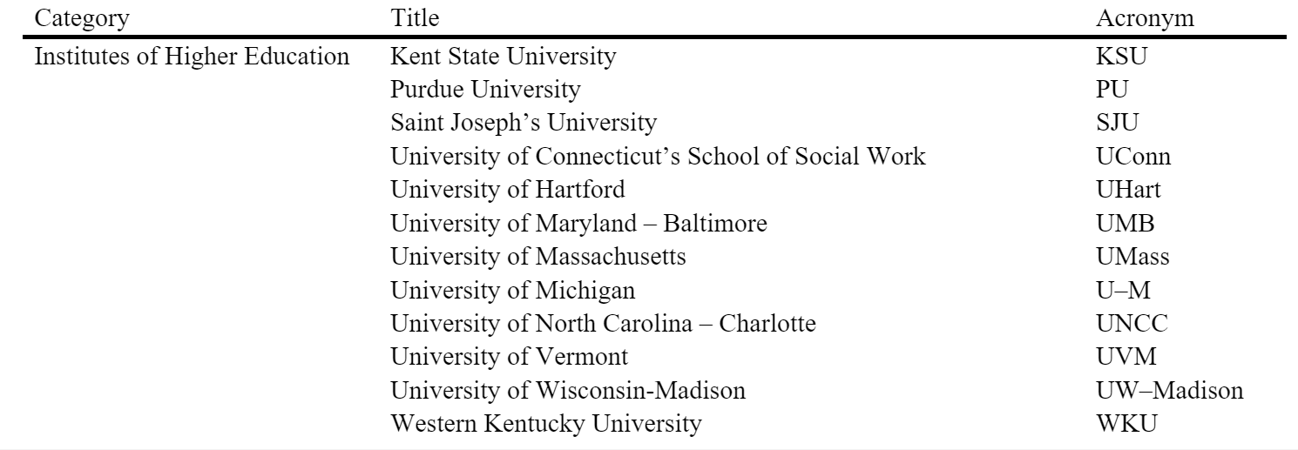
IHEs Represented (n=12)

Slide 46
IHEs Omitted (n=2)
The following IHEs were omitted from the analysis because the DEI statements were more than one page in length and/or spanned across multiple web-pages.
Coastal Carolina University (Multiple web-pages)
https://www.coastal.edu/dei/
https://www.coastal.edu/dei/inclusivepedagogyandclassrooms/
https://www.coastal.edu/dei/diversityequityandinclusionatccu/
Mount St. Joseph University (8-page PDF)
https://www.msj.edu/about/diversity-inclusion/17F-WO-002037-Inclusive-by-Design-Plan-1.pdf

Slide 47
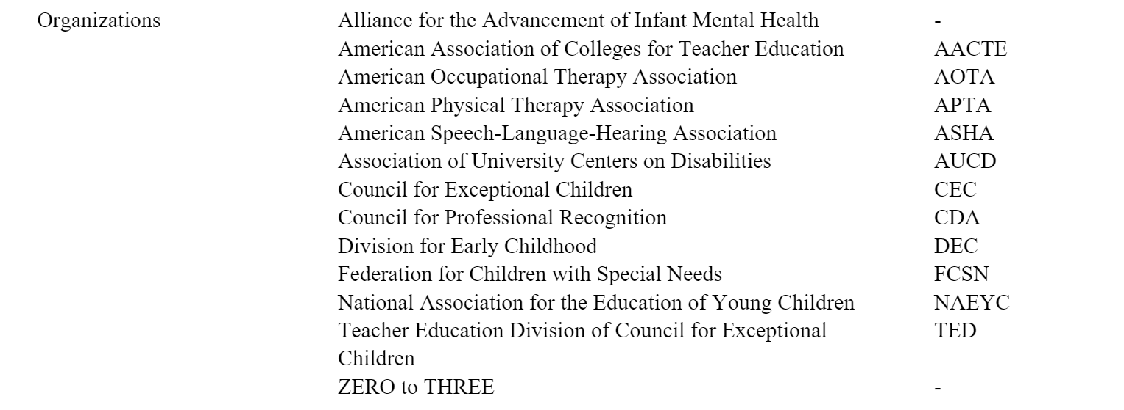
Organizations Represented (n=13)

Slide 48
Inductive Analysis of Qualitative Data
Familiarize yourself with the data
Collected DEI statements from IHE and Organization websites and organized them within an excel spreadsheet.
1
Generate initial codes
Broke each statement into meaningful phrases.
2
Generate themes
Grouped similar phrases together and generated themes.
Braun & Clarke, 2012; Kiger & Varpio, 2020; Terry et al., 2017
3

Slide 49
Analysis Continued
Review themes
Reviewed and revised groupings with feedback from additional parties - 6 rounds total!
4
Define and name themes
Generated theme and sub-theme names with consensus across parties.
5
Produce written report/manuscript
Summarized findings in a written report.
Braun & Clarke, 2012; Kiger & Varpio, 2020; Terry et al., 2017
6

Slide 50
Key Themes across IHEs and Organizations
1
2
3
4
5
6
7
8
Persons Supported
Embracing Differences
Values
Agents of Change
Disparities
Outcomes
Belonging
Engagement
Diversity
Equity
Inclusion

Slide 51
Summary
Support for All
We support all persons, regardless of identity, background,and experience.
Celebrating Differences
We listen, embrace, and celebrate different perspectives.
Values
We are guided by values including integrity, respect and accountability for our attitudes and behavior.
Agents of Change
We are agents of change through advocacy and action.
Desparities
We work to overcome desparities in society by addressing structural and systemic barriers to equity such as racism and oppression in all its forms.
Outcomes
We promote positive outcomes through our ECI personnel
preparation and professional development standards, services,
policies, research and scholarship
Belonging
We promote belonging within our early childhood intervention personnel community by creating an inclusive environments.
Engagement
We provide access and opportunity for all to participate and thrive.

Slide 52
References
Braun, V., & Clarke, V. (2012). Thematic analysis. American Psychological Association.
Kiger, M. E., & Varpio, L. (2020). Thematic analysis of qualitative data: AMEE Guide No. 131. Medical Teacher, 42(8), 846-854.
Terry, G., Hayfield, N., Clarke, V., & Braun, V. (2017). Thematic analysis. The SAGE Handbook of Qualitative Research in Psychology, 2, 17-37.

Slide 53
Question 1: What does equity mean in the context of ECI and personnel preparation? (n = 36)
Individualized (4)
Providing meaningful and individualized support that they need, not one size for all (e.g., student advising/mentoring) (3)
Mindset shift: everyone gets what they need not everyone gets the same thing.
Individualized support and communication with their families
Appropriate timeframes for growth for the child and teaching to support goals (1)
Family Centered (3)
It is okay to slow down… ask families where and when they need support (i.e., procedural safeguards) (2)
Families get what they need to be successful.
All families are informed of the supports/services available (1)
Evidence-based (1)
Using data to examine equity issues (e.g., school district data) (1)
Diversity (7)
Creating space for valuing, infusing, and advocating for the knowledge, wisdom, and practices of multiple individuals, groups, and communities (2)
Value the multidimensional components and variations of families
Kids and families in all environments are seen and heard.
Address language and cultural barriers
Reflective of diverse needs and values (3)
Reflect diversity.
Instruction reflects their communities (e.g., season units reflect the weather in their region)

Slide 54
Question 1: What does equity mean in the context of ECI and personnel preparation? (n = 36)
Individualized (4)
Providing meaningful and individualized support that they need, not one size for all (e.g., student advising/mentoring) (3)
Mindset shift: everyone gets what they need not everyone gets the same thing.
Individualized support and communication with their families
Appropriate timeframes for growth for the child and teaching to support goals (1)
Family Centered (3)
It is okay to slow down… ask families where and when they need support (i.e., procedural safeguards) (2)
Families get what they need to be successful.
All families are informed of the supports/services available (1)
Evidence-based (1)
Using data to examine equity issues (e.g., school district data) (1)
Diversity (7)
Creating space for valuing, infusing, and advocating for the knowledge, wisdom, and practices of multiple individuals, groups, and communities (2)
Value the multidimensional components and variations of families
Kids and families in all environments are seen and heard.
Address language and cultural barriers
Reflective of diverse needs and values (3)
Reflect diversity.
Instruction reflects their communities (e.g., season units reflect the weather in their region)

Slide 55
Screening/Entry into the EI System (n = 55)
Universal Screening (7)
Universal screening system (4)
Universal best practices - no variation from states to states.
Screening universal +follow-up for all
Common eligibility criteria on a national level
Ongoing & following up.
Follow up for all disabilities/medical needs.
Regularly updated.
Family Centered Practices (9)
Nobody explains to the families what is happening especially if they do not speak English (3)
Information must be communicated to families.
Using parent friendly language
Should gather background of families (i.e.: health, birth, family, structure, etc.) (2)
Include family determinant of health.
True family partnership/collaboration and valuing and intentionally seeking parent report. (3)
Interviewing and building family capacity
Listening to families concerns and priorities.
Remind parents of their right to request screening and evaluations if they consider it needed.

Slide 56
Equity in Early Childhood Intervention
Every infant and young child with a delay in development or disability,
and their family,
will have access to, and fully participate in
early childhood intervention,
that is individually designed to be racially, ethnically, culturally, and linguistically responsive,
to ensure equitable, appropriate, and optimal
child and family outcomes.

Slide 57
When we achieve Equity in Early Childhood Intervention, we will see…..
the absence of systematic disparities and unjust policies and practices that impact infants and young children with disabilities and their families in their pursuit of what they want and need to be included as valued members of their communities;
and the removal of structural barriers that deny infants and young children with disabilities and their families' opportunities to belong, thrive and learn because of their disability, and other identities and affiliations they may have such as culture, race, ethnicity, language, national origin, geography or place, ideology, sexual orientation and gender identity, socioeconomic status, and spirituality.*
* Adapted from Braveman & Gruskin (2003)

Slide 58
Historical, Socio-Cultural, Economic and Political Context
Early Childhood Systems
Early Childhood Intervention Systems under IDEA
Screening
IFSP/IEP
Intervention
Monitoring
Transitions
Assessment
Equity Centered ECI IHE Programs and PD Systems
Equity Centered IHE Programs of Study and State PD Systems
Diverse, Responsive and Competent Workforce
Equitable and Individualized ECI Service Delivery
Equitable
Child and Family Outcomes

Slide 59
Our Equity Framework Consists of:
Equity in ECI
Policy
Practice
Outcomes

Slide 60
Equitable Policies
National and State Personnel Standards that Reflect Equity for the Early Childhood Intervention Workforce Providing Services under IDEA
Equitable National and State Early Childhood Intervention Program Requirements under IDEA for Infants, Young Children and their Families
Equitable Practices
IHE Programs of Study, Syllabi and Curriculum Reflect Equity in ECI
Recruitment and Retention of Diverse ECI Faculty, Students, and Service Providers
Equitable Outcomes
Each Child and Family has Access to a Diverse, Competent, and Effective Early Childhood Intervention Workforce
Each Child and Family Participates in Appropriate, Responsive, and Effective Early Childhood Intervention
Equitable, Individualized and Responsive ECI Service Delivery

Slide 61
Let’s Unpack What This Means: Outcomes
Each Child and Family has Opportunity and Access to a Diverse, Competent, and Effective Early Childhood Intervention Workforce
Each Child and Family has Opportunity and Access to Participate in Appropriate and Effective Early Childhood Intervention

Slide 62
Let’s Unpack What This Means: Policies
Personnel Standards
Requirements of FAPE
Recommended Practices in Developmental Systems Approach of ECI (Guralnick)

Slide 63
Let’s Unpack What This Means: Practice
IHE Programs of Study, Syllabi and Curriculum Reflect Equity in ECI
Recruitment and Retention of Diverse ECI Faculty, Students, and Service Providers
Equitable, Individualized and Responsive ECI Service Delivery:
Screening
Assessment
IFSP/IEP
E.B. Interventions in Inclusive Settings
Ongoing Progress Monitoring and Evaluation
Transitions to the Next Age Level Program

Slide 64
Equity In Early Childhood Intervention Service Delivery
What is it?

Slide 65
Historical, Socio-Cultural, Economic and Political Context
Early Childhood Systems
Early Childhood Intervention Systems under IDEA
Screening
IFSP/IEP
Intervention
Monitoring
Transitions
Assessment
Equity Centered ECI IHE Programs and PD Systems
Equity Centered IHE Programs of Study and State PD Systems
Diverse, Responsive and Competent Workforce
Equitable and Individualized ECI Service Delivery
Equitable
Child and Family Outcomes

Slide 66
Equitable Developmental Screening
Universal and Accessible for All Families
Involves Parents/ Caregivers as Informants --at Whatever Mode They are Comfortable ( interviews, checklists etc.)

Slide 67
Equitable Assessment
Conducted in Partnership with Families/Caregivers
Involvement of Interdisciplinary Team Members
Nondiscriminatory, Valid and Individualized Tools and Procedures
Authentic

Slide 68
Equitable IFSP/IEP Planning
Developed by a Cross-disciplinary Team that Includes the Family/Caregiver
Contains Functional Goals/Objectives
Describes Measurable Indicators and Outcomes

Slide 69
Equitable Interventions
Families are Involved in Interventions
Implemented by a Interdisciplinary Team
Uses Systematic and Evidenced Based Practices
Embedded in Developmentally Appropriate and Individualized Routines and Activities
Implemented in Inclusive Classrooms and Inclusive Community Settings

Slide 70
Equitable Data Collection and Progress Monitoring
Families Participate in the Assessment and Evaluation of Progress
Data collected from Multiple Sources on All Interventions
Data Informs All Decisions About Intervention Frequency, Intensity, Duration, Accommodations, Modifications and Adaptations
Families Participate in the Assessment and Evaluation of Progress

Slide 71
Equitable Transitions
Families are Informed of their Child’s Future Options
A Transition Team Including the Family Meets And Collaboratively Plans When A Child is Moving into a Part B Program
The IEP is a Continuation of the IFSP.

Slide 72
Historical, Socio-Cultural, Economic and Political Context
Early Childhood Systems
Early Childhood Intervention Systems under IDEA
Universal
Screening
Screening
IFSP/IEP
Intervention
Monitoring
Transitions
Assessment
Equity Centered IHE Programs of Study and PD
Diverse and Competent Workforce
Culturally, Racially, Ethnically and Linguistically Responsive ECI Services
To Meet Child and Family’s Individualized Needs
Accommodations and Modifications
Equitable
Child and Family Outcomes

Slide 73
Change is not magic or inspiration.
It’s completing many undramatic, small steps successfully.
Danziel & Schoonover, 1988

Slide 74
ecpcta.org

