Slide 1
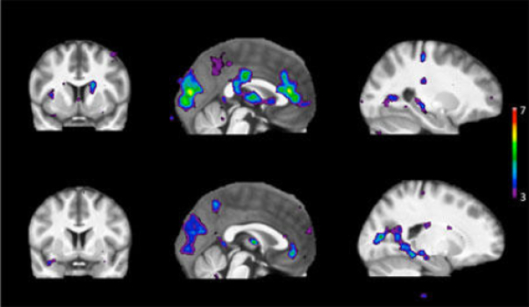
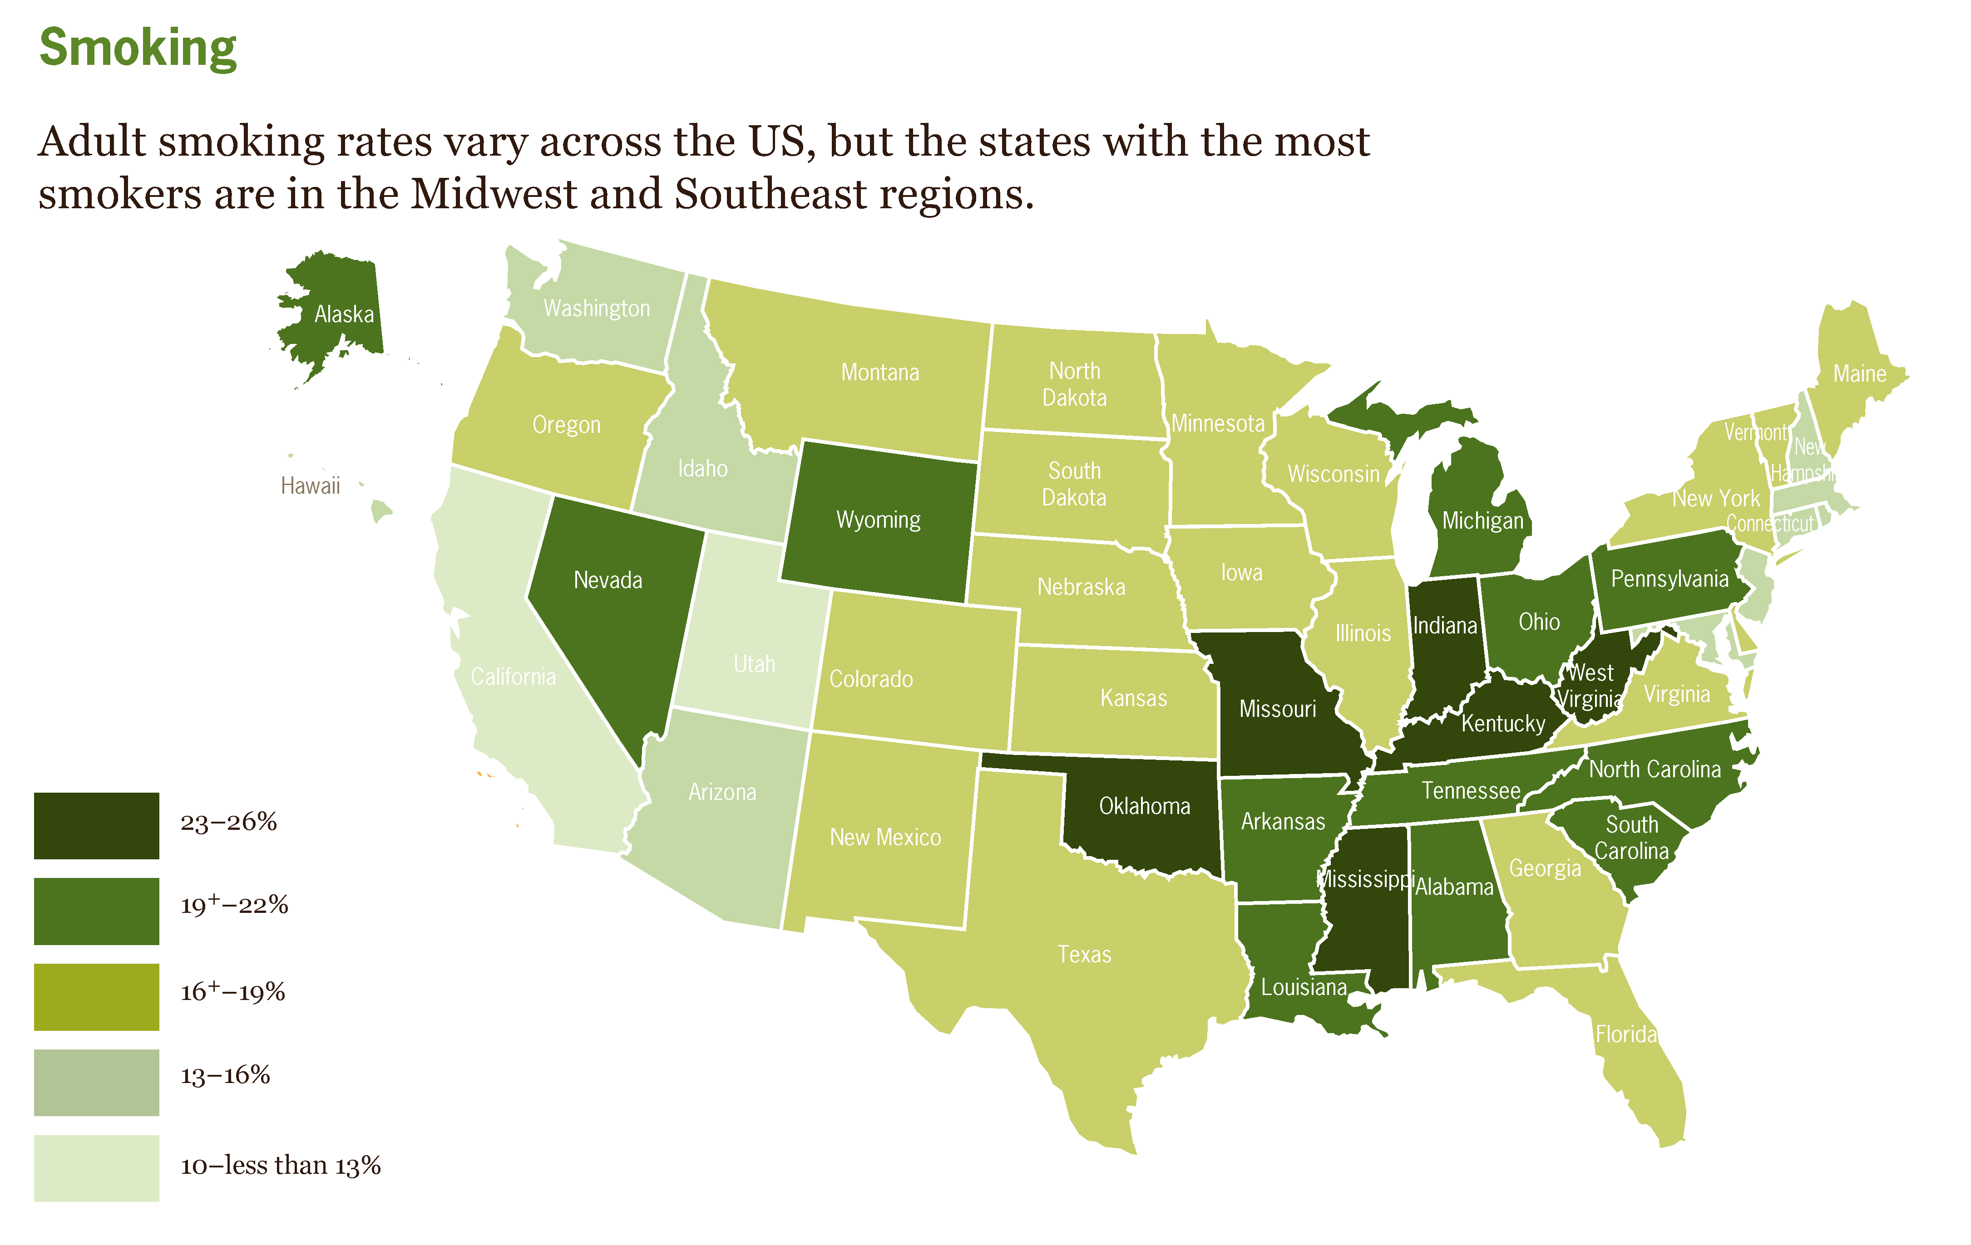
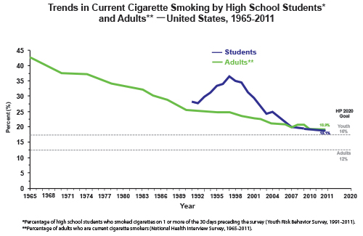
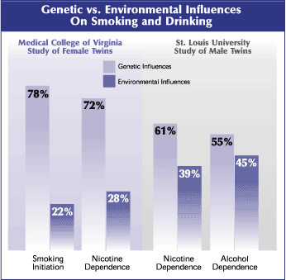
The Public Health Implications of Genetic Research on Addiction
Personalizing Risk: Addiction, Genetics, & What Varies
CDC: http://www.cdc.gov/vitalsigns/pdf/2011-09-vitalsigns.pdf
Jonathan Kaplan
Oregon State University

Slide 2
Highlighting Two (Related) Interests:
Where we look matters to what interventions seem reasonable
Consider two related contrasts:
Between Population versus Within Population differences in outcomes
Public Health versus Individual Intervention
It is not a new observation that for many health-related outcomes we care about, more variation occurs between populations than within them, and that interventions aimed at helping individuals are markedly less effective at influencing health outcomes than are public health approaches*
But as the technology for new interventions increases, and as the ability to find causal associations within populations increases, it is worth reminding ourselves of these limitations.
* Cf Rose Geoffrey. 1985. “Sick individuals and sick populations.” International Journal of Epidemiology 14(1): 32-38.

Slide 3
Highlighting Two (Related) Interests:
Where we look can determine where we ‘place blame’
Focusing on the causes of individual variation can have the effect of making what might otherwise seem like social problems into problems internal to individuals
If it is something about individuals (the particular alleles they carry, the particular environments they encountered) that explains why they developed some problematic trait, or suffered from some disease, then it is easier to ignore the social causes.*
Again, as the technology to uncover associations between individual variations in genes or in environments and the traits of interests increase, more sources of variation that can be traced back to individuals will be found.
* Evan Willis. 2002. “Public health and the ‘new’ genetics: Balancing individual and collective outcomes” Critical Public Health 12(2) 139-151

Slide 4
Highlighting Two (Related) Interests:
Where we look matters to our interventions
Where we look influences where we place blame
Examples:
MAOA and violence: Gene x Environment Interaction. The studies’ authors (and many commentators) suggested pharmacological intervention, and headlines focus on the association of the alleles with violence, rather than the environmental aspect…
Single parenthood and childhood poverty: Here, a focus on within-population variation hides (perhaps deliberately?) the far greater degree of between-population variation, and points (again, perhaps deliberately?) away from public policy differences and towards individual behaviors as the “important” causes.
Nicotine addiction and genetic variations: “To Prove This is the Industry’s Best Hope”* – The tobacco industry hoped to make addiction out to be a problem of individuals genetically prone to addiction, and not an addictive product…
*Grundle, Dingel, and Koenig. Addiction. Jun 2010; 105(6): 974–983

Slide 5
Explaining Traits:
Different Questions, Different Approaches
Depending on our interests, we can look towards:
Ontogeny
Phylogeny
Individual Variation
Population Variation
An Example:
Nicotine Addiction
NOTE: The initiation of regular tobacco use may be thought of as different trait, separate from both the addictive behaviors and the physical dependence on nicotine.
In what follows, the focus will be on the addictive behavior rather than on the initiation, but the latter will be noted on occasion…

Slide 6
Explanations and Aims
In the case of traits for which there is systematic variation in humans, especially those traits (like addiction) that are considered problematic (that are, for example, associated with individual and/or social costs & harms), the explanatory project is often part of a project of control or intervention.
We wish not just to explain the trait, but to control it.
The costs of addiction are difficult to quantify accurately, but for example in the U.S., economic costs of around $500 billion per year are often claimed, along with perhaps a half-million or so excess deaths per year, and associated high excess morbidity.
Some claim that e.g. nicotine addiction in the U.S., via its “usual” delivery system (cigarette smoking), has economic costs of perhaps a few hundred billion dollars per year, and is associated with perhaps 300,000 deaths per year (mostly from cancer, and heart and lung diseases).

Slide 7
Explaining Traits: Different Questions, Different Approaches
Ontogeny
Phylogeny
Individual Variation
Population Variation
Ontogeny:
How does the trait develop in the organisms in question?
How does the trait in question arise in the development of the individual organism?
Developmental accounts can include, for example:
Analyses of cell differentiation,
Analysis of the various genetic pathways employed,
Analysis of the relationship between particular kinds of environmental inputs & the above,
Etc.
Nicotine addiction: Ontogeny
Nicotine addiction develops primarily with self-administration of nicotine, via the effects of nicotine on the nicotinic acetylcholine receptors (nAChRs).

Slide 8
Explanation and Intervention Strategies
Ontogeny: Nicotine Addiction
Ontogeny: Understanding how a trait develops in individual organisms can be useful for targeting interventions.
Nicotine addiction develops primarily with self-administration of nicotine, via the effects of nicotine on the nicotinic acetylcholine receptors (nAChRs).
Interventions suggested:
Understanding the biological pathways involved in nicotine addiction might point towards new pharmacological interventions aimed at “treating” the addiction itself – “Understanding the neural substrates of nicotine dependence is essential for the development of more effective antismoking medications than those currently available.”*
Understanding the biological pathways involved in nicotine addiction might point towards possible “harm reduction” strategies that leave the addiction in place, but change the delivery method to be less harmful
* D’Souza and Markou, 2011. “Neuronal Mechanisms Underlying Development of Nicotine Dependence: Implications for Novel Smoking-Cessation Treatments.” Addict Sci Clin Pract. 6(1): 4–16.

Slide 9
Explaining Traits: Different Questions, Different Approaches
Ontogeny
Phylogeny
Individual Variation
Population Variation
Phylogeny: What explains the presence of the trait in the population (at whatever level it is present)?
Phylogenetic account are evolutionary in nature – they attempt to explain, from the perspective of the evolutionary history of the type of organisms, how the traits in question came to be.
How / when did the trait first emerge?
Co-opted from another use? (What other use?) Mechanism of change?
Developmental plasticity?
How and why did it spread in the population?
Drift / founder effect? Selection? (For what? When?) “Hitchhiking” with another trait? Side-effect? (Of what?)
What is responsible for the continued existence of the trait in the population in question?
If the trait is being actively maintained in population now via e.g. selection, what is the particular casual system that is maintaining it?
If something like “phylogenetic inertia” explains it, are there costs?
If there is systematic variation in the trait, is there an evolutionary account of that variation?
Stable polymorphism under selection?
Neutral variation?
Change in selective regimes?
No evolutionary account, but developmental? New environments? Breakdown in developmental stability?

Slide 10
Explanation and Intervention Strategies
Phylogeny: Nicotine Addiction
Phylogeny: Phylogenetic accounts can be useful for understanding the (evolutionary) history of a trait, but they rarely suggest intervention strategies.
The nicotinic acetylcholine receptors (nAChRs) are part of a highly conserved (ancient) set of receptors involved in neurotransmission. The nAChRs play a number of functional roles in various tissues in organisms in the Bilateria phylum.
Given this, addiction to nicotine can occur with exposure to (self-administered) nicotine, with tobacco use being the primary mechanism in humans.
Note: Smoking initiation itself is a “complex” trait
While there are no evolutionary accounts of maintenance of differences in e.g. nicotine receptors in humans (that I could find, at least!), there are evolutionary accounts of the maintenance of differences in purported correlates to smoking initiation.
(E.g. the BDNF regions association with smoking initiation and with traits like “neuroticism” and “extroversion”)

Slide 11
Explaining Traits: Different Questions, Different Approaches
Ontogeny
Phylogeny
Individual Variation
Population Variation
Individual Variation: If the trait varies between individuals within a population, what explains the variability of the trait in that population?
Why do different individuals have different versions of the trait, or why do some individuals have the trait and not others? Approaches include:
ANVOA: An analysis of variance attempts to partition the variation in the population between potential variables associated with the extant variation (often these causes are roughly divided into genetic, environmental, and interactive causes of various sorts)
NOTE: “Heritability” estimates emerge from this set of techniques
Specific Factors: Looking for particular variables associated with the variation within particular populations / ranges of environments
Genatic variations associated with variation in the trait
Environmental / developmental variations associated with variations in the trait
GxE variations associated with variations in the trait
etc

Slide 12
Explanation and Intervention Strategies
Individual Variation: Nicotine Addiction
Individual variation within populations:
Within populations, there are a number of identifiable environmental / developmental factors associated with the probability of an individual’s starting to use tobacco products and becoming addicted to nicotine; these include gender, SES, etc.
In addition to environmental influences, there is evidence that different variants of e.g. nAChRs may play a role in the probability of addiction, and that other genes might be associated with the probability of starting to smoke.
Note: Both smoking-initiation and nicotine addiction are broadly heritable (numbers in the .4-.6 range get tossed around here, unsurprisingly as those are the numbers that get tossed around for more or less every behavioral trait), but attempts to find particular genetic variants that account for any significant part of the variance associated with genetic differences have not met with much unambiguous success.
Here is where people interested in intervention tend to focus…

Slide 13
Explanation and Intervention Strategies
Individual Variation: Nicotine Addiction
Interventions associated with individual variation within populations include:
Targeting genetic variation for intervention:
Tailored pharmacogenetic approaches
Targeted Behavioral interventions & warnings
Targeting environmental variation to identify and ameliorate particular environmental risks
Examples

Slide 14
Explanation and Intervention Strategies
Individual Variation: Nicotine Addiction
Given genetic variation associated with the outcomes, one can target the genetic variation for:
Tailored pharmacogenetic approaches
e.g. “Smoking Cessation Pharmacogenetics: Analysis of Varenicline and Bupropion in Placebo-Controlled Clinical Trials” King et al Neuropsychopharmacology (2012) 37, 641–650
“These data provide evidence for multiple genetic loci contributing to smoking cessation and therapeutic response. Different loci are associated with varenicline vs bupropion response, suggesting that additional research may identify clinically useful markers to guide treatment decisions…”
Behavioral interventions & warnings for “high risk” alleles
e.g. “A Preliminary Exploration of College Smokers’ Reactions to Nicotine Dependence Genetic Susceptibility Feedback” Lipkus et al Nicotine Tob Res (2014)

Slide 15
Explanation and Intervention Strategies
Individual Variation: Nicotine Addiction
Given specific environmental risk factors associated with the outcomes, one can target the environmental variation:
Example: Stress and smoking initiation / nicotine addiction
Given the relationship between stress and starting to smoke, and stress and becoming addicted to nicotine, some researchers have suggested targeting individuals with particular stressors for intervention in order to prevent smoking
“Interventions that offer support and resources to students entering college with PTSD may help to prevent smoking behaviors from escalating and may ultimately prevent the adoption of daily smoking in later adulthood.”
“Transition and change: Prospective effects of posttraumatic stress on smoking trajectories in the first year of college.” Read et al Health Psychology, Vol 32(7), Jul 2013, 757-767

Slide 16
A Pause:
How problems / problematic traits become individualized
Given a particular problematic behavior or trait…
Focus on individual (within-population) variation…
Focus on the parts of that variation with a plausible biomedical component…
Propose biomedical solutions, given the parts of the individual variation that seem plausibly susceptible to biomedical intervention…
Treat individuals

Slide 17
The problems with approaches focused on individuals?
Relatively few individuals are successfully treated this way.
The total number of e.g. smokers world-wide who have been genotyped for likely response to varenicline vs bupropion is tiny, and is unlikely to ever be substantial…
Indeed, the fraction of smokers world-wide, or even in the U.S., who will ever make use of drugs like vareniclin as an aid to quitting smoking is likely to remain relatively small…
Often, the people most at risk are the least likely to have easy access to the medical system
In the U.S. today, smoking is associated with low SES, lack of education, depression, and living in places with problematic healthcare systems more generally.
These are not the traits that are associated with easy access to high quality / cutting edge medical (including psychiatric) care.

Slide 18
The problems with approaches focused on individuals?
One of the lessons of a public health approach to improving outcomes is that individual interventions aimed at ‘high risk’ individuals rarely have a measureable impact on population health!*
Part of the reason for this is that interventions focused on individual variation, will, by their very nature, fail to address the largest parts of the problems
Population-level variation tends to get ignored in these discussions, and the differences associated with between-population variation tend to be missed…
*.Frohlich & Potvin. 2008. “Government, Politics, and Law: Transcending the Known in Public Health Practice.” American Journal of Public Health. 98(2): 216-221.

Slide 19
Explaining Traits: Different Questions, Different Approaches
Ontogeny
Phylogeny
Individual Variation
Population Variation
Population Variation: If the frequency or form of the trait varies between populations, what explains the variation of that trait between populations?
Population Variation: Why is a particular trait, or some form of a trait, more common in one population than another?
Different allele frequencies / genetic backgrounds
Different founding populations
Different selective pressures
Isolation & drift
Different developmental environments
Different environmental exposures more generally
Searches for specific “difference makers” – particular variables casually associated with the differences in question.

Slide 20
Explanation and Intervention Strategies
Population Variation: Nicotine Addiction
Rates of smoking initiation and nicotine addiction vary enormously over time and across populations
Spatial Variation within the U.S.
More than a 2x difference in rate between lowest and highest states
CDC: http://www.cdc.gov/vitalsigns/pdf/2011-09-vitalsigns.pdf

Slide 21
Explanation and Intervention Strategies
Population Variation: Nicotine Addiction
Rates of smoking initiation and nicotine addiction vary enormously over time and across populations
Temporal Variation within the U.S.
More than a 2x difference in rate between 1965 and 2011

Slide 22
Population Variation: If the frequency or form of the trait varies between populations, what explains the variation of that trait between populations?
Population Variation: Why is a particular trait, or some form of a trait, more common in one population than another?
Different allele frequencies / genetic backgrounds
Different founding populations
Different selective pressures
Isolation & drift
Different developmental environments
Different environmental exposures more generally
Searches for specific “difference makers” – particular variables casually associated with the differences in question.

Slide 23
While a focus on genetics tends to push towards individual explanations, and towards popular accounts that make e.g. addiction out to be a problem with the individuals…
“Gene Keeps Some From Nicotine Addiction, Study Says.” NYT, 1998
“Gene Glitch Tied to Youth Smoking Addiction.” WebMD, 2004
“Studies Find Genetic Link to Smoking” – NYT, 2008
“Can't quit smoking? Blame your genes” - NBC News, 2008
“Genes May Determine Who Gets Addicted to Cigarettes.” Everyday Health 2013
“Can't quit smoking? Your GENES might be to blame, rather than a lack of willpower “ Daily Mail UK, 2013.

Slide 24
Successful public health approaches – which tend to be both more cost effective, and to have a larger impact on population – rarely focus on individual-level interventions…
Population Variation: Why is a particular trait, or some form of a trait, more common in one population than another?
Different allele frequencies / genetic backgrounds
Different founding populations
Different selective pressures
Isolation & drift
Different developmental environments
Different environmental exposures more generally
Searches for specific “difference makers” – particular variables casually associated with the differences in question.
Successful Public Health Approaches Include: 1) higher prices on tobacco products (taxation), 2) restrictions on smoking (workplace bans, restaurant and bar bans, public-place bans), 3) limitations on the advertising and promotion of tobacco products 4) education campaigns and warning labels, etc.,

Slide 25
A few reflections:
The broad (albeit uneven) success of public-health approaches to smoking in the U.S. likely make the individual-level stories about smoking less influential than they would otherwise be…
But alcoholism is still mostly perceived to be a problem of individuals, either of individuals with a “disease” (a genetic disease, triggered by alcohol use?), or with some moral failings, or both.
In other cases, even where the “between-population” variation is recognized as dominant, the social associations are seen as too intractable (e.g. interpersonal violence)…

Slide 26
Ontogeny
Phylogeny
Individual Variation
Population Variation
None of this implies that research into the biochemical pathways involved in addiction, or the variation in genes associated with particular addictive behaviors, is uninteresting, nor that it is useless, and still less that it is (usually) undertaken with anything other than the best intentions…
It is rather to suggest that such work will rarely turn out to be useful for making large improvements in population-level health outcomes, and will sometimes make the work necessary to achieve those kinds of outcomes harder to “see.”

Slide 27
It may be that for many of the problems that matter to us, there is neither the political will nor public support for improving public health outcomes in these areas via a focus on population-level differences.
But I want to suggest that researchers would do well to keep the limitations of approaches focused on individuals in mind…
And that the potential of approaches focused on populations, whether locally realize-able or not, should be kept in mind, too.

Slide 28
Thank You
Acknowledgements:
I want to thank Audrey Chapman for inviting me to present at this conference, and for inviting me to contribute to the volume Genetic Research on Addiction: Ethics, the Law, and Public Health. My discussions, and ongoing work, with her and Adrian Carter (NHMRC Research Fellow at The University of Queensland) have been particularly useful. I have benefited from many conversations with my colleagues at OSU surrounding bioethics, individual responsibility, and public health, including especially those with Courtney Campbell, Stephanie Bernell, and Stephanie Jenkins.

