Slide 1
Alcohol Policy and Adolescent Drinking: Using Science in the Public Interest
Module 3
Key Elements of an Advocacy Campaign

Slide 2
How do we translate research into action?
Notes:
We CAN do this. We can organize and build the coalitions and advocate for the change that needs to happen, if we are prepared, and if we are open to the opportunities that are present before us.

Slide 3
What it takes: Research
Traditional (“evidence-based”)
Public opinion (polling, focus groups)
Non-traditional
Relationship building
Listening
Opposition research
Notes:
We can do this, but what is takes is more than what public health generally is doing. Yes it takes traditional research, but it also takes the non-traditional forms of research such as public opinion polling, the relational and networks research that organizers do to figure out who has influence and how to reach them, the research that comes about by listening to the people who are suffering worst from the problem, and of course, research into the nature and tactics of the opposition.

Slide 4
What it takes: Advocacy!
Articulation of a socially (as well as scientifically) credible threat
Ability to mobilize a diverse organizational constituency
Convergence of political opportunities with larger vulnerabilities

Slide 5
LUCK = PREPARATION + OPPORTUNITY
ADVOCACY IS ALL ABOUT PREPARATION

Slide 6
Campaign steps
Frame your issue and develop a policy action statement
Engage enforcement
Collect data
Make your case
Draft your policy
Use media advocacy
Mobilize support and provide community education
Present the policy to decision makers
Evaluate the campaign and its outcomes

Slide 7
Where do you start?
Most campaigns start with a core group of committed advocates
Building a broad-based coalition is often the next step
Along the way, advocates must decide:
Vehicles – formal or informal coalition? Grassroots or grasstops? National or local?
Decision-making process
Communications

Slide 8
Possible coalition members?
BRAINSTORM
Regional, national, state and local public health departments
Community substance abuse prevention coalitions
Faith-based community
Educational community
Parent groups
Small Business Organizations
Employers
Trade unions
Law Enforcement
Civil Society Organizations
Medical community
Children’s advocacy groups
Notes:
Building a broad-based coalition is important to the success of a policy campaign. Coalitions having a diverse constituency tend to garner more support from elected or appointed
decision makers. The coalition should include groups that care about alcohol-related problems or whose mission or interests align with the anticipated public health benefits of the policy. One of the strongest allies in this policy work is law enforcement. Because many alcohol-related issues require a response from law enforcement, they understand how serious the problems are. They can be quick to offer their support and become willing participants in the policy campaign. The faith community can also be a key ally. Religious leaders and can be influential with particular legislators (since they may be that legislator’s faith leader) as well as with the public at large. Trade and labor unions are another important constituency. They tend to understand organizing, and can turn out visible support at key moments in a policy campaign. Here is a list of the people and organizations to include in a coalition.
Each of the coalition members should be responsible for garnering resolutions of support from their membership or constituencies. Resolutions do not cost anything to obtain and can demonstrate the breadth and depth of voter support when it is time for decision makers to support the policy. Also, the process organizations go through to approve a simple supporting resolution will provide useful opportunities for educating that organization’s leadership and members about alcohol use and associated problems.

Slide 9
Key coalition tasks
Analyzing and reporting public health data on excessive alcohol consumption and related harms;
Providing maps that highlight alcohol-related problems associated with excessive drinking;
Assisting community coalitions in developing media campaigns to support the policy;
Determining how to best gain access to decision makers and briefing them prior to hearings on the policy;
Responding to requests for written information on proposed policy;
Responding to questions from decision makers during testimony in parliamentary enquiries or public hearings on general impacts of proposed policy;
When permitted, providing testimony on the health and social impacts of the proposed policy during enquiries or hearings; and
Evaluating the impact of the policy, including identifying and tracking outcome measures.
Notes:
It is important to understand coalition members will have different roles to play in the campaign. Keep in mind that those organizations supported by government or state funding obtained through grants and contracts, particularly awards obtained from government sources, may have to play a different, and in some ways more limited role, than those with other funding sources. The coalition should be comprised of a broad enough array of members that all aspects of the work can be carried out. Some of the key tasks coalition members will need to consider are: [see slide]
Other supporters of the policy have important roles to play as well. Community coalitions that have signed on to the campaign are in an excellent position to carry some of the load of educating decision makers and influencing how they view the policy. Local representatives from the business community can work to blunt opposition from the national or state-level business organizations that may oppose the policy.

Slide 10
Step 1: Frame your issue and develop a policy statement
The difference between a problem and an issue
Issues are:
actionable,
specific,
immediate,
winnable, and
worthwhile.
Notes:
Framing is a term that is used to describe how different policy issues are described. The way that a policy issue or problem is described will determine the policy solutions that are selected to deal with the problem.
Framing your issue and making the case for why the policy is important is essential to being able to build support. The coalition should frame the debate and advance specific solutions or policies. Engaging the coalition in the process of deciding what the case should say builds important commitment to the policy and energizes the group to organize its support.

Slide 11
Framing the issue
Framing = how different policy issues are described
determines the policy solutions that are selected to deal with the problem
essential to being able to build support
Example: the problem is young people are irresponsible
Example: the problem is alcohol marketing encourages youth risk-taking
Notes:
Framing is a term that is used to describe how different policy issues are described. The way that a policy issue or problem is described will determine the policy solutions that are selected to deal with the problem.
Framing your issue and making the case for why the policy is important is essential to being able to build support. The coalition should frame the debate and advance specific solutions or policies. Engaging the coalition in the process of deciding what the case should say builds important commitment to the policy and energizes the group to organize its support.

Slide 12
Framing the issue (cont.)
Frames: “labels the mind uses to find what it knows” (Gilliam 2003)
Framing: 3 levels
Level 1: overarching values and symbols
Level 2: general issue being addressed (housing, schools, environment, health, etc.)
Level 3: details about Level 2 – policies, strategies, facts, etc.
“Frames trump facts.”
Always best to set Level 1 frames ourselves – not react to opposition’s frames.

Slide 13
Public health framings
Alcohol: “Too many liquor stores detract from the quality of life. It is not fair that certain families are subjected to such degraded conditions. Every family should have the opportunity to raise their children in a healthy environment. The city should make a rule to limit the number of liquor stores allowed within a certain radius.”
Tobacco: “While we have achieved great progress in reducing smoking, there are still large populations, primarily in low income communities of color, that are regularly exposed to toxic secondhand smoke. It is not fair that some of our cities’ workers are protected and others are not. We should enact uniform clean indoor ordinances to protect workers in all workplaces, including restaurants and bars.”

Slide 14
Industry framings
What’s needed is more personal responsibility, not government regulation
As a precursor to taking personal initiative, education can solve the problem
If the issue involves children or youth, it is the parent’s responsibility.

Slide 15
Constructing frames (re-framing)
Elements of a frame:
Values – these guide reasoning and are paramount
Metaphors – simplifying models – these guide understanding
“One a day is good for vitamins but not for alcohol ads”
“Fish in a polluted stream”
Context – where does this fit in people’s lives
Messengers
Tone
Reasonable (empowering) vs. argumentative (skepticism-breeding)
Visuals
Solutions
Solutions ahead of problem statement?

Slide 16
The importance of symbols
What symbols or values will touch and mobilize existing and/or potential bases of support because the cultural resonances of those symbols speak to their lives?
What are the shared symbols and values of for your country in 2014?

Slide 17
Shared values?
DISCUSS AND MAKE LISTS

Slide 18
Example: Shared values in the USA
Fairness
Equity
Protection of children and “underdogs”
Generosity
Human rights
Self-determination
Independence
Self-reliance
Trust
Sportsmanship
Individualism
Opportunity
Free enterprise
Freedom
Competition
Education
Patriotism
Motherhood/family
Responsibility
Empowerment
Leadership

Slide 19
Two dominant frames
Market Justice (industry)
Self-determination and self-discipline
Rugged individualism and self-interest
Benefits based solely on personal effort
Limited obligation to collective good
Limited government intervention
Voluntary and moral nature of behavior
Social Justice (public health)
Shared responsibility
Interconnection and cooperation
Basic benefits should be assured
Strong obligation to the collective good
Government involvement is necessary
Community well-being supersedes individual well-being

Slide 20
Alcohol policy: two frames
Industry frame | Public health frame
Alcohol consumption is normal, fun and healthy. | Alcohol consumption is linked to more than 60 diseases and health conditions.
The majority of people drink responsibly. | Most of the alcohol is consumed “irresponsibly” (i.e. by binge and underage drinkers).
The small minority of irresponsible drinkers causes all the problems. | So many people drink irresponsibly occasionally that population-level solutions are needed.
Effective solutions are education, industry self-regulation, and public-private partnerships. | Evidence suggests that effective solutions are those that affect availability, price and marketing of alcohol.

Slide 21
Step 1: Develop a Policy Action Statement
Write a Policy Action Statement based on the local condition and policy solution previously identified (25 words or less):
State the problem
State a policy solution
What will the policy do?
Who will benefit from the policy?
Who are the decision makers (who can make it happen)?

Slide 22
Step 1: Develop a Policy Action Statement
The [national][state][local] government will pass an increase in alcohol taxes to reduce underage drinking, the number one drug problem among youth, and to raise funds to support alcohol and other drug prevention and treatment, mental health services, and increased access to health care.

Slide 23
Step 2: Include enforcement organizations early in the campaign
Enforcing policies is central to its effectiveness
Including enforcement organizations early increases the likelihood that the policies, once adopted, will actually be enforced
They need to understand the benefits of the policy for them
Better use of scarce resources
Financial resources for enforcement
Additional benefits:
Collection of local data
Selection of policy responses
Crafting policy language
Notes:
Enforcing policies is central to its effectiveness. This is especially true for public policies and formal institutional policies. Many of the alcohol polices that have the most evidence behind them are public policies that require some level of enforcement to operationalize the actual strategy. For example, a mandatory city ordinance requiring server training needs an organizational entity to ensure that merchants are enrolling the personnel in the training within the required period of time. In many parts of the world young persons below the legal purchasing age can buy alcohol because of lax enforcement. Without such enforcement the policies have no power and will not reduce the problems they are intended to address.
Engaging the appropriate enforcement body early in the policy campaign is essential. Doing so increases the likelihood that the policies, once adopted, will actually be enforced. No entity wants to be told to enforce a policy in which they had no input. But beyond this, including enforcement can have additional benefits:
Collection of local data: Policies need to be backed by data. Formal policies require a “nexus” between the identified problem and the proposal policy solution. This nexus creates the legal foundation for the policy. And as the policy campaign unfolds there will be an ongoing need to educate the community about the problem the policy is intended to address. The enforcement entity may be in the best position to assist with any required additional data. The police department is a good example of an organization that can contribute significant amounts of data to support the policy.
Selection of policy responses: The entity charged with enforcing a policy is probably in the best position to inform what is enforceable and what is not. It is important to develop a policy that makes it easier for the enforcement body to do their job.
Crafting policy language: It is advisable for the coalition to draft its own policy language. This enables the group to produce its ideal policy over which compromises will later be discussed. The enforcement entity will likely have much to add in terms of suggested policy structure. Encourage them to be part of the draft process; it will build commitment to the policy as well as to the campaign process.

Slide 24
Step 3: Collect data
Identify whom you want to persuade (your target)
Know your facts
Key pieces of information that help you make the strongest case possible
Begin to communicate
What is your ask? (embodied in your policy statement)
Advocate
Follow-up (it is all about relationships)

Slide 25
Making your argument
What are your “facts”?
Mortality
Morbidity
Costs
Salient comparisons/“social math”
Anecdotes/”authentic voices”
PICTURES

Slide 26
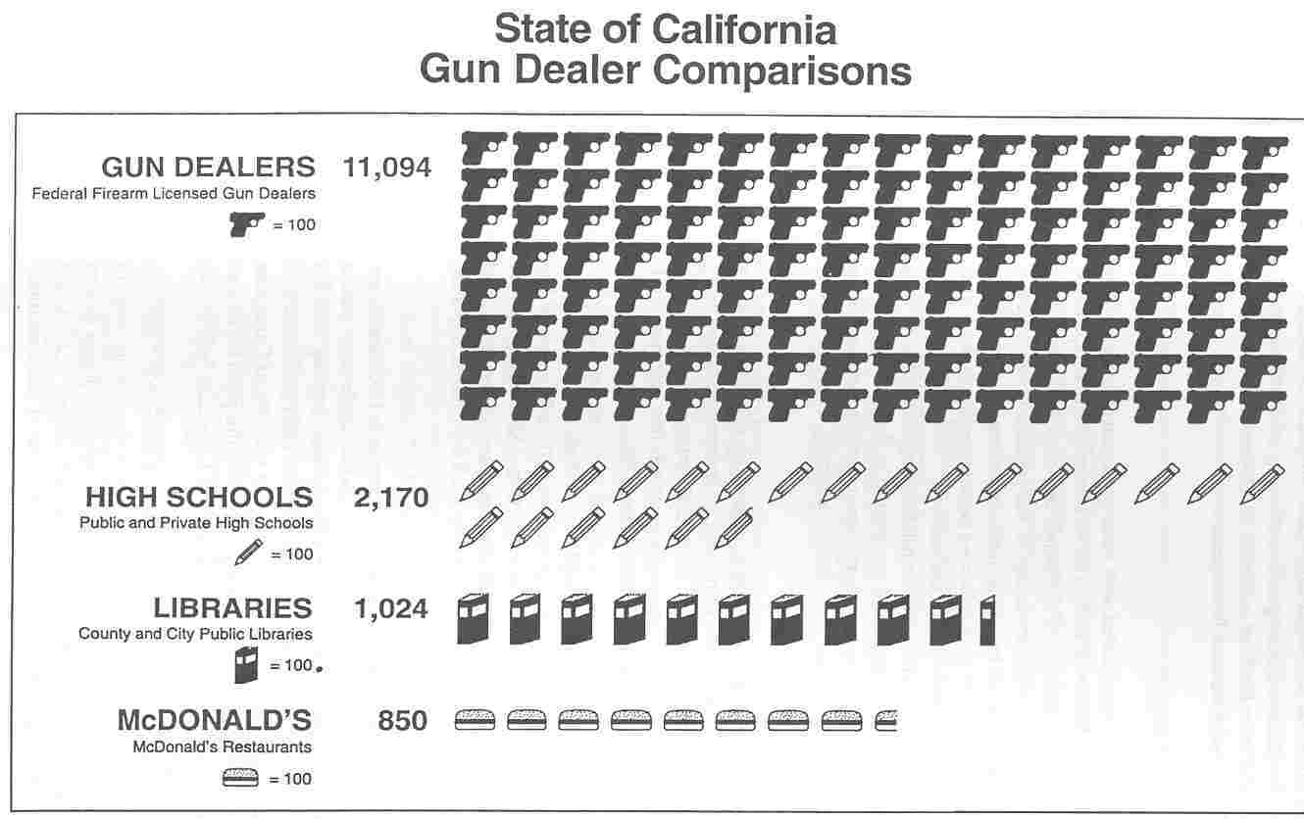
“Social math”: Example

Slide 27
Social math techniques
Break down numbers by time
4500 children under 16 start drinking every day
Break down numbers by place
This is the equivalent of 160 classrooms a day of new underage drinkers
Provide comparisons with familiar things
Gun dealers vs. McDonald’s
If Arizona's highway system were in the same condition as its health care system, every five miles that you drove along the highway, you would come to a pothole a mile long
Provide ironic comparisons
Childcare workers earn $10 an hour, prison guards earn $18 an hour
Personalize the number
6 tons of pollutants a day from a local gasoline refinery – the equivalent of 25 balloons full of toxic pollution for every school child in town

Slide 28
More social math examples
A child born today is more likely to be diagnosed with Type II diabetes than to graduate from college.
In Baltimore, more than 1 out of 3 students drink a high-calorie soda at least once a day. These extra calories add up: just one can of soda for a year can make you gain an extra 14 pounds.
Every minute in the U.S. two women are injured in a domestic violence incident.
In Ward 8 in Washington, DC, there are 27 liquor stores for every library.

Slide 30
Data about the policy itself
What are the policy options?
Evidence of effectiveness (scientific credibility)
Evidence of public support (social credibility)
Polling data
Editorials
News coverage
Coalition members
Celebrities
Evidence of feasibility
Other comparable jurisdictions that have done this

Slide 31
Step 4: Make your case
Message components
What’s wrong?
Why does it matter? (Level 1 statements)
What should be done about it?

Slide 32
“Five sentence” exercise
Construct a five sentence pitch for your issue and solution, as follows:
1 sentence on need
2 sentences on values
2 sentences on solutions

Slide 33
Arguing and counter-arguing
There will be two sides (at least)
What are the opposition’s arguments?
How do you respond to those arguments, and set your own frames?
Attack
Avoid and restate
Absorb
Who is symbolic of the opposition’s frames vs. your frames?

Slide 34
Develop an Issue Brief
Create an Issue Brief that:
Describes the problem and its impact on the community
Identify costs to community if problem is not resolved
Explain how the proposed policy addresses community concerns
Identifies ways for community members to get involved

Slide 35
Checklist for Issue Briefs
Understand that there are two competing frames of the alcohol ‘problem’
Critically assess how alcohol issues are being framed in your jurisdiction
Identify your key advocacy goal and the outcome that you are seeking
Identify your key target audiences and potential ‘messengers’ and choose the messages likely to resonate most with each audience
Ensure that your messaging links with your key advocacy goals

Slide 36
Step 5: Draft your policy
Draft policy language
Research similar policy examples from other jurisdictions
Tie to local conditions
Clarify legal basis
Compile supporting documents (case law, etc..)
Control the language
Work with the legal gatekeeper (City Attorney/County Counsel/City Solicitor, etc.)

Slide 37
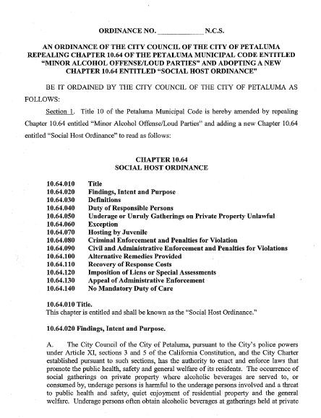
Step 5: Draft your policy (cont.)
Policy Language
Alcohol: No Ordinary Commodity | An advocate’s user guide

Slide 38
Step 6: Use media advocacy
Media advocacy is
the strategic use of
the mass media to support
organizing campaigns
to advance social or
public policy initiatives.
Notes:
Read definition – again emphasize that media advocacy is about changing policies. In this way it differs from other ways we have used the media. It has borrowed heavily from other forms of media work certainly -- i.e. standard media relations, guerrilla media, political campaign media, social marketing. But it represents a unique mix in the public health field, using the media to promote policy change.

Slide 39
Media advocacy: The challenges
Framing for access:
Getting on the news
Surmounting the “who cares” barrier
Winning the framing battle (framing for content)
Getting the story told the way you want it told
Moving from individual to environment
Pointing towards a policy solution
Notes:
Read definition – again emphasize that media advocacy is about changing policies. In this way it differs from other ways we have used the media. It has borrowed heavily from other forms of media work certainly -- i.e. standard media relations, guerrilla media, political campaign media, social marketing. But it represents a unique mix in the public health field, using the media to promote policy change.

Slide 40
Framing challenges
Translate individual problem to social issue
Assign primary responsibility
Present solution
Make practical/policy appeal
For news media, develop story elements
use compelling visuals and symbols
develop social math
identify authentic voices
seize symbols
brainstorm media bites
Tailor to audience
Notes:
Translate individual problem into social issue – Koop had done this for us – also example of release of TMI epi study and use of recovering alcoholic to make link – in Koop campaign, young person does this
Assign primary responsibility – hitting the industry for irresponsible marketing practices – did this by virtue of the recs we chose to highlight
Present solution – not only detailed stuff in Koop report, but also 7 point program for California, keying into tax initiative we were backing
Make practical/policy appeal – nickel a drink, equal time – simple and clear – also tell story of ABC enforcement cuts in California, on-air interview and station running governor’s phone number
Story elements – here is where we had fun - student interns - beer marketing materials – college posters, talking spuds; press conference visual extravaganza. Evocative symbols – Spuds certainly; press conf. at local ER, anchor was chief emergency surgeon
social math – examples e.g. jumbo jets; USA today op-ed piece opening
authentic voices – young people’s press conference, community voices - list of spokespersons all of whom were prepped
media bites – “we’ve let Spuds...”; also warning/eye test etc.
Tailoring - again, location of press conf; program for Calif etc.

Slide 41
Media bite examples
“I’m tired of Cadillac prisons and jalopy schools.”
“It is easy to think of smoking as an adult problem. But nicotine addition begins when most smokers are in their teens, so let’s call this what it is: a pediatric disease.”
“Too many kids are born into zip codes of shame. They live in a city glutted with guns, drugs, and alcohol. They plan more for their funerals than their futures.”
“Toys are subjected to strict safety measures, but in the gun industry, there is absolutely no regulation or standards of manufacture.”
“Saying that unwed mothers cause poverty is like saying that hungry people cause famine or sick people cause disease.”
“In my neighborhood, it is as easy for children to buy guns as school supplies.”
“The Golden Gate bridge is the world’s leading suicide landmark…putting up a suicide barrier would provide many, many people with a second chance.”
“Employment-based health care is like an electricity grid run on individual generators, or a water system based on scattered wells – what’s missing is a health care infrastructure.”

Slide 42
Alcohol policy stages of change and implications for messaging
Legislators currently have no interest in alcohol control measures | Message to increase recognition of alcohol as a problem
Legislators are beginning to be interested | Messaging to encourage population-level policy interventions
Legislation is being proposed | Messaging to support the specific legislation
Legislation is being implemented | Messaging to inform the public that there are new rules, options for intervention, or a “new sheriff” in town
Legislation is being enforced | Messaging to emphasize positive outcomes from the policy change

Slide 43
Preparation
Be ready for the hard questions
What question do you most fear you will be asked?
Exercise

Slide 44
Step 7: Mobilize support and provide community education
Building a grass-roots base for the policy campaign – to establish “bottom up” support
Influencing key decision makers to support the policy – to establish “top down” support
Notes:
This step is at the heart of the entire campaign and provides a foundation for all the other steps. It involves two key activities: (1) Building a grass-roots base for the policy campaign – to establish “bottom up” support; and (2) Influencing key decision makers to support the policy – to establish “top down” support.
To be successful, the citizen voice of the community and professional groups must be organized. Unless the citizen voice is heard, more traditional constituencies with economic clout and with the ear of decision makers are more likely to be able to sway policy decisions, even when their proposals are detrimental to large sectors of the community. Community organizing and mobilization go hand in hand with media advocacy and also involve both art and skill. It is here that local groups can play a key role in partnership for the larger coalition driving the campaign, by serving as the public face and focusing the policy opposition on the community advocates.

Slide 45
Points of influence on decision-makers
Policy change
Decision maker
Community voices / support / relationships
Corporate lobbyists/
relationships
Media definitions of problem and support
Electoral / political context
Research
Public health / public interest coalitions

Slide 46
Notes:
This reflects the community organizing process to build support for enacting alcohol policy.
Community organizing is critical because a campaign to change any alcohol policy involves shifting a community’s public health and economic agenda. Opposition can be expected from sectors of the community that have influence with decision makers. It is not uncommon to find EU, national, state and local business interests and business-oriented service clubs initially opposed the idea of creating alcohol regulations. But this local opposition can sometimes be turned to support or at least minimized with careful messaging and an emphasis on community mobilization. However, businesses with EU, national and state economic reach are often more difficult to move to a position of support. Studies on the economic impacts of outlet-related alcohol problems (e.g., noise complaints, litter, violence, injuries) compared to the community costs associated with addressing the problems (e.g. police, emergency, cleaning costs) can fuel a compelling argument for business leaders. The more localized the cost data, the greater the potential there will be to move local business interests from opposed to support.

Slide 47
Who are Grassroots and Grasstops supporters?
Go back to lists of possible coalition members – which have “top down” and which have “bottom up” potential?
Notes:
In seeking support for the implementation of effective alcohol policies, you will want to target the people who make the policy decisions. These are primarily elected representatives and their advisors. However, there are also other groups of people who can influence the decision-makers and it is helpful to know who they are. Identifying what information would help them to support your advocacy goal will help you decide on the messages that they need to enable them to become your ‘messengers’. Groups who can be influential with decision-makers include professionals (health, education, criminal justice and law enforcement); children’s organisations; the faith community; parents; community leaders; civil society; the media and the general public.

Slide 48
Assess the individuals who can give you what you want Who has the power to adopt your policy? ________________
Who are the most important individuals?
Who must you talk with before you approach him/her?
How do you influence the them if they are elected officials?
What is the self-interest of each?
Who will approach this person?

Slide 49
Step 8: Present the policy to decision-makers
PREPARE!
Consider the voices in the presentation, and choose them to speak to decision makers
Speak from the frame in the issue brief, and anticipate and counter opposition arguments
Know which decision makers support the policy, and if numbers are not sufficient for adoption, delay
Know how many supporters need to be in the room and be sure to turn out at least that many and make them identifiable to decision makers
Try to control who speaks in support if there is an “open comment” period, and to have the “last word”

Slide 50
Step 9: Evaluate the campaign and its outcomes
Engage the relevant agencies in a discussion about what is needed for effective administration and enforcement
Integrate implementation and enforcement steps into the policy itself
Identify necessary data from health departments, law enforcement, and other organizations
Set up a mechanism for ongoing communication between the relevant local and EU, national or state organizations and the coalition to promote cooperation and to establish a monitoring procedure
Use coalition media contacts to publicize regularly enforcement and administrative efforts
Notes:
This crucial step is too often neglected and it can ultimately undermine the entire campaign. A law on the books is of little value if it is not enforced, a situation that is all too common at both the federal, national, state and local levels. A common misperception is that a policy campaign is complete once it is adopted, the tasks of enforcement and implementation will occur as a matter of course by those responsible for these activities. This, unfortunately, is not always the case. The coalition needs to monitor the implementation of the new policy. This post-adoption agenda can be greatly facilitated if planning for it occurs at earlier stages of the campaign. Specifically: [see slide]

Slide 51
Getting started
Considerations for moving forward – Next steps

Slide 52
Parting thoughts
“I've been absolutely terrified every moment of my life – and I've never let it keep me from doing a single thing I wanted to do.”
-- Georgia O’Keeffe
“Hope is like a road in the country; there was never a road, but when many people walk on it, the road comes into existence.”
-- Lin Yu Tang
Notes:
Moving out of our comfort zone is scary. Media work and public debate can be scary. I am inspired by the American artist Georgia O’Keefe, who wrote “I’ve been absolutely terrified every moment of my life, and I’ve never let it keep me from doing a single thing I wanted to do.” I am also inspired by the Chinese writer and activist Lin Yu Tang, who wrote, “Hope is like a road in the country; there was never a road, but when many people walk on it, the road comes into existence.” This is our job in public health – we build roads of hope, of better and safer and longer and healthier lives for our families, our children and our communities.

Slide 53
“Never doubt that a small group of thoughtful, committed citizens can change the world.”
-- Margaret Mead
Notes:
The challenge of Margaret Mead is appropriate for us. Look around you. Why shouldn’t we be the ones who make the fundamental difference in the world? We have the data, we have the knowledge, and we can acquire the skills to become more and more effective advocates. We can do this, and I look forward to doing it with all of you. Thank you.

